Slide 1
Chapter 6
Digital Filter Structures

Slide 2
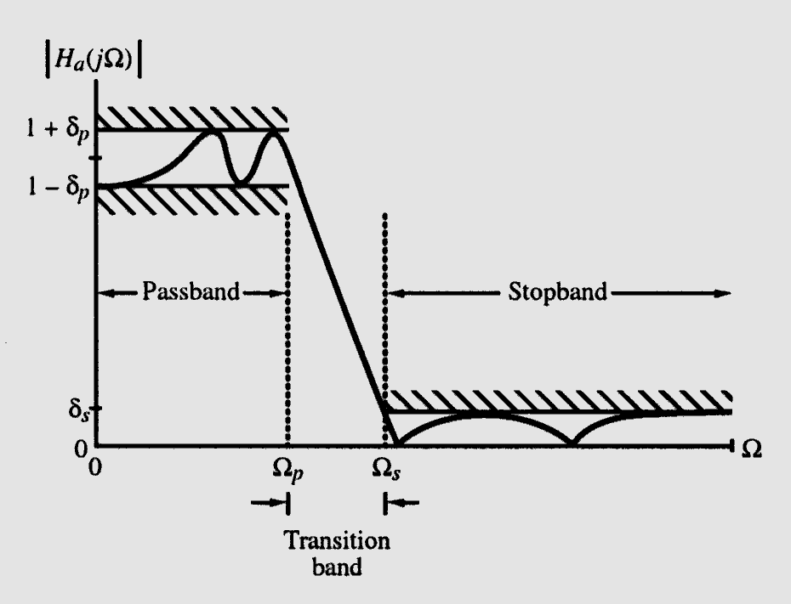
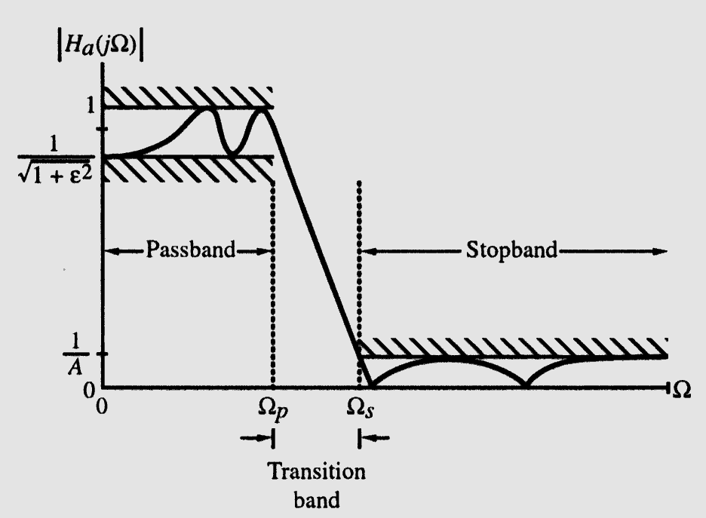
Ω_{p} - passband edge frequency
Ω_{s} - stopband edge frequency
δ_{p} - peak ripple value in the passband
δ_{s} - peak ripple value in the stopband
1 / √(1 + ε²) - Maximum passband deviation
1/A - Maximum stopband magnitude
Transition ratio k = Ω_{p}/ Ω_{s}
k1 = ε/ √(A² -1)

Slide 3
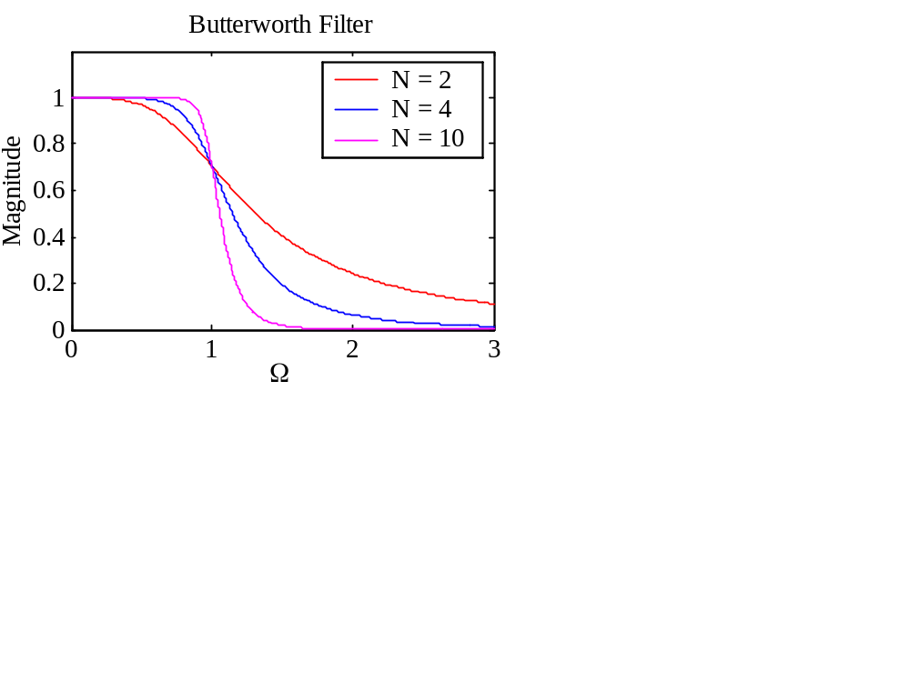
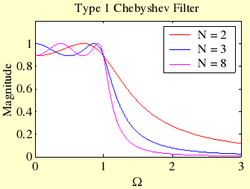
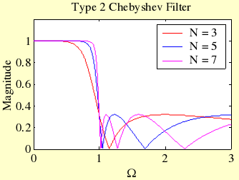
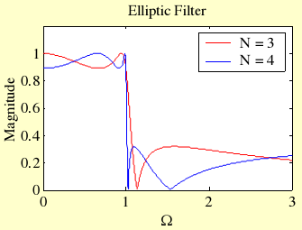

Slide 4
§6.1 Introduction
The convolution sum description of an LTI discrete-time system can, in principle, be used to implement the system
For an IIR finite-dimensional system this approach is not practical as here the impulse response is of infinite length
However, a direct implementation of the IIR finite-dimensional system is practical

Slide 5
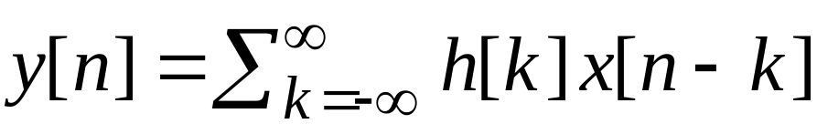
§6.1.1 Block Diagram Representation
In the time domain, the input-output relations of an LTI digital filter is given by the convolution sum
or, by the linear constant coefficient difference equation

Slide 6
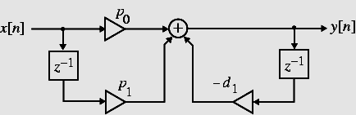
§6.1.1 Block Diagram Representation
For the implementation of an LTI digital filter, the input-output relationship must be described by a valid computational algorithm
To illustrate what we mean by a computational algorithm, consider the causal first-order LTI digital filter shown below

Slide 7
§6.1.1 Block Diagram Representation
Each step of the calculation requires a knowledge of the previously calculated value of the output sample (delayed value of the output), the present value of the input sample, and the previous value of the input sample (delayed value of the input)
As a result, the first-order difference equation can be interpreted as a valid computational algorithm

Slide 8


§6.1.2 Basic Building Blocks
The computational algorithm of an LTI digital filter can be conveniently represented in block diagram form using the basic building blocks shown below
A
x[n]
y[n]
y[n]
x[n]
w[n]
Multiplier
Adder
x[n]
x[n]
x[n]
y[n]
x[n]
Unit delay
Pick-off node

Slide 9
§6.1.3 Analysis of Block Diagrams
Carried out by writing down the expressions for the output signals of each adder as a sum of its input signals, and developing a set of equations relating the filter input and output signals in terms of all internal signals
Eliminating the unwanted internal variables then results in the expression for the output signal as a function of the input signal and the filter parameters that are the multiplier coefficients

Slide 10
§6.2 Equivalent Structures
Two digital filter structures are defined to be equivalent if they have the same transfer function
We describe next a number of methods for the generation of equivalent structures
However, a fairly simple way to generate an equivalent structure from a given realization is via the transpose operation

Slide 11
§6.2 Equivalent Structures
There are literally an infinite number of equivalent structures realizing the same transfer function
It is thus impossible to develop all equivalent realizations
In this course we restrict our attention to a discussion of some commonly used structures

Slide 12
§6.2 Equivalent Structures
Under infinite precision arithmetic any given realization of a digital filter behaves identically to any other equivalent structure
However, in practice, due to the finite wordlength limitations, a specific realization behaves totally differently from its other equivalent realizations

Slide 13
§6.2 Equivalent Structures
Hence, it is important to choose a structure that has the least quantization effects when implemented using finite precision arithmetic
One way to arrive at such a structure is to determine a large number of equivalent structures, analyze the finite wordlength effects in each case, and select the one showing the least effects

Slide 14
§6.2 Equivalent Structures
In certain cases, it is possible to develop a structure that by construction has the least quantization effects
We defer the review of these structures after a discussion of the analysis of quantization effects
Here, we review some simple realizations that in many applications are quite adequate

Slide 15
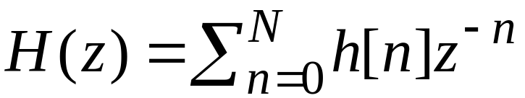
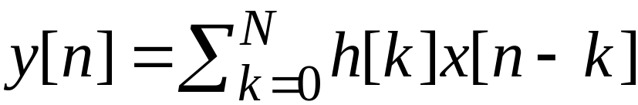
§6.3 Basic FIR Digital Filter Structures
A causal FIR filter of order N is characterized by a transfer function H(z) given by
which is a polynomial in z⁻¹
In the time-domain the input-output relation of the above FIR filter is given by

Slide 16
§6.3.1 Direct Form FIR Digital Filter Structures
An FIR filter of order N is characterized by N+1 coefficients and, in general, require N+1 multipliers and N two-input adders
Structures in which the multiplier coefficients are precisely the coefficients of the transfer function are called direct form structures

Slide 17
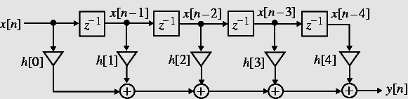
§6.3.1 Direct Form FIR Digital Filter Structures
A direct form realization of an FIR filter can be readily developed from the convolution sum description as indicated below for N = 4

Slide 18
§6.3.1 Direct Form FIR Digital Filter Structures
An analysis of this structure yields
which is precisely of the form of the convolution sum description
The direct form structure shown on the previous slide is also known as a tapped delay line or a transversal filter

Slide 19
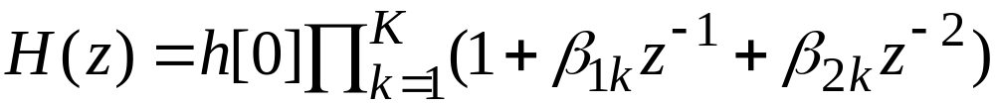
§6.3.2 Cascade Form FIR Digital Filter Structures
A higher-order FIR transfer function can also be realized as a cascade of second-order FIR sections and possibly a first-order section
To this end we express H(z) as
where k=N/2 if N is even, and k=(N+1)/2 if N is odd, with β_{2k}=0

Slide 20
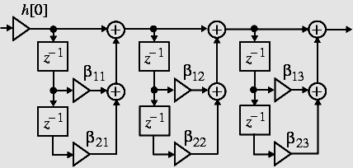
§6.3.2 Cascade Form FIR Digital Filter Structures
A cascade realization for N = 6 is shown below

Slide 21
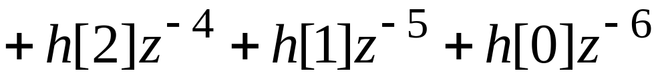
§6.3.3 Linear-Phase FIR Structures
The symmetry (or antisymmetry) property of a linear-phase FIR filter can be exploited to reduce the number of multipliers into almost half of that in the direct form implementations
Consider a length-7 Type 1 FIR transfer function with a symmetric impulse response

Slide 22
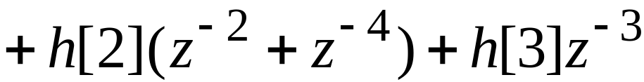
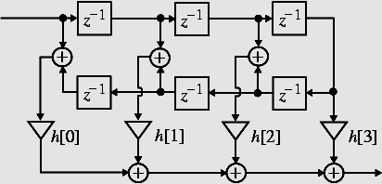
§6.3.3 Linear-Phase FIR Structures
Rewriting H(z) in the form
we obtain the realization shown below

Slide 23
§6.4 Basic IIR Digital Filter Structures
An N-th order IIR digital transfer function is characterized by 2N+1 unique coefficients, and in general, requires 2N+1 multipliers and 2N two-input adders for implementation
Direct form IIR filters: Filter structures in which the multiplier coefficients are precisely the coefficients of the transfer function

Slide 24
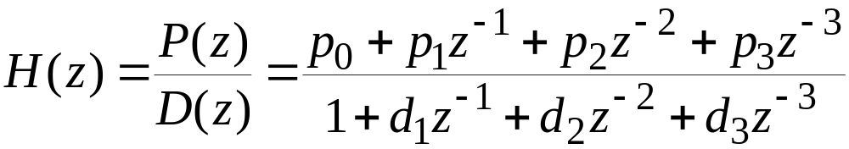
§6.4.1 Direct Form IIR Digital Filter Structures
Consider for simplicity a 3rd-order IIR filter with a transfer function
We can implement H(z) as a cascade of two filter sections as shown on the next slide

Slide 25
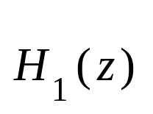




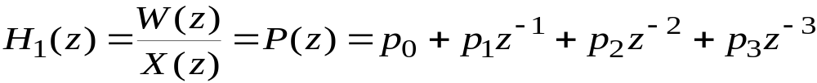
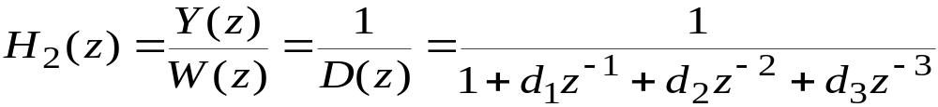
§6.4.1 Direct Form IIR Digital Filter Structures

Slide 26
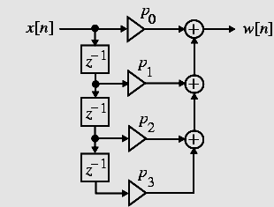
§6.4.1 Direct Form IIR Digital Filter Structures
The filter section H₁(z) can be seen to be an FIR filter and can be realized as shown right

Slide 27
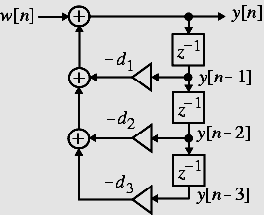
§6.4.1 Direct Form IIR Digital Filter Structures
The time-domain representation of H₂(z) is given by
Realization of follows from the above equation and is shown on the right

Slide 28
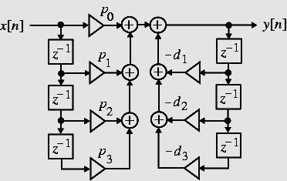
§6.4.1 Direct Form IIR Digital Filter Structures
A cascade of the two structures realizing H₁(z) and H₂(z) leads to the realization of H(z) shown below and is known as the Direct Form I structure

Slide 29
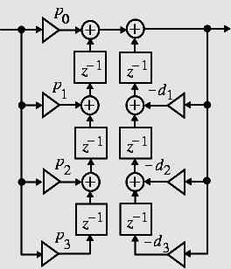
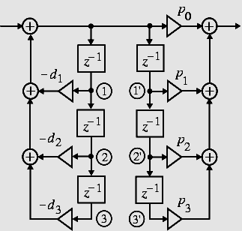
§6.4.1 Direct Form IIR Digital Filter Structures
Various other noncanonic direct form structures can be derived by simple block diagram manipulations as shown below

Slide 30

§6.4.1 Direct Form IIR Digital Filter Structures
Observe in the direct form structure shown right, the signal variable at nodes and are the same, and hence the two top delays can be shared
1

Slide 31


§6.4.1 Direct Form IIR Digital Filter Structures
Likewise, the signal variables at nodes and are the same, permitting the sharing of the middle two delays
Following the same argument, the bottom two delays can be shared
Sharing of all delays reduces the total number of delays to 3 resulting in a canonic realization shown on the next slide along with its transpose structure

Slide 32
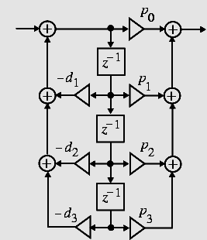
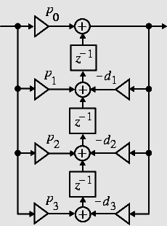
§6.4.1 Direct Form IIR Digital Filter Structures
Direct form II realizations of an N-th order IIR transfer function should be evident

Slide 33
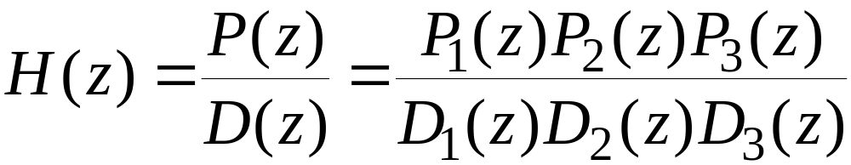
§6.4.2 Cascade Form IIR Digital Filter Structures
By expressing the numerator and the denominator polynomials of the transfer function as a product of polynomials of lower degree, a digital filter can be realized as a cascade of low-order filter sections
Consider, for example, H(z) = P(z)/D(z) expressed as

Slide 34
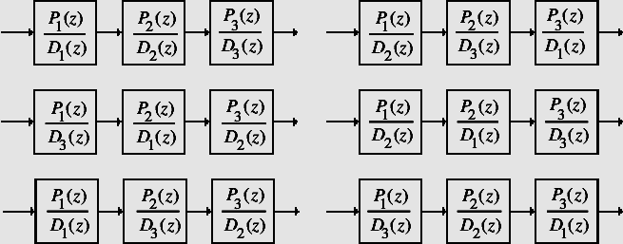
§6.4.2 Cascade Form IIR Digital Filter Structures
Examples of cascade realizations obtained by different pole-zero pairings are shown below

Slide 35
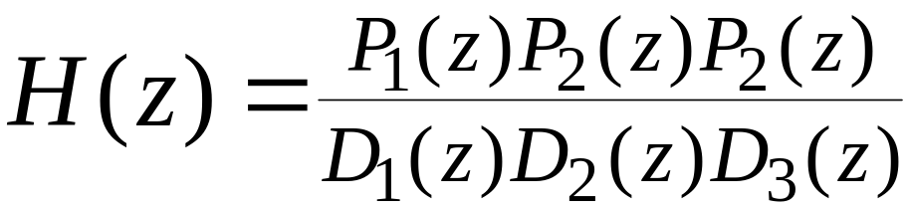
§6.4.2 Cascade Form IIR Digital Filter Structures
There are altogether a total of 36 different cascade realizations of
based on pole-zero-pairings and ordering
Due to finite wordlength effects, each such cascade realization behaves differently from others

Slide 36
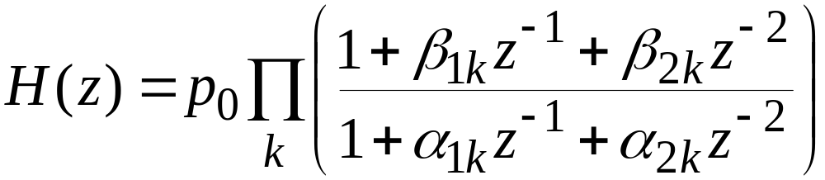
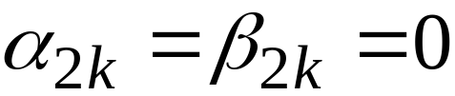
§6.4.2 Cascade Form IIR Digital Filter Structures
Usually, the polynomials are factored into a product of 1st-order and 2nd-order polynomials:
In the above, for a first-order factor

Slide 37
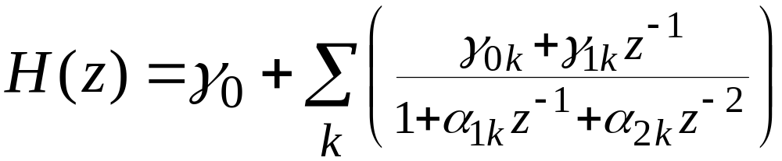
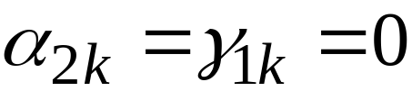
§6.4.3 Parallel Form IIR Digital Filter Structures
A partial-fraction expansion of the transfer function in z⁻¹ leads to the parallel form I structure
Assuming simple poles, the transfer function H(z) can be expressed as
In the above for a real pole

Slide 38
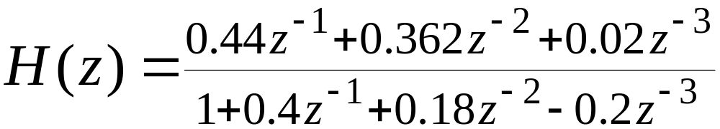
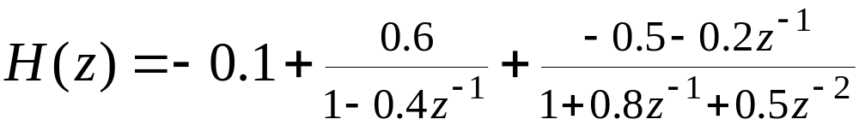
§6.4.3 Parallel Form IIR Digital Filter Structures
Example - A partial-fraction expansion of
in z⁻¹ yields

Slide 39
Homework
Read the textbook from p.359 to 378
Problems
6.4, 6.10, 6.26, 6.28, 6.56

