Slide 1
Chapter 7
Digital Filter Design

Slide 2
Objective - Determination of a realizable transfer function G(z) approximating a given frequency response specification is an important step in the development of a digital filter
If an IIR filter is desired, G(z) should be a stable real rational function
Digital filter design is the process of deriving the transfer function G(z)

Slide 3
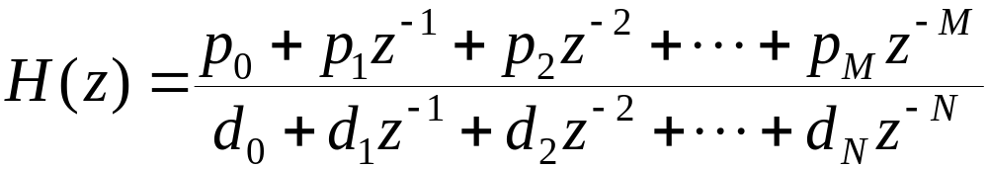
§7.2 Selection of Filter Type
The transfer function H(z) meeting the frequency response specifications should be a causal transfer function
For IIR digital filter design, the IIR transfer function is a real rational function of z⁻¹:
H(z) must be a stable transfer function and must be of lowest order N for reduced computational complexity

Slide 4
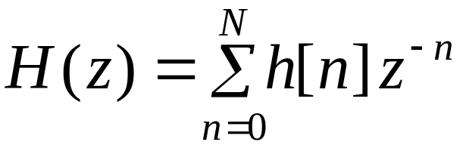
§7.2 Selection of Filter Type
For FIR digital filter design, the FIR transfer function is a polynomial in z⁻¹ with real coefficients:
For reduced computational complexity, degree N of H(z) must be as small as possible
If a linear phase is desired, the filter coefficients must satisfy the constraint:
h[n] = ± h[N-n]

Slide 5
§7.2 Selection of Filter Type
Advantages in using an FIR filter -
(1) Can be designed with exact linear phase,
(2) Filter structure always stable with quantized coefficients
Disadvantages in using an FIR filter - Order of an FIR filter, in most cases, is considerably higher than the order of an equivalent IIR filter meeting the same specifications, and FIR filter has thus higher computational complexity

Slide 6
§7.3 Digital Filter Design:
Basic Approaches
Most common approach to IIR filter design –
(1) Convert the digital filter specifications into an analog prototype lowpass filter specifications
(2) Determine the analog lowpass filter transfer function H_{a}(s)
(3) Transform H_{a}(s) into the desired digital transfer function G(z)

Slide 7
§7.3 Digital Filter Design:
Basic Approaches
An analog transfer function to be denoted as
H_{a}(s)= P_{a}(s) / D_{a}(s)
where the subscript “a” specifically indicates the analog domain
A digital transfer function derived from H_{a}(s) shall be denoted as
G(z)=P(z)/D(z)

Slide 8
§7.3 Digital Filter Design:
Basic Approaches
Basic idea behind the conversion of H_{a}(s) into G(z) is to apply a mapping from the s-domain to the z-domain so that essential properties of the analog frequency response are preserved
Thus mapping function should be such that
  Imaginary (jΩ ) axis in the s-plane be mapped onto the unit circle of the z-plane
  A stable analog transfer function be mapped into a stable digital transfer function

Slide 9
§7.3 Digital Filter Design:
Basic Approaches
FIR filter design is based on a direct approximation of the specified magnitude response, with the often added requirement that the phase be linear
The design of an FIR filter of order N may be accomplished by finding either the length-(N+1) impulse response samples {h[n]} or the (N+1) samples of its frequency response H(e^{jω})

Slide 10
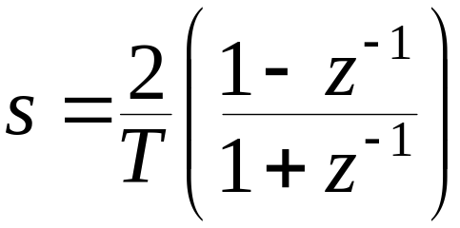
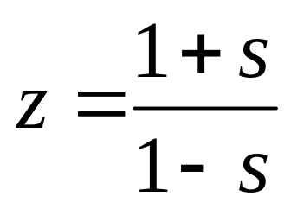
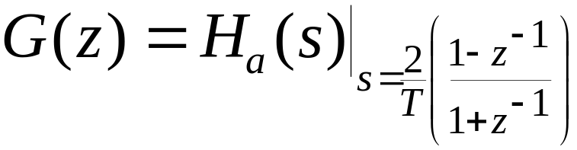
§7.4 IIR Digital Filter Design: Bilinear Transformation Method
Bilinear transformation
Above transformation maps a single point in the s-plane to a unique point in the z-plane and vice-versa
Relation between G(z) and H_{a}(s) is then given by

Slide 11
§7.4 IIR Digital Filter Design: Bilinear Transformation Method
Digital filter design consists of 3 steps:
(1) Develop the specifications of H_{a}(s) by applying the inverse bilinear transformation to specifications of G(z)
(2) Design H_{a}(s)
(3) Determine G(z) by applying bilinear transformation to H_{a}(s)
As a result, the parameter T has no effect on G(z) and T = 2 is chosen for convenience

Slide 12
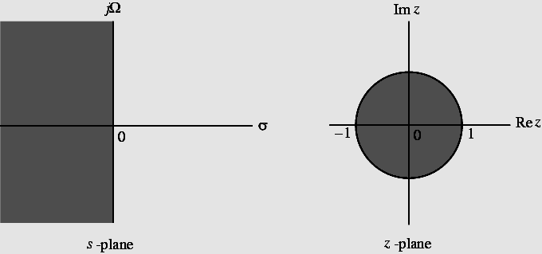
§7.4 IIR Digital Filter Design: Bilinear Transformation Method
Mapping of s-plane into the z-plane

Slide 13
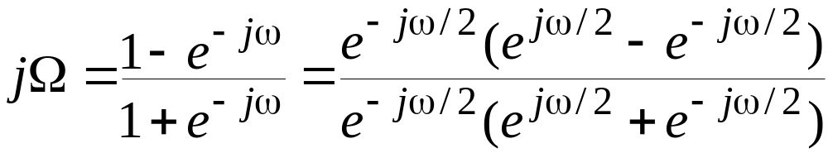
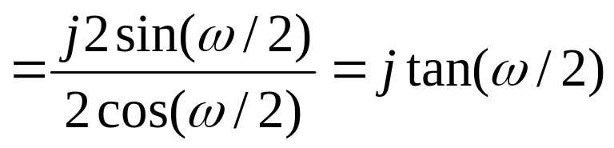
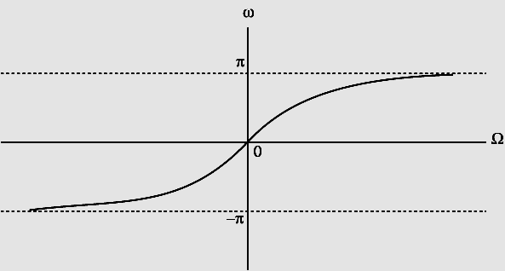
§7.4 IIR Digital Filter Design: Bilinear Transformation Method
For z=e^{jω} with T = 2 we have
or Ω=tan(ω/2)

Slide 14
§7.4 IIR Digital Filter Design: Bilinear Transformation Method
Mapping is highly nonlinear
Complete negative imaginary axis in the s-plane from Ω= - ∞ to Ω=0 is mapped into the lower half of the unit circle in the z-plane from z = -1 to z = 1
Complete positive imaginary axis in the s-plane from Ω=0 to Ω= ∞ is mapped into the upper half of the unit circle in the z-plane from z = 1 to z = - 1

Slide 15
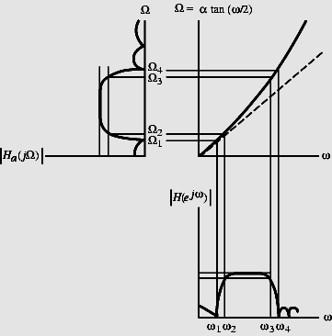
§7.4 IIR Digital Filter Design: Bilinear Transformation Method
Nonlinear mapping introduces a distortion in the frequency axis called frequency warping
Effect of warping shown right

Slide 16
§7.4 IIR Digital Filter Design: Bilinear Transformation Method
Steps in the design of a digital filter -
(1) Prewarp (ω_{p}, ω_{s}) to find their analog equivalents (Ω_{p}, Ω_{s})
(2) Design the analog filter H_{a}(s)
(3) Design the digital filter G(z) by applying bilinear transformation to H_{a}(s)
Transformation can be used only to design digital filters with prescribed magnitude response with piecewise constant values
Transformation does not preserve phase response of analog filter

Slide 17
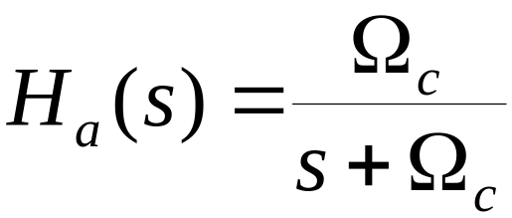
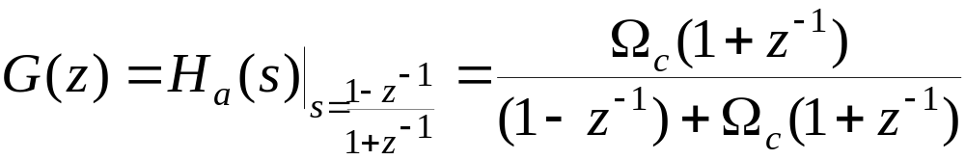
§7.4 IIR Digital Filter Design: Bilinear Transformation Method
Example - Consider
Applying bilinear transformation to the above we get the transfer function of a first-order digital lowpass Butterworth filter

Slide 18
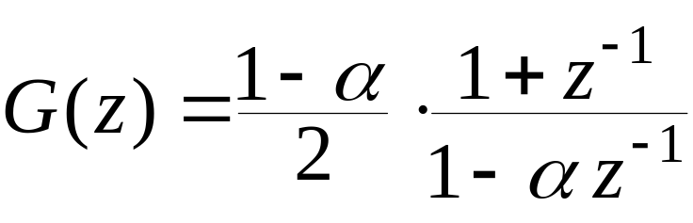
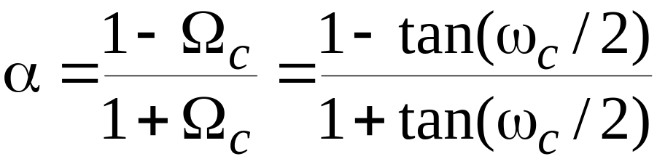
§7.4 IIR Digital Filter Design: Bilinear Transformation Method
Rearranging terms we get
where

Slide 19
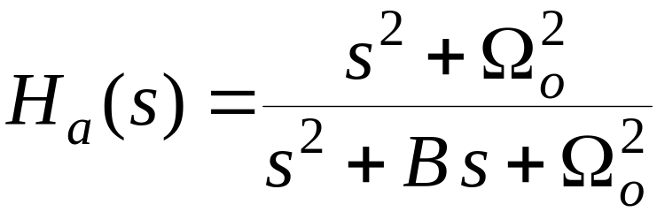
§7.4 IIR Digital Filter Design: Bilinear Transformation Method
Example - Consider the second-order analog notch transfer function
for which |H_{a}(jΩ₀)| = 0
|H_{a}(j0)| = |H_{a}(j∞)| = 0
Ω₀ is called the notch frequency
If |H_{a}(jΩ₂)| = |H_{a}(jΩ₁)| =1/√2 then B = Ω₂ - Ω₁ is the 3-dB notch bandwidth

Slide 20
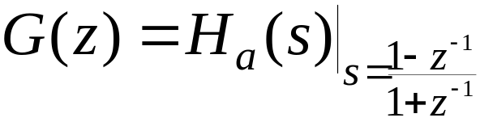
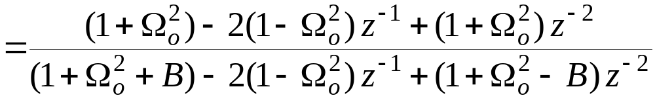
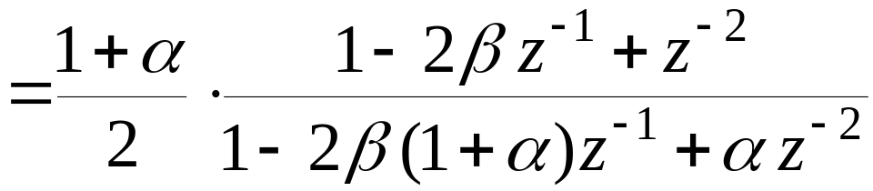
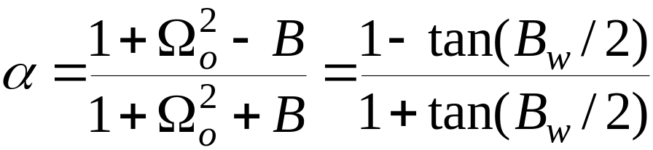
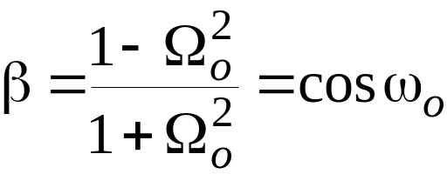
§7.4 IIR Digital Filter Design: Bilinear Transformation Method
Then
where

Slide 21
§7.4 IIR Digital Filter Design: Bilinear Transformation Method
Example - Design a 2nd-order digital notch filter operating at a sampling rate of 400 Hz with a notch frequency at 60 Hz, 3-dB notch bandwidth of 6 Hz
Thus ω₀ = 2π(60/400) = 0.3 π
B_{w} = 2π(6/400) = 0.03 π
From the above values we get
α = 0.90993
β = 0.587785

Slide 22
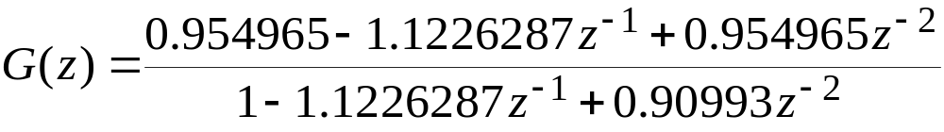
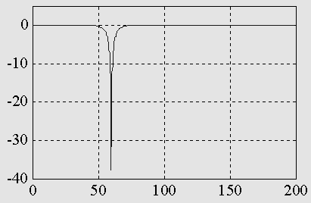
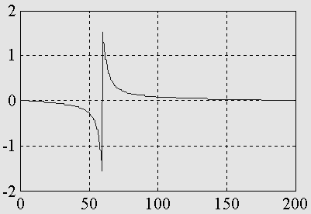
§7.4 IIR Digital Filter Design: Bilinear Transformation Method
Thus
The gain and phase responses are shown below

Slide 23
§7.4 IIR Digital Filter Design: Bilinear Transformation Method
Example - Design a lowpass Butterworth digital filter with
Passband edge frequency ω_{p} =0.25π,
Stopband edge frequency ω_{s} = 0.55π,
Passband ripple not exceeding 0.5 dB,
Minimum stopband attenuation is 15 dB

Slide 24
§7.4 IIR Digital Filter Design: Bilinear Transformation Method
From the specified passband ripple of 0.5 dB, ε²=0.1220185
From the minimum stopband attenuation of 15 dB, A²=31.622777
If |G(e^{j0})|=1 which implies
20log₁₀|G(e^{j0.25π})| ≥-0.5
20log₁₀|G(e^{j0.55π})| ≤-15

Slide 25
§7.4 IIR Digital Filter Design: Bilinear Transformation Method
Prewarping we get
Ω_{p}=tan(ω_{p}/2)=tan(0.25π/2)=0.4142136
Ω_{s} =tan(ω_{s}/2)=tan(0.55π/2)=1.1708496
The inverse transition ratio is
1/k = Ω_{s}/ Ω_{p} = 2.8266809
The inverse discrimination ratio is
1/k₁ = √(A²-1)/ε = 15.841979

Slide 26
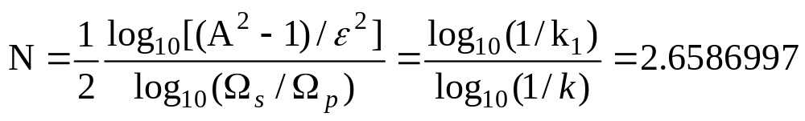
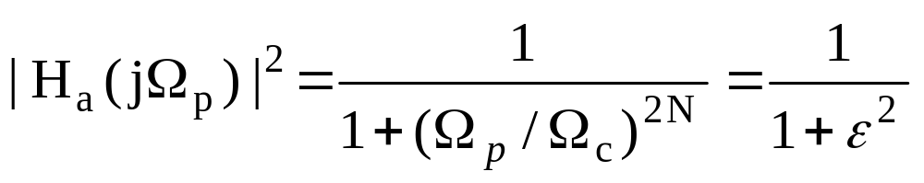
§7.4 IIR Digital Filter Design: Bilinear Transformation Method
From the Butterworth expression for the order N
Choose N = 3
To determine Ω_{c} we use

Slide 27
§7.4 IIR Digital Filter Design: Bilinear Transformation Method
We then get
Ω_{c}= 1.419915(Ω_{p})=0.588148
3rd-order lowpass Butterworth transfer function for Ω_{c}=1 is
H_{an}(s)=1/[(s+1)(s²+s+1)]
Denormalizing to get Ω_{c}=0.588148 we arrive at
H_{a}(s)= H_{an}(s/0.588148)

Slide 28
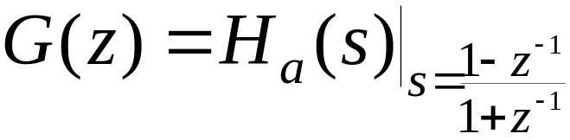
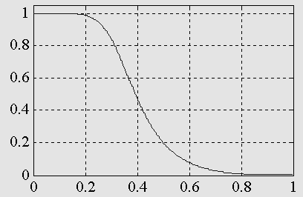
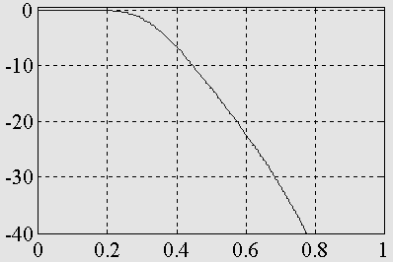
§7.4 IIR Digital Filter Design: Bilinear Transformation Method
Applying bilinear transformation to H_{a}(s) we get the desired digital transfer function
Magnitude and gain responses of G(z) shown below:

Slide 29
Design of IIR Highpass, Bandpass, and Bandstop Digital Filters
First Approach -
(1) Prewarp digital frequency specifications of desired digital filter G_{D}(z) to arrive at frequency specifications of analog filter H_{D}(s) of same type
(2) Convert frequency specifications of H_{D}(s) into that of prototype analog lowpass filter H_{LP}(s)
(3) Design analog lowpass filter H_{LP}(s)

Slide 30
Design of IIR Highpass, Bandpass, and Bandstop Digital Filters
(4) Convert H_{LP}(s) into H_{D}(s) using inverse frequency transformation used in Step 2
(5) Design desired digital filter G_{D}(z) by applying bilinear transformation to H_{D}(s)

Slide 31
Design of IIR Highpass, Bandpass, and Bandstop Digital Filters
Second Approach -
(1) Prewarp digital frequency specifications of desired digital filter G_{D}(z) to arrive at frequency specifications of analog filter H_{D}(s) of same type
(2) Convert frequency specifications of H_{D}(s) into that of prototype analog lowpass filter H_{LP}(s)

Slide 32
Design of IIR Highpass, Bandpass, and Bandstop Digital Filters
(3) Design analog lowpass filter H_{LP}(s)
(4) Convert H_{LP}(s) into an IIR digital transfer function G_{LP}(z) using bilinear transformation
(5) Transform G_{LP}(z) into the desired digital transfer function G_{D}(z)
We illustrate the first approach

Slide 33
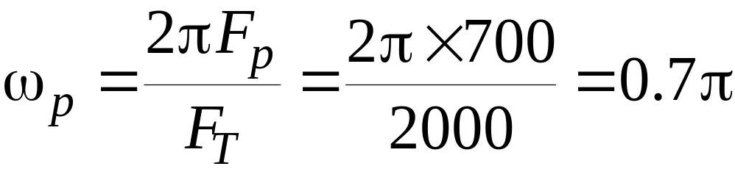
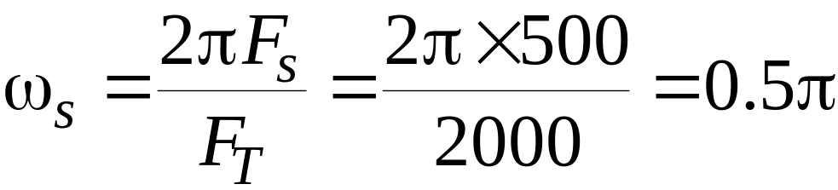
IIR Highpass Digital Filter Design
Design of a Type 1 Chebyshev IIR digital highpass filter
Specifications: F_{P}=700 Hz, F_{S}=500 Hz,
α_{p}=1 dB, α_{s}=32 dB, F_{T}= 2 kHz
Normalized angular bandedge frequencies

Slide 34
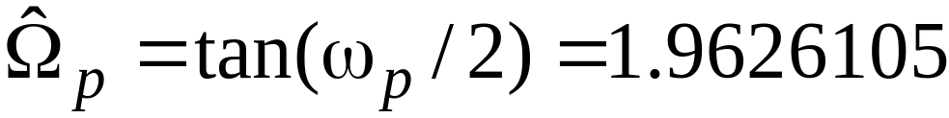
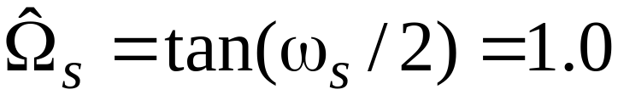
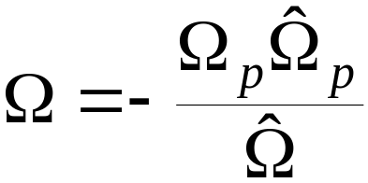
IIR Highpass Digital Filter Design
Prewarping these frequencies we get
For the prototype analog lowpass filter choose Ω_{p}=1
Using
we get Ω_{s}= 1.962105
Analog lowpass filter specifications: Ω_{p}=1 , Ω_{s}= 1.962105 , α_{p}=1 dB, α_{s}=32 dB

Slide 35
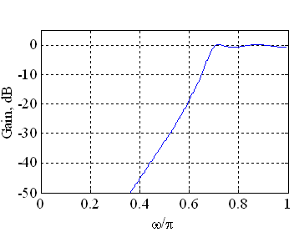
IIR Highpass Digital Filter Design
MATLAB code fragments used for the design
[N, Wn] = cheb1ord(1, 1.9626105, 1, 32, ’s’)
[B, A] = cheby1(N, 1, Wn, ’s’);
[BT, AT] = lp2hp(B, A, 1.9626105);
[num, den] = bilinear(BT, AT, 0.5);

Slide 36
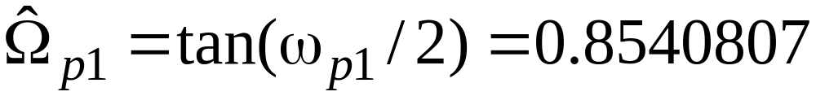
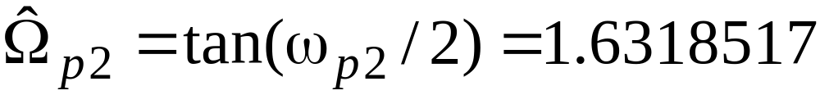
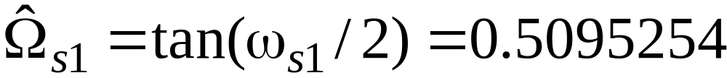
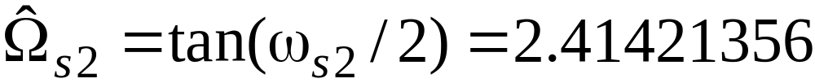
IIR Bandpass Digital Filter Design
Design of a Butterworth IIR digital bandpass filter
Specifications: ω_{p1}=0.45π, ω_{p2}=0.65π ,
ω_{s1}=0.3π, ω_{s2}=0.75π, α_{p}=1dB, α_{s}=40dB
Prewarping we get

Slide 37
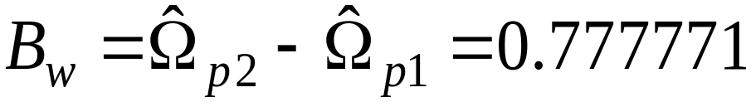
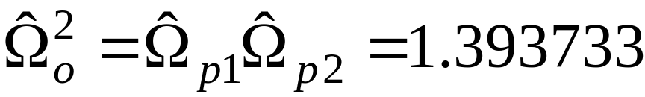
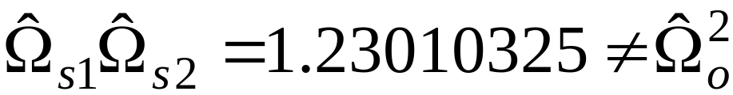
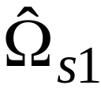
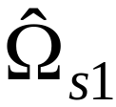
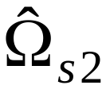
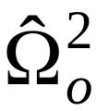
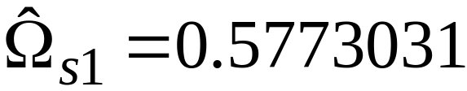
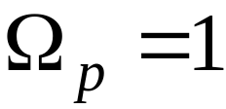
IIR Bandpass Digital Filter Design
Width of passband
We therefore modify so that and exhibit geometric symmetry with respect to
We set
For the prototype analog lowpass filter we choose

Slide 38
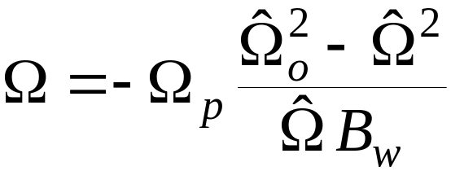
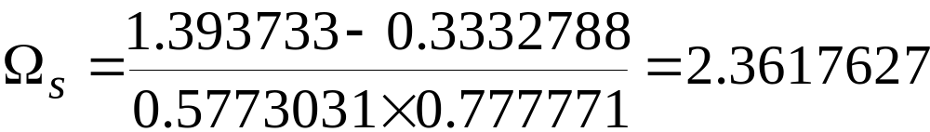
IIR Bandpass Digital Filter Design
Using we get
Specifications of prototype analog Butterworth lowpass filter:
Ω_{p}=1, Ω_{s}=2.3617627 , α_{p}=1dB, α_{s}=40dB

Slide 39
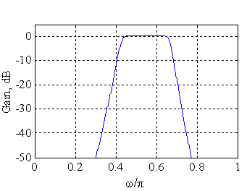
IIR Bandpass Digital Filter Design
MATLAB code fragments used for the design
[N, Wn] = buttord(1, 2.3617627, 1, 40, ’s’)
[B, A] = butter(N, Wn, ’s’);
[BT, AT] = lp2bp(B, A, 1.1805647, 0.777771);
[num, den] = bilinear(BT, AT, 0.5);

Slide 40







IIR Bandstop Digital Filter Design
Design of an elliptic IIR digital bandstop filter
Specifications: ω_{s1}= 0.45π , ω_{s2}= 0.65π , ω_{p1}= 0.3π, ω_{p2}= 0.75π , α_{p}=1dB, α_{s}=40dB
Prewarping we get
Width of stopband

Slide 41







IIR Bandstop Digital Filter Design
We therefore modify so that and exhibit geometric symmetry with respect to
We set
For the prototype analog lowpass filter we choose
Using
we get

Slide 42

IIR Bandstop Digital Filter Design
MATLAB code fragments used for the design
[N, Wn] = ellipord(0.4234126, 1, 1, 40, ’s’);
[B, A] = ellip(N, 1, 40, Wn, ’s’);
[BT, AT] = lp2bs(B, A, 1.1805647, 0.777771);
[num, den] = bilinear(BT, AT, 0.5);

Slide 43
§7.5 Low pass FIR filter design
1. Choose a pass band edge frequency for design that is midway through the transition width.
2. Find the impulse response h_{L}[n] for the ideal low pass filter with this pass band edge frequency.
3. Choose a window w[n] that gives adequate stop band attenuation, and determine the number of terms N needed to give the required transition width. An odd number should be chosen, so that the impulse response will be perfectly symmetrical around its middle point.

Slide 44
§7.5 Low pass FIR filter design
4. Find the impulse response h[n] = h_{L}[n]w[n] for the FIR filter.
5. Shift the impulse response to the right by (N-1)/2 samples.
The impulse response produced by this design method can be used to create a difference equation for the filter and also a plot of the filter shape.

Slide 45


Low Pass Filter
Impulse Response and Shape
Impulse Response
Shape

Slide 46




Filtering a Voltage Signal
After High Pass Filtering (pass band edge 80 Hz)
After Low Pass Filtering (pass band edge 40 Hz)
After Band Stop Filtering (pass band edges 40 Hz and 80 Hz)
After Band Pass Filtering (pass band edges 40 Hz and 80 Hz)

Slide 47
§7.6 Fixed Window Functions
Using a tapered window causes the height of the sidelobes to diminish, with a corresponding increase in the main lobe width resulting in a wider transition at the discontinuity
Hann:
W[n[=0.5+0.5cos[2πn/(2M+1)], -M≤n ≤M
Hamming:
W[n[=0.54+0.46cos[2πn/(2M+1)], -M≤n ≤M
Blackman:
W[n[=0.42+0.5cos[2πn/(2M+1)] +0.08cos[4πn/(2M+1)]

Slide 48




Slide 49

Rectangular Window

Slide 50

Hanning Window
w[n[=0.5+0.5cos[2πn/(2M+1)], -M≤n ≤M

Slide 51

Hamming Window
w[n[=0.54+0.46cos[2πn/(2M+1)], -M≤n ≤M

Slide 52

Blackman Window
w[n[=0.42+0.5cos[2πn/(2M+1)]
+0.08cos[4πn/(2M+1)]

Slide 53
§7.6 Fixed Window Functions
Plots of magnitudes of the DTFTs of these windows for M = 25 are shown below
Rectangular window
Hanning window
0
0
-20
-20
Gain, dB
Gain, dB
-40
-40
-60
-60
-80
-80
-100
-100
0
0.2
0.4
0.6
0.8
1
0
0.2
0.4
0.6
0.8
1
ω
/
π
ω
/
π
Hamming window
Blackman window
0
0
-20
-20
-40
-40
Gain, dB
Gain, dB
-60
-60
-80
-80
-100
0
0.2
0.4
0.6
0.8
1
-100
0
0.2
0.4
0.6
0.8
1
ω
/
π
ω
/
π

Slide 54
§7.6 Fixed Window Functions
Magnitude spectrum of each window characterized by a main lobe centered at ω = 0 followed by a series of sidelobes with decreasing amplitudes
Parameters predicting the performance of a window in filter design are:
Main lobe width
Relative sidelobe level

Slide 55
§7.6 Fixed Window Functions
Main lobe width Δ_{ML}- given by the distance between zero crossings on both sides of main lobe
Relative sidelobe level A_{sl} - given by the difference in dB between amplitudes of largest sidelobe and main lobe

Slide 56
§7.6 Fixed Window Functions
To ensure a fast transition from passband to stopband, window should have a very small main lobe width
To reduce the passband and stopband ripple δ, the area under the sidelobes should be very small
Unfortunately, these two requirements are contradictory

Slide 57


Rectangular and Blackman windows

Slide 58
§7.5 Fixed Window Functions
Properties of some fixed window functions
Type of windows | Main lobe width Δ_{ML} | Relative sidelobe level A_{sl} | Minimum stopband attenuation | Transition bandwidth Δ_{M}
Rectangular | 4π/(2M+1) | 13.3dB | 20.9dB | 0.92 π/M
Hann | 8π/(2M+1) | 31.5dB | 43.9dB | 3.11 π/M
Hamming | 8π/(2M+1) | 42.7dB | 54.5dB | 3.32 π/M
Blackman | 12π/(2M+1) | 75.3dB | 75.3dB | 5.56 π/M

Slide 59
§7.7 Design Steps for Windowed Low Pass FIR Filters
Choose a pass band edge frequency in Hz for the filter in the middle of the transition width:
f_{c} =(f_{p} + f_{s} )/2
(2) Calculate Ω_{c}= 2πf_{c}/f_{T} and substitute into h₁[n], the infinite impulse response for an ideal low pass filter:
h₁[n]=sin(nΩ_{c})/nπ
(3) Choose a window based on the specified, and calculate the number of nonzero window terms
Calculate FIR h[n] from h[n]=h₁[n]w[n], notice the response is noncausal.
Shift the impulse response to the right by (N-1)/2 to make the filter causal

Slide 60
FIR Filter Design Example 1
The specifications of a low pass filter:
Pass band edge 2kHz
Stop band edge 3kHz
Stop band attenuation 40dB
Sampling frequency 10kHz

Slide 61
FIR Filter Design Example 1
Transition width = 3 – 2 = 1 kHz
f₁= 2000+1000/2=2500Hz
Ω₁=2πf₁/f_{T}=2π2500/10000=0.5π
h₁[n]=sin(nΩ₁)/nπ=sin(0.5πn)/nπ
Choose Hanning window, with
N=3.32f_{T}/T.W.=33.2, choose N=33
w[n]=0.5+0.5cos(2 πn/32)
*T.W. Transition Width

Slide 62
FIR Filter Design Example 1
Impulse Response
frequency Response
G(jω_{p})=-0.06 dB at ω_{p} =2.013 kHz
G(jω_{s})=-40 dB at ω_{s} =2.976 kHz

Slide 63
FIR Filter Design Example 2
FIR bandpass filter :
center frequency 4kHz
pass band edges 3.5 and 4.5 kHz
Sampling frequency 22kHz
transition width 500Hz
stop band attenuation 50 dB

Slide 64
FIR Filter Design Example 2
f₁=500 + 500/2 = 750 Hz
Ω₁=2πf₁/f_{Y} = 0.06818π
h₁[n]=sin(nΩ₁)/nπ=sin(0.06818nπ)/nπ
Based on the stop band attenuation, choose a Hamming window, and
N=3.44f_{T}/T.W=3.44(22000/500)=151.4
The nearest odd integer is N=151, so
w[n]=0.54 + 0.46cos(2nπ/150)

Slide 65


FIR Filter Design Example 2
The center frequency f₀ is 4 kHz, the center digital frequency Ω₀ is
Ω₀ =2π f₀/f_{T} = 2π(4000/22000)=0.3636π

Slide 66
FIR Filter Design Example 2
The -6dB edges occur at 3.501kHz and 4.499kHz.
An attenuation of 50 dB is obtained at 3.005kHz and 4.994kHz, producing the specified 500 Hz

Slide 67
Homework
Problems
7.6, 7.14, 7.60, 7.61, 7.62

