Slide 1
Chapter 9
Analysis of Finite Wordlength Effects

Slide 2
Introduction
Ideally, the system parameters along with the signal variables have infinite precision taking any value between -∞ and ∞
In practice, they can take only discrete values within a specified range since the registers of the digital machine where they are stored are of finite length
The discretization process results in nonlinear difference equations characterizing the discrete-time systems

Slide 3
Introduction
These nonlinear equations, in principle, are almost impossible to analyze and deal with exactly
However, if the quantization amounts are small compared to the values of signal variables and filter parameters, a simpler approximate theory based on a statistical model can be applied

Slide 4
Introduction
Using the statistical model, it is possible to derive the effects of discretization and develop results that can be verified experimentally
Sources of errors -
(1) Filter coefficient quantization
(2) A/D conversion
(3) Quantization of arithmetic operations
(4) Limit cycles

Slide 5
Introduction
Consider the first-order IIR digital filter
y[n]= αy[n-1]+x[n]
When implemented on a digital machine, the filter coefficient α can assume only certain discrete values approximating the original design value α
^
α

Slide 6
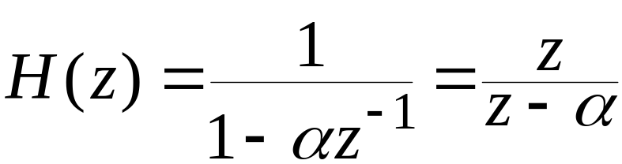
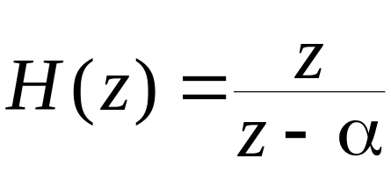
Introduction
The desired transfer function is
The actual transfer function implemented is
^
^
which may be much different from the desired transfer function H(z)

Slide 7
Introduction
Thus, the actual frequency response may be quite different from the desired frequency response
Coefficient quantization problem is similar to the sensitivity problem encountered in analog filter implementation

Slide 8

Introduction
A/D Conversion Error - generated by the filter input quantization process
If the input sequence x[n] has been obtained by sampling an analog signal x_{a}(t), then the actual input to the digital filter is
^
where e[n] is the A/D conversion error

Slide 9

Introduction
Arithmetic Quantization Error - For the first-order digital filter, the desired output of the multiplier is
Due to product quantization, the actual output of the multiplier of the implemented filter is
^
where e_{α}[n] is the product roundoff error

Slide 10
Introduction
Limit Cycles - The nonlinearity of the arithmetic quantization process may manifest in the form of oscillations at the filter output, usually in the absence of input or, sometimes, in the presence of constant input signals or sinusoidal input signals

Slide 11
§9.1 Quantization Process and Error
In DSP applications, it is a common practice to represent the data either as a fixed-point fraction or as a floating-point binary number with the mantissa as a binary fraction
Assume the available wordlength is (b+1) bits with the most significant bit (MSB) representing the sign
Consider the data to be a (b+1)-bit fixed-point fraction

Slide 12
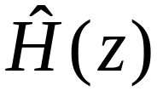
§9.1.3 Analysis of Coefficient Quantization Effects
The transfer function of the digital filter implemented with quantized coefficients is different from the desired transfer function H(z)
Main effect of coefficient quantization is to move the poles and zeros to different locations from the original desired locations

Slide 13
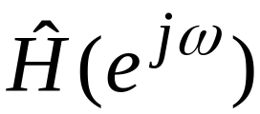
§9.1.3 Analysis of Coefficient Quantization Effects
The actual frequency response is thus different from the desired frequency response H(e^{jω})
In some cases, the poles may move outside the unit circle causing the implemented digital filter to become unstable even though the original transfer function H(z) is stable

Slide 14
§9.2 A/D Conversion Noise Analysis
A/D converters used for digital processing of analog signals in general employ two’s-complement fixed-point representation to represent the digital equivalent of the input analog signal
For the processing of bipolar analog signals, the A/D converter generates a bipolar output represented as a fixed-point signed binary fraction

Slide 15
§9.2 A/D Conversion Noise Analysis
The digital sample generated by the A/D converter is the binary representation of the quantized version of that produced by an ideal sampler with infinite precision
If the output word is of length (b+1) bits including the sign bit, the total number of discrete levels available for the representation of the digital equivalent is 2^{b+1}

Slide 16






§9.2 A/D Conversion Noise Analysis
The dynamic range of the output register depends on the binary number representation selected for the A/D converter
The model of a practical A/D conversion system is as shown below
Ideal
Quantizer
sampler
Quantizer
Coder

Slide 17
§9.2 A/D Conversion Noise Analysis
The quantization process employed by the quantizer can be either rounding or truncation
Assuming rounding is used, the input-output characteristic of a 3-bit A/D converter with the output in two’s-complement form is as shown next

Slide 18
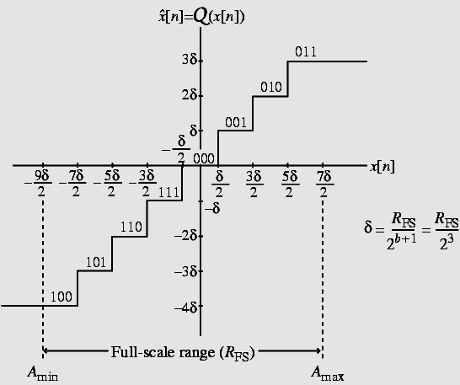
§9.2 A/D Conversion Noise Analysis
Input-output characteristic

Slide 19
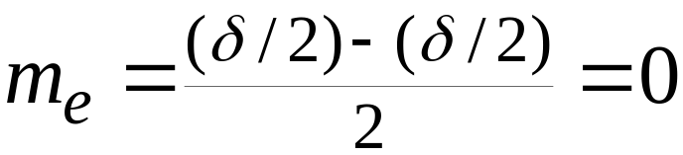
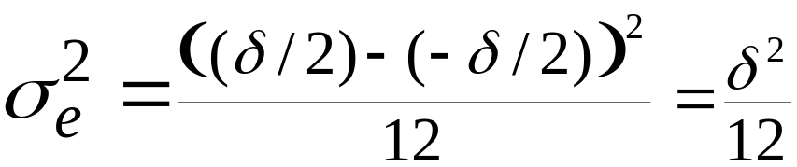
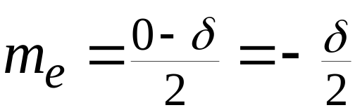
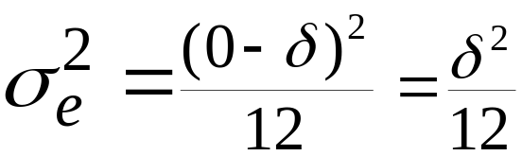
§9.2 A/D Conversion Noise Analysis
Mean and variance of the error sample e[n]:
Rounding -
Two’s-complement truncation -

Slide 20
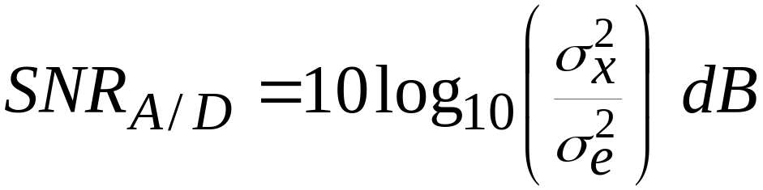
§9.3 Signal-to-Quantization Noise Ratio
The effect of the additive quantization noise e[n] on the input signal x[n] is given by the signal-to-quantization noise ratio given by
where σ_{x}² is the input signal variance representing the signal power and σ_{e}² is the noise variance representing the quantization noise power

Slide 21
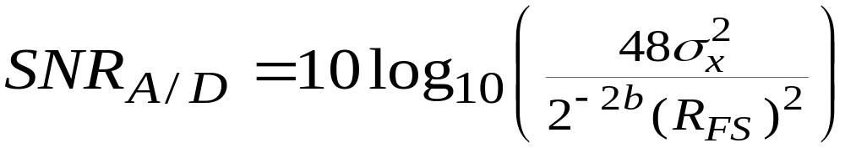
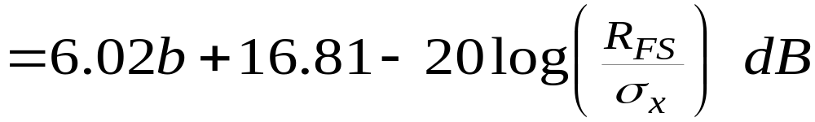
§9.3 Signal-to-Quantization Noise Ratio
Therefore
This expression can be used to determine the minimum wordlength of an A/D converter needed to meet a specified SNR_{A/D}
Note: SNR_{A/D} increases by 6 dB for each bit added to the wordlength

Slide 22
§9.4 Limit Cycles in IIR Digital Filters
So far we have treated the analysis of finite wordlength effects using a linear model of the system
A practical digital filter is a nonlinear system caused by the quantization of the arithmetic operations
Such nonlinearities may cause an IIR filter, which is stable under infinite precision, to exhibit an unstable behavior under finite precision arithmetic for specific input signals

Slide 23
§9.4 Limit Cycles in IIR Digital Filters
This type of instability usually results in an oscillatory periodic output called a limit cycle
The system remains in this condition until an input of sufficiently large amplitude is applied to move the system into a more conventional operation

Slide 24
§9.4 Limit Cycles in IIR Digital Filters
Limit cycles occur in IIR filters due to the presence of feedback
Such oscillations are absent in FIR filters as they do not have any feedback path

Slide 25



§9.4 Limit Cycles in IIR Digital Filters
x[n]
+
Consider the first-order IIR filter as shown right
Q
α
Assume the quantization operation to be rounding and the filter to be implemented with a signed 6-bit fractional arithmetic
The nonlinear difference equation characterizing the filter is given by

Slide 26

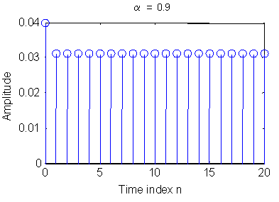
§9.4 Limit Cycles in IIR Digital Filters
For x[n] = 0.03δ[n], , and α = 0.9, the output of the filter is as shown below
The limit cycle generated has a period of 1

Slide 27
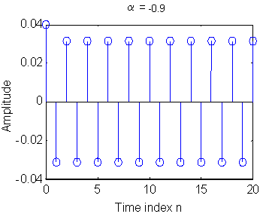
§9.4 Limit Cycles in IIR Digital Filters
For x[n] = 0.03δ[n], , and the output of the filter is as shown below
The limit cycle generated has a period of 2

Slide 28
Homework
Problems:
9.8, 9.13, 9.14, 9.15,

