Slide 1
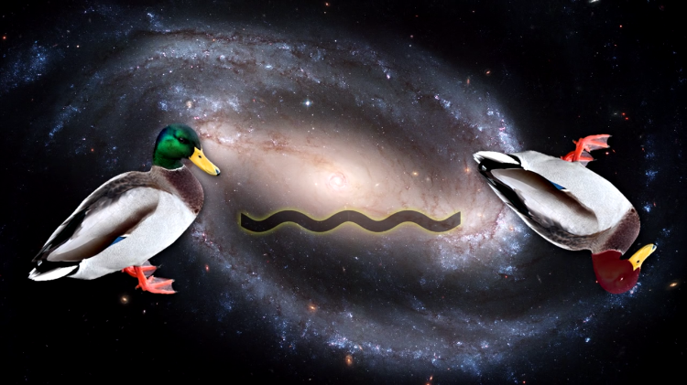
QUACKD-Bot:
A Slackbot interface powered by the B92 Protocol
Jessie Chen, Nikhil Harle, Richard Li, Allen Mi, Will Sun
Notes:
https://laughingsquid.com/wp-content/uploads/2017/04/ducks.png

Slide 2
Overview
Slackbot interface allows users to send and receive quantum keys generated via the B92 Protocol, encrypt messages, and send to individuals or groups
Randomized benchmarking examines characteristics of noise channel
Measurement error mitigation combats quantum readout noise
Information reconciliation, privacy amplification, and randomness extraction guarantees key effectiveness and security
Notes:
Python file allows choice of backend.

Slide 3
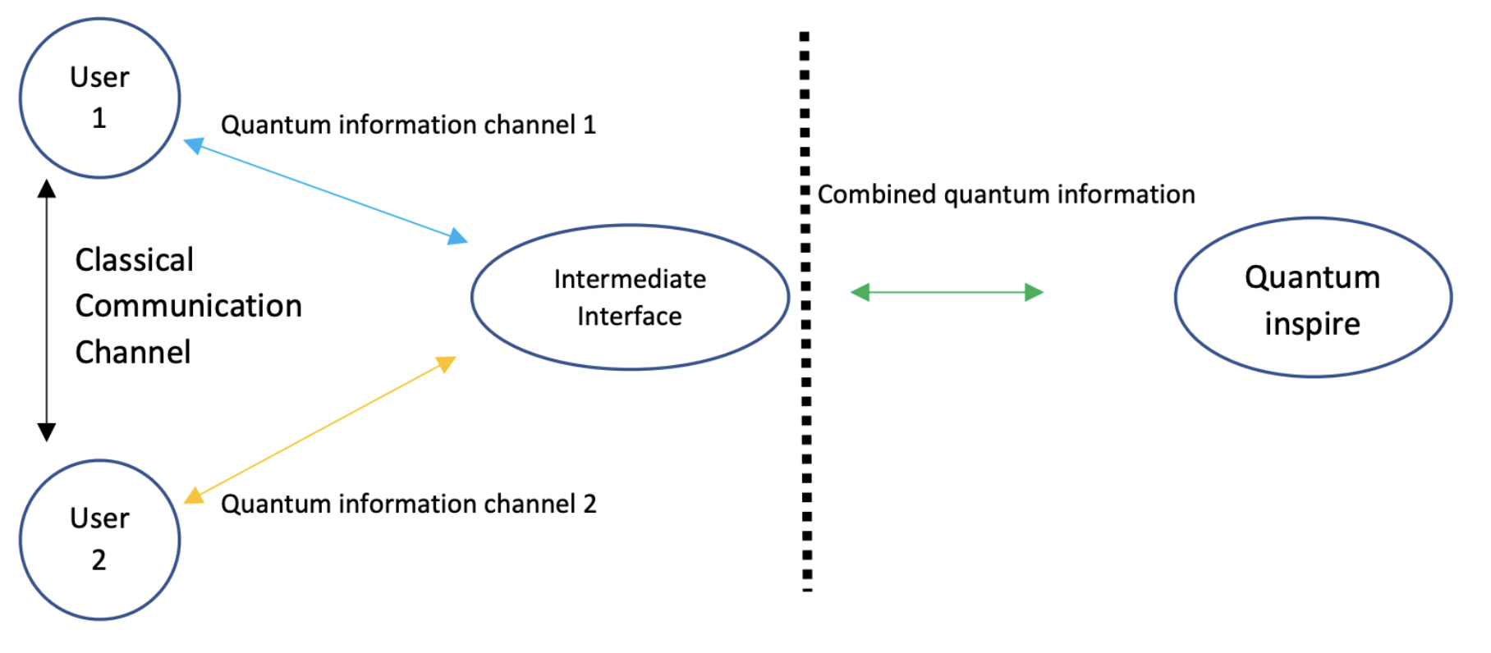
How the B92 Protocol is used within our network structure
Alice generates a random N bit string and sends it to the intermediate interface, which prepares N qubits in either the |0> (|+>) state if the corresponding bit is 0 (1).
Bob sends a list of N bases (either X or Z) in which to measure the qubits.
The intermediate interface creates a circuit measuring the qubits in the specified basis and passes it to Quantum Inspire, where the circuits are run n_shots times.
Notes:
Update diagram for our project

Slide 4
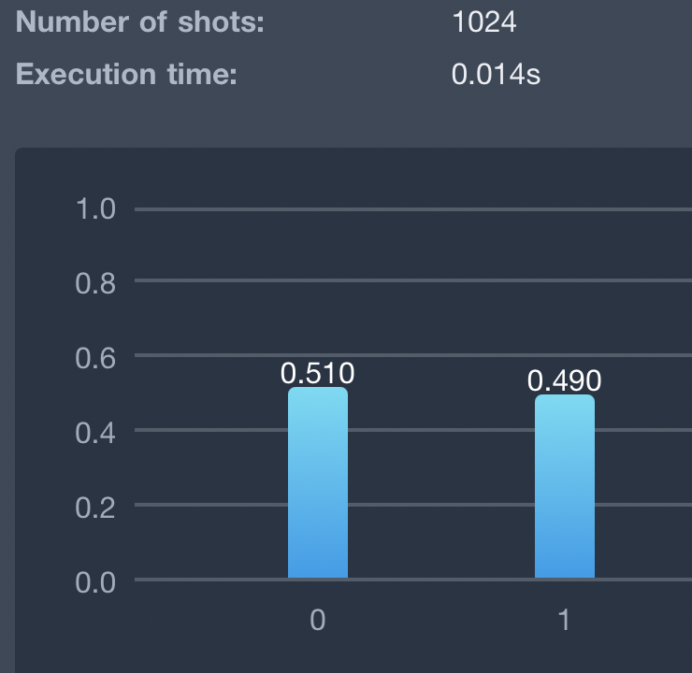
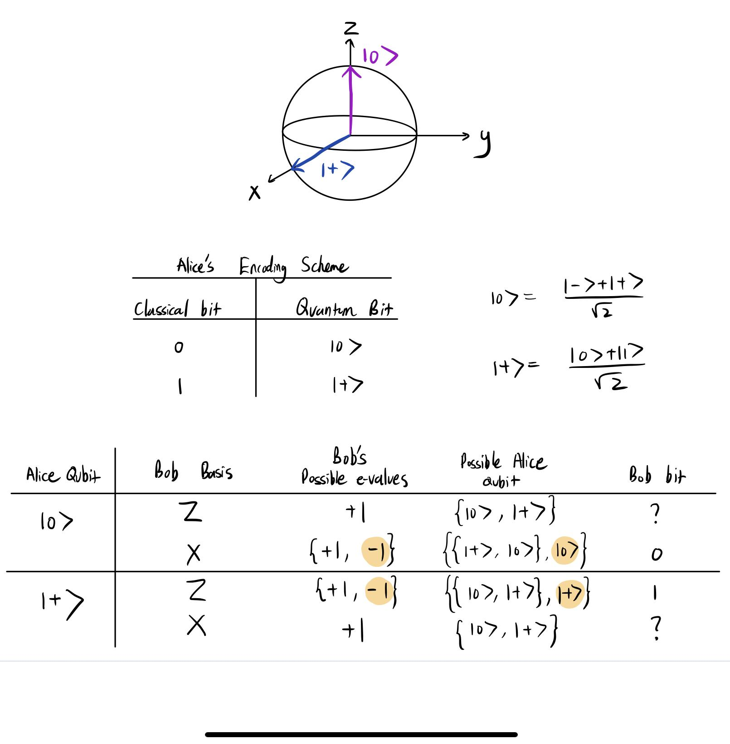
Implementation of the B92 Protocol
With multiple measurements (default: 1024 shots) we identify Alice’s input state, through analyzing the distribution of results, ½ of the time (but with efficiency cost).
Only when Bob obtains a measurement result of -1 can he determine Alice’s original qubit with certainty. This happens, on average, ¼ of the time.
Notes:
Protection against Eve:
Eve cannot reliably duplicate intercepted qubits sent by Alice, because she is forced to guess the correct measurement axes just like Bob
Interception leads to an increase in the single-qubit error rate (can be detected in principle by sacrificing a subset of the noisy key to check(, and/or a decrease in the efficiency (can be detected readily)

Slide 5
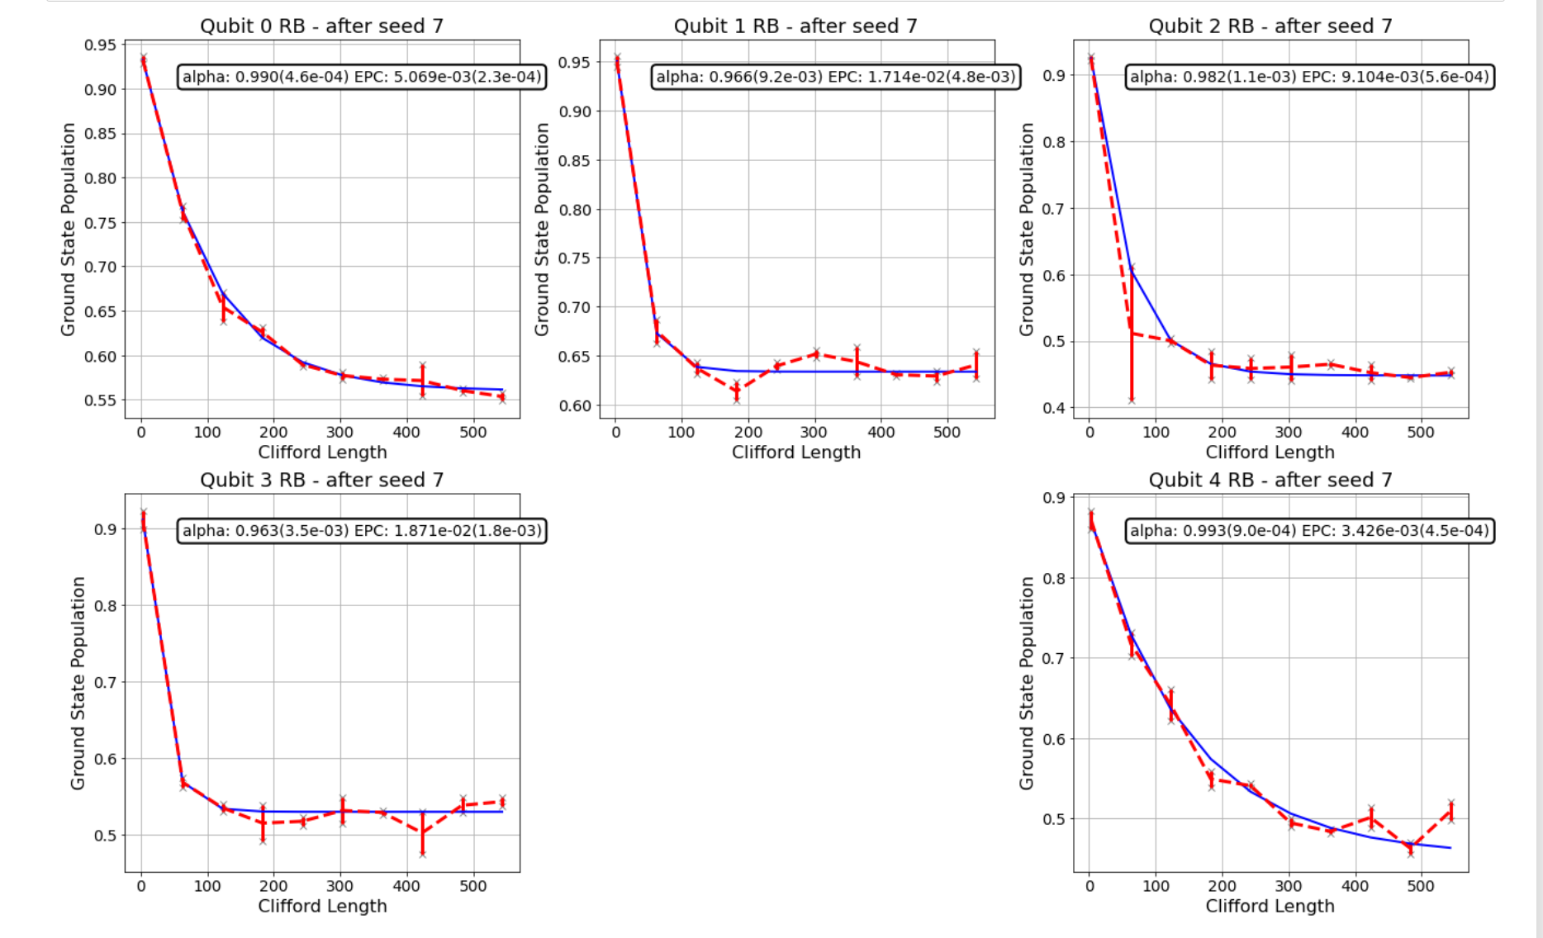
Randomized Benchmarking
Jessie (update slides)
Purpose: to understand the characteristics of the noise channel (experiment performed on Starmon-5)
Notes:
Single-qubit gate errors (Rx/Ry) per qubit on Starmon-5, based on randomized benchmarking experiments:
q0: 0.0029730010985011823
q1: 0.010237693816128046
q2: 0.007855523206786
q3: 0.01059506716556
q4: 0.0027522358822953397
Based on these metrics, we propose the choice to perform QKD on the subset of 2 qubits [q0 and q4] with the highest single qubit fidelities, while somewhat sacrificing the runtime of the procedure.
The single-qubit fidelities also inform the choice of the average single-qubit error rate, which is the input to the CASCADE protocol, and also determines the theoretical minimum lower bound

Slide 6
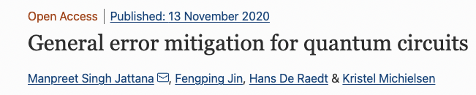
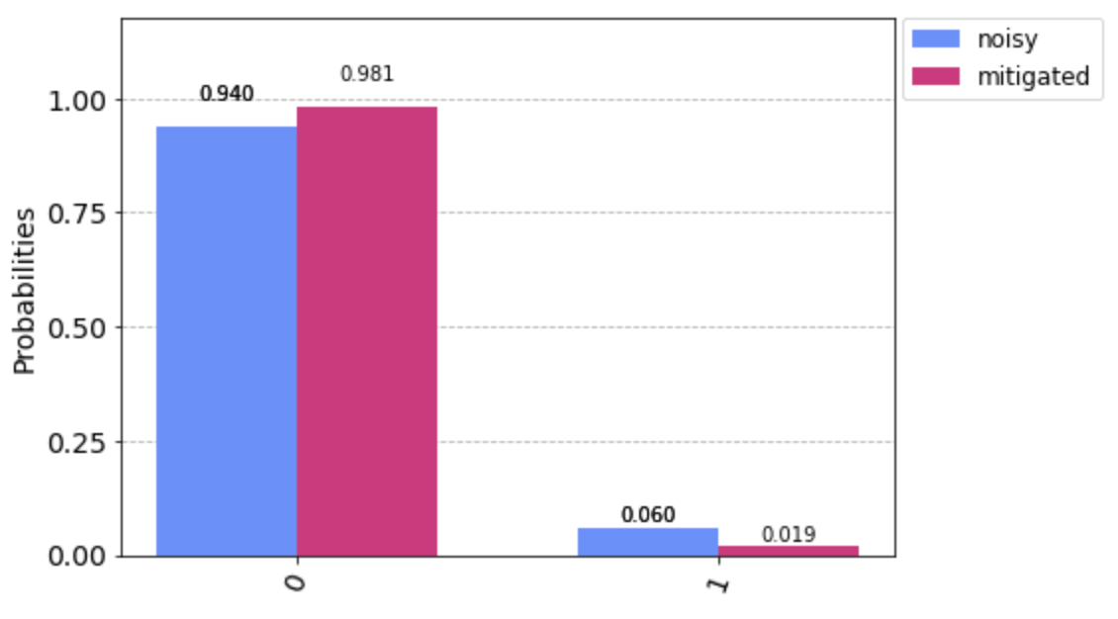
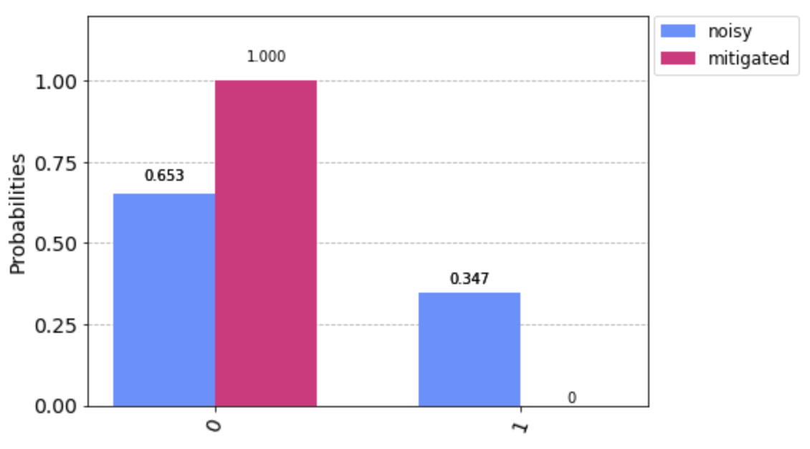
Measurement Error Mitigation
Purpose: to combat readout noise
Form the calibration matrix M, then multiply all measurement counts by its inverse
Assumes readout errors are roughly the same between the time of calibration and experiment
Leveraged Qiskit’s CompleteMeasFitter
https://qiskit.org/documentation/tutorials/noise/3_measurement_error_mitigation.html
Improvements are especially pronounced on Spin-2
Starmon-5 Noisy and Mitigated Results with bit 0 and basis Z
Spin-2 Noisy and Mitigated Results with bit 1 and basis X
Notes:
Quantum error mitigation is needed to reduce the number of parity checks, and hence information leaked later, in the classical error correction step
Another advantage is that the cost of forming calibration matrices is fixed (only need to create the calibration matrices at the start; runtime does not scale with the size of the desired key)
Could have used tensoredmeasfitter instead to form calibration matrices on desired subsets of qubits
https://link.springer.com/article/10.1007/s11128-020-02913-0
Example image left: Z on 0, on starmon-5
Example image right: X on 1, on spin-2

Slide 7
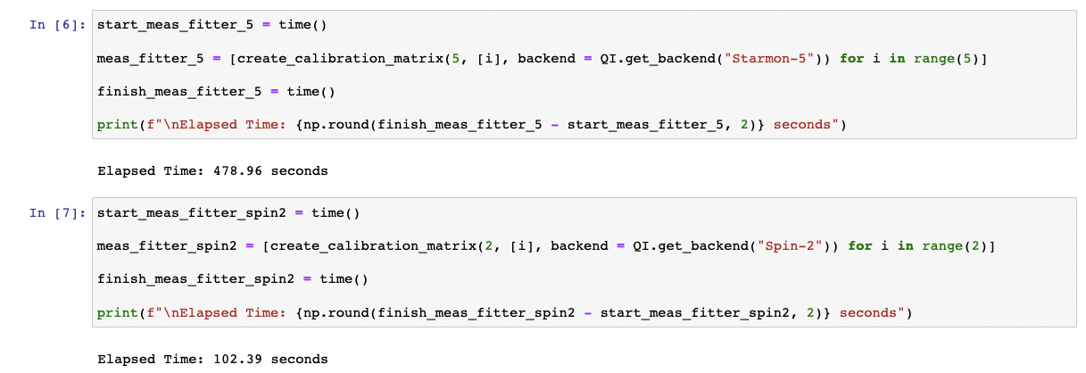
Example calibration Matrices: Morning of January 30th

Slide 8
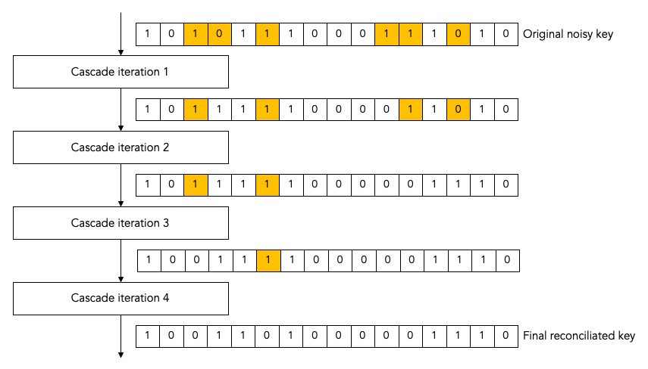
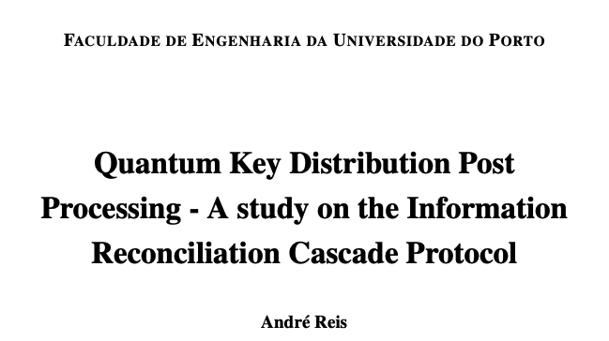
Information Reconciliation using the CASCADE protocol
Purpose: to correct Bob’s key such that it matches Alice’s key
Idea: leak part of the key to perform parity-checks between the two keys, subsequently correcting any errors
RB quantities average bit error rate, Q, which determines initial block size
The binary algorithm: hones in on the exact location of each error & corrects it
Quantify efficiency by comparing to theoretical Shannon entropy bound H_min = -Qln(Q)-(1-Q)ln(1-Q)
Notes:
https://hikingandcoding.wordpress.com/2020/01/15/a-cascade-information-reconciliation-tutorial/

Slide 9
More info on CASCADE
For each iteration i:
Shuffle using some bijection p_i
Split into top-level blocks of size k(i,Q)
k(1, Q) = 0.73 / Q
k(i + 1, Q) = 2 k(i, Q)
On each top-level block, perform the Binary Algorithm
Recursive algorithm that compares parity of each sub-block between Alice and Bob
Unshuffle using p_i
Intuition: each block of size 1/Q contains roughly 1 error -> make blocks slightly smaller than that to decrease chance of 2 (or any even # of errors) occurring in same block (which are undetectable), while increasing the chance of blocks with no errors at all (which only marginally increase the run-time)
Different permutations allow previous undetected errors to eventually become detected
Block size increases as iteration index increases because overall there is less error, since we will have corrected some per iteration (the expected number of errors corrected per iteration is roughly 0.5*total number of errors remaining)

Slide 10
Privacy Amplification & Randomness Extraction
Idea: Compensate for information leaked during reconciliation
Even very similar, but not identical inputs, get mapped to very different outputs
Also balances # of 0’s and 1’s in key, especially important for image encryption
Use SHA-3 Hash function
Advantage over other methods: don’t have to discard a subset of the key

Slide 11
Encryption & Decryption
Symmetric key cryptography
To encode: Use bitwise “exclusive or” (XOR) between the plaintext and the key
To decode: XOR between the ciphertext and the key
Examples:
Excerpt from Text
Picture (in Jupyter notebook)

Slide 12
Generalizing to more parties
multi-party communication modeled by graph
E.g. bipartite graph where each agent in subgraph A performs QKD with each agent with subgraph B

Slide 13
Project Demo [maybe we can move this near the beginning]
Allen (include schematic of client-Slackbot-backend network structure)
Such a design maximizes accessibility, potential applications, and convenience

Slide 14
Notes
Describe how we cut down the time progressively: e.g. Bunching 5 qubits at a time etc.; bunch all circuits together in 1 job, etc.
Increasing # shots only marginally increases run-time, while # circuits/jobs does so by a lot
Nikhil: freedom in choosing the majority voting threshold for each qubit due to n_shots not being 1
Future idea: use Mitiq’s Zero-noise extrapolation functionality to further combat gate noise and hence efficiency of the protocol
Can comment on how this project could be useful/beneficial to the social good
Include example results from tests on simulator and backend
E.g key of length x generated in time y with efficiency z

