Slide 1
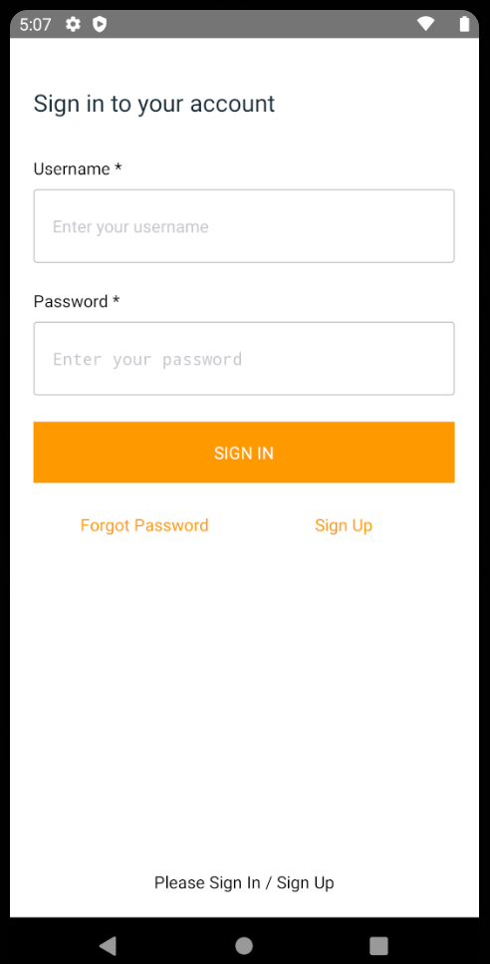
Sign In
Sign in done using amplify auth (Click Sign Up to create an account to use)

Slide 2
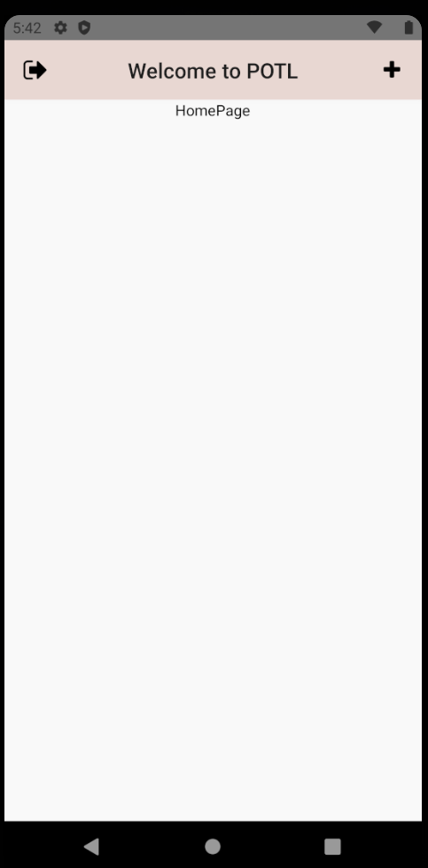
POTL Home Page
To navigate to post pet page
To sign out

Slide 3
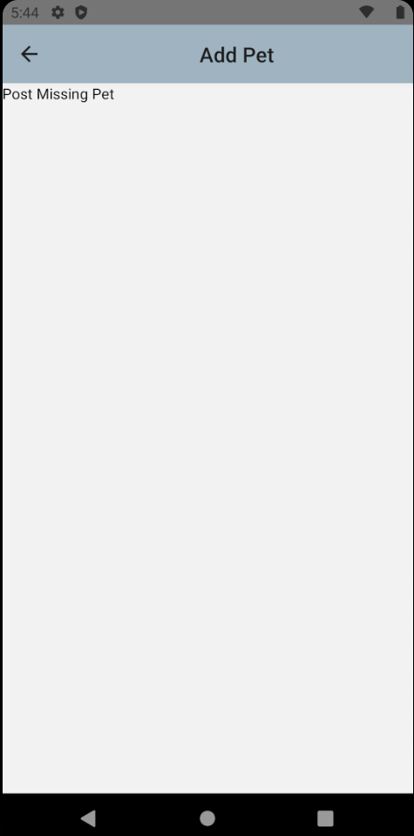
Add Pet Page

