Slide 1

Pet On The Loose
Mobile app

Slide 2
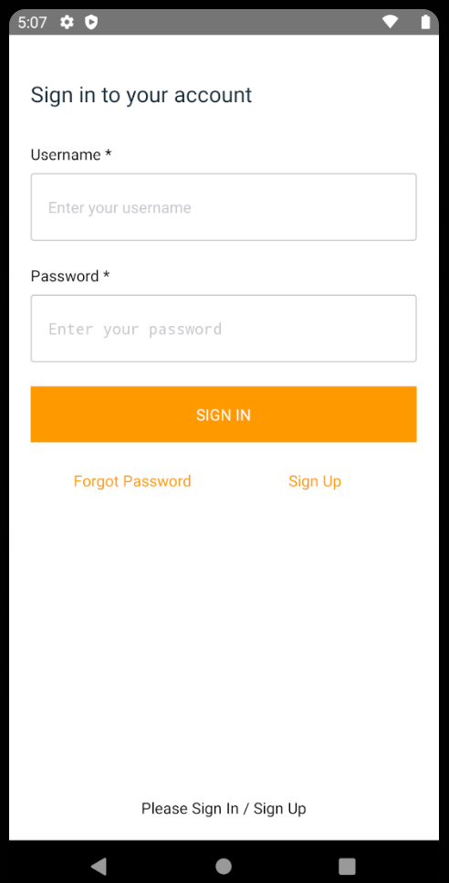
Sign In
Sign in done using amplify auth (Click Sign Up to create an account to use)

Slide 3
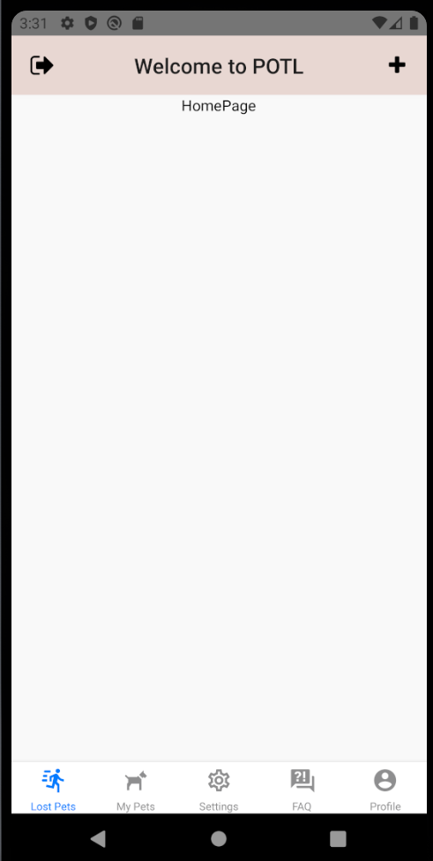
POTL Home Page
To navigate to post pet page
To sign out

Slide 4
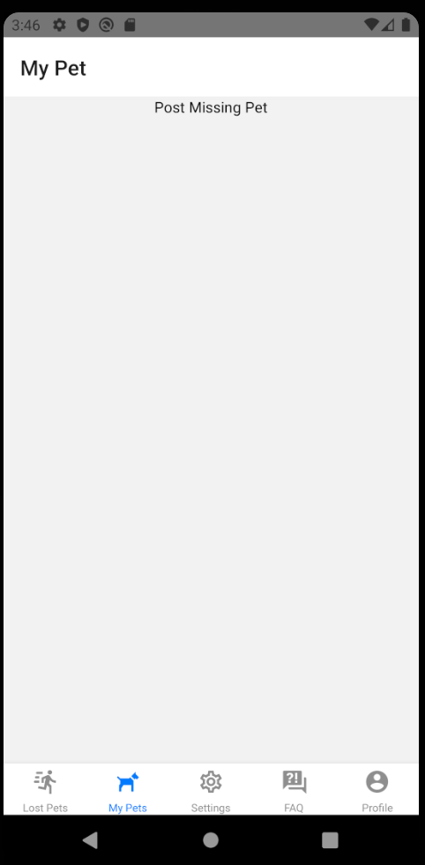
My Pet Page

Slide 5
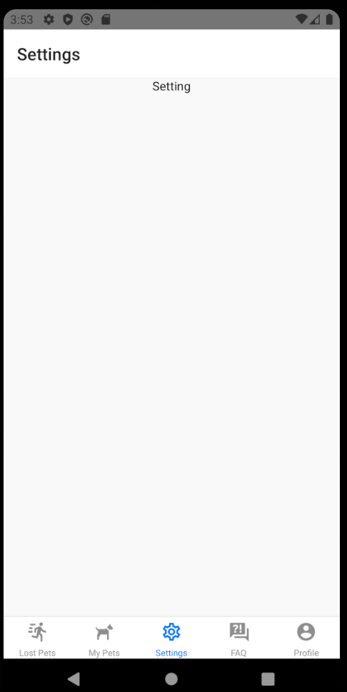
Settings Page

Slide 6
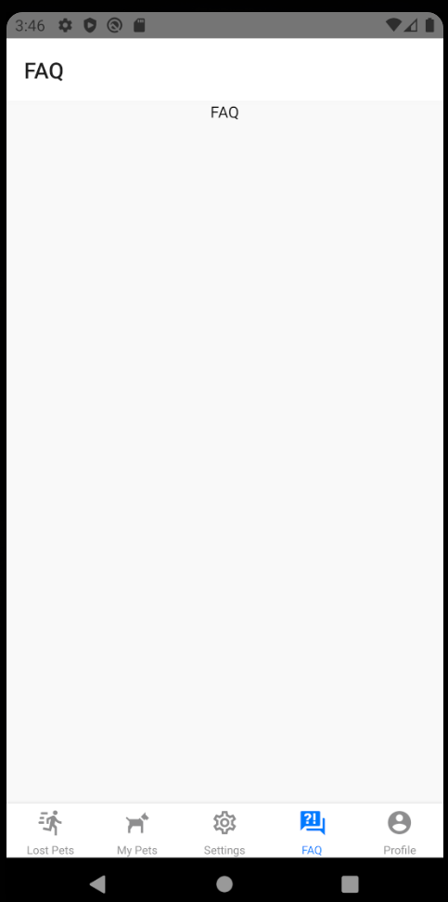
FAQ Page

Slide 7
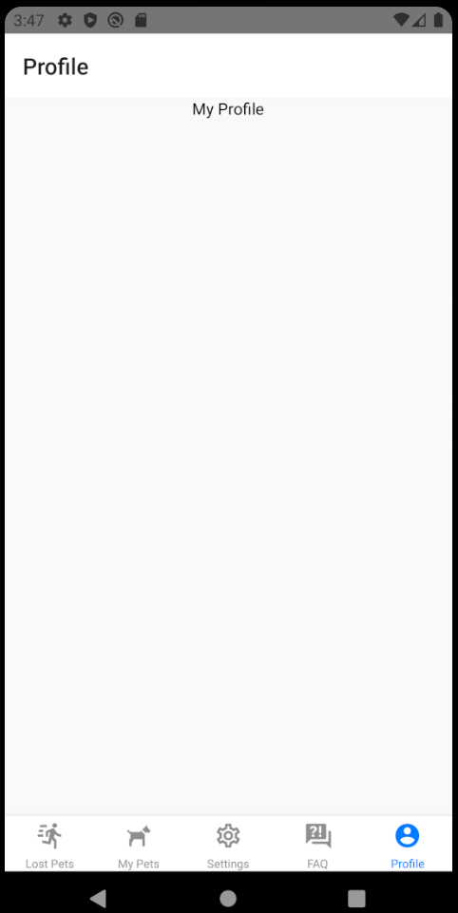
Profile Page

Slide 8
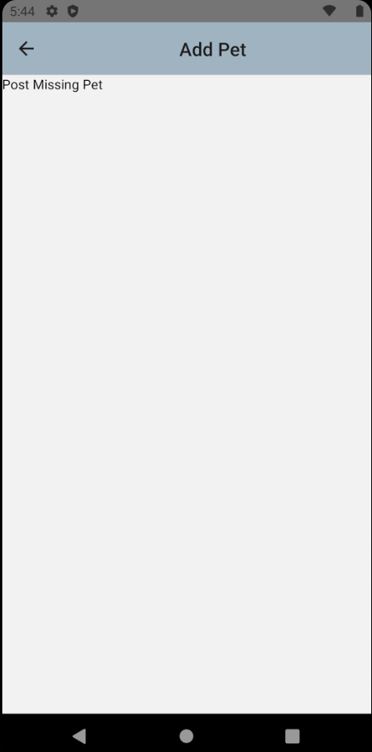
Add Pet Page

Slide 9
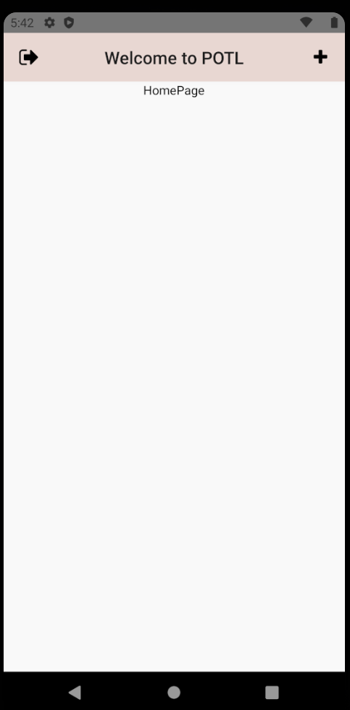
POTL Home Page
To navigate to post pet page
To sign out

