Slide 1

A Review of Obstructive Sleep Apnea Detection Approaches
答辩人
WT、WYL
指导老师

Slide 2
CONTENTS
目录
1
Background and Significance
03
2
Why ECG？
10
3
Model of ConCAD
17
4
Result of Model
24
5
Futher
31

Slide 3
1
Background and Significance

Slide 4
Sleep-related breathing disorders
第 页
obstructive sleep apnea (OSA)
central sleep apnea
sleep-related hypoxemia
hypoventilation
In many countries, those disorders are usually diagnosed in sleep laboratories, by polysomnography, which is an expensive procedure involving much effort for the patient.

Slide 5
Obstructive sleep apnea
第 页
Sleep disorders are a common health condition that can affect numerous aspects of life. Obstructive sleep apnea is one of the most common disorders and is characterized by a reduction or cessation of airflow during sleep.
OSA is the most common disorder in this group and is characterized by partial or complete obstruction and recurrent collapse of the upper airway, affecting ventilation during sleep.

Slide 6
The symptoms of this disorder
第 页
The symptoms of this disorder are excessive daytime sleepiness caused by non-restorative sleep. It is estimated that an OSA prevalence in the general adult population ranges from 6% to 17%, considering an apnea-hypopnea index (AHI) of greater than or equal to 15 events/hour, with males being more affected than females, and this prevalence becomes more relevant with increasing age .

Slide 7
PSG
第 页
01
Polysomnography (PSG) is the gold standard for OSA diagnosis
Disadvantages of PSG
slow and expensive
Need professionals
Uncomfortable
PSG
04
02
breath airflow, respiratory movement,
oxygen saturation (SpO2), electroencephalogram (EEG),
electro-oculogram (EOG),
electromyogram (EMG), electrocardiogram (ECG) and
body position
PSG recording
OSA is diagnosed if the patient has reported the indicated symptoms and presents 5 or more obstructive respiratory events per hour of sleep during a PSG recording.
03

Slide 8
keywords
第 页
The keywords employed in the search
“algorithm AND sleep apnea”
“oximetry AND apnea”
“ECG AND apnea”
“Respiration analysis AND apnea”
“snoring AND apnea”
“sound AND apnea”
“apnea AND deep”

Slide 9
2
WHY ECG ？

Slide 10
The purpose of the study
第 页
1
The traditional apnea detection process is too complex, therefore new algorithms which can perform rapidly and accurately on nonintrusive device is required.
The effect of sleep apnea on heart rate and parasympathetic nerve is reflected in ECG signal, which is the physiological basis of using ECG signal to detect sleep apnea.
why ECG ？
2
3
Meanwhile, the clinical medical experiments showed that there was a significant correlation between sleep apnea and arrhythmia, and it could cause abnormal RR interval time series .

Slide 11
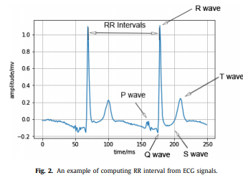
ECG-signal
第 页
“
RR intervals (intervals between R-peaks) and EDR (ECG-derived respiration) signals are two kinds of ECG-based time series. Most of feature engineering were carried based on RR intervals and EDR signals . RR intervals are characterized by the time intervals between two consecutive R-peaks of heartbeats (see Fig. 2).
”

Slide 12
Database
第 页
Physio Net apnea-ECG
1
Scaling Up Scientific Discovery in Sleep
5
2
University College
Dublin Sleep Apnea
4
3
MITBIH polysomnography database
Sleep Heart Health Study

Slide 13
3
ConCAD: Contrastive Learning-based Cross Attention for Sleep Apnea Detection

Slide 14
ECG-signal
第 页
ConCAD: Contrastive Learning-based Cross Attention for Sleep Apnea Detection
Guanjie Huang and Fenglong Ma
College of Information Sciences and Technology, Pennsylvania State University, PA,
Keywords: Contrastive learning · Cross attention · Sleep apnea detection.
Recently, with the development of deep learning methods, some studies extract RR interval (RRI) and the R-peak envelope (RPE) and build deep learning model to automatically learn representation and detect sleep apnea.
Furthermore, several studies develop deep learning models to directly learn features from the raw ECG data and detect sleep apnea in an end-to-end style.

Slide 15
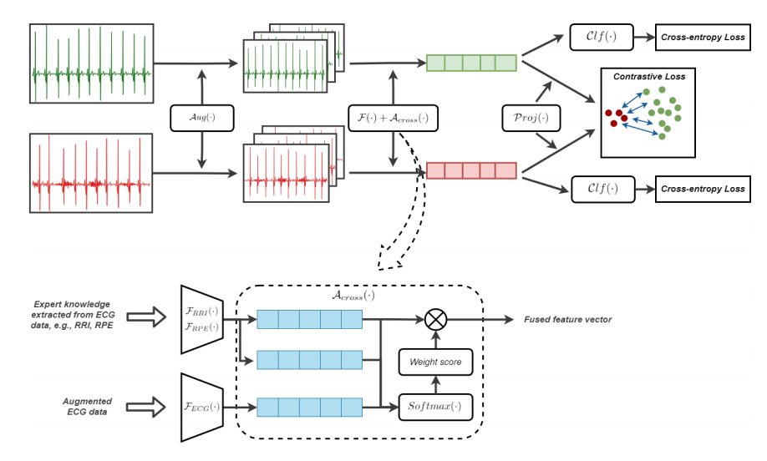
Model-ConCAD
第 页

Slide 16
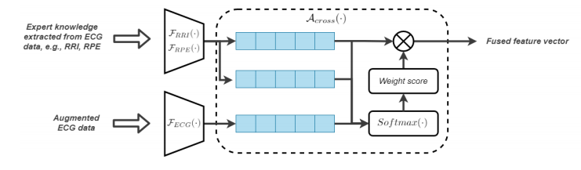
The cross attention
第 页
The goal of this work is to design an effective framework for leveraging the power of both the deep learning-based features and the expert knowledge-based features simultaneously to enhance the performance of sleep apnea detection.
The cross attention fuses the features by generating an attention weight mask. It can highlight the effective discriminant parts and suppress the irrelevant parts of features from ECG, RRI, and RPE collaboratively. Besides the cross-entropy, the supervised contrastive loss is also computed to optimize the intra-class to inter-class similarity ratio.

Slide 17
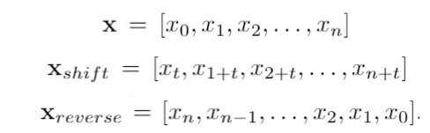


Contrastive Learning
第 页
step
1
We are augmenting the ECG, RRI and RPE by two simple approaches: random time shift and reversion
step2
Contrastive learning is adopted to assist the model to learn more general and robust features by maximizing intra-class similarity while minimizing inter-class similarity.
step
3
we propose a novel hybrid loss

Slide 18
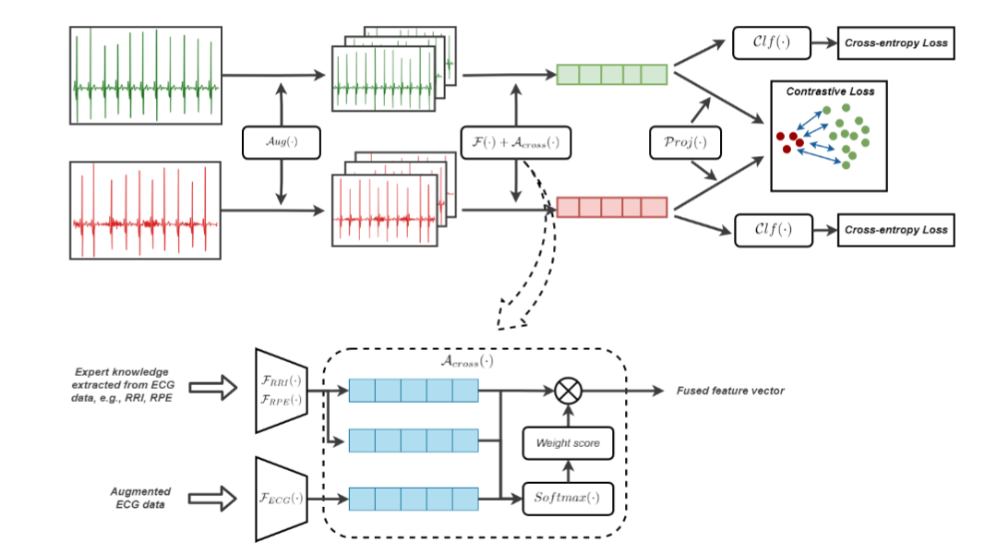
Model-ConCAD
第 页

Slide 19
4
Result of model

Slide 20
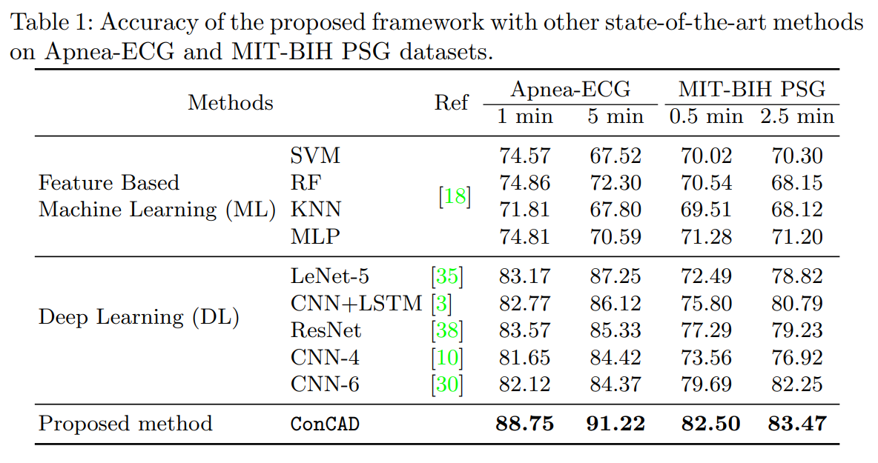
Model-ConCAD
第 页

Slide 21
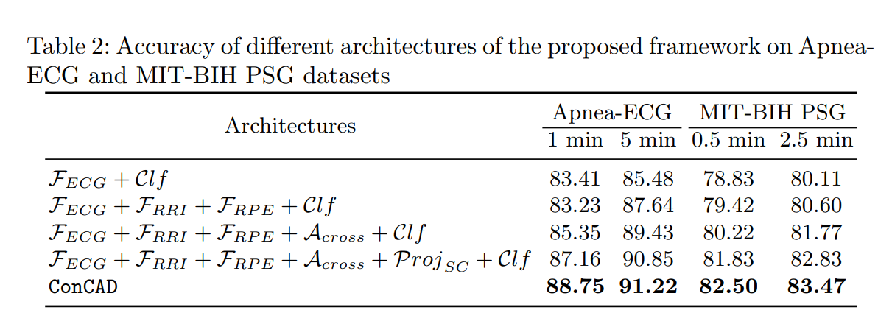
Model-ConCAD
第 页

Slide 22
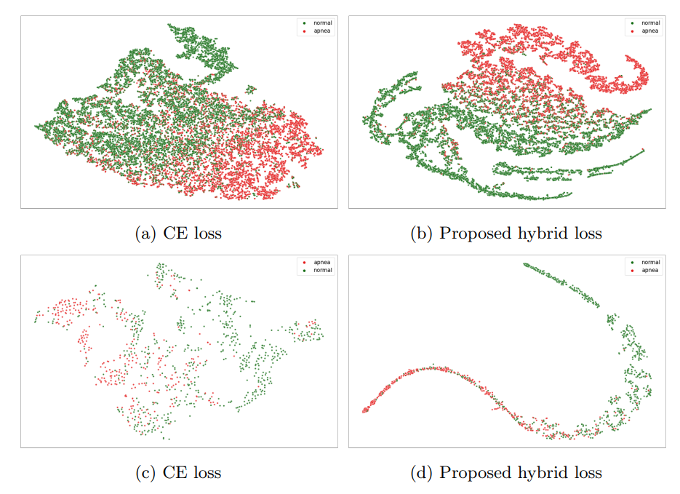
Model-ConCAD
第 页

Slide 23
参考文献
第 页
[1][瑞士] 亚历山大·奥斯特瓦德（AlexanderOsterwalder），（比利时）伊夫·皮尼厄（YvesPigneur） 《Business Model Generation》[M]出版社：机械工业出版社，2011
[2]C. K. Prahalad（C·K·普拉哈拉德），Venkat Ramaswamy（文卡特·拉马斯瓦米） 《The Future of Competition: Co-Creating Unique Value With Customers》 [M]出版社：Harvard Business Press ，2003
[3]胡世良《移动互联网商业模式创新与变革》[M]出版社：人民邮电出版社，2013
[4]陈洪等 《游戏运营管理》[M]出版社：清华大学出版社，2009
[5]许可，张春鹏 《移动运营商手机游戏业务的战略定位和发展策略探讨》[J]世界电信2004年第10期，2004
[6]网络评论《深入解读国产手机游戏盈利模式和市场前景》[OL]，2013
[7]中国互联网络信息中心（CNNIC）《第32次中国互联网络发展统计报告》[R]，2013
[8]中国互联网络信息中心（CNNIC）《第 33 次中国互联网络发展状况统计报告》[R]，2014
[9]百度移动 《移动互联网发展趋势报告》[R]，2012
[10]艾媒咨询 《中国手机游戏市场年度报告》[R]，2013
[11]李振勇 《商业模式创新与战略转型》[M] 出版社：国家行政学院音像出版社，2009
[12]付玉辉 《4G时代的手机游戏裂变》[J].广告大观综合版2014-1，2014

