Slide 1
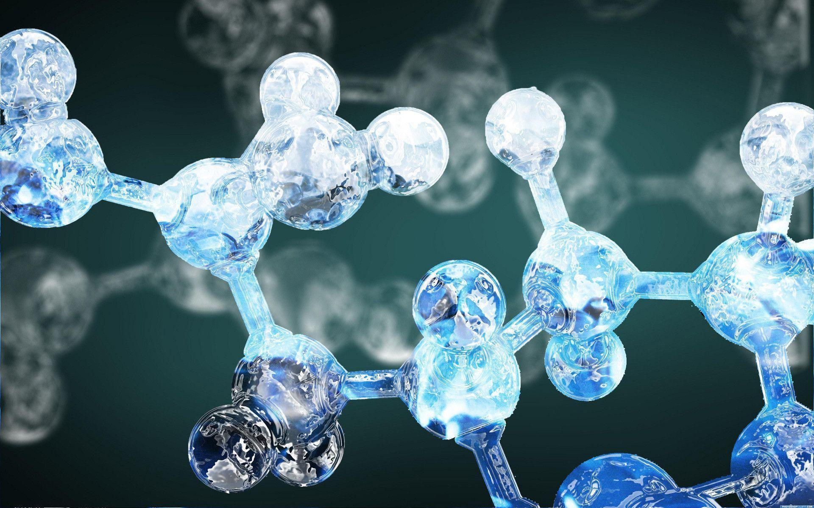
Connections and Combinations of Generative Models
Junhan Chang¹
¹College of Chemistry and Molecular Engineering
2020.03.17 Advanced Deep Learning Seminar

Slide 2
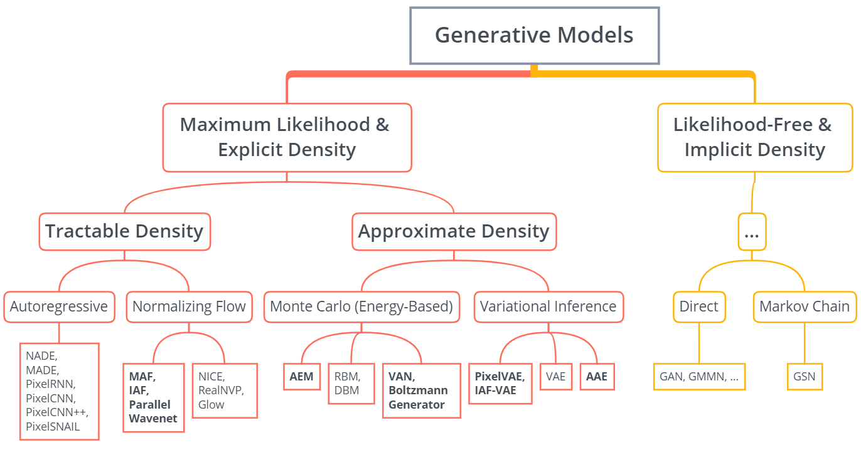
Generative Model Zoo

Slide 3
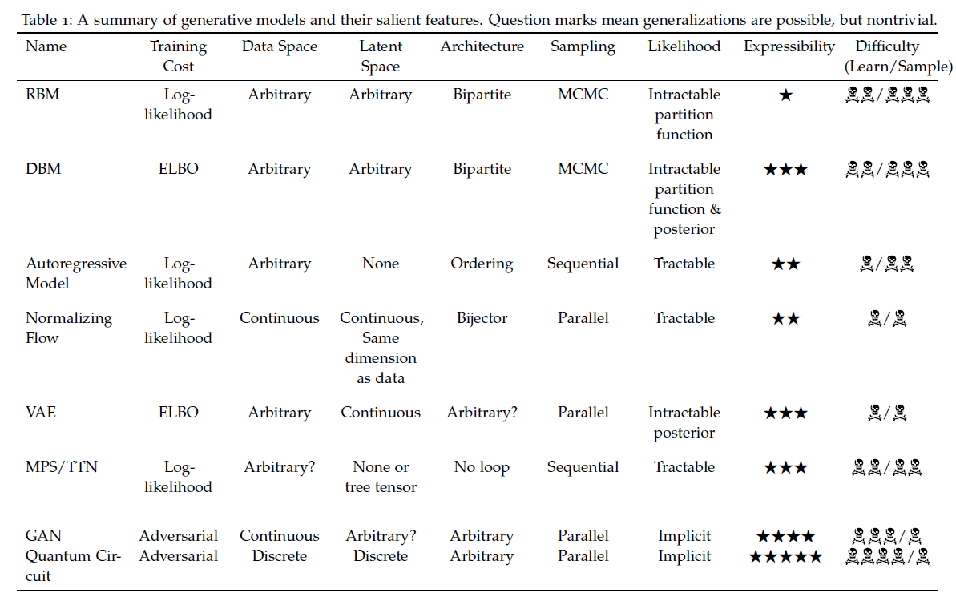

Slide 4
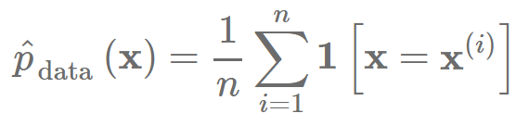
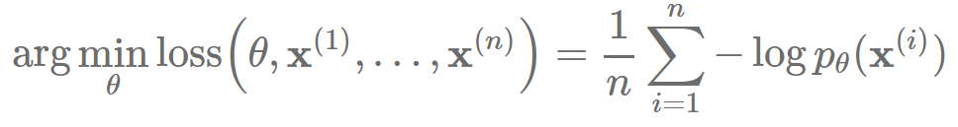
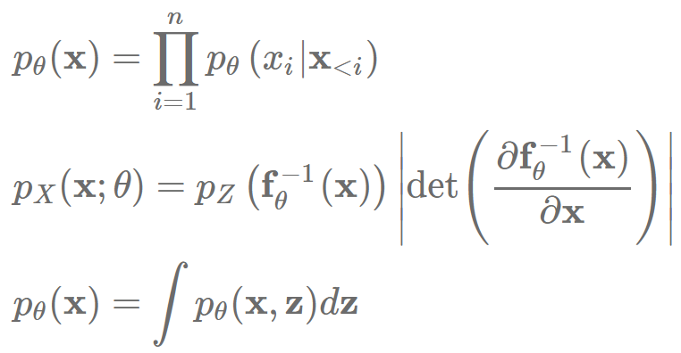
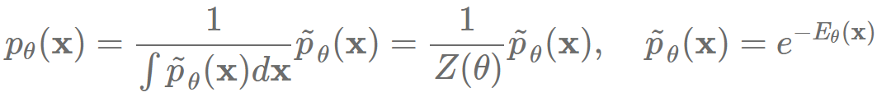

Maximum Likelihood Learning
Likelihood-based: estimate $p_{data}$ from $x^{(i)}∼p_{data}(x)$: learn $p_{θ}\left(x\right)≈p_{data}(x)$
Maximum likelihood: given dataset $\left\{x^{\left(i\right)}\right\}$, find $θ$ by solving the optimization problem
Model families
Autoregressive Models:
Normalizing Flow Models:
Latent Variable Models (VAE):
Energy-Based Models:
Negative Log-Likelihood (NLL)
Unit: bits/dim or nats/dim

Slide 5
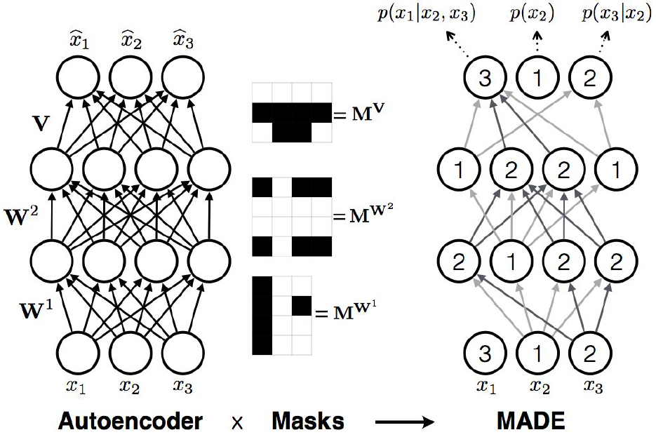
Likelihood-based Models I: Autoregressive Models
Characteristics:
Chain rule based factorization is fully general
Compact representation
Pros:
Easy to evaluate likelihoods
Easy to train
Parameter sharing improves generalizability
Cons:
Requires an ordering
Generation is sequential, sampling time is slow for practical deployment
Cannot learn features in an unsupervised way:
No single layer of learned representation
Not directly usable for downstream tasks.
No interpolations.

Slide 6
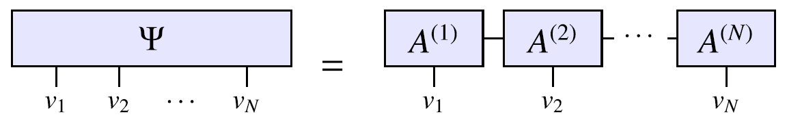

TensorNetwork Based Methods (in progress)
Probability (likelihood)
$$ℙ(v)=\frac{|Ψ(v)|^{2}}{Z}$$
Loss
$$ℒ=−\frac{1}{|𝒯|}\sum_{v∈𝒯}{\ln{ℙ(v)}}$$
$$\frac{∂ℒ}{∂A_{i_{k−1}i_{k+1}}^{(k,k+1)w_{k}w_{k+1}}}=\frac{Z^{′}}{Z}−\frac{2}{|𝒯|}\sum_{v∈𝒯}{\frac{Ψ^{′}(v)}{Ψ(v)}}$$

Slide 7
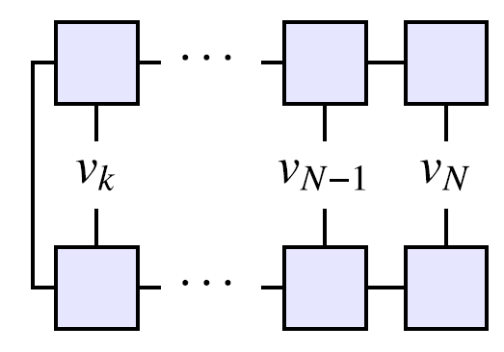

Sequential Sampling
Conditional Probability
$$ℙ(v_{k−1}|v_{k},v_{k+1},…,v_{N})=\frac{ℙ(v_{k−1},v_{k},…,v_{N})}{ℙ(v_{k},v_{k+1}…,v_{N})}$$
$$ℙ(v_{k},v_{k+1},…,v_{N})={|x^{v_{k},v_{k+1}…,v_{N}|}|}^{2}/Z$$

Slide 8
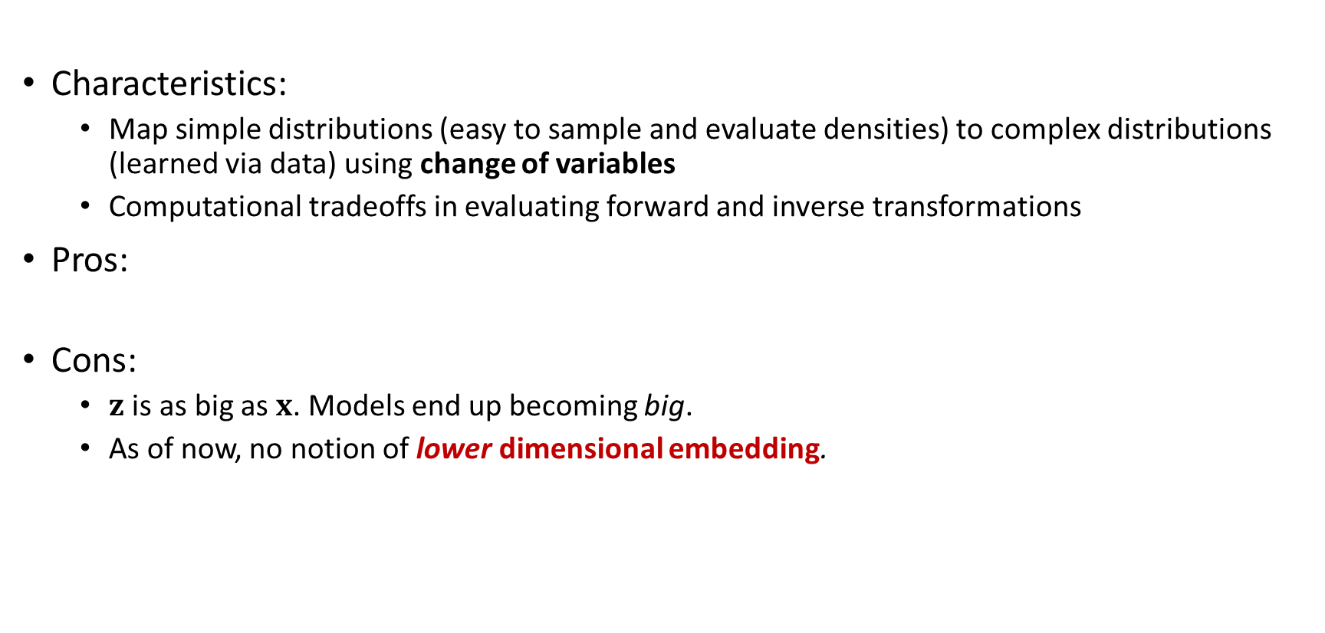
Likelihood-based Models II: Normalizing Flow Models
Characteristics:
Map simple distributions (easy to sample and evaluate densities) to complex distributions (learned via data) using change of variables
Computational tradeoffs in evaluating forward and inverse transformations
Pros:
Cons:
$z$ is as big as $x$. Models end up becoming big.
As of now, no notion of lower dimensional embedding.

Slide 9
Generative Model Zoo

Slide 10
Flows in High Dimensions
Needs Triangular Jacobian for efficient evaluation of log-likelihoods
Affine flows, elementwise flows
Coupling layers. NICE/RealNVP
Constructions based on directed graphical models.
(Masked) Autoregressive Flows
Inverse Autoregressive Flows
More types of flows: invertible 1x1 convs, FFJORD, etc.

Slide 11
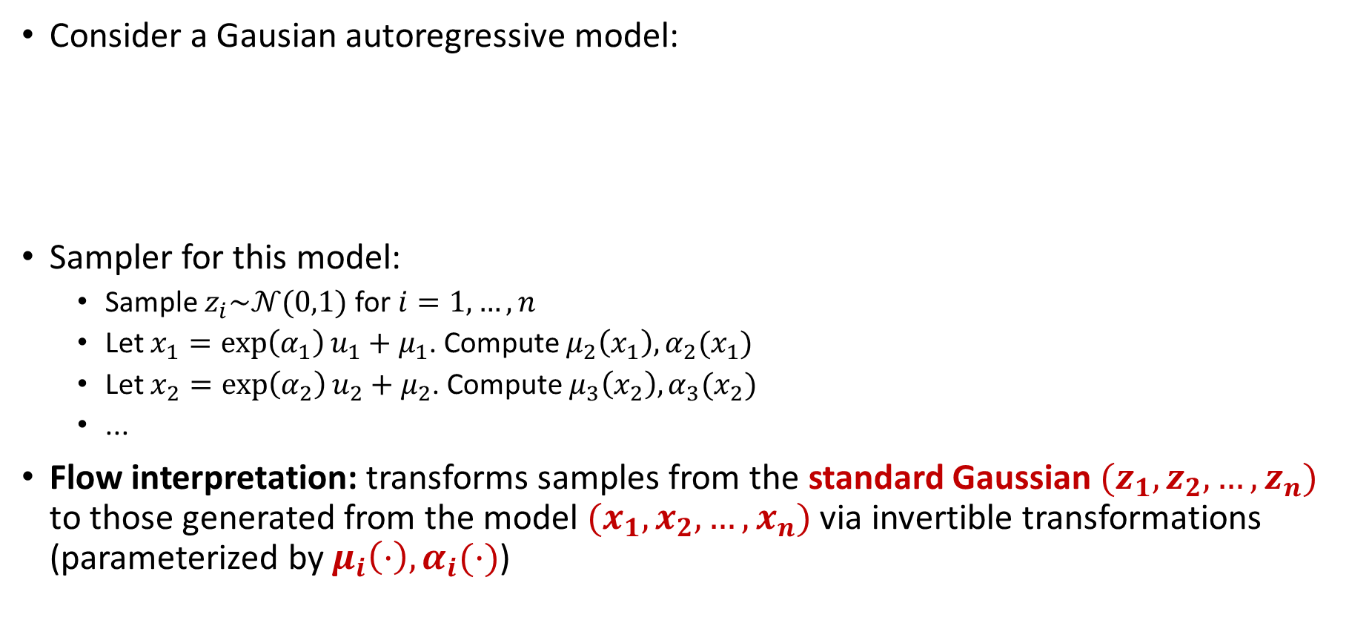
Autoregressive Models as Flow Models
Consider a Gausian autoregressive model:
Sampler for this model:
Sample $z_{i}\sim 𝒩(0,1)$for $i=1,…,n$
Let $x_{1}=\exp\left(α_{1}\right)u_{1}+μ_{1}$. Compute $μ_{2}\left(x_{1}\right),α_{2}(x_{1})$
Let $x_{2}=\exp\left(α_{2}\right)u_{2}+μ_{2}$. Compute $μ_{3}\left(x_{2}\right),α_{3}(x_{2})$
...
Flow interpretation: transforms samples from the standard Gaussian $(z_{1},z_{2},…,z_{n})$ to those generated from the model $(x_{1},x_{2},…,x_{n})$ via invertible transformations (parameterized by $μ_{i}\left(·\right),α_{i}(·)$)

Slide 12
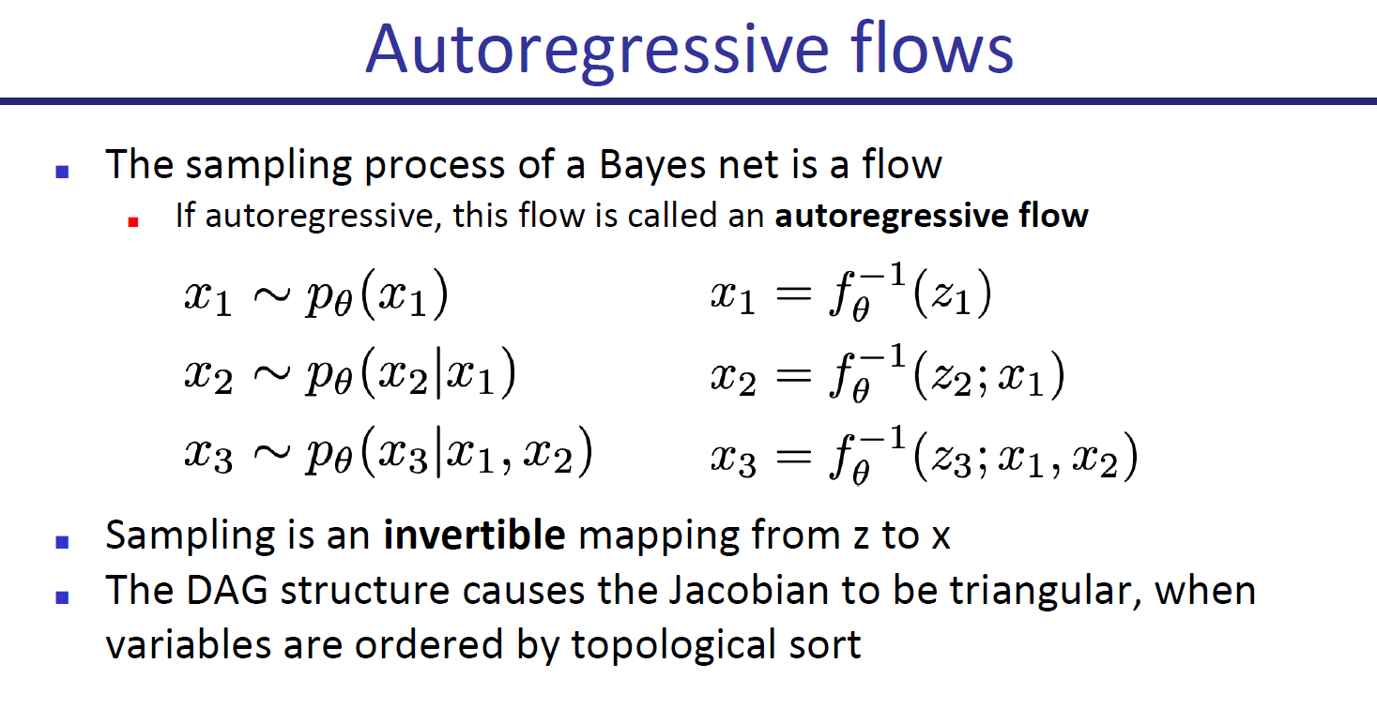

Slide 13
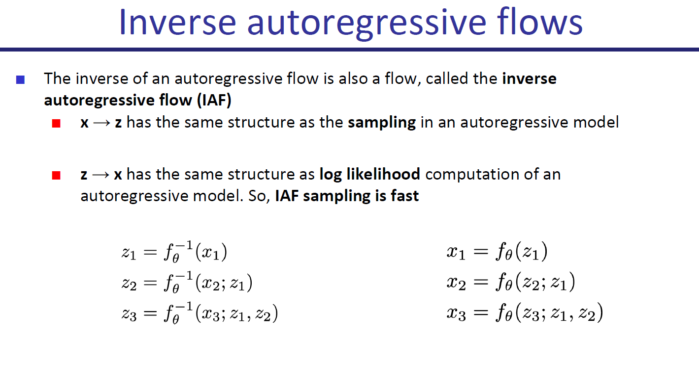

Slide 14
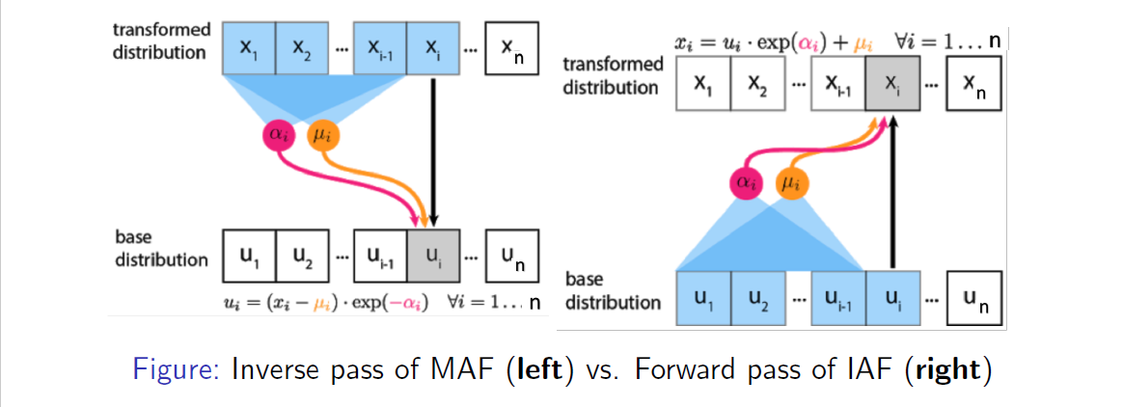

IAF is inverse of MAF
Interchanging $u$ and $x$ in the inverse transformation of MAF gives the forward transformation of IAF
Similarly, forward transformation of MAF is inverse transformation of IAF

Slide 15
MAF vs IAF
Computational tradeoffs
MAF: Fast likelihood evaluation, slow sampling
IAF: Fast sampling, slow likelihood evaluation
MAF more suited for training based on MLE, density estimation
IAF more suited for real-time generation
There are models (Parallel Wavenet, IAF-VAE) that exploit IAF’s fast sampling

Slide 16
Parallel Wavenet
Two part training with a teacher and student model
Step 1: Train teacher model (MAF) via MLE
Step 2: Train student model (IAF) to minimize KL divergence with teacher
Test-time: Use student model for testing
Improves sampling efficiency over original Wavenet (vanilla autoregressive model) by 1000x!

Slide 17
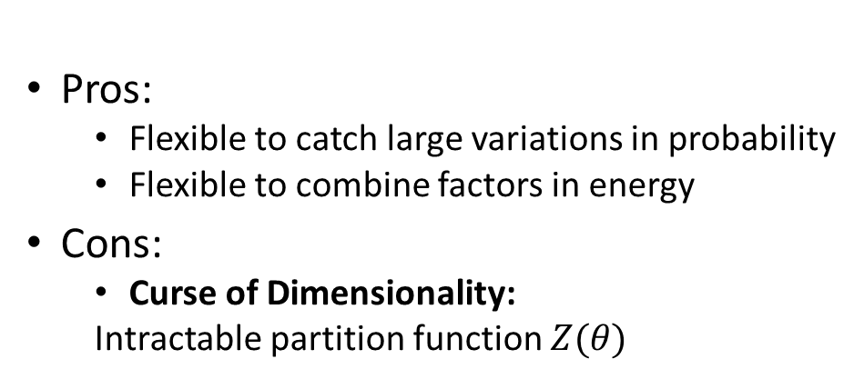
Energy-Based Models Latent Variable Models (VAE)
Pros:
Flexible to catch large variations in probability
Flexible to combine factors in energy
Cons:
Curse of Dimensionality:
Intractable partition function $Z(θ)$
Pros:
Easy to build flexible models
Suitable for unsupervised learning
Cons:
Curse of Dimensionality: Intractable posterior
Approximation methods: Variational Inference / Monte Carlo
Or: factorization / change of variables
Alternatives: Give up KL-divergence and likelihoods (GAN)

Slide 18
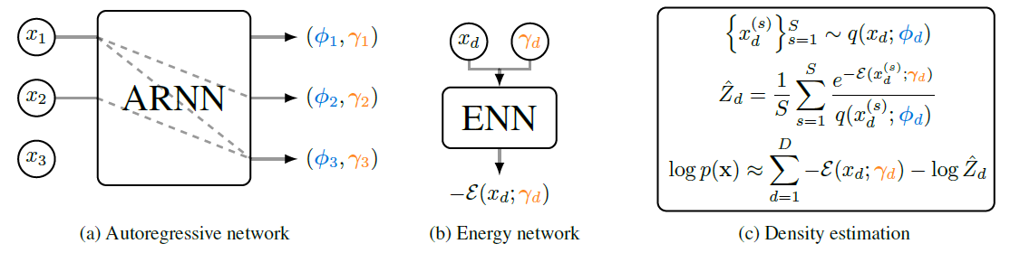
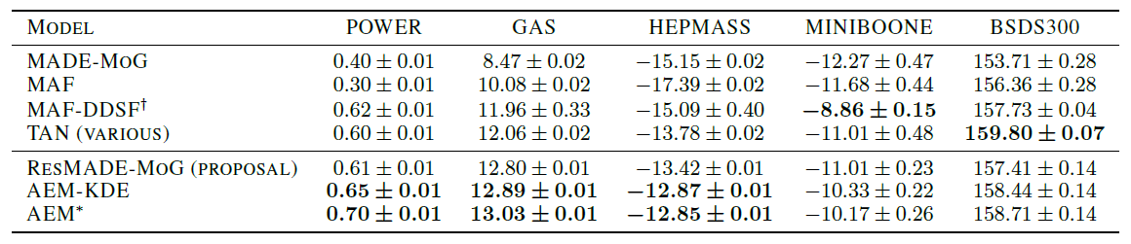

Autoregressive Energy Machine
Context vector $γ_{i}$, the vector of parameters for the d^{th} proposal conditional $φ_{d}$

Slide 19
Generative Model Zoo

Slide 20
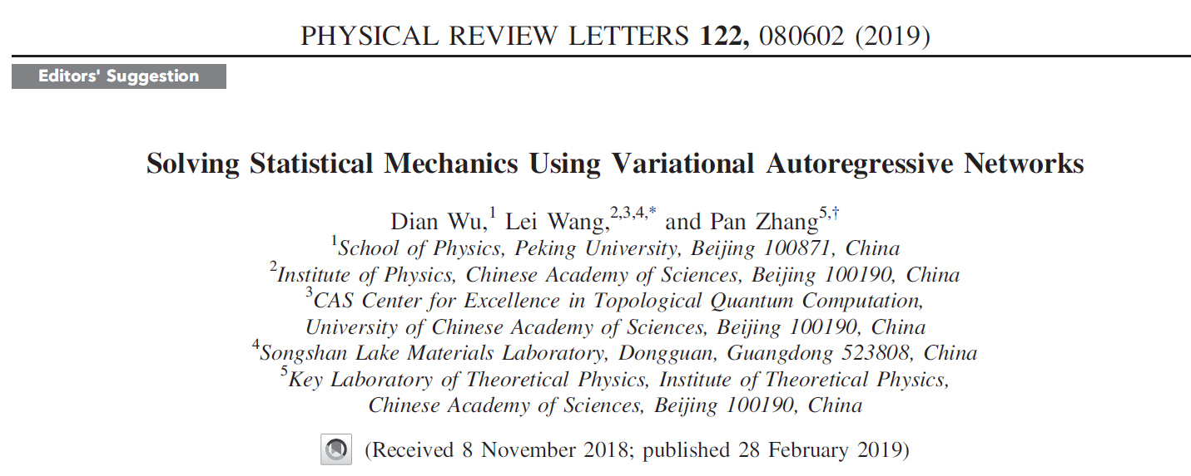
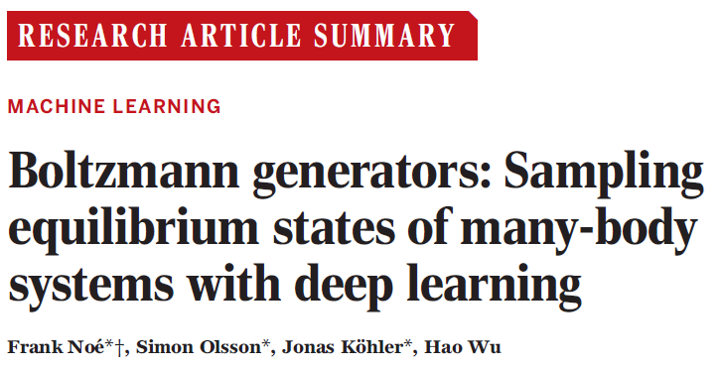
Sampling in Energy-Based Models with VI + (AR or Flow)
Notes:
Ising spin flip

Slide 21
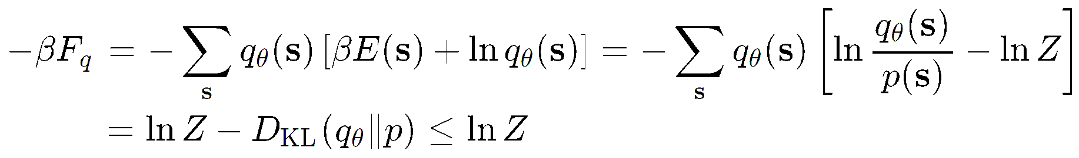
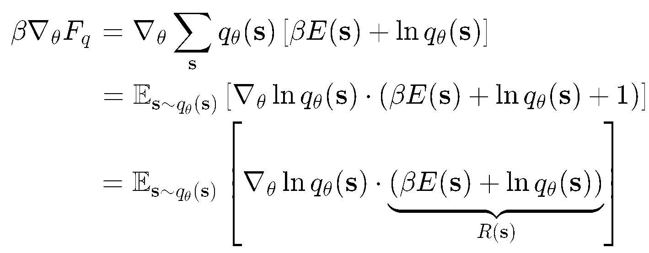
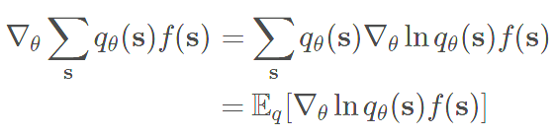

Methods (Framework using Deep Learning)
Variational Free Energy (approximate Boltzmann distribution $p(s)$ using NN $q_{θ}\left(s\right)$)
Gradient
Log-derivative trick
Computing by sampling

Slide 22
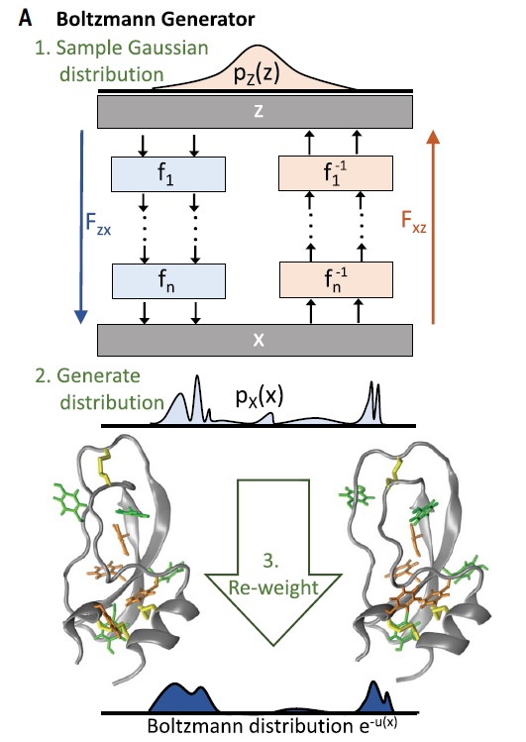
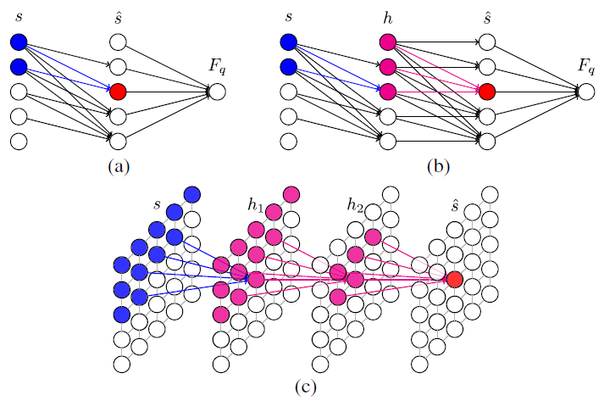
Variational Inference + (Autoregressive / Flow)

Slide 23

PixelVAE (Gulrajani et al., 2017)
$z$ is a feature map with the same resolution as the image $x$
Autoregressive structure with latent: $p\left(x|z\right)=\prod_{i}{p\left(x_{i} | x_{<i},z\right)}$
$p\left(x|z\right)$is a PixelCNN
Prior $p(z)$ can also be autoregressive

Slide 24
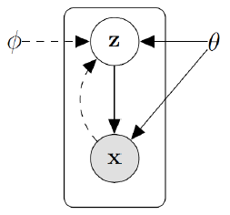
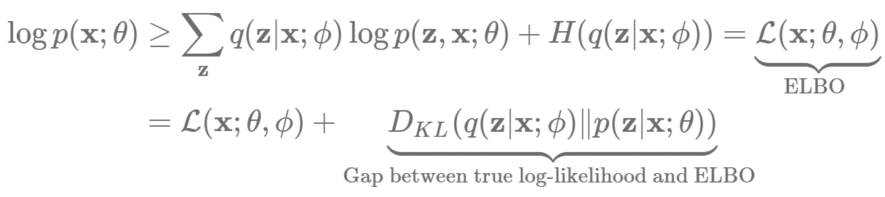
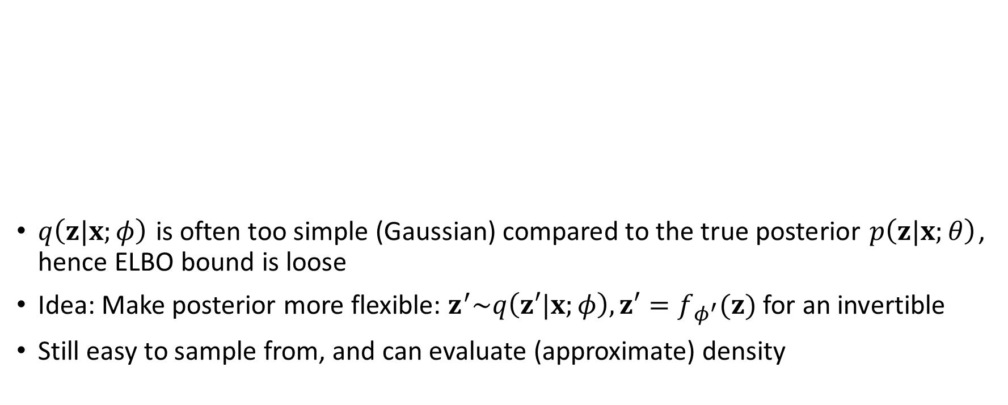
IAF-VAE
$q\left(z|x;φ\right)$ is often too simple (Gaussian) compared to the true posterior $p\left(z|x;θ\right)$, hence ELBO bound is loose
Idea: Make posterior more flexible: $z^{′}\sim q\left(z′|x;φ\right), z′=f_{φ^{′}}(z)$ for an invertible
Still easy to sample from, and can evaluate (approximate) density

Slide 25
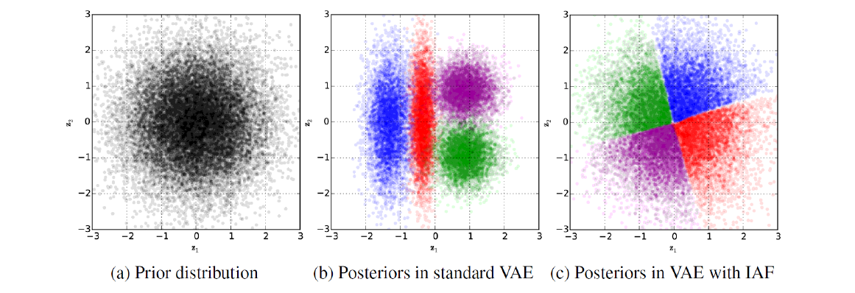
IAF-VAE
Posterior approximation is more flexible, hence tighter ELBO

Slide 26
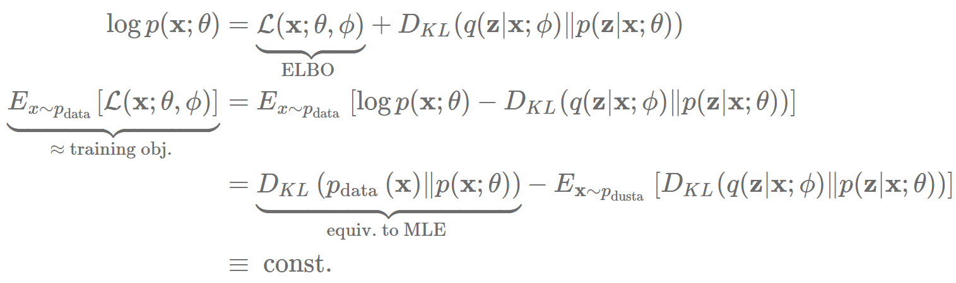

Adversarial Autoencoder (VAE+GAN)
Note: regularized maximum likelihood estimation
Can add in a GAN objective $JSD(p_{data}||p_{θ}(x))$to get sharper samples,
i.e., discriminator attempting to distinguish VAE samples from real ones.

Slide 27
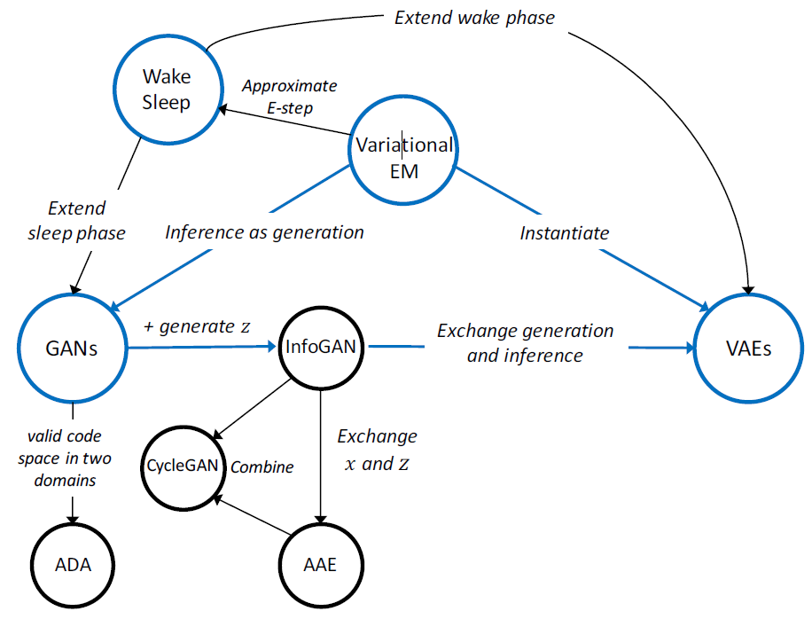
On Unifying Deep Generative Models

Slide 28
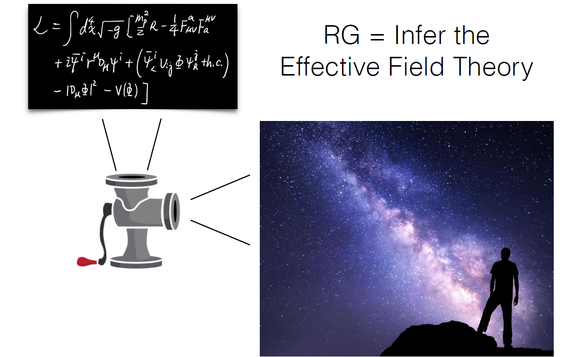
The Universe as a Generative Model

Slide 29
References
CS 236: Deep Generative Models
CS 294-158: Deep Unsupervised Learning
Lei Wang, Generative Models for Physicists
…

