Slide 1
GAN’s optimization
柴劲航 数学科学学院

Slide 2
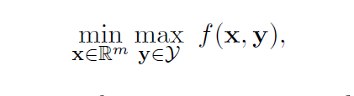

优化目标：
Saddle point！

Slide 3
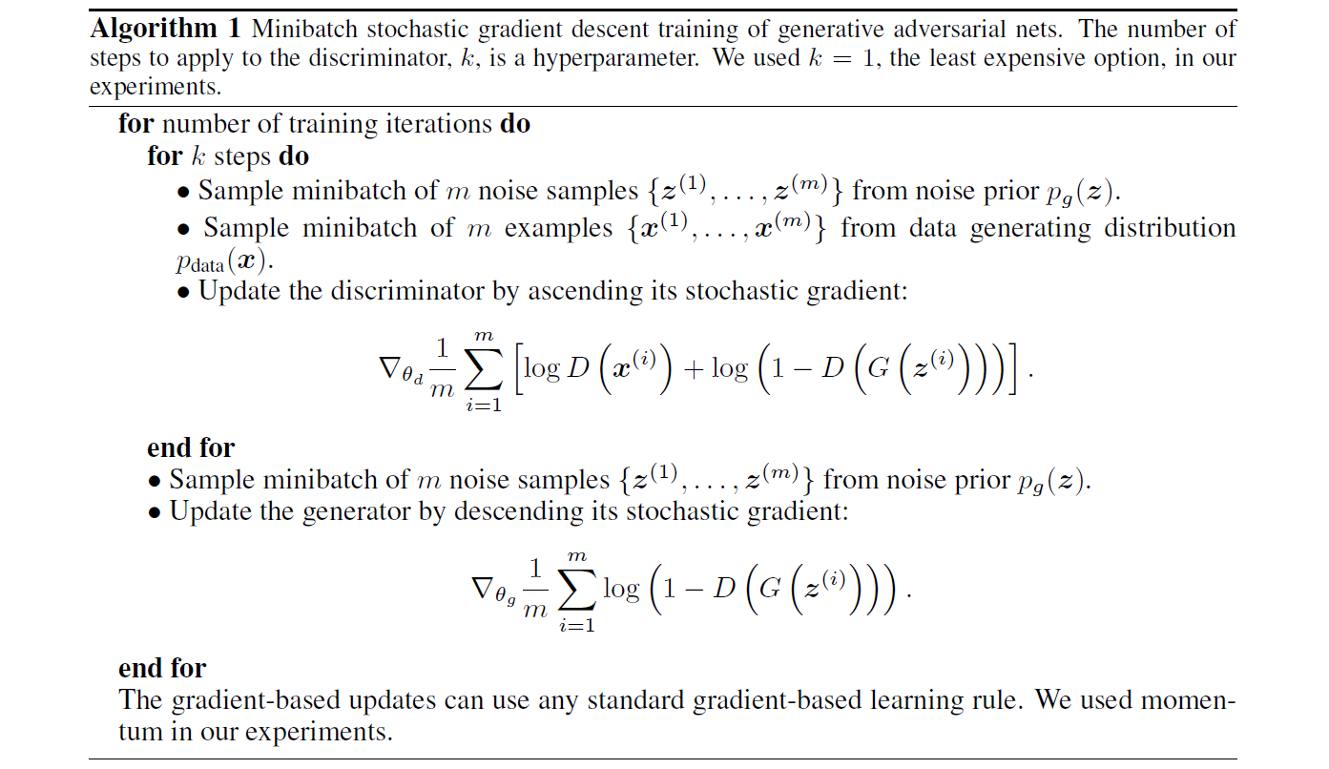

Gradient descent ascent

Slide 4
About GDA
Local linear convergence under the additional assumption that f is locally strongly convex in x and strongly concave in y
GDA with equal step sizes can converge to limit cycles or even diverge

Slide 5
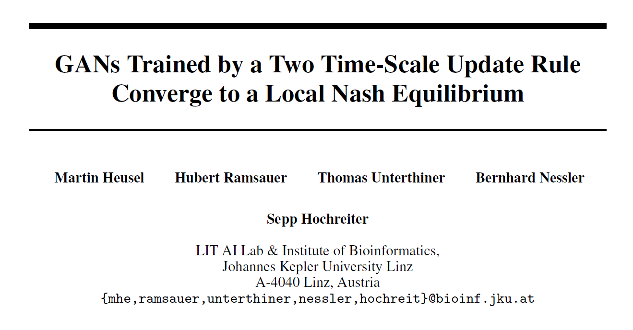
Two Time-Scale Update Rule(TTUR)

Slide 6
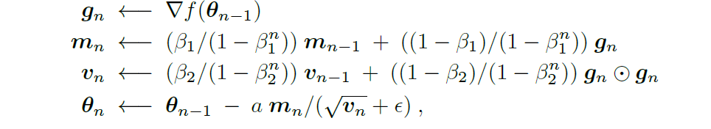
Adam+TTUR

Slide 7
About TTUR
alleviate the issues of limit circle
theoretical support in terms of local asymptotic convergence to local Nash equilibria

Slide 8

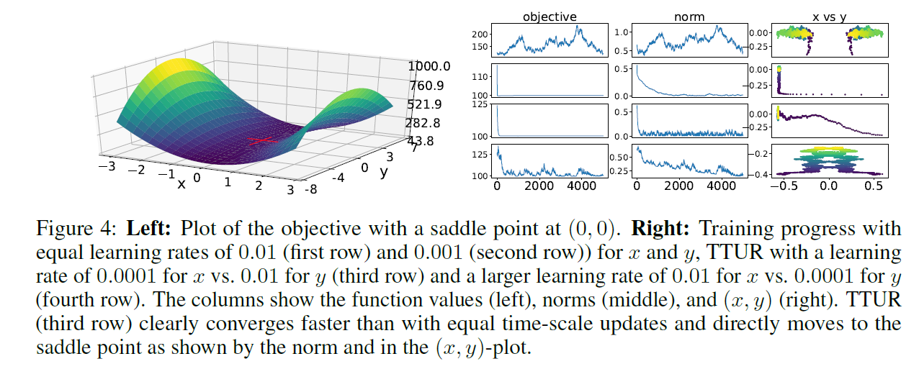
Experiment

Slide 9
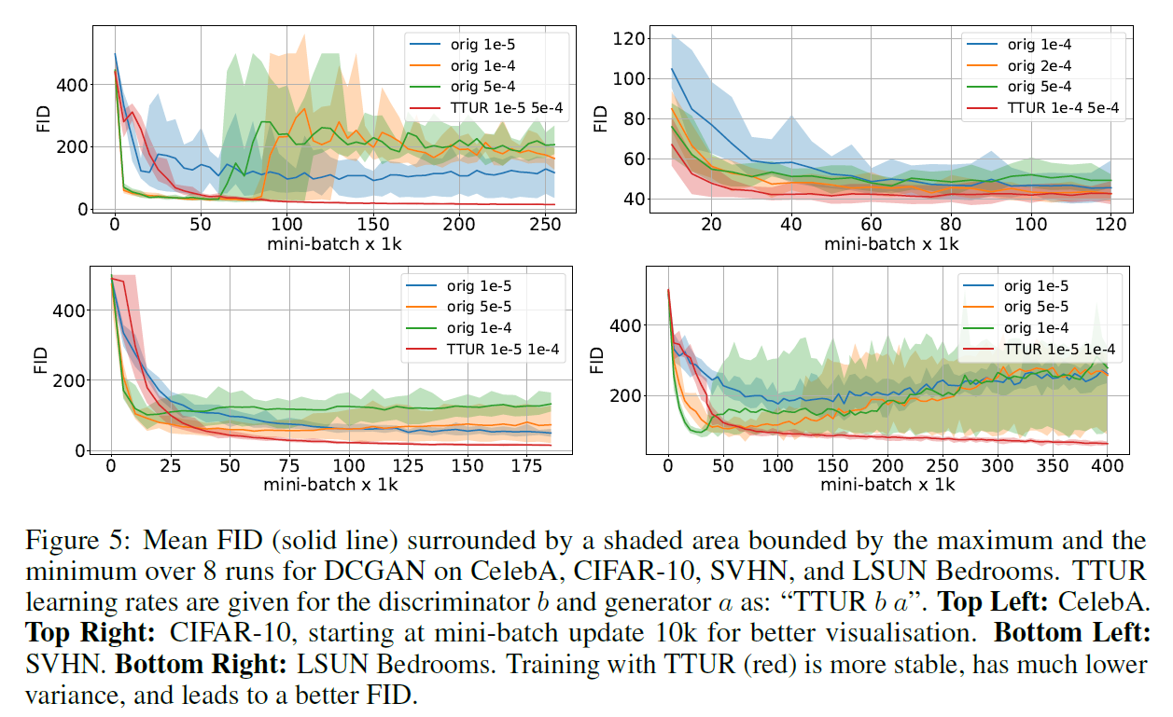
Experiment

Slide 10

Non-asymptotic Converging rate analysis of TTUR

Slide 11
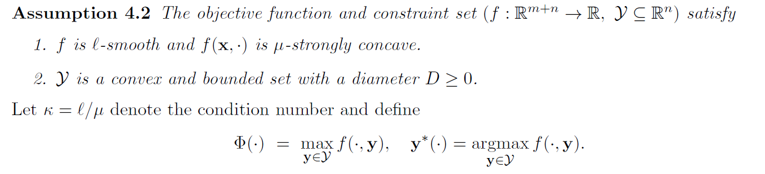
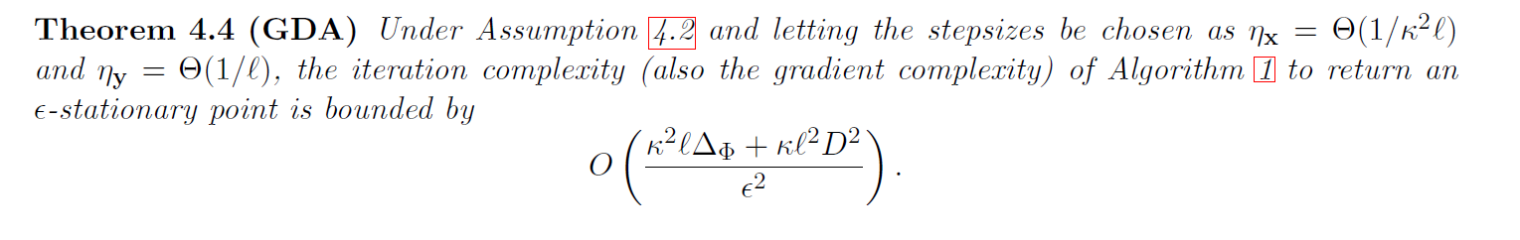
Nonconvex-Strongly-Concave case

Slide 12
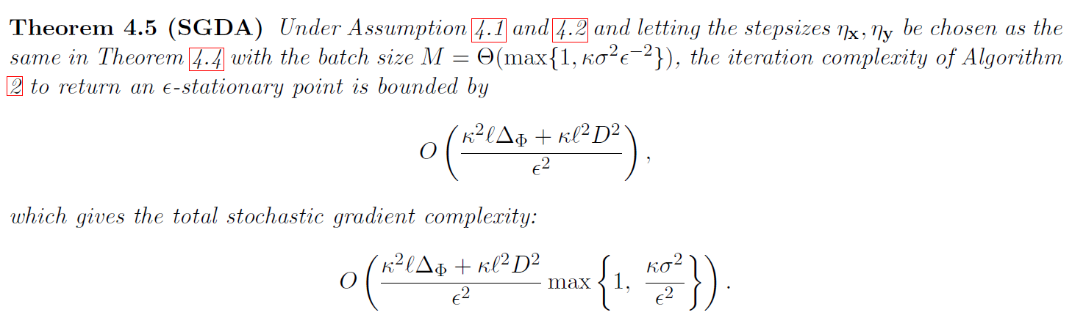
Nonconvex-Strongly-Concave case

Slide 13
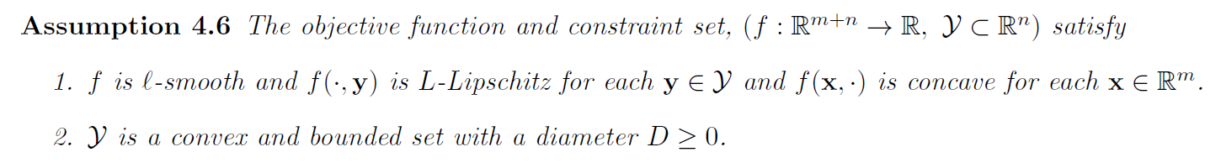
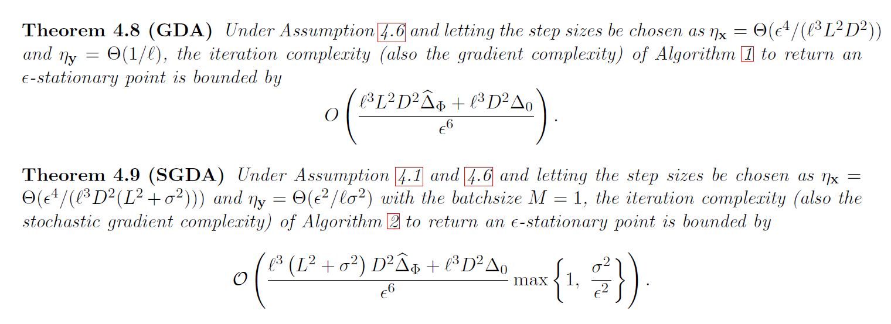
Nonconvex-concave case

Slide 14



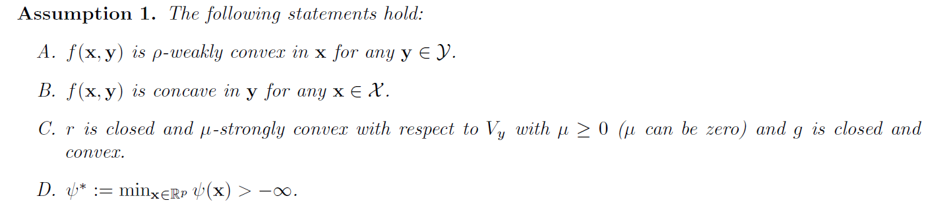
Notes:
Bregman divergence

Slide 15

Proximal-guided：

Slide 16
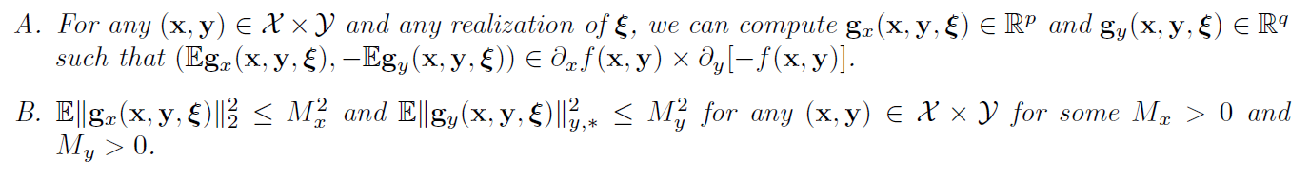
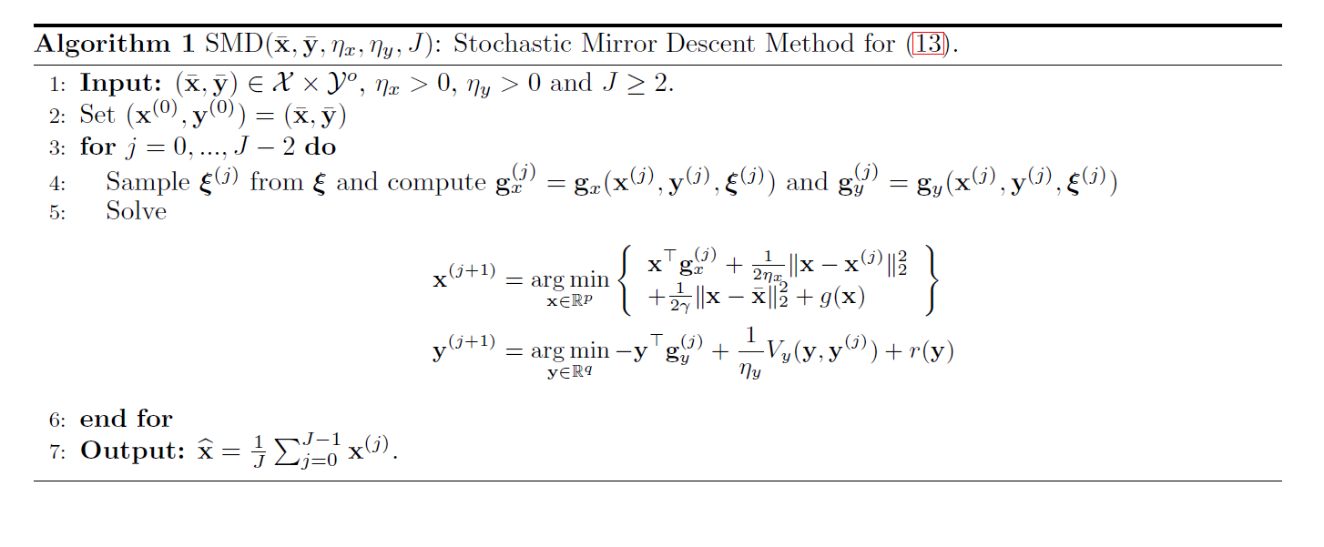
Stochastic Mirror Descent Method(SMD)

Slide 17
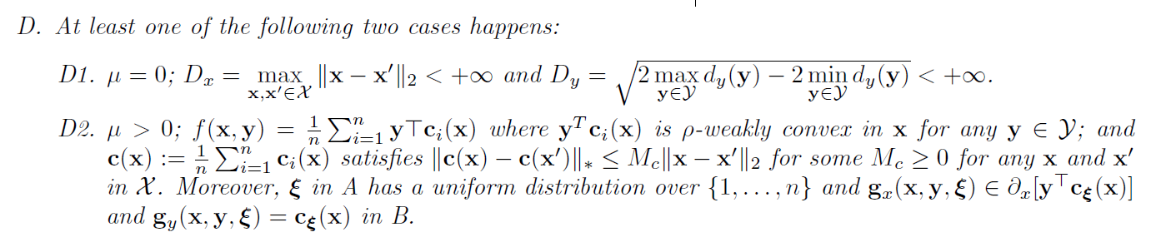
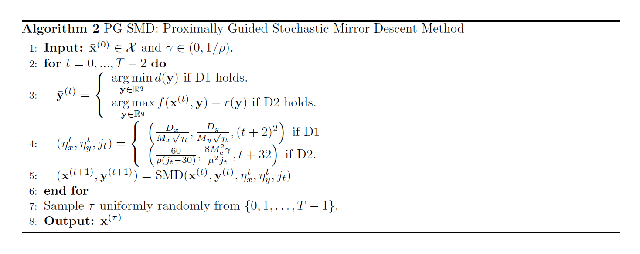
proximally guided stochastic mirror descent (PG-SMD)

Slide 18

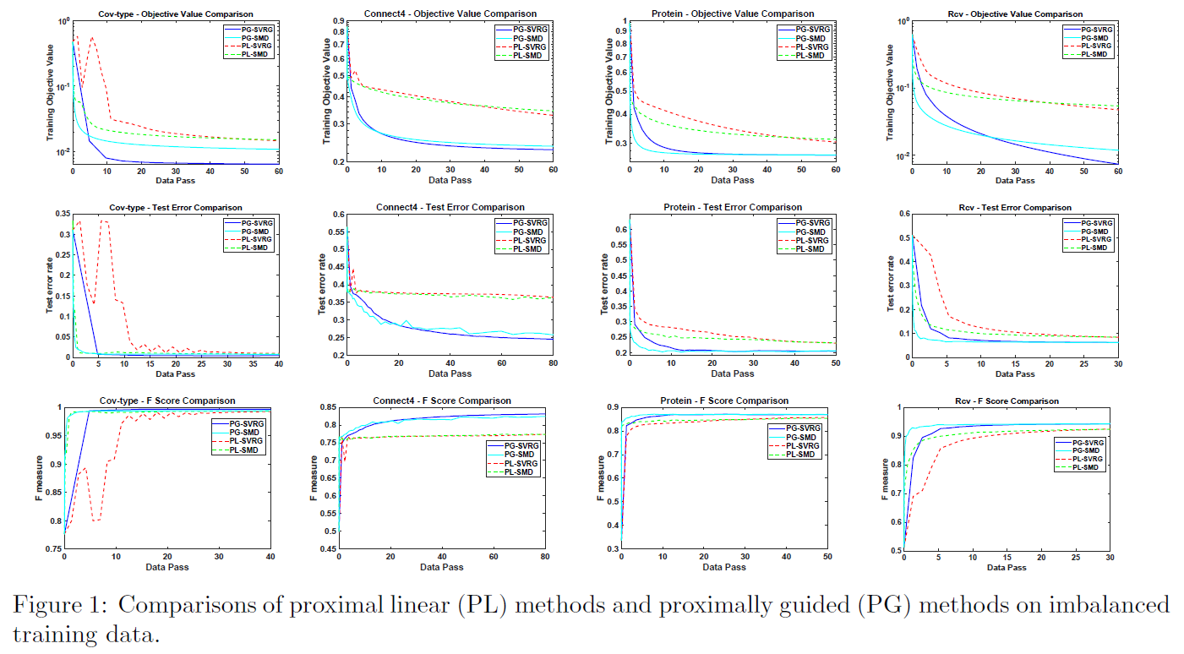
Experiment

Slide 19
In the general nonconvex-nonconcave setting, one cannot expect to find Nash equilibria efficiently as it is NP-hard.
Local Nash equilibria is in the case of simultaneous games, while GAN is based on sequential games

Slide 20
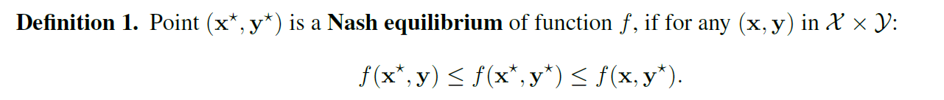
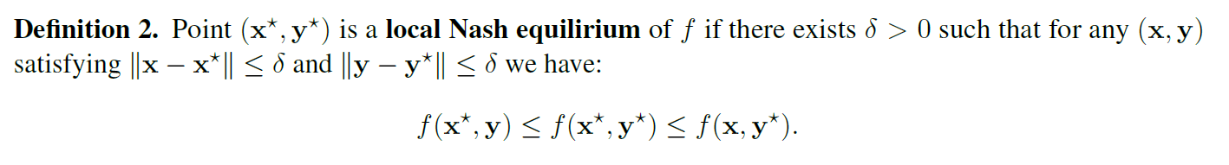
Simultaneous games

Slide 21


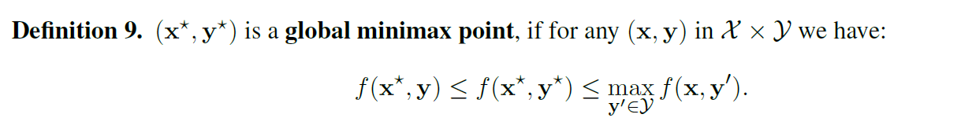
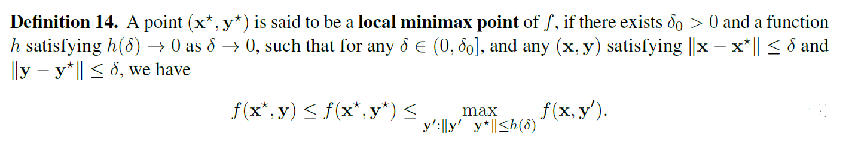
Sequential games

Slide 22
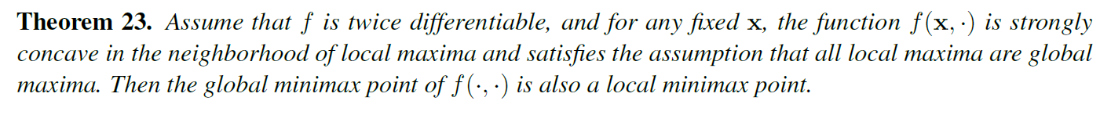
Some results

Slide 23
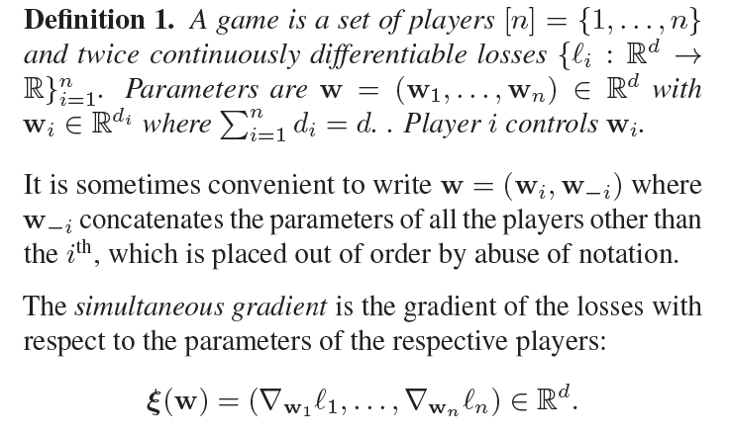
How to find stable fixed points

Slide 24
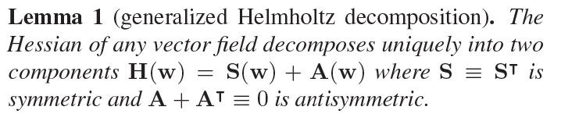


Slide 25
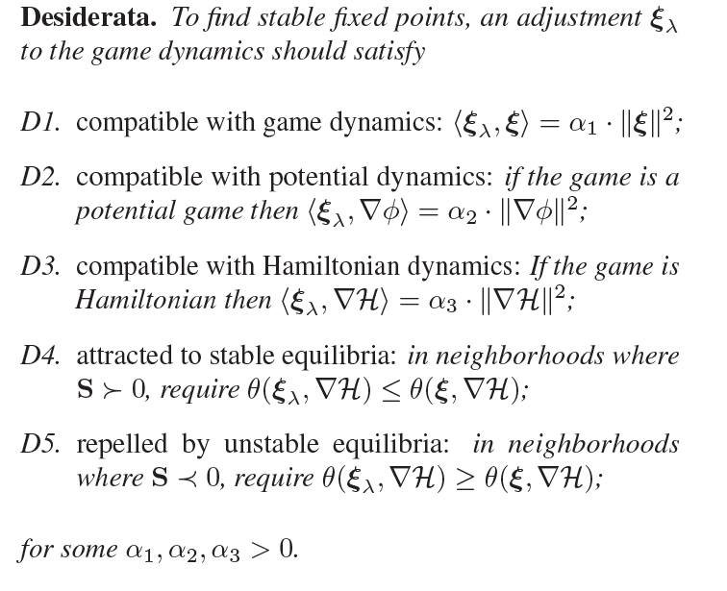

How to determine better direction adjustment
Fixed points of potential and Hamiltonian games can be found by descent on
respectively.

Slide 26
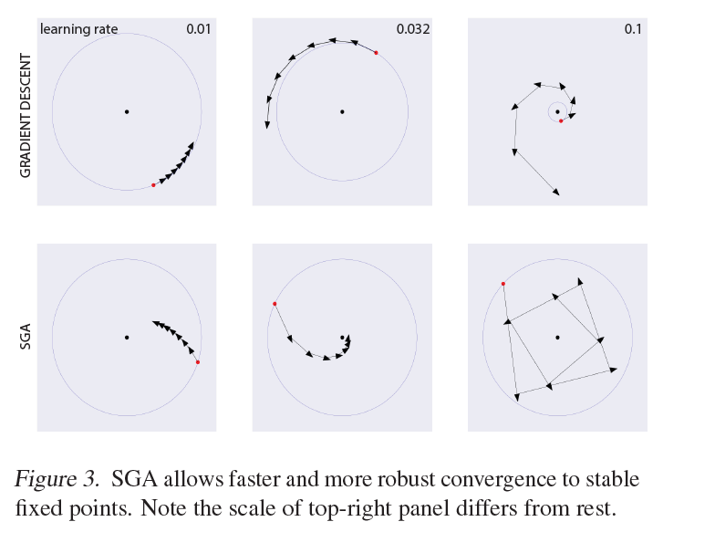
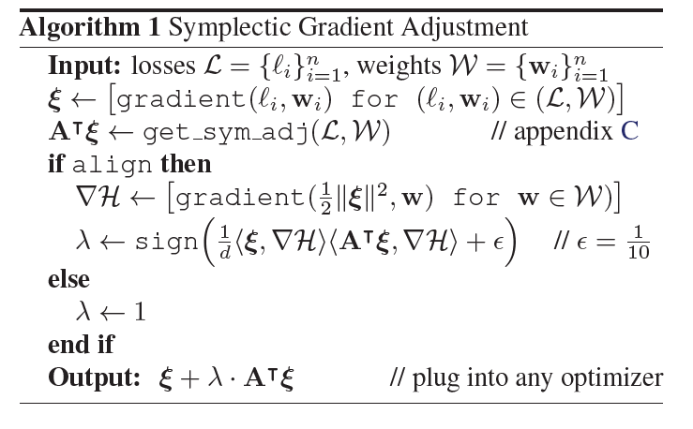
Symplectic gradient adjustment(SGA)

Slide 27
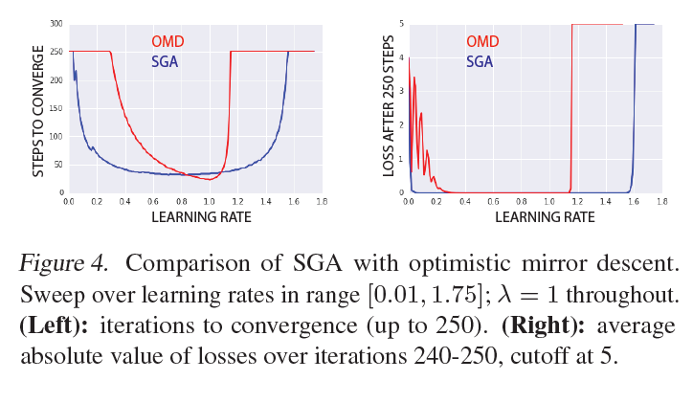
Experiment

Slide 28

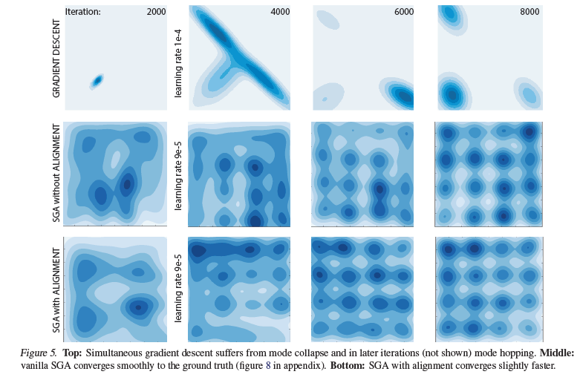
Experiment
Aligned consensus:

Slide 29
Reference
GANs Trained by a Two Time-Scale Update Rule Converge to a Local Nash Equilibrium
On Gradient Descent Ascent for Nonconvex-Concave Minimax Problems
What is Local Optimality in Nonconvex-Nonconcave Minimax Optimization?
The Mechanics of n-Player Differentiable Games
Non-Convex Min-Max Optimization: Provable Algorithms and Applications in Machine Learning
A Review on Generative Adversarial Networks: Algorithms, Theory, and Applications
Which Training Methods for GANs do actually Converge?

Slide 30
Thanks！

