Slide 1
Deep Learning: Connection Double Descent Phenomenon Analysis and Beyond
林大超
前沿交叉学科研究院

Slide 2
Double Descent
Mystery of generalization of deep neural networks
Overparameterized but generalized well
Conventional statistical wisdom
Bias-variance tradeoff
Interpolation (vanishing training error) is taken to be a proxy for overfitting
Big Data and Large Models

Slide 3
Outline
Linear Regression
Vanilla
Misspecified model
Regularization
Random Feature Regression
Two layer neural network
Non-linear target function
Kernel Regression
Multiple Descent

Slide 4

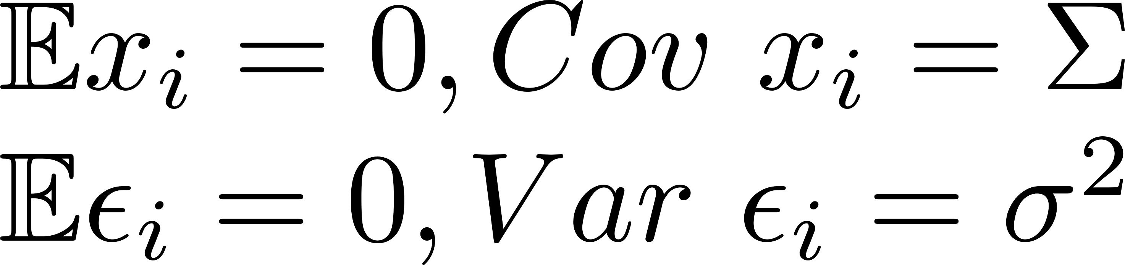
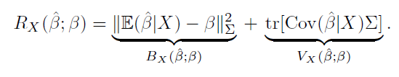
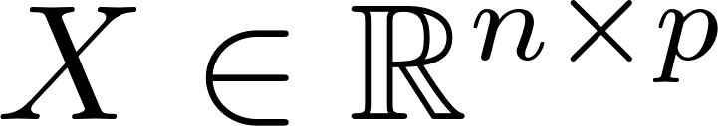
Ridgeless Linear Regression
Independent data and noise:
Sample for test:
[Hastie et al., 2019]

Slide 5


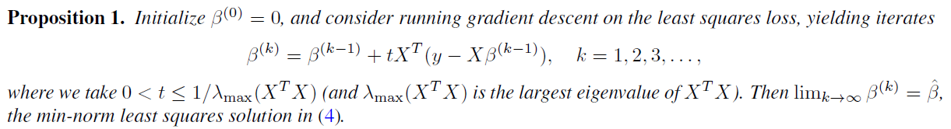
Ridgeless Linear Regression
The minimum L2 norm (min-norm) least squares regression estimator
Gradient descent on the least squares loss:
[Hastie et al., 2019]

Slide 6
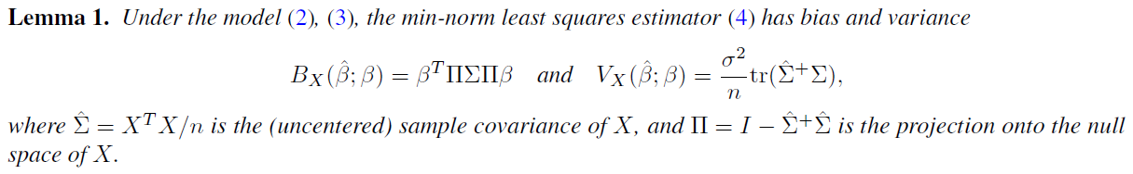
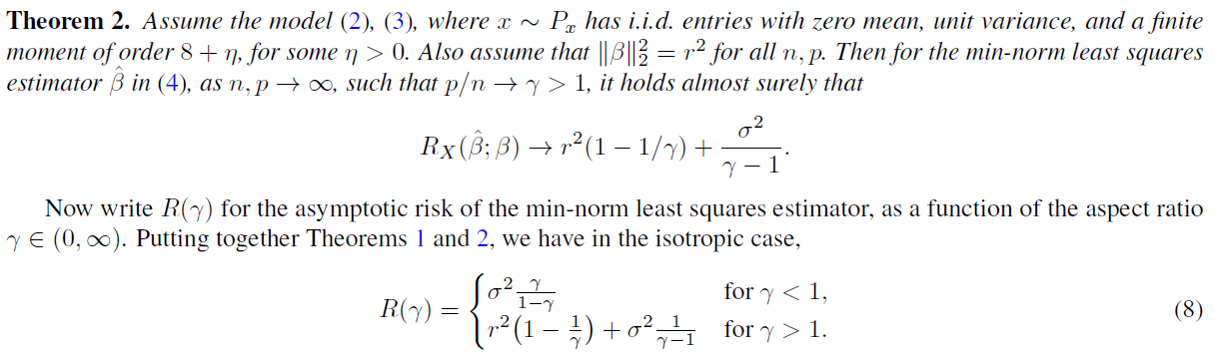
Ridgeless Linear Regression
[Hastie et al., 2019]
Notes:
Bias: n>p zero else nonzero
Variance: singular value of X^TX

Slide 7
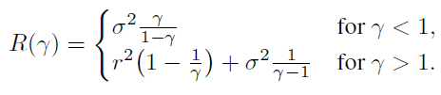
Ridgeless Linear Regression
Variance (main reason)
Symmetry
Infinite when n = p
Bias
Zero when n > p
Best Risk: p/n -> 0.
[Hastie et al., 2019]
Notes:
Variance: 高维空间内随机向量几乎正交，当n~p，新加入的数据对X的行空间补充越来越少。
对称性可以把n, p互换理解
Bias：与传统NN矛盾 因为线性模型限制了数据维数和参数量一样！
Gamma=0.5，SNR=r^2/sigma^2.

Slide 8
Remarks in Ridgeless Linear Regression
Problems
No need for overparameterization
Bias term is contradictory to NN
Regularization is more common
General models and assumptions
Sample-wise Double Descent
Model-wise Double Descent
[Nakkiran et al., 2019]

Slide 9
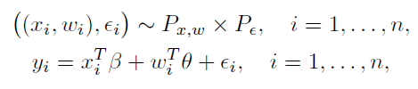
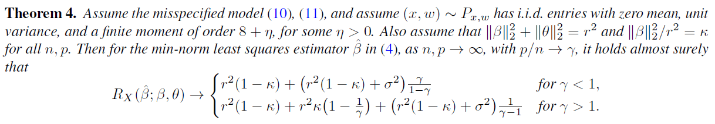

Misspecified model
—— We observe only a subset of the features.
misspecification bias + bias + misspecification variance
E.g.
[Hastie et al., 2019]

Slide 10


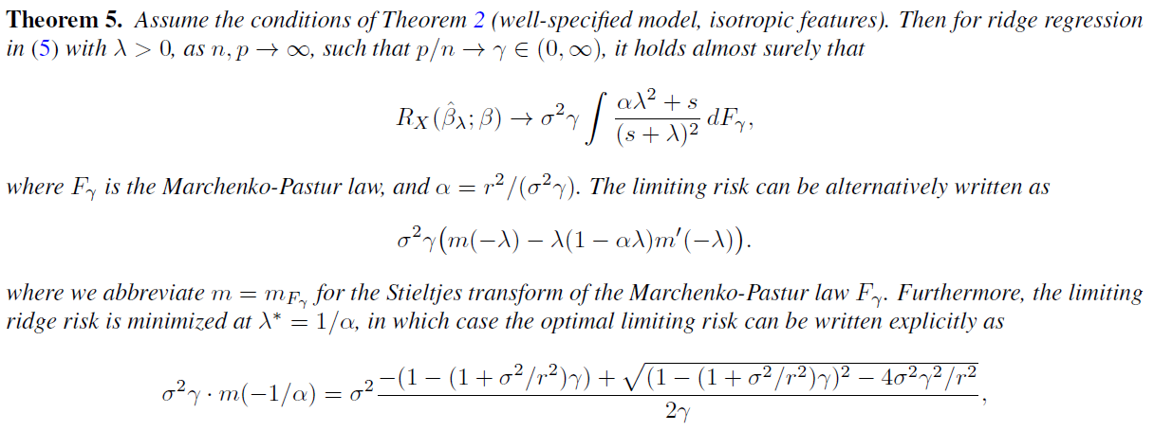
Ridge Regression
[Hastie et al., 2019]
Notes:
n -> 0, same as ridgeless regression
n -> infinite, beta=0.

Slide 11
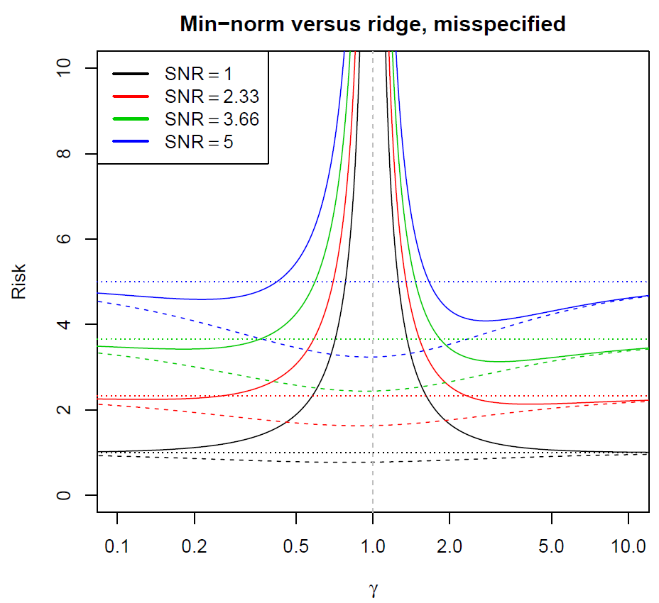
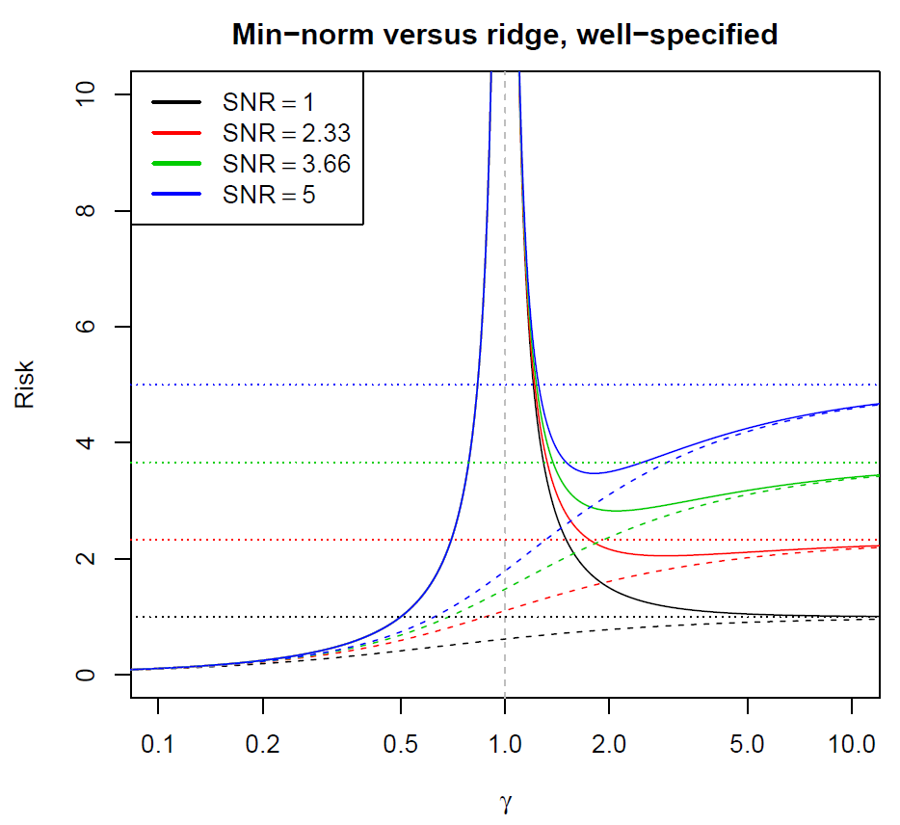
Ridge Regression
L2 regression eliminates the infinite variance
Stability of regularized model
[Hastie et al., 2019]

Slide 12

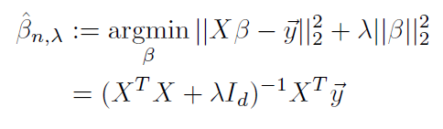




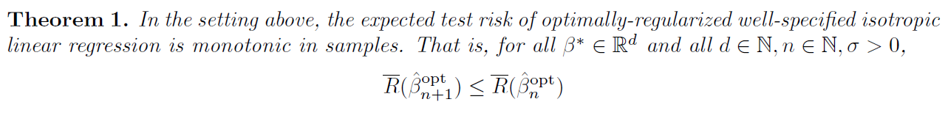
Sample Monotonicity in Ridge Regression
[Nakkiran et al., 2020]

Slide 13
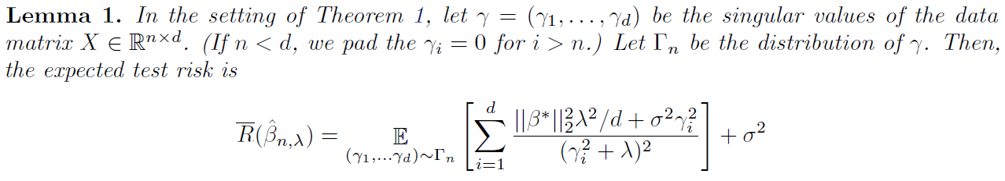
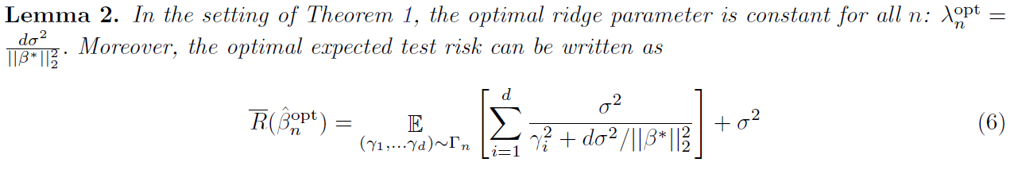
Sample Monotonicity in Ridge Regression
Cauchy interlacing theorem
[Nakkiran et al., 2020]

Slide 14
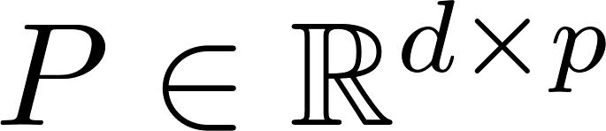


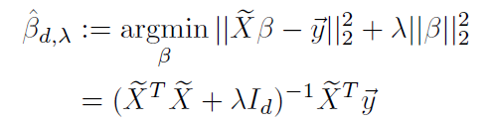



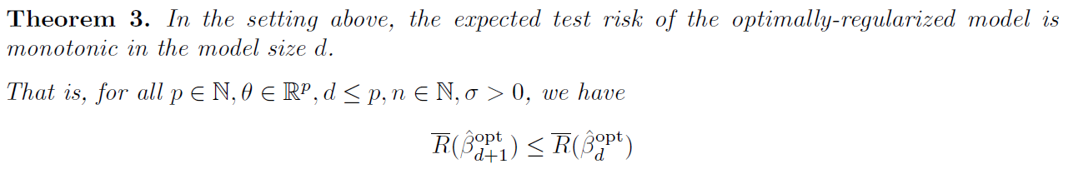
Model-wise Monotonicity in Ridge Regression
A uniformly random orthonormal matrix
[Nakkiran et al., 2020]

Slide 15
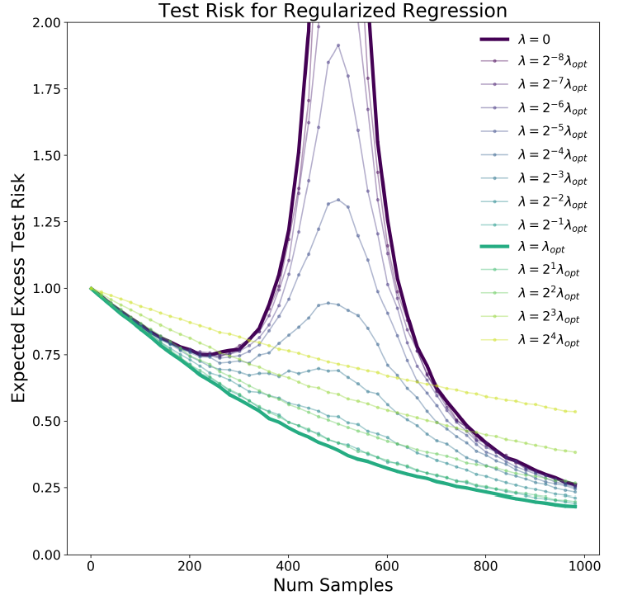
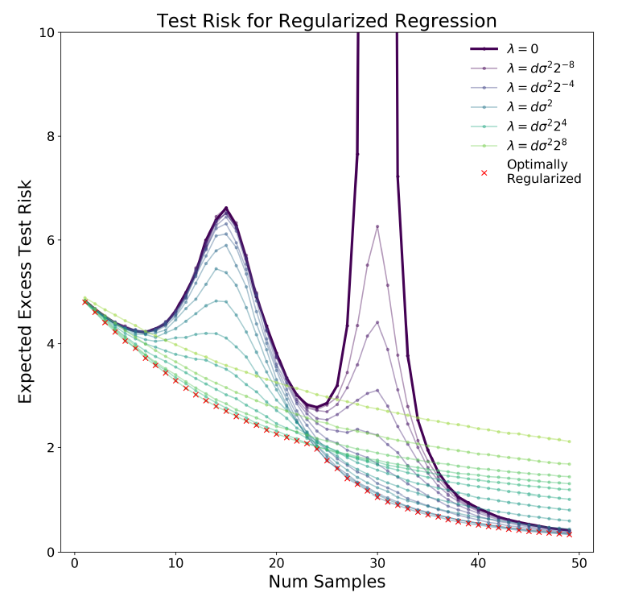
Sample Monotonicity in Ridge Regression
General Covariates
d = 500
[Nakkiran et al., 2020]

Slide 16

Random Feature Regression
Overparameterization
Neural Tangent Kernel
Lazy regime: where the weights stay close to their initial value during training.
Only optimize final layer while fix other layers:
[Ascoli et al., 2020]

Slide 17


Random Feature Regression
Lipschitz continuous activation function with bounded Gaussian moments
Student-teacher setup (F: teacher, f: student):
[Jimmy Ba et al., 2020]

Slide 18
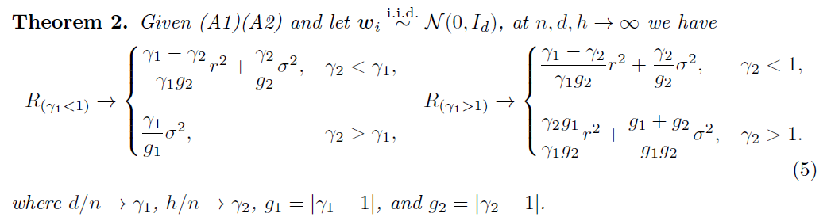
Warm-up: Linear Network
Training the Second Layer:
When n < d, double descent occurs.
[Jimmy Ba et al., 2020]

Slide 19
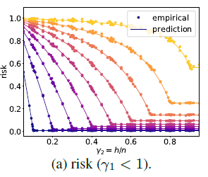
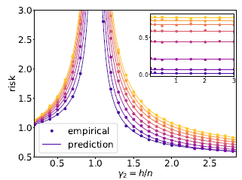
Warm-up: Linear Network
[Jimmy Ba et al., 2020]

Slide 20
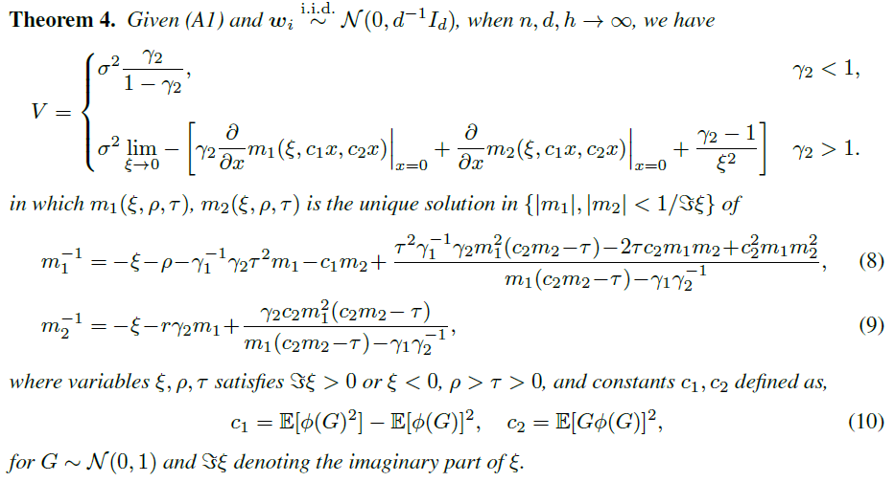
Nonlinear Model: Optimizing the second layer
[Jimmy Ba et al., 2020]

Slide 21
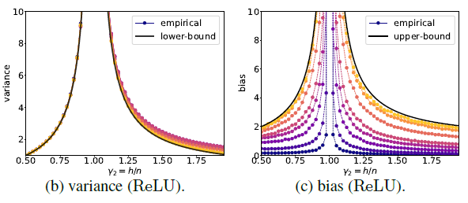
Nonlinear Model: Optimizing the second layer
Two-layer ReLU neural networks with optimized second layer.
[Jimmy Ba et al., 2020]

Slide 22
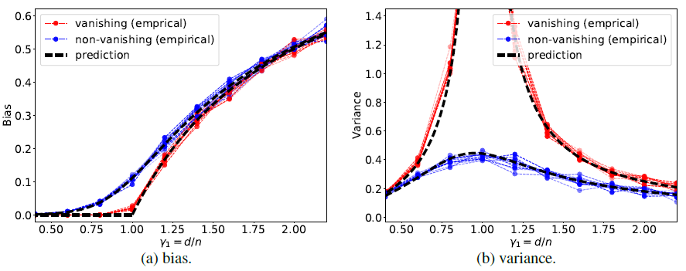
Nonlinear Model: Optimizing the first layer
No double descent with model parameters.
[Jimmy Ba et al., 2020]

Slide 23




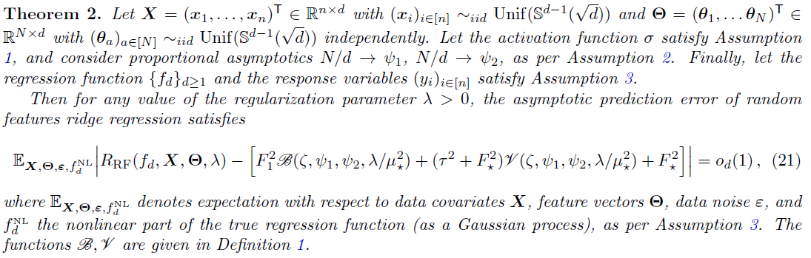
Non-linear target function:
Nonlinear component is centered Gaussian process indexed by x.
[Mei et al., 2019]

Slide 24
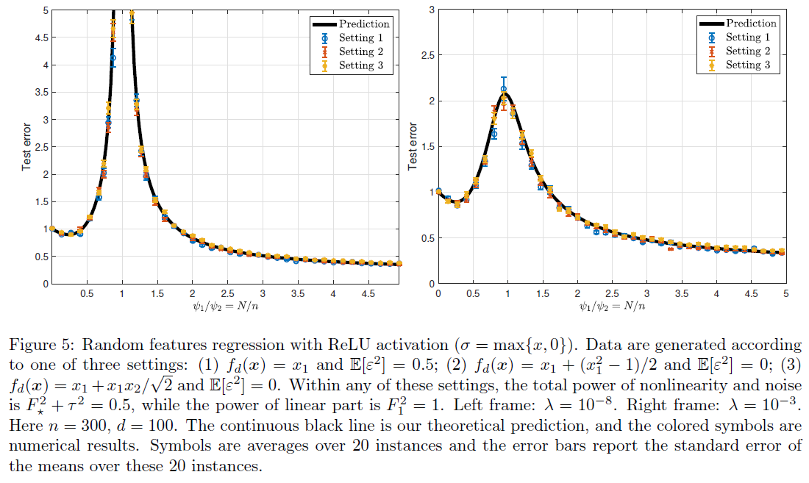
Non-linear target function:
[Mei et al., 2019]

Slide 25
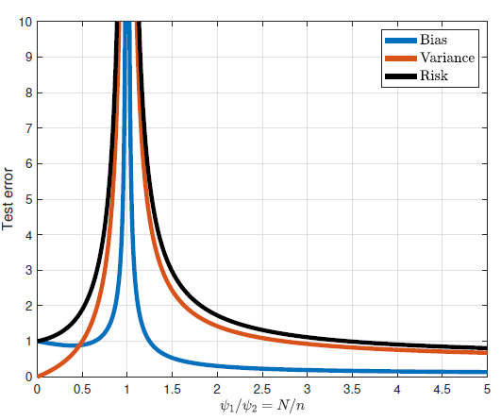
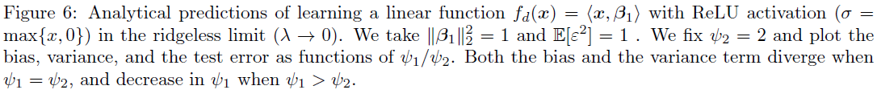
Bias and Variance View
[Mei et al., 2019]

Slide 26
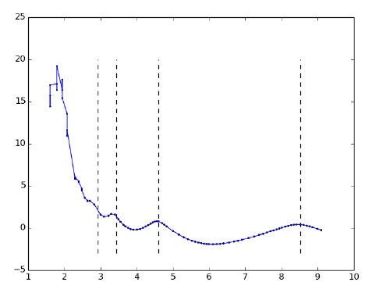




Kernels Regression
The variance of the estimator can be upper
bounded by
[Liang et al., 2019]

Slide 27

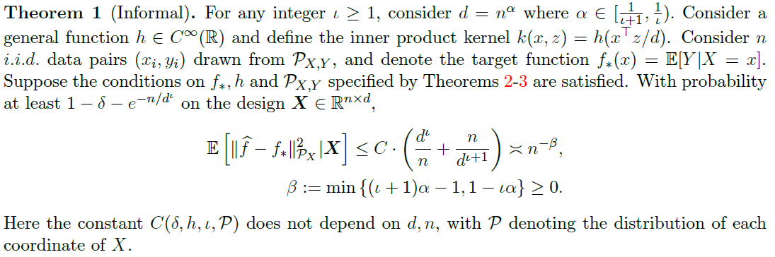
Kernels Regression
[Liang et al., 2019]

Slide 28

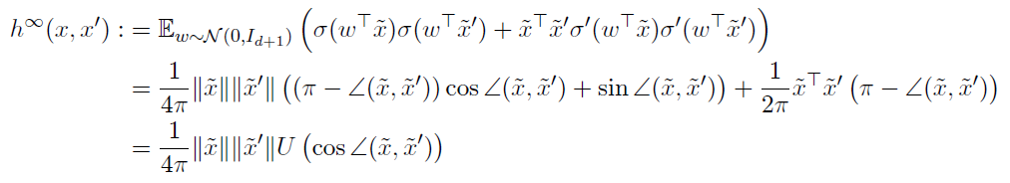
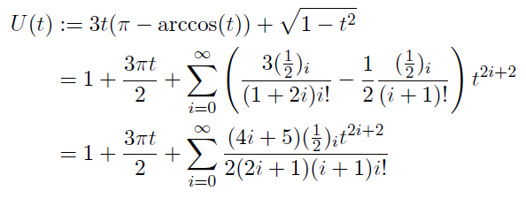
Wide Neural Networks (NTK)
[Liang et al., 2019]

Slide 29
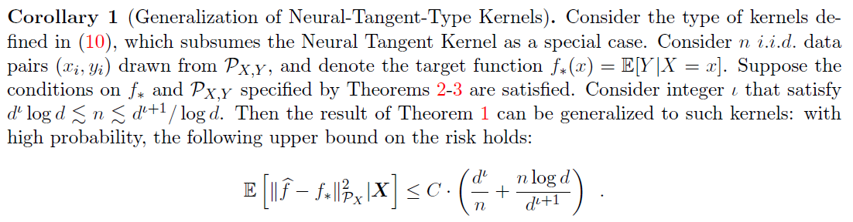
Wide Neural Networks (NTK)
[Liang et al., 2019]

Slide 30
Summary
Linear Regression: linear teacher with label noise and linear student
Vanilla: Variance √ Bias ×
Misspecified model: Variance √ Bias ×
Regularization (Optimal): Variance × Bias ×
Random Feature Regression : non-linear student
Linear teacher with label noise
First layer: no double descent
Second layer: Variance √ Bias √
Non-linear teacher w/o label noise: Variance √ Bias √
Kernel Regression
Multiple Descent (Upper Bound): Variance √ Bias √

Slide 31
Explanation
Unstable to noise
Label noise
Data noise: mismatch model
Number of potential models
Implicit regularization
Overparameterization
Application

Slide 32
Reference Paper List:
Surprises in High-Dimensional Ridgeless Least Squares Interpolation
Optimal Regularization Can Mitigate Double Descent
More Data Can Hurt for Linear Regression: Sample-wise Double Descent
Double Trouble in Double Descent: Bias and Variance(s) in the Lazy Regime
Generalization of Two-layer Neural Networks: An Asymptotic Viewpoint
The generalization error of random features regression: Precise asymptotics and double descent curve
On the Multiple Descent of Minimum-Norm Interpolants and Restricted Lower Isometry of Kernels

