Slide 1
Deep Learning: Advanced topics Mode Connectivity
韩洋
数学科学学院
hanyang2019@pku.edu.cn

Slide 2
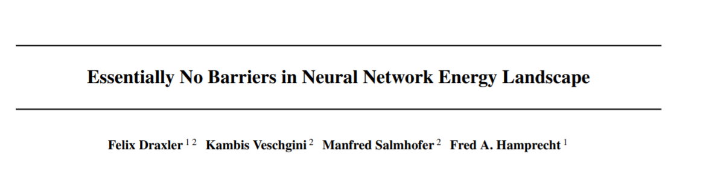

Slide 3
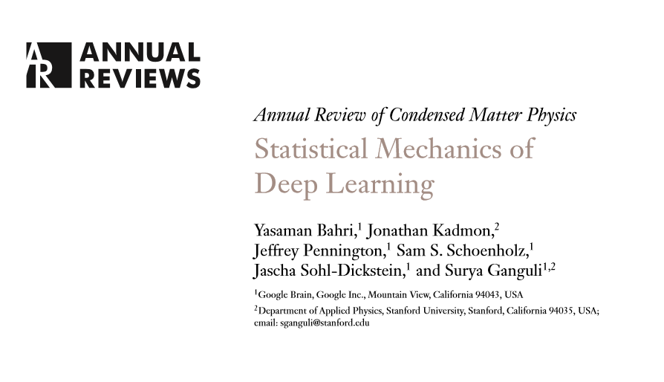

Slide 4
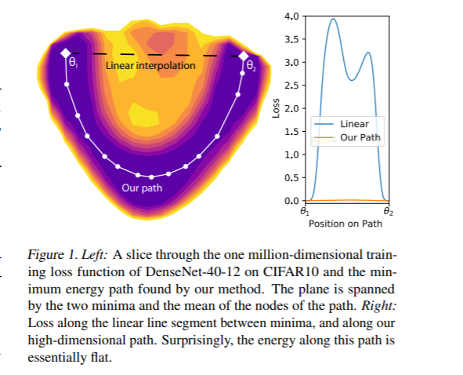
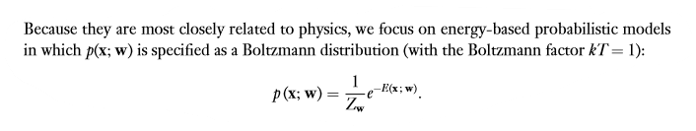

Slide 5
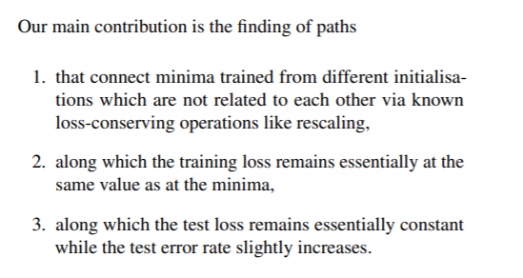

Slide 6

Method
Architecture
Training set
Network parameters θ
The goal is to find the continuous path p ∗ from θ1 to θ2 through parameter space with the lowest maximum loss:

Slide 7
Notations
minimum energy path (MEP) -p ∗
We refer to the parameter set with the maximum loss on a path as the “saddle point” of the path
because it is a true saddle point of the loss function.

Slide 8
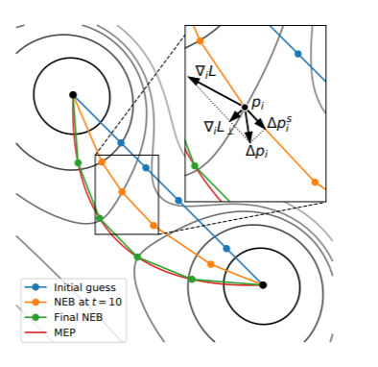
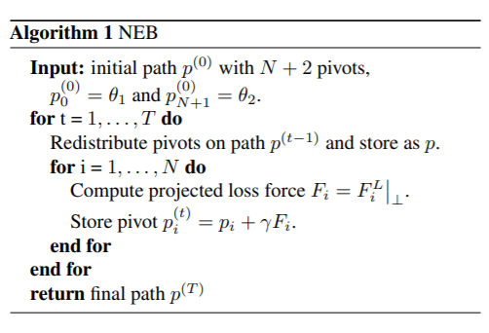
NEB(Nudged Elastic Band)

Slide 9
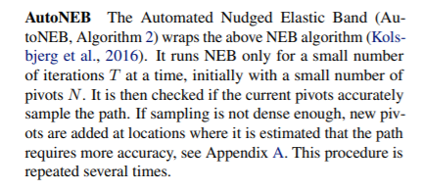
AutoNEB

Slide 10
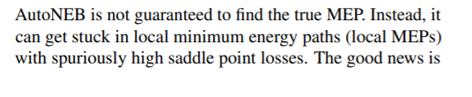
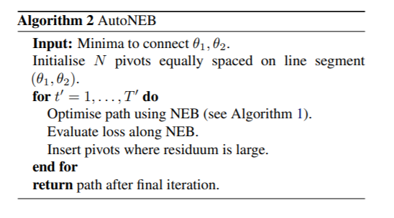
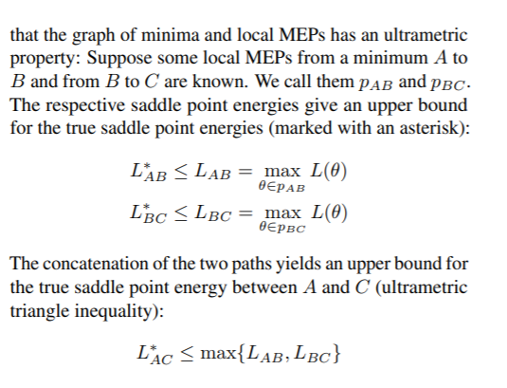

Slide 11
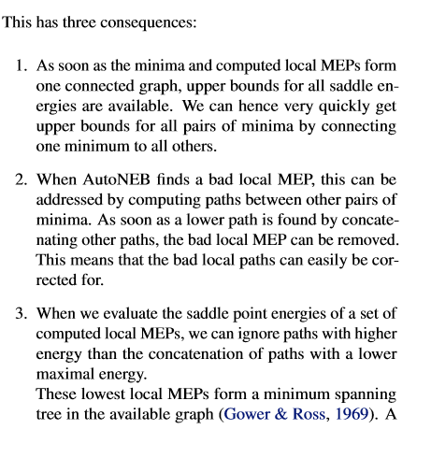
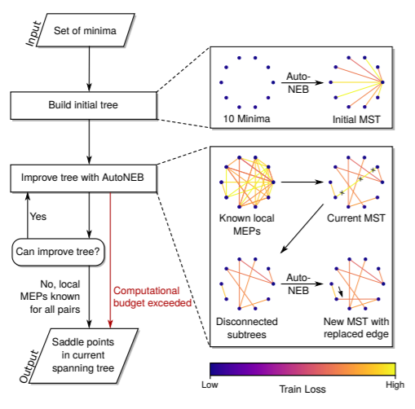

Slide 12
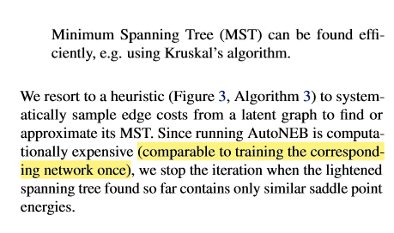
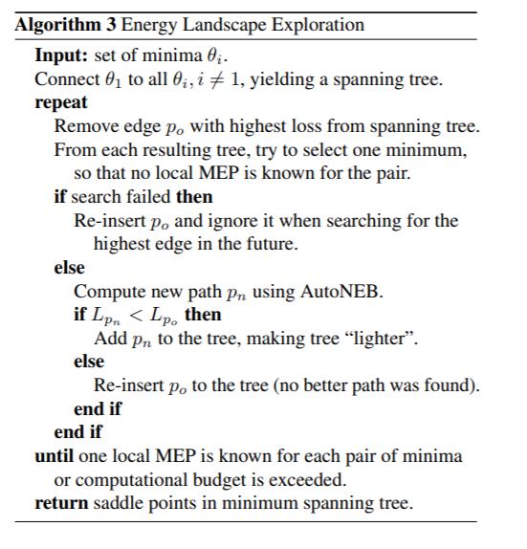

Slide 13
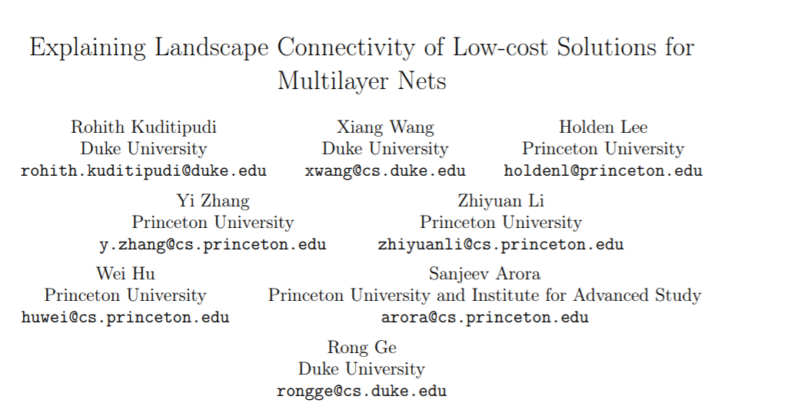

Slide 14
However, the glimmer of hope is that since the phenomenon exists for a variety of architectures and datasets, it must arise from some generic property of trained nets. The fact that the connecting paths between optima can have as few as two linear segments further bolsters this hope.
The number of linear segments grows linearly with the depth of the net.

Slide 15
Preliminaries

Slide 16
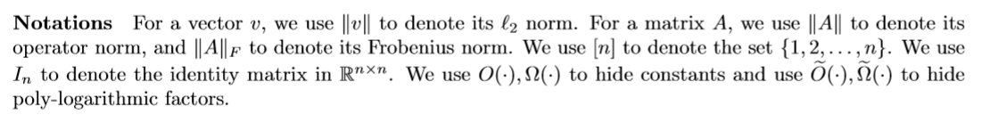
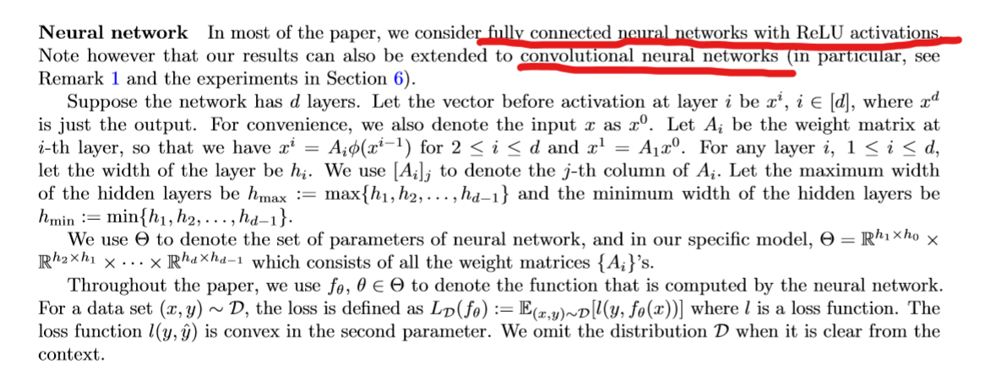

Slide 17
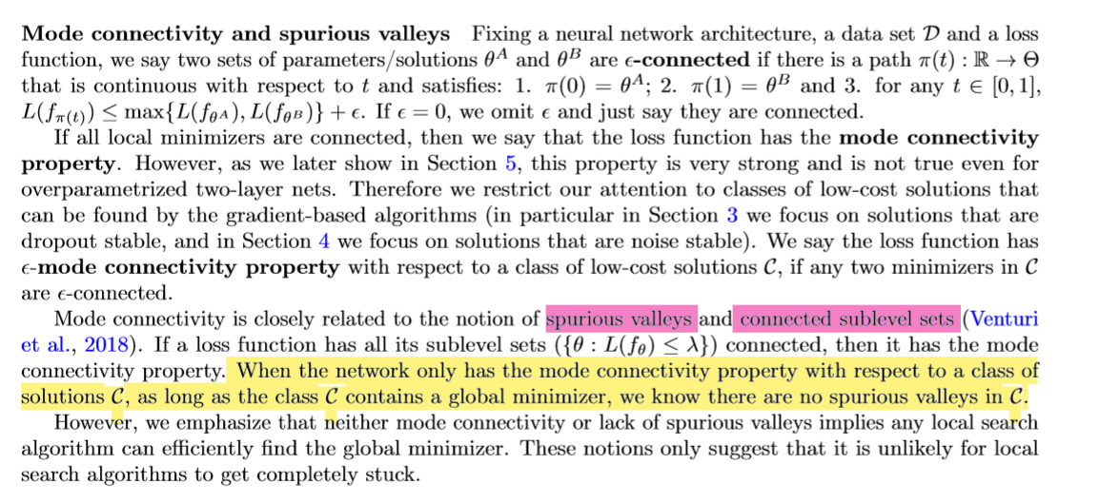

Slide 18


Slide 19
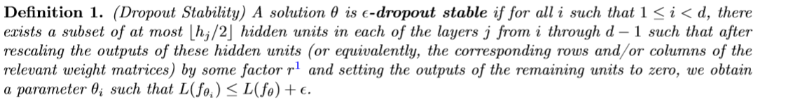
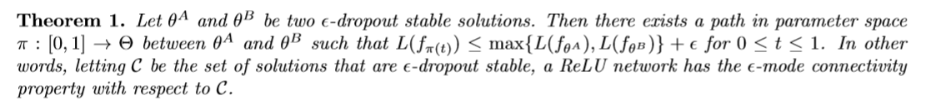

Slide 20
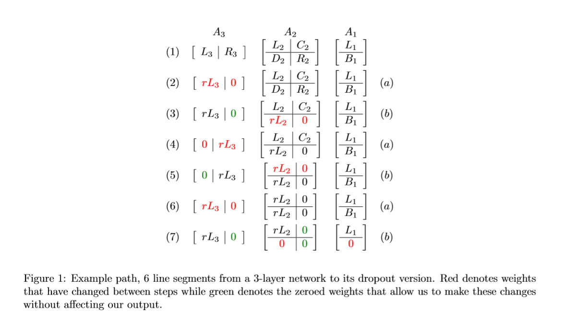

Slide 22
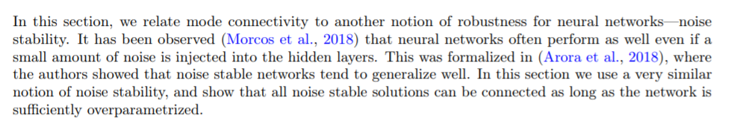

Slide 23

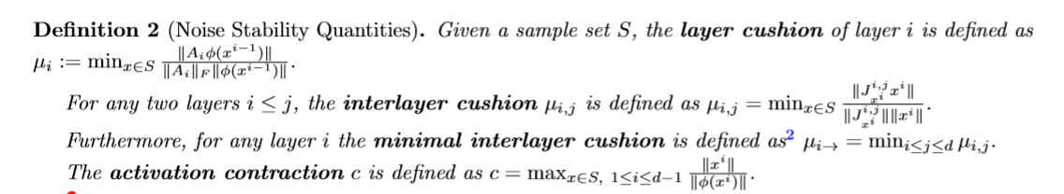
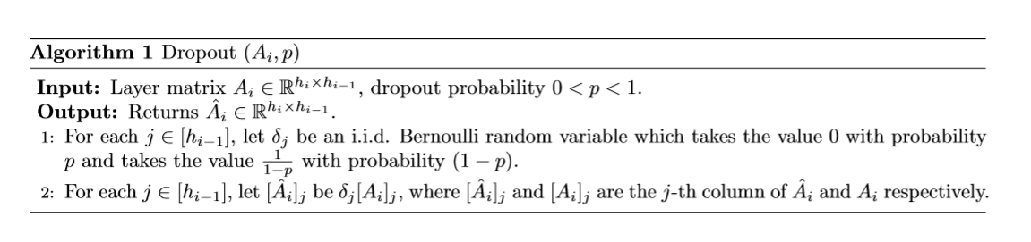

Slide 24
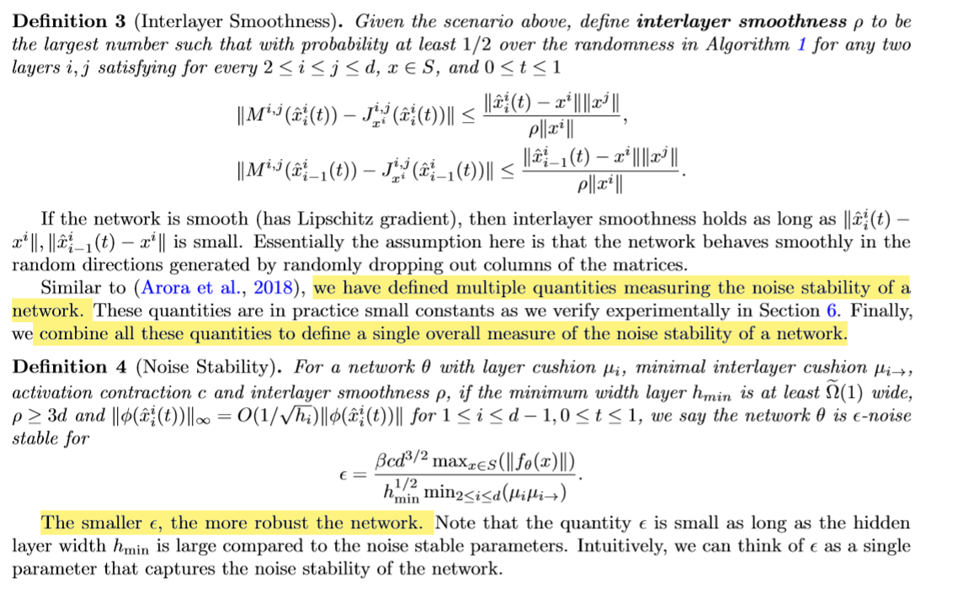

Slide 25

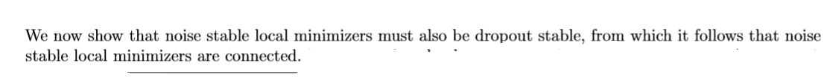

Slide 26
References:
Essentially no barriers in neural network energy landscape
Statistical Mechanics of Deep Learning
Explaining landscape connectivity of low-cost solutions for multilayer nets
Spurious Valleys in Two-hidden-layer Neural Network Optimization Landscapes

