Slide 1
Deep Learning: Advanced topics Loss Landscape, geometric property of solutions and generalization performance II
罗 月
数学科学学院
moonluo@pku.edu.cn

Slide 2
Outline
Introduction: critical points and classification
Hessian analysis: distribution of eigenvalues; sharpness/flatness and generalization
Spurious local minima (I)： valleys/basins, existence/non-existence

Slide 3
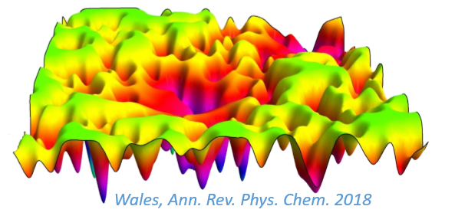
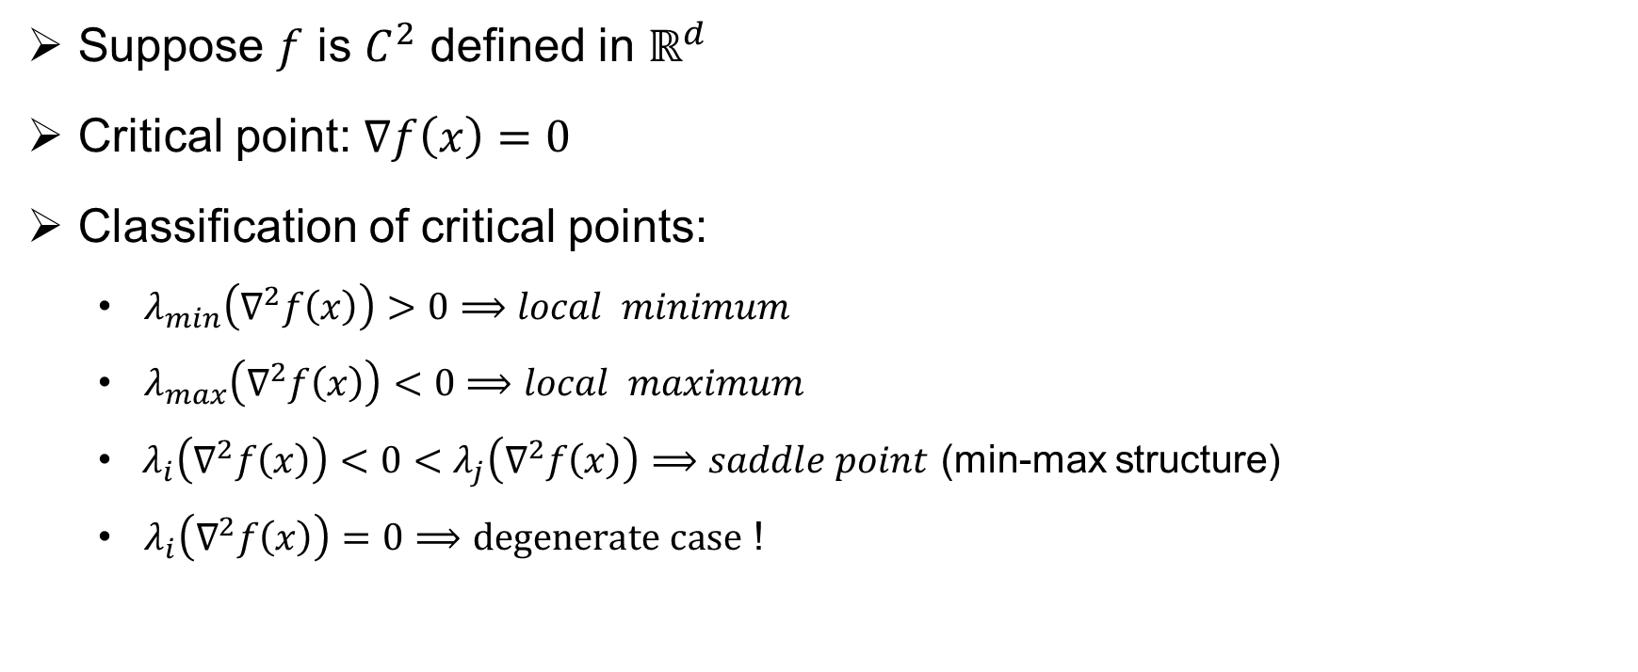
Description of critical points
Suppose $f$ is $C^{2}$ defined in $ℝ^{d}$
Critical point: $∇f\left(x\right)=0$
Classification of critical points:
$λ_{min}\left(∇^{2}f\left(x\right)\right)>0⟹local minimum$
$λ_{max}\left(∇^{2}f\left(x\right)\right)<0⟹local maximum$
$λ_{i}\left(∇^{2}f\left(x\right)\right)<0<λ_{j}\left(∇^{2}f\left(x\right)\right)⟹saddle point$ (min-max structure)
$λ_{i}\left(∇^{2}f\left(x\right)\right)=0⟹degenerate case$ !

Slide 4
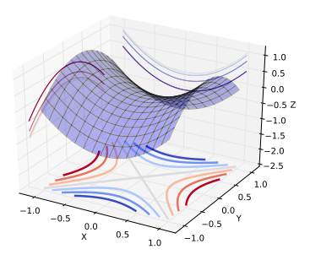
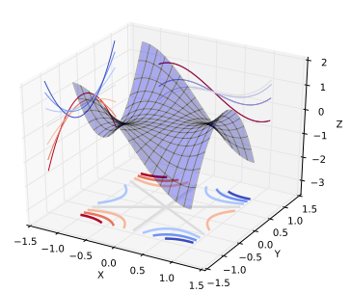
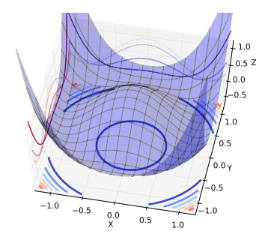
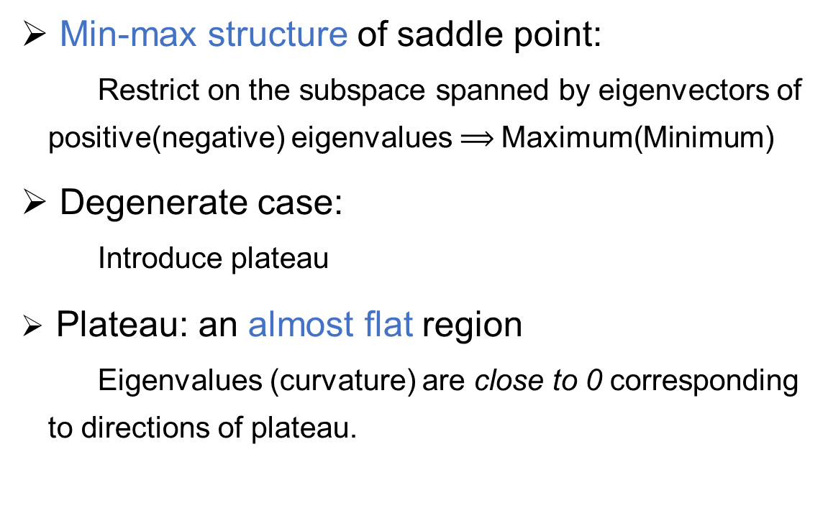
Saddle point and degenerate case
Min-max structure of saddle point: Restrict on the subspace spanned by eigenvectors of positive(negative) eigenvalues $⟹$Maximum(Minimum)
Degenerate case: Introduce plateau
Plateau: an almost flat region Eigenvalues (curvature) are close to 0 corresponding to directions of plateau.
Dauphin, Y. N et al, NIPS. 2014

Slide 5
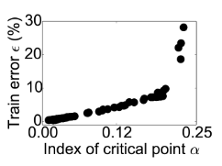
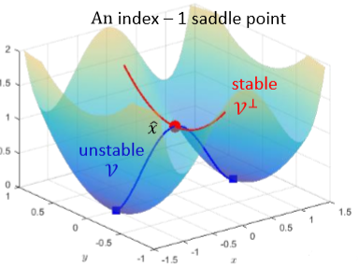
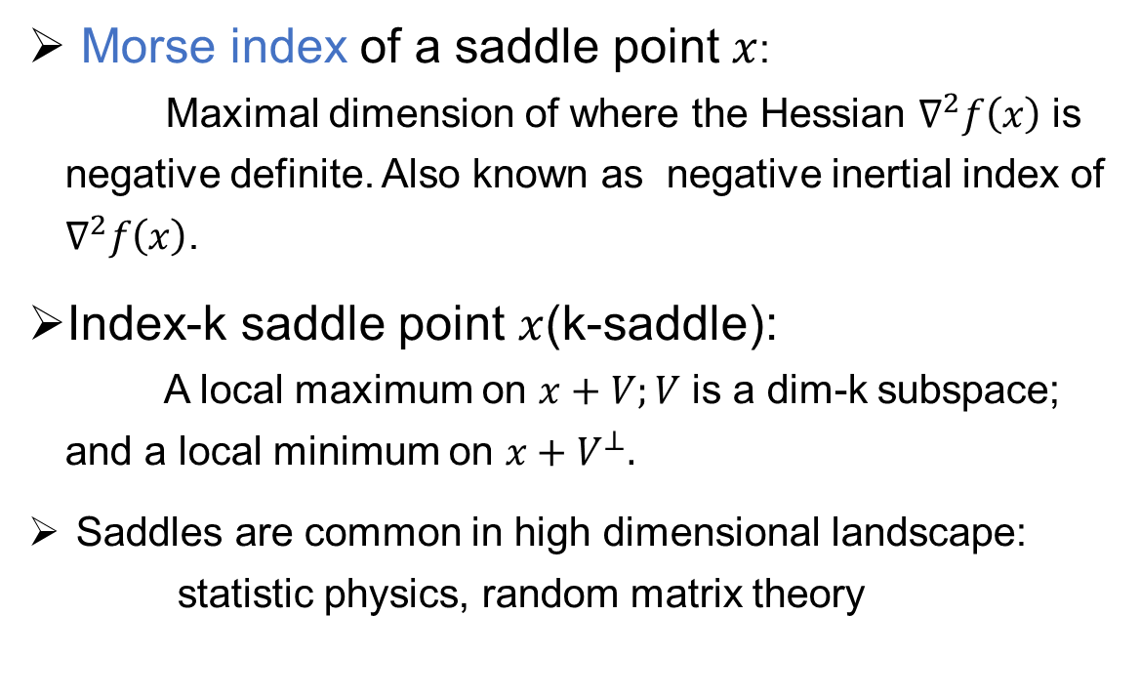
Saddle point and Morse index
Morse index of a saddle point $x$: Maximal dimension of where the Hessian $∇^{2}f\left(x\right)$ is negative definite. Also known as negative inertial index of $∇^{2}f\left(x\right)$.
Index-k saddle point $x$(k-saddle): A local maximum on $x+V;V$ is a dim-k subspace; and a local minimum on $x+V^{⊥}.$
Saddles are common in high dimensional landscape: statistic physics, random matrix theory
Dauphin, Y. N., NIPS, 2014; Yin, J.Y., Talks in XTU.2018

Slide 6

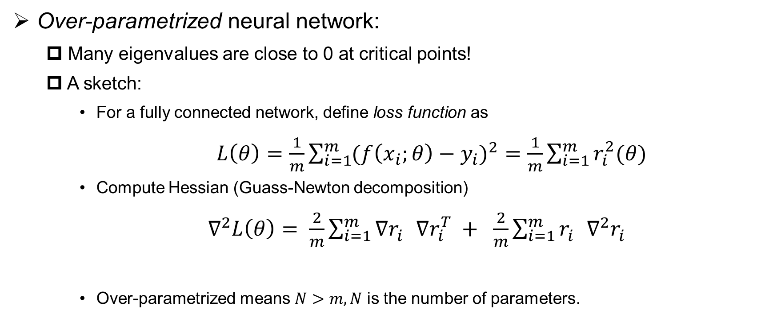
Explore landscape: Hessian analysis
Over-parametrized neural network:
Many eigenvalues are close to 0 at critical points!
A sketch:
For a fully connected network, define loss function as
$L\left(θ\right)=\frac{1}{m}\sum_{i=1}^{m}{{(f\left(x_{i};θ\right)−y_{i})}^{2}}=$ $\frac{1}{m}\sum_{i=1}^{m}{r_{i}^{2}(θ)}$
Compute Hessian (Guass-Newton decomposition)
$∇^{2}L\left(θ\right)= \frac{2}{m}\sum_{i=1}^{m}{{∇r}_{i}^{}{∇r}_{i}^{T} + \frac{2}{m}\sum_{i=1}^{m}{r_{i}^{}{∇^{2}r}_{i}^{} }}$
Over-parametrized means $N>m, N$ is the number of parameters.
Small residual
Semi-positive definite, $rank≤N−m$
Sagun, L et al, ICLR. 2018

Slide 7
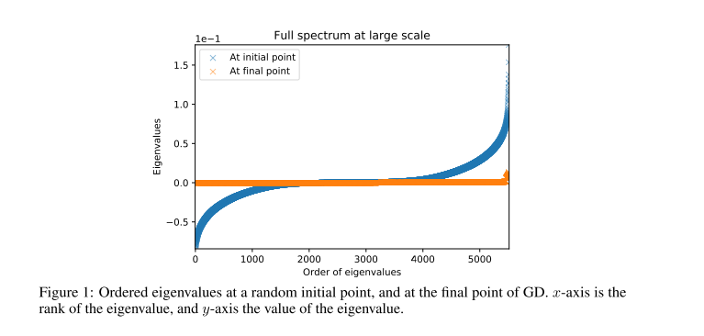
Explore landscape: Hessian analysis
An example of 2-hidden layer network with 5000 parameters
Sagun, L et al, ICLR. 2018

Slide 8
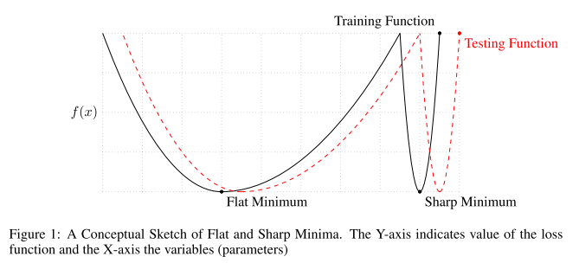

Flatness and related properties
Many eigenvalues near zero $⟹$ Flatness at the bottom of the landscape
Numerical exploration: mode connectivity, wide basins…
Relation between flatness and generalization
Keskar, N. S. et al, ICLR. 2017

Slide 9
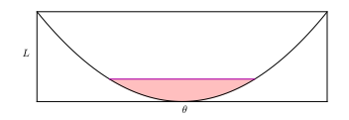
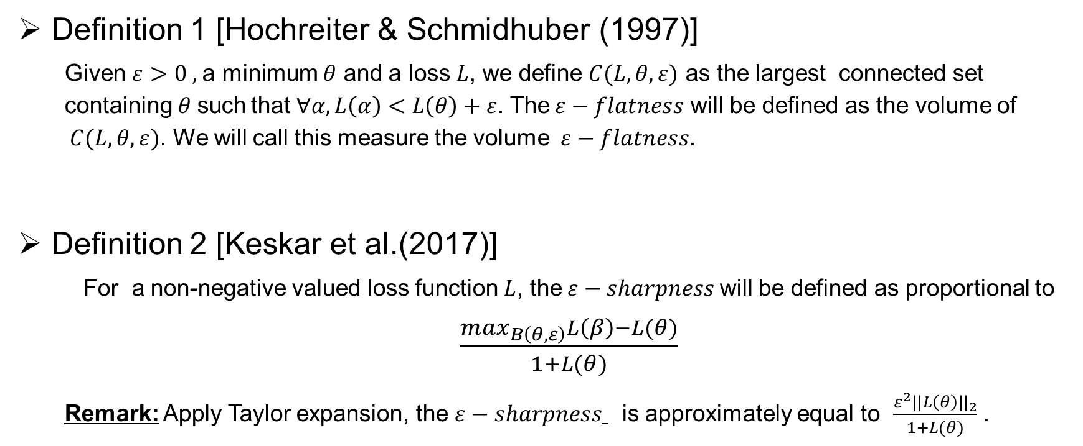
Definition of Flatness
Definition 1 [Hochreiter & Schmidhuber (1997)]
Given $ε>0 ,$a minimum $θ$ and a loss $L$, we define $C(L,θ,ε)$ as the largest connected set containing$θ$such that $∀α, L\left(α\right)<L\left(θ\right)+ε$. The$ε−flatness$ will be defined as the volume of $C(L,θ,ε)$. We will call this measure the volume$ε−flatness$.
Definition 2 [Keskar et al.(2017)]
For a non-negative valued loss function $L$, the$ε−sharpness$will be defined as proportional to $\frac{\max_{B\left(θ,ε\right)}L\left(β\right)−L(θ)}{1+L(θ)}$
Remark: Apply Taylor expansion, the $ε−sharpness$ is approximately equal to $\frac{ε^{2}||L\left(θ\right)||_{2}}{1+L(θ)}$ .
Dinh, L. et al, ICML. 2017

Slide 10
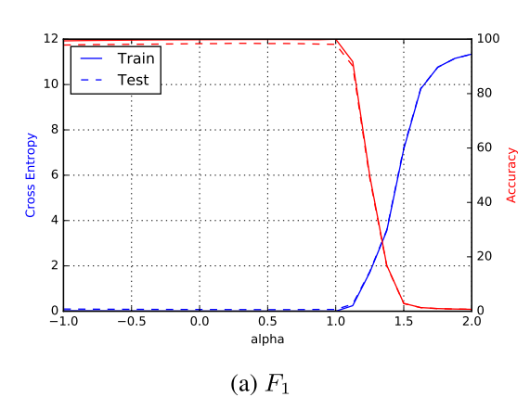
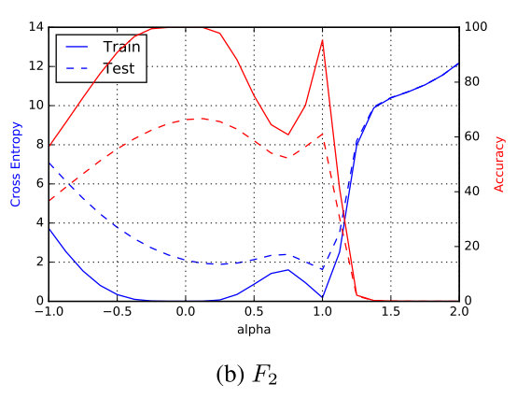
Flatness and generalization
Numerical experiments show some relationship between flatness/sharpness and generalization
Network Type: Fully connected
Data set: MNIST
$α=0$: small-batch(SB) minimizer;$α=1$: large-batch(LB) minimizer. The x-axis is the line interpolation between SB and LB minimizer
Keskar, N. S. et al, ICLR. 2017

Slide 11
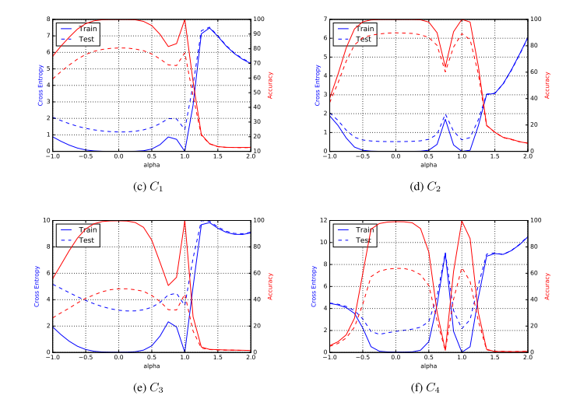
Flatness and generalization
Network Type: Shallow/Deep convolutional
Data set: CIFAR-10
Network Type: Shallow/Deep convolutional
Data set: CIFAR-100

Slide 12

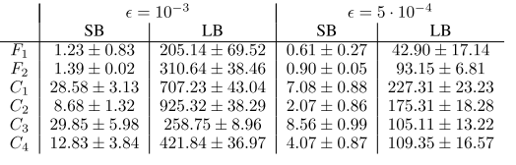
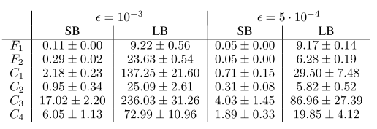
Flatness leads to better generalization?
Compute sharpness:
Full space
Random space (dim=100)
Remark: The choice of “sharpness” metric is for computational feasibility. Magnitude of eigenvalues should be a more proper metric. Randomized numerical linear algebra algorithm and efficient hessian-vector product may provide a good way to compute eigenvalues
Keskar, N. S. et al, ICLR. 2017

Slide 13
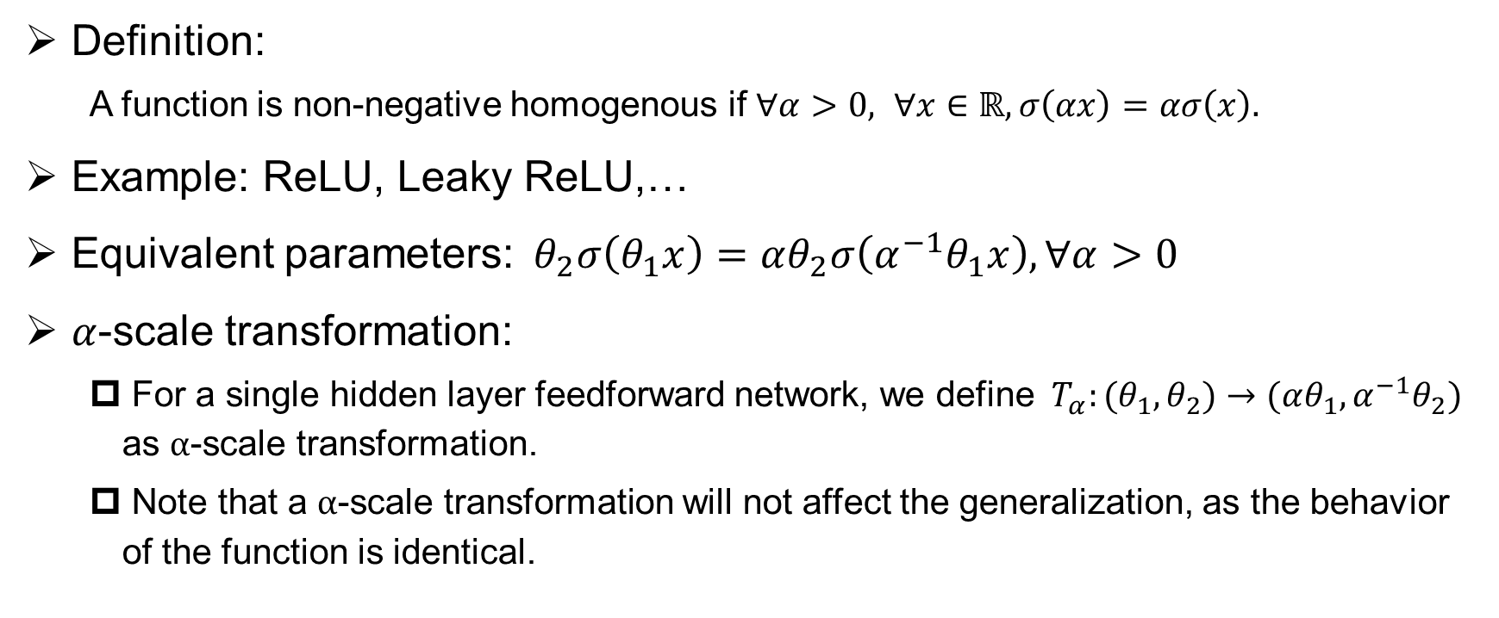
Sharp minima can generalize!
Definition:
A function is non-negative homogenous if $∀α>0, ∀x∈ℝ, σ\left(αx\right)=ασ\left(x\right).$
Example: ReLU, Leaky ReLU,…
Equivalent parameters:${ θ}_{2}σ\left(θ_{1}x\right)=αθ_{2}σ\left(α^{−1}θ_{1}x\right), ∀α>0$
$α$-scale transformation:
For a single hidden layer feedforward network, we define ${ T}_{α}:(θ_{1},θ_{2})→(αθ_{1},α^{−1}θ_{2})$ as $α$-scale transformation.
Note that a $α$-scale transformation will not affect the generalization, as the behavior of the function is identical.
Dinh, L. ICML. 2017

Slide 14

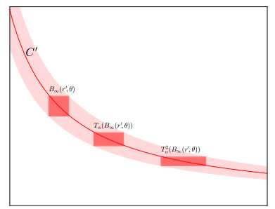


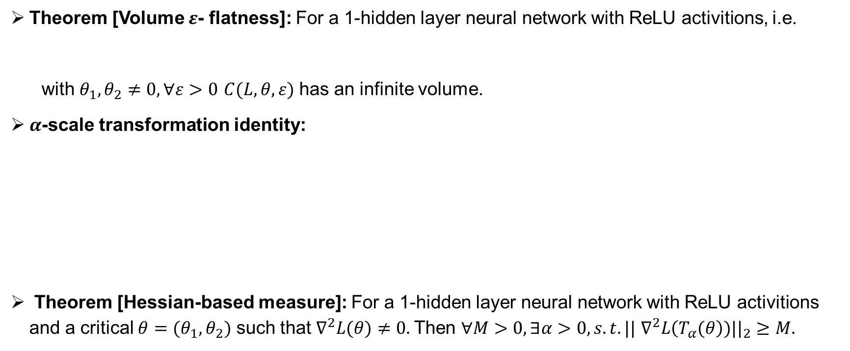
Sharp minima can generalize!
Theorem [Volume $ε$- flatness]: For a 1-hidden layer neural network with ReLU activitions, i.e.
with $θ_{1},θ_{2}≠0, ∀ε>0$ $C(L,θ,ε)$ has an infinite volume.
$α$-scale transformation identity:
Theorem [Hessian-based measure]: For a 1-hidden layer neural network with ReLU activitions and a critical ${θ=(θ}_{1},θ_{2})$ such that $∇^{2}L(θ)≠0.$Then $∀M>0,∃α>0, s.t. ||$ $∇^{2}L\left(T_{α}(θ\right))||_{2}≥M.$
Dinh, L. ICML. 2017

Slide 15

Sharp minima can generalize!
Theorem [Hessian-based measure]: For a 1-hidden layer neural network with ReLU activations and a critical ${θ=(θ}_{1},θ_{2})$ such that $∇^{2}L(θ)≠0.$Then $∀M>0,∃α>0, s.t. ||$ $∇^{2}L\left(T_{α}(θ\right))||_{2}≥M.$
A sketch of proof: Denote the diagonal entries of $∇^{2}L(θ)$ as $l_{ii }$, then ${{||∇}^{2}L(T_{α}(θ))}_{ }||_{F}^{2}≥α^{−2}\sum_{i=1}^{n_{1}}{l_{ii}^{2}+}α^{2}\sum_{i=1+n_{1}}^{N_{}}{l_{ii}^{2}}$. Note that as $α→0+or α→+∞，$ ${{||∇}^{2}L(T_{α}(θ))}_{ }||_{F}^{2}→∞.$And note that equivalence between Frobenius norm and spectral norm, then we can get the result.
Dinh, L. ICML. 2017

Slide 16
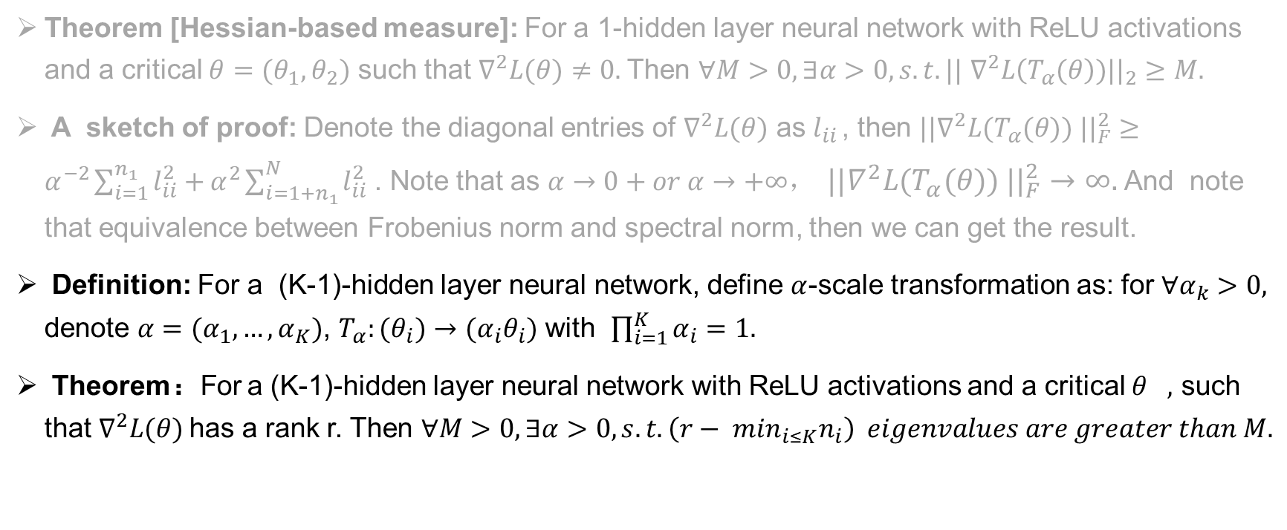
Sharp minima can generalize!
Theorem [Hessian-based measure]: For a 1-hidden layer neural network with ReLU activations and a critical ${θ=(θ}_{1},θ_{2})$ such that $∇^{2}L(θ)≠0.$Then $∀M>0,∃α>0, s.t. ||$ $∇^{2}L\left(T_{α}(θ\right))||_{2}≥M.$
A sketch of proof: Denote the diagonal entries of $∇^{2}L(θ)$ as $l_{ii }$, then ${{||∇}^{2}L(T_{α}(θ))}_{ }||_{F}^{2}≥α^{−2}\sum_{i=1}^{n_{1}}{l_{ii}^{2}+}α^{2}\sum_{i=1+n_{1}}^{N_{}}{l_{ii}^{2}}$. Note that as $α→0+or α→+∞，$ ${{||∇}^{2}L(T_{α}(θ))}_{ }||_{F}^{2}→∞.$And note that equivalence between Frobenius norm and spectral norm, then we can get the result.
Definition: For a (K-1)-hidden layer neural network, define $α$-scale transformation as: for $∀α_{k}>0,$ denote $α=(α_{1},…,α_{K})$, $T_{α}:(θ_{i})→$ $(α_{i}θ_{i})$ with $\prod_{i=1}^{K}{α_{i}=1.}$
Theorem：For a (K-1)-hidden layer neural network with ReLU activations and a critical $θ_{},$ such that $∇^{2}L(θ)$has a rank r. Then $∀M>0,∃α>0, s.t. \left(r− \min_{i≤K}n_{i}\right) eigenvalues are greater than M.$
Dinh, L. ICML. 2017

Slide 17
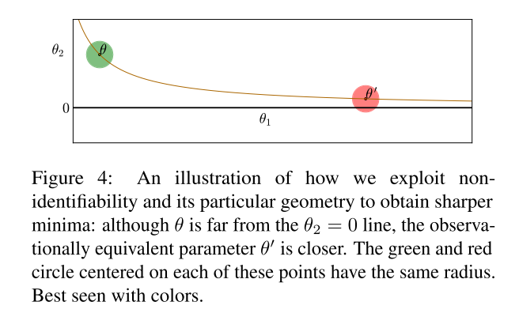



Sharp minima can generalize!
Analysis: $ε$-sharpness
1-hidde layer neural network

Slide 18
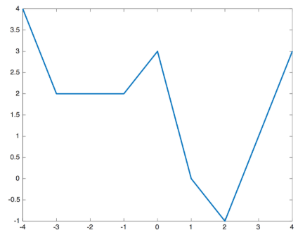
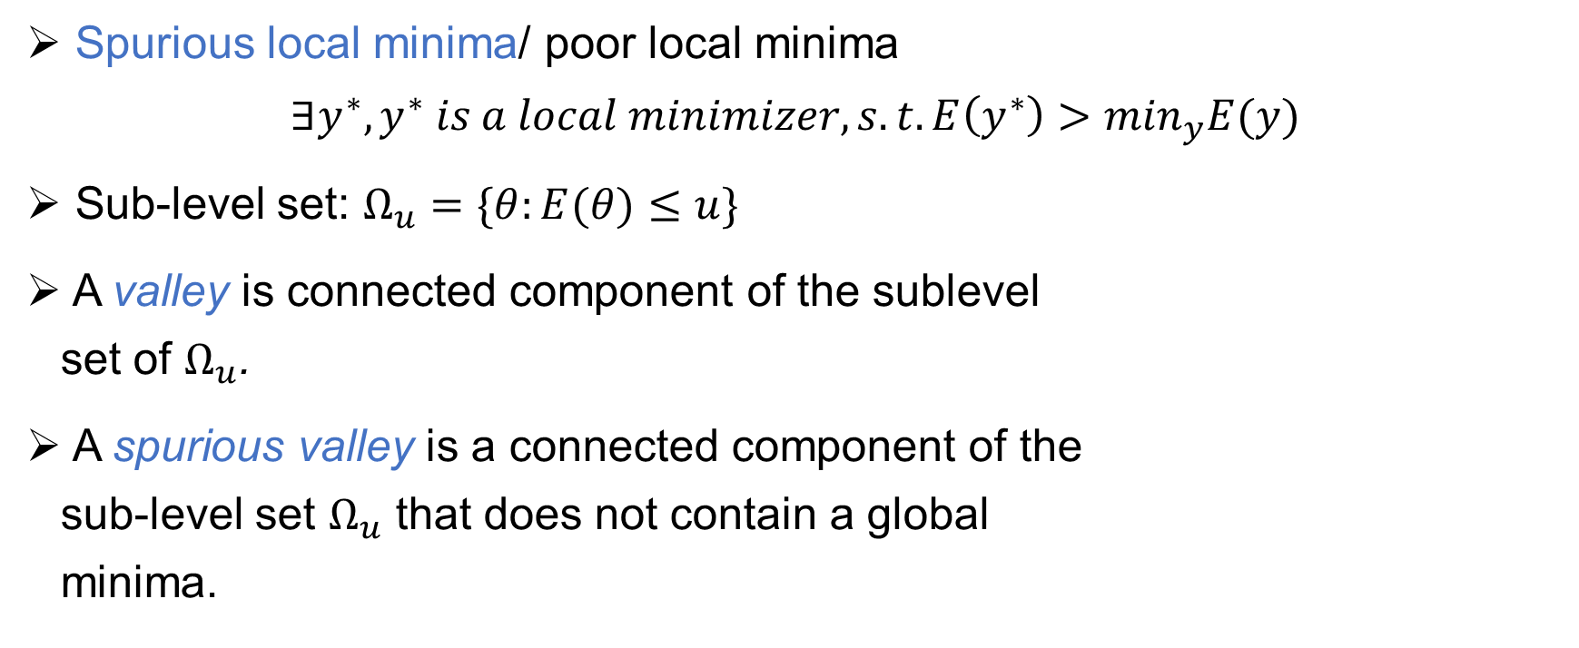
Spurious local minima
Spurious local minima/ poor local minima
$$∃y^{∗}, y^{∗} is a local minimizer, s.t. E\left(y^{∗}\right)>\min_{y}E(y)$$
Sub-level set: $Ω_{u}=\{θ:E(θ)≤u\}$
A valley is connected component of the sublevel set of $Ω_{u}$.
A spurious valley is a connected component of the sub-level set $Ω_{u}$ that does not contain a global minima.
Li, D., Ding, T., & Sun, R. 2018
Ref: https://github.com/joanbruna/MathsDL-spring18

Slide 19
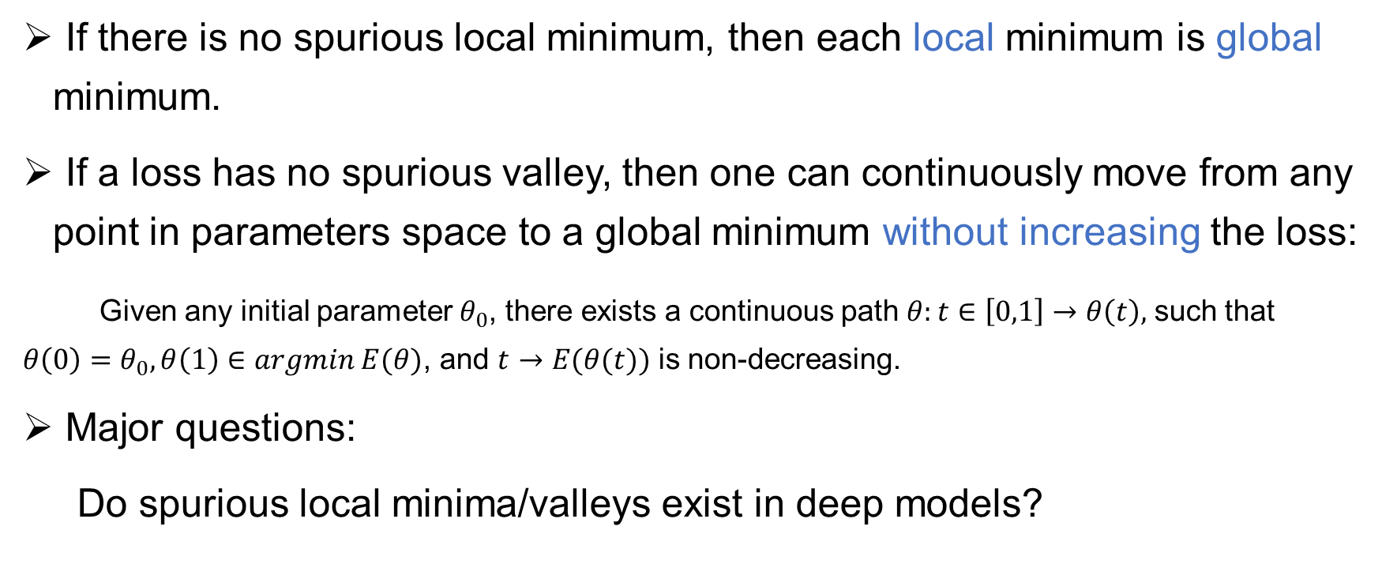
Spurious valleys
If there is no spurious local minimum, then each local minimum is global minimum.
If a loss has no spurious valley, then one can continuously move from any point in parameters space to a global minimum without increasing the loss:
Given any initial parameter $θ_{0}$, there exists a continuous path $θ:t∈\left[0,1\right]→θ\left(t\right),$ such that $θ\left(0\right)=θ_{0}, θ\left(1\right)∈argmin E(θ)$, and $t→E(θ(t))$ is non-decreasing.
Major questions:
Do spurious local minima/valleys exist in deep models?

Slide 20

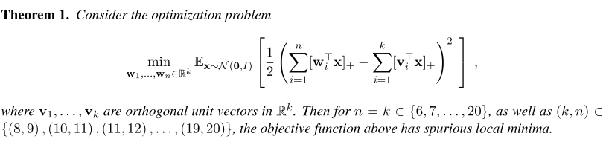

Example: Spurious minima are common
Consider a simple non-trivial ReLU neural network: $f\left(x\right)= \sum_{i=1}^{n}{[w_{i}^{T}x]_{+}}$
And corresponding risk:
Safran, I., & Shamir, O., ICML 2018.

Slide 21
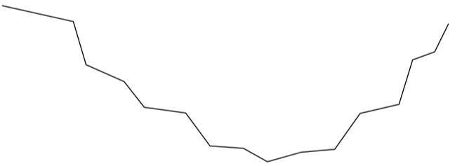

Non-convex $≠$ Not optimizable
We can perturb any convex function in such a way it is no longer convex, but such that gradient descent still converges.
E.g. quasi-convex functions.
NYU course: Mathematics of Deep Learning, Joan Bruna

Slide 22
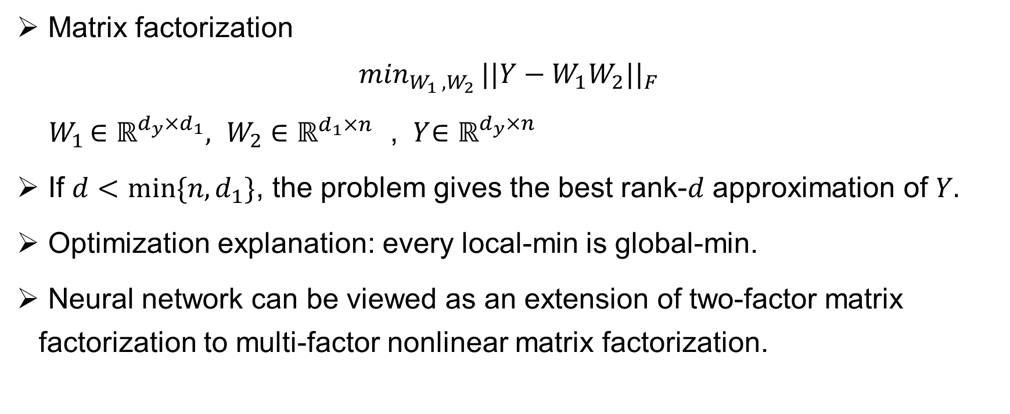
Non-convex $≠$ Not optimizable
Matrix factorization
$$\min_{W_{1 },W_{2} }||Y−W_{1}W_{2}||_{F}$$
${ W}_{1 }∈ℝ^{d_{y}{×d}_{1}},{ W}_{2 }∈ℝ^{d_{1}{×n}_{}}$, ${ Y}_{ }∈ℝ^{d_{y}{×n}_{}}$
If $d<min⁡\{n, d_{1}\}$, the problem gives the best rank-$d$ approximation of $Y.$
Optimization explanation: every local-min is global-min.
Neural network can be viewed as an extension of two-factor matrix factorization to multi-factor nonlinear matrix factorization.
Sun, R. (2019). Optimization for deep learning: theory and algorithms.

Slide 23
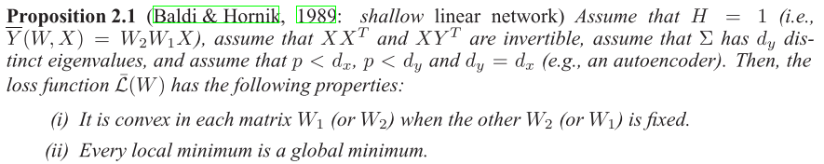

Linear models
Fed forward deep linear models: $\overline{Y}\left(W,X\right)=W_{H+1}W_{H}…W_{1}X$
$X∈ℝ^{d_{x}×m}, Y∈ℝ^{d_{y}×m}$, $W_{i}∈ℝ^{d_{i}×d_{i−1}}$.
Loss function: $L\left(W\right)= \frac{1}{2}||\overline{Y}\left(W,X\right)−Y||_{F}^{2}$
Kawaguchi, K. NIPS. 2016

Slide 24
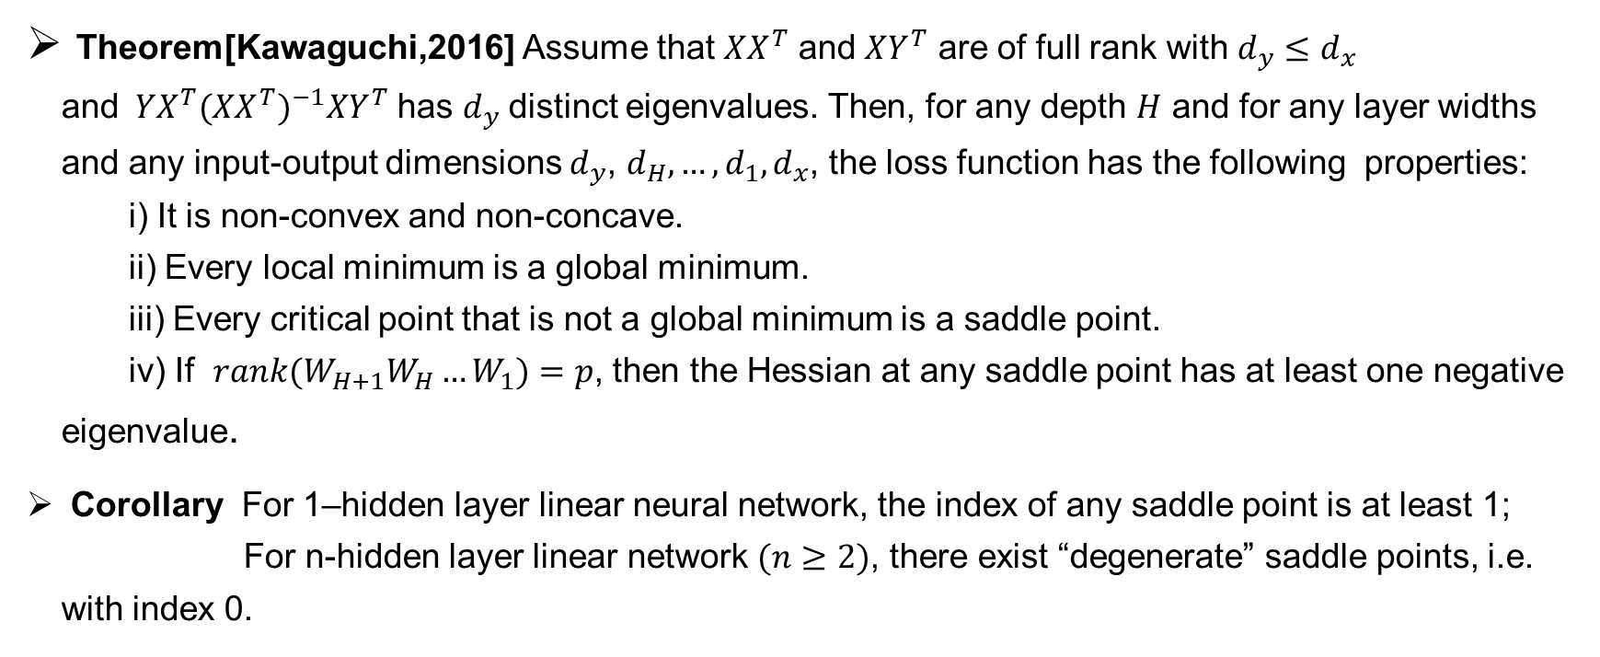
Deep linear models
Theorem[Kawaguchi,2016] Assume that $XX^{T}$ and $XY^{T}$ are of full rank with $d_{y}≤d_{x}$ and${ YX}^{T}({XX^{T})}^{−1}XY^{T}$ has $d_{y}$distinct eigenvalues. Then, for any depth $H$ and for any layer widths and any input-output dimensions $d_{y}$, $d_{H},…,d_{1},d_{x}$, the loss function has the following properties: i) It is non-convex and non-concave. ii) Every local minimum is a global minimum. iii) Every critical point that is not a global minimum is a saddle point. iv) If ${rank(W}_{H+1}W_{H}…W_{1})=p$, then the Hessian at any saddle point has at least one negative eigenvalue.
Corollary For 1–hidden layer linear neural network, the index of any saddle point is at least 1; For n-hidden layer linear network $(n≥2)$, there exist “degenerate” saddle points, i.e. with index 0.
Kawaguchi, K. NIPS. 2016

Slide 25


Deep nonlinear model
Under what kinds of assumptions will spurious local minima vanish?
Influence factors:
# of data
Data
Distribution
…
Activations: ReLU, polynomial,…
Architecture
Type: Fully connected, CNN, ResNet,…
Depth
Width
$L_{2}$ Loss
Loss Type
$L_{1}$ Loss
Cross entropy Loss, …

Slide 26
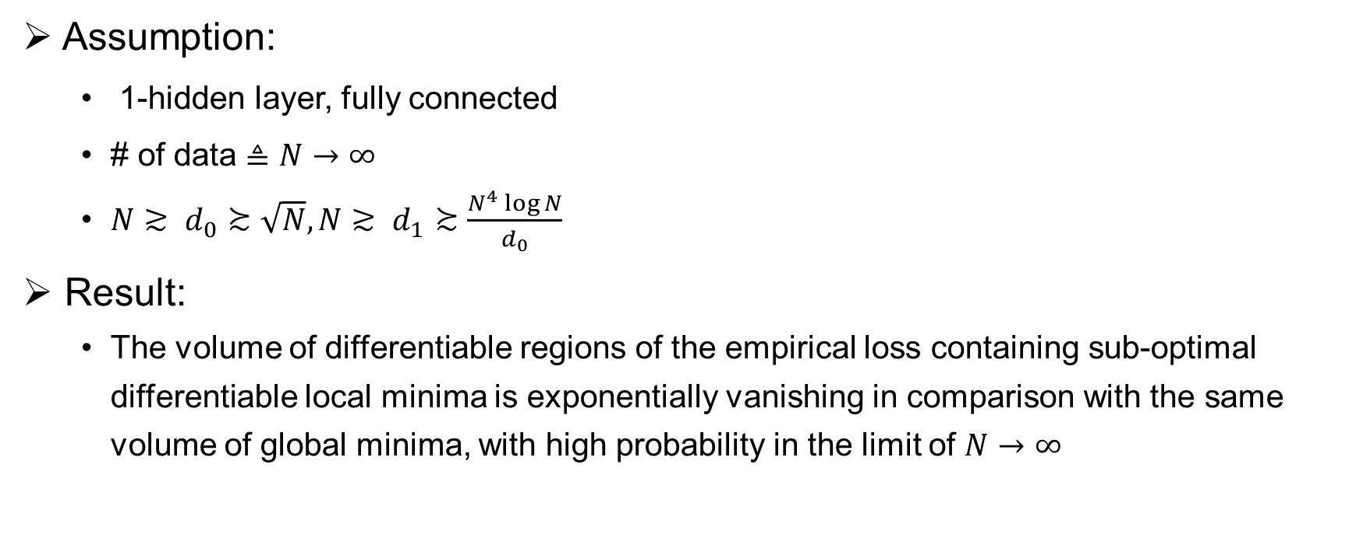
Spurious minima: exponentially vanish
Assumption:
1-hidden layer, fully connected
# of data $≜N→∞$
$N≳ d_{0}≿\sqrt{N}, N≳ d_{1}≿\frac{N^{4}\log{N}}{d_{0}}$
Result:
The volume of differentiable regions of the empirical loss containing sub-optimal differentiable local minima is exponentially vanishing in comparison with the same volume of global minima, with high probability in the limit of $N→∞$
Soudry, D., & Hoffer, E, ICLR. 2018

Slide 27
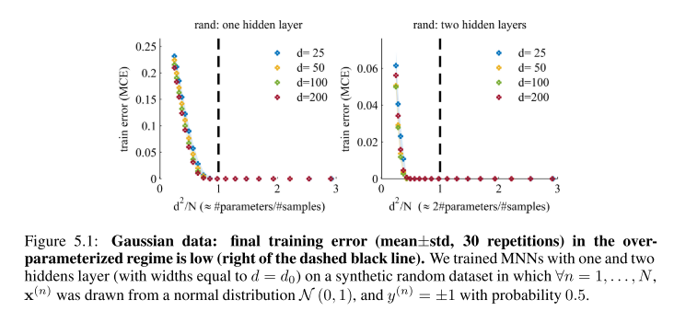
Spurious minima: exponentially vanish
Numerical experiments support:
Soudry, D., & Hoffer, E, ICLR. 2018

Slide 28
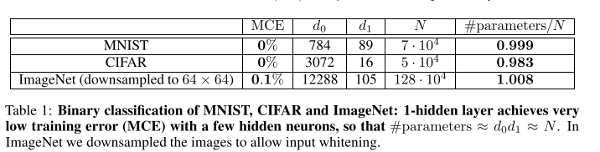
Spurious minima: exponentially vanish
Numerical experiments support:
Soudry, D., & Hoffer, E, ICLR. 2018

Slide 29
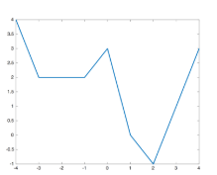
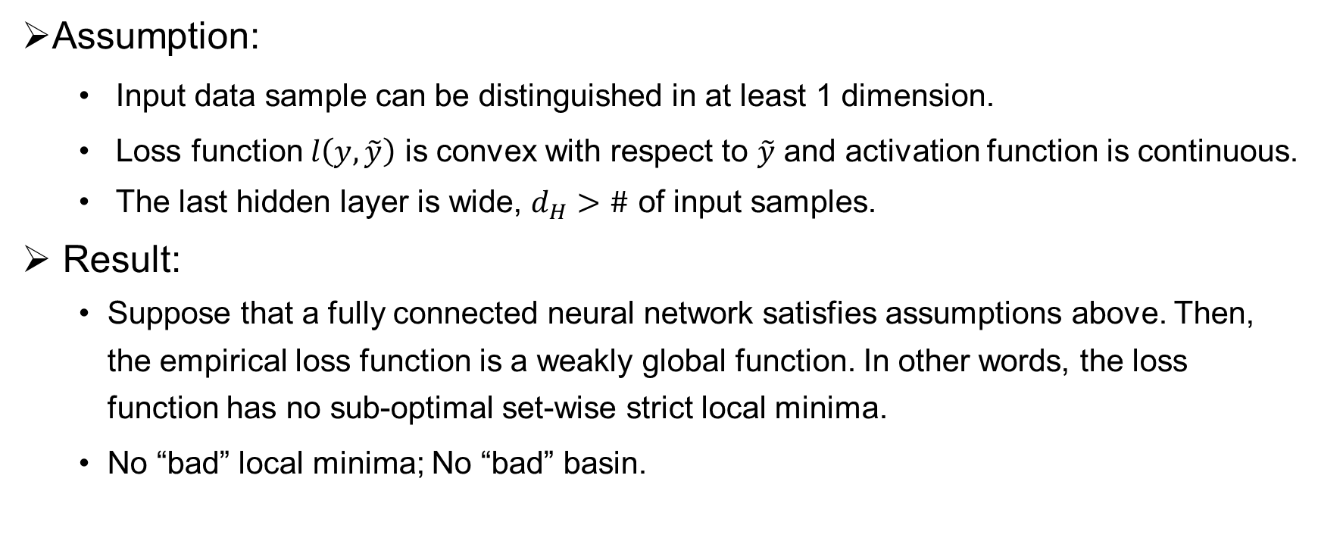
Width help eliminating bad basin
Assumption:
Input data sample can be distinguished in at least 1 dimension.
Loss function $l\left(y,\tilde{y}\right)$ is convex with respect to $\tilde{y}$ and activation function is continuous.
The last hidden layer is wide, $d_{H}>\#$ of input samples.
Result:
Suppose that a fully connected neural network satisfies assumptions above. Then, the empirical loss function is a weakly global function. In other words, the loss function has no sub-optimal set-wise strict local minima.
No “bad” local minima; No “bad” basin.
Li, D., Ding, T., & Sun, R. 2018.

Slide 30
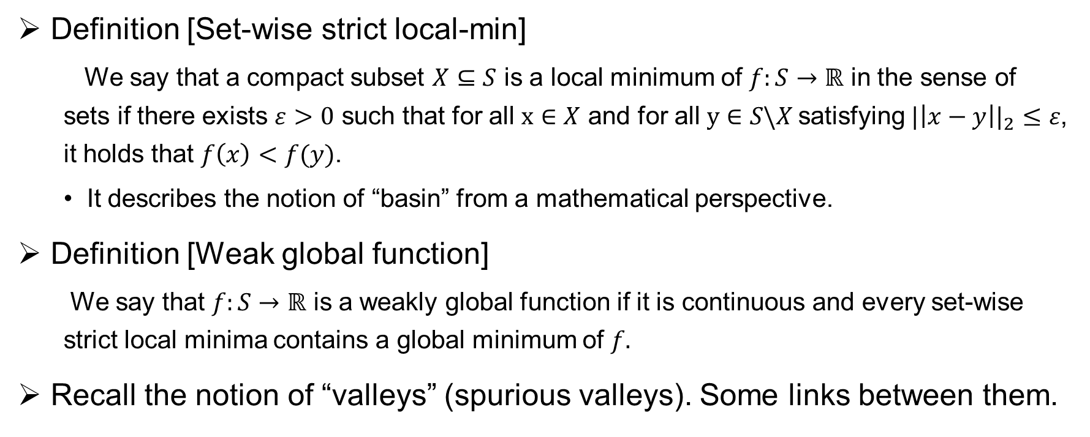
Width help eliminating bad basin
Definition [Set-wise strict local-min]
We say that a compact subset $X⊆S$ is a local minimum of $f:S→ℝ$ in the sense of sets if there exists $ε>0$ such that for all $x∈X$ and for all$y∈S\backslash X$satisfying $|\left|x−y\right||_{2}≤ε$, it holds that $f\left(x\right)<f(y)$.
It describes the notion of “basin” from a mathematical perspective.
Definition [Weak global function]
We say that $f:S→ℝ$ is a weakly global function if it is continuous and every set-wise strict local minima contains a global minimum of $f.$
Recall the notion of “valleys” (spurious valleys). Some links between them.

Slide 31
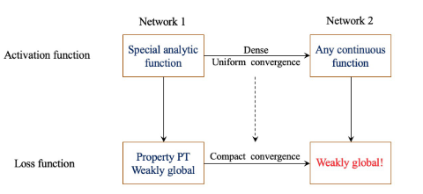
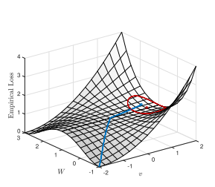

Proof sketch
Property PT: if starting from any point$θ$, there exists an arbitrary small perturbation such that from the perturbed point $\check{θ}$, there exists a strictly decreasing path to a global minimum.
PT $⇏$ No bad minimum
Outline:
Li, D., Ding, T., & Sun, R. 2018.

Slide 32
Reference(empirical exploration) :
Sagun, L. , Bottou, L. , & Lecun, Y. . (2016). Eigenvalues of the hessian in deep learning: singularity and beyond.
Sagun, L., Evci, U., Güney, V. U., Dauphin, Y., & Bottou, L. (2018). Empirical analysis of the hessian of over-parametrized neural networks.
Keskar, N. S., Nocedal, J., Tang, P. T. P., Mudigere, D., & Smelyanskiy, M. (2017). On large-batch training for deep learning: Generalization gap and sharp minima.
Dinh, L., Pascanu, R., Bengio, S., & Bengio, Y. (2017). Sharp minima can generalize for deep nets. 34th International Conference on Machine Learning
Yao, Z., Gholami, A., Keutzer, K., & Mahoney, M. (2019). PyHessian: Neural Networks Through the Lens of the Hessian. 10. http://arxiv.org/abs/1912.07145

Slide 33
Reference(theoretical analysis) :
Li, D., Ding, T., & Sun, R. (2018). Over-Parameterized Deep Neural Networks Have No Strict Local Minima For Any Continuous Activations. 1–43. http://arxiv.org/abs/1812.11039
Soudry, D., & Hoffer, E. (2018). Exponentially vanishing sub-optimal local minima in multilayer neural networks. 6th International Conference on Learning Representations, ICLR 2018 - Workshop Track Proceedings.
Safran, I., & Shamir, O. (2018). Spurious local minima are common in two-layer ReLU neural networks. 35th International Conference on Machine Learning, ICML 2018, 10(1), 7031–7052.
Kawaguchi, K. (2016). Deep learning without poor local minima. Advances in Neural Information Processing Systems, Nips, 586–594.
Sun, R. (2019). Optimization for deep learning: theory and algorithms. 1–60. http://arxiv.org/abs/1912.08957

