Slide 1
Generative models ——Sequential data
Peking University
School of mathematical science
2020.03.25

Slide 2
AttnGAN: Fine-Grained Text to Image Generation with Attentional Generative Adversarial Networks
Object：
Text to Image
Model：
attentional generative network
deep attentional multimodal similarity model
Contribution:
Attentional generative network and the DAMSM.
Significantly outperforms previous state-of-the-art GAN models
For the first time, it is demonstrated that the layered conditional GAN is able to automatically attend to relevant words to form the condition for image generation.

Slide 3
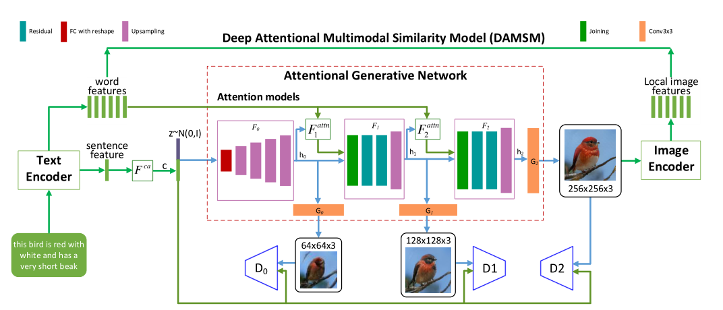
Framework

Slide 4

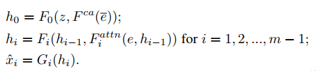



Attentional Generative Network
Purpose: draw different sub-regions of the image conditioned on words that are most relevant to those sub-regions
Architecture：m generators
input : m hidden states, attention
output: image of small-to-large scales
Attention:
Then:
Notes:
$\overline{e}$ :global sentence vector
e :word feature
z :noise vector with standard normal distribution
h :image feature
e’: e’ = Ue common semantic space
βj;i: indicates the weight the model attends to the ith word when generating the jth sub-region of the image

Slide 5

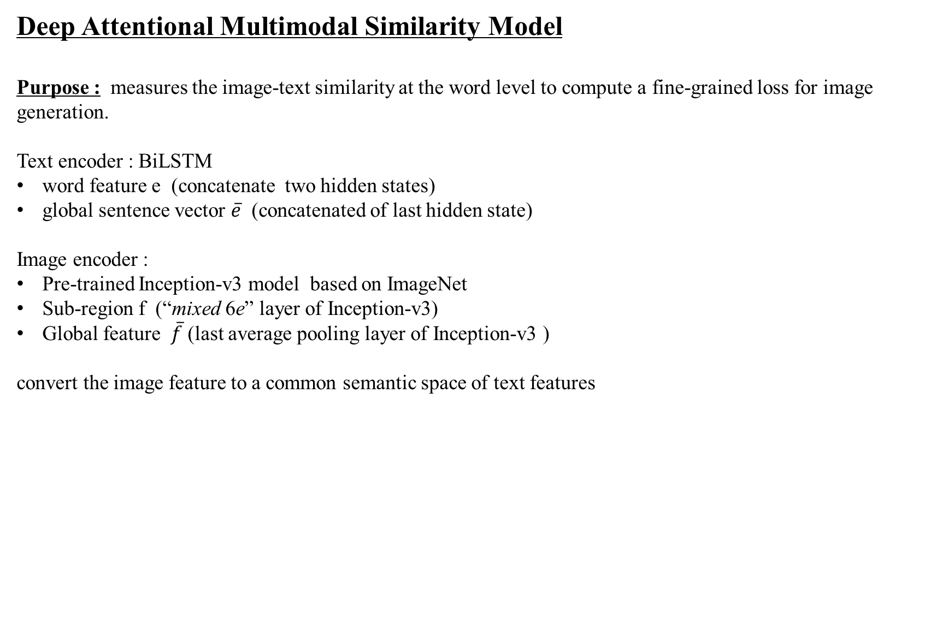
Deep Attentional Multimodal Similarity Model
Purpose : measures the image-text similarity at the word level to compute a fine-grained loss for image generation.
Text encoder : BiLSTM
word feature e (concatenate two hidden states)
global sentence vector $\overline{e}$ (concatenated of last hidden state)
Image encoder :
Pre-trained Inception-v3 model based on ImageNet
Sub-region f (“mixed 6e” layer of Inception-v3)
Global feature $\overline{f}$ (last average pooling layer of Inception-v3 )
convert the image feature to a common semantic space of text features

Slide 6





The attention-driven image-text matching score
the similarity matrix for all possible pairs of words in the sentence and sub-regions in the image
normalize the similarity matrix as follows
the relevance between the ith word and the image
region-context vector

Slide 7






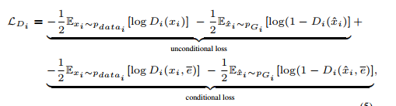

Objective Function
The DASAM Loss
The Gan Loss

Slide 8
2. MirrorGAN: Learning Text-to-image Generation by Redescription
Object:
Text to image
Model:
semantic text embedding module (STEM)
global-local collaborative attentive module for cascaded image generation (GLAM)
semantic text regeneration and alignment module (STREAM)
Contribution:
MirrorGAN: modeling T2I and I2T together; embodying the idea of learning T2I generation by redescription
global-local collaborative attention model; preserve cross-domain semantic consistency; smoothen the generative process ;
propose a CE-based text-semantics reconstruction loss; supervise the generator to generate visually realistic and semantically consistent images;
achieve new state-of-the-art performance on two benchmark datasets

Slide 9
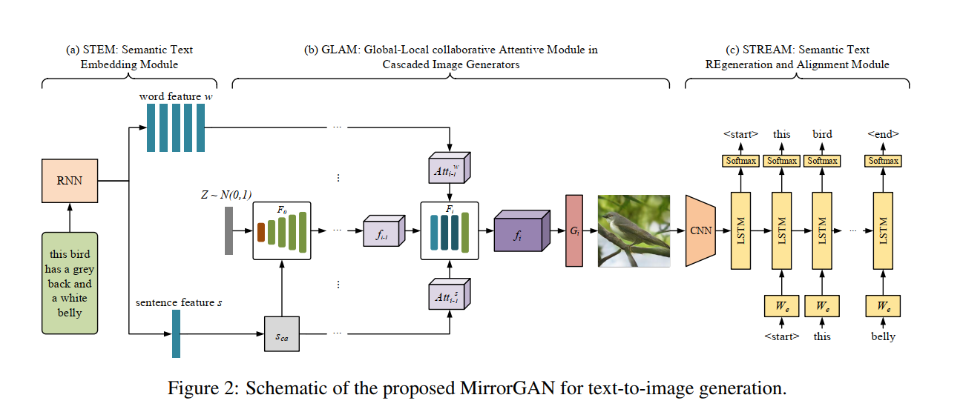
Framework

Slide 10


STEM: Semantic Text Embedding Module
conditioning augmentation method(StackGAN)
This produces more image-text pairs and thus encourages robustness to small perturbations along the conditioning text manifold

Slide 11


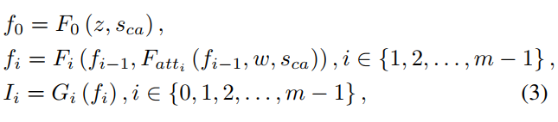
GLAM: Global-Local collaborative Attentive Module in Cascaded Image Generators
m visual feature transformers m image generators

Slide 12
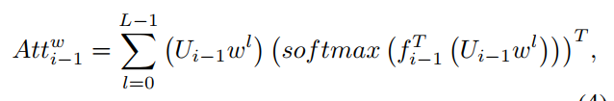

$$F_{{att}_{i}}\left(f_{i−1},w, s_{ca}\right)=concat({Att}_{i−1}^{w},{Att}_{i−1}^{s})$$

Slide 13
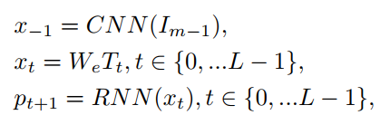
STREAM: Semantic Text REgeneration and Alignment Module
Encoder decoder-based image caption framework
Encoder: CNN ; pretrained on ImageNet
Decoder: RNN
W_e: maps word features to the visual feature space p_{ t+1} : predicted probability distribution over the words

Slide 14
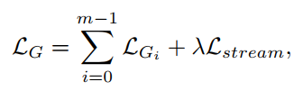

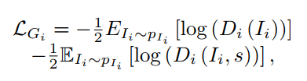
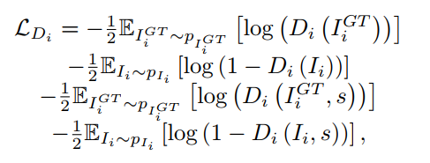
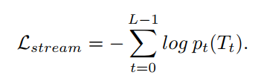
Objective Function
Final objective function for generator:
Final object function for discriminator:

Slide 15
3.SeqGAN: Sequence Generative Adversarial Nets with Policy Gradient
Object:
generating sequences of discrete tokens
Model:
Reinforcement learning
Policy gradient
Monte Carlo (MC) search
Contribution:
Address two problems for discrete data :
gradient update between D and G;
GAN can only give the score/loss for an entire sequence when it has been generated;

Slide 16
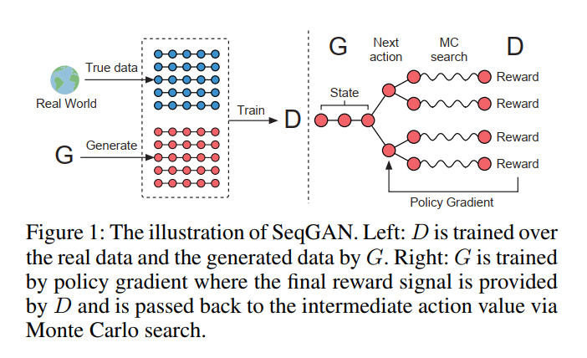
Framework

Slide 17






SeqGAN via Policy Gradient
RL-based Generator model
Current state s :
Action : $y_{t}$
Policy model:
reward:
Policy gradient
objective function:
action-value : reward value for a finished sequence
$$Y_{1:t−1}=(y_{1},…y_{t−1})$$
$$D_{φ}(Y_{1:T})$$

Slide 18
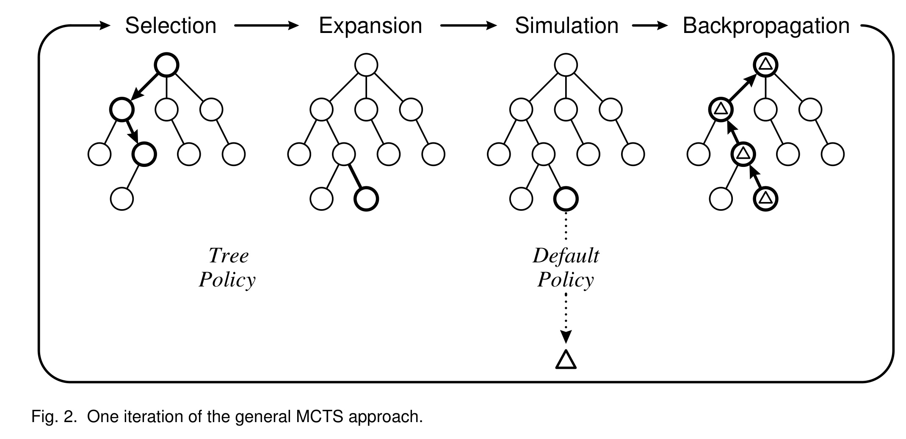
Monte Carlo search
选择（Selection）、扩展（Expansion）、模拟（Simulate）和反向传播（Backpropagation）

Slide 19

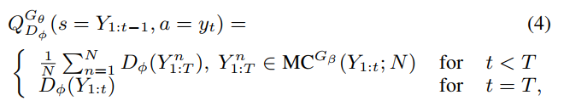
Monte Carlo search

Slide 20


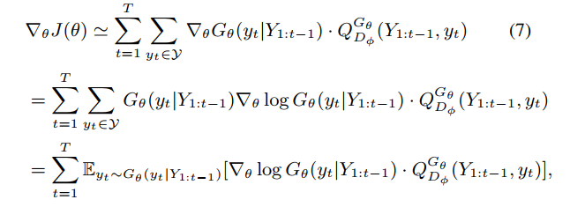

Re-train the discriminator model as follows:
Update generator : use policy based method

Slide 21
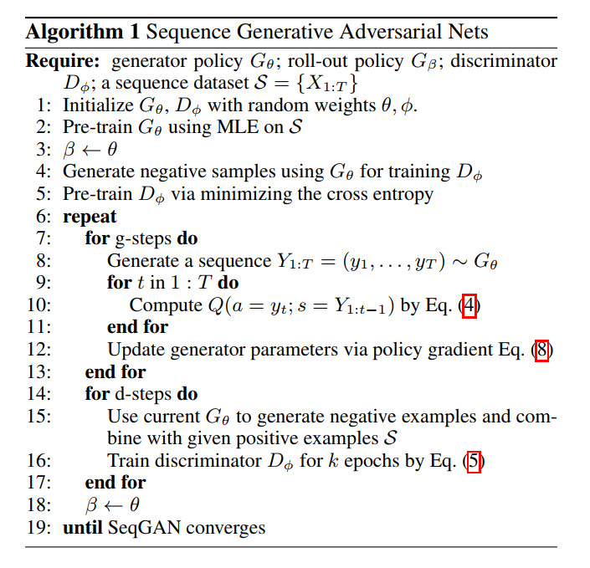

Slide 22





The Generative Model for Sequences
RNN with LSTM (can also use GRU soft attention mechanism )
The Discriminative Model for Sequences
CNN
max-over-time pooling

Slide 23
4. MASKGAN: BETTER TEXT GENERATION VIA FILLING IN THE ____
Objective:
Text generation
Model:
Seq2Seq(RNN)
RL-based generator
maximum likelihood and SGD: discriminator
Contribution:
introduce a text generation model trained on in-filling (MaskGAN)
Consider the actor-critic architecture in extremely large action spaces.
Consider new evaluation metrics and the generation of synthetic training data.

Slide 24
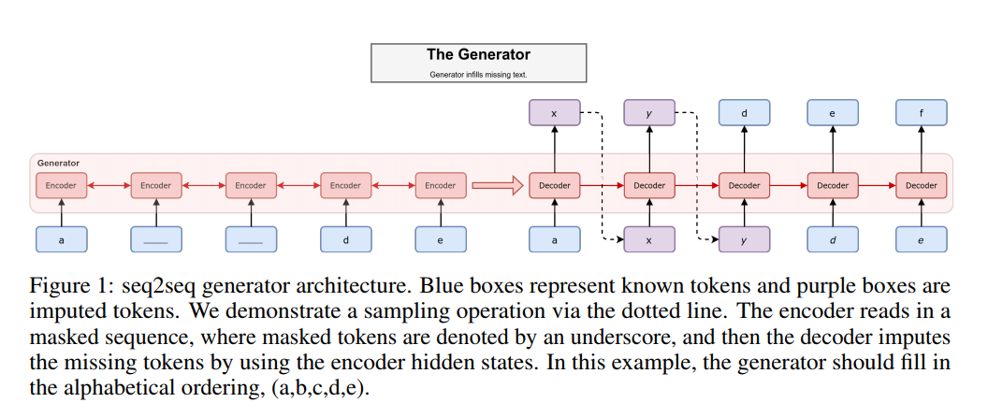
Framework

Slide 25



Discrete sequence:
Masked sequence: with m_i in {0,1}
Generator decomposes the distribution over the sequence into an ordered conditional sequence

Slide 26

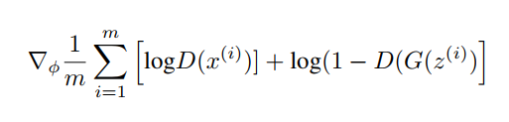
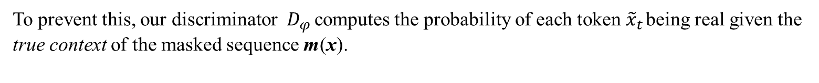
A critical failure mode:
the director director guided the series
the *associate* director guided the series the director *expertly* guided the series
Without the context of which words are real, the discriminator was found to assign equal probability to both words
To prevent this, our discriminator $D_{φ }$computes the probability of each token ${\tilde{x}}_{t}$ being real given the true context of the masked sequence m(x).
Objective function for discriminator:

Slide 27




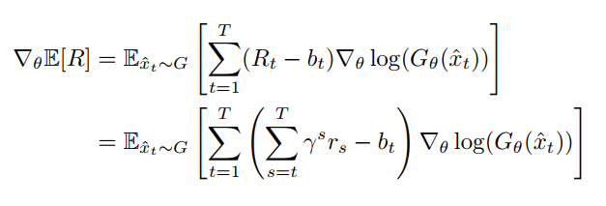
Reward funticon:
Objective function for generator:
Actor-critic architecture :
G determines the policy $π(s_{t})$ and the baseline $b_{t}$ is the critic
Notes:
The variance of this gradient estimator may be reduced by using the learned value function as a baseline R_t b_t MC sampling

Slide 28
5. Adversarial Training for Community Question Answer Selection Based on Multi-scale Matching
Object:
Community Question Answer
Model:
Generative Adversarial Nets for answer selection (RL-based)
Multi-scale Matching Model
Contribution:
Employs a generative model to produce challenging negative samples; significantly improve performance on CQA task ;
Extend the current matching-aggregating framework for CQA selection task by also considering matchings from multiple levels of granularity ;
The proposed model ranks first on SemEval 2017 dataset and ranks second on SemEval 2016 dataset

Slide 29
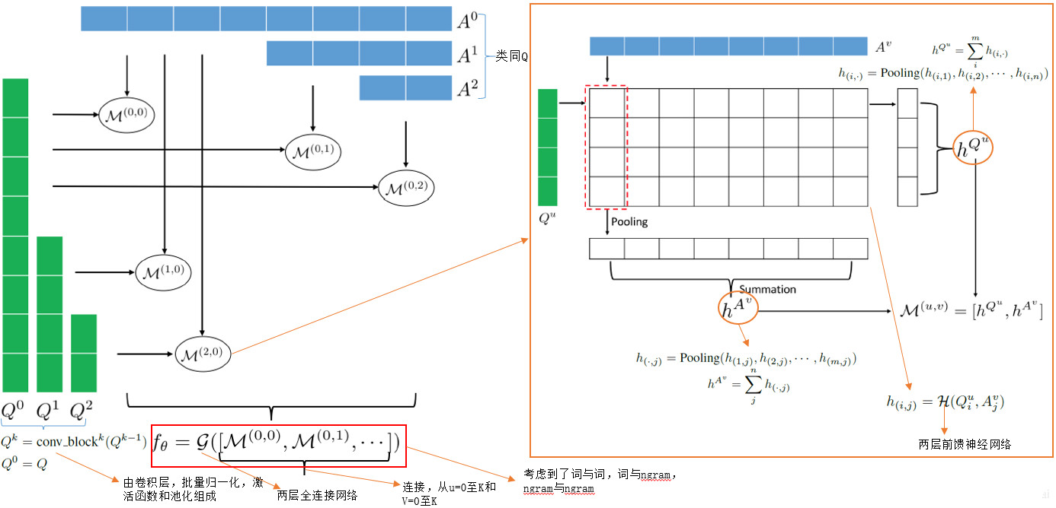
Framework

Slide 30
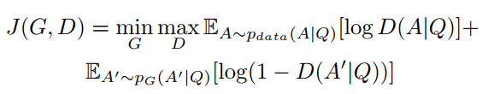
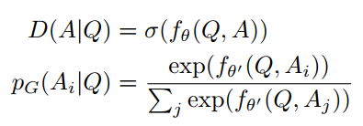
Adversarial Training for Answer Selection
Objective function:
Discriminator and generator:
with σ being a sigmoid function.

Slide 31

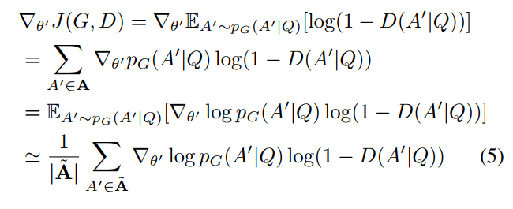
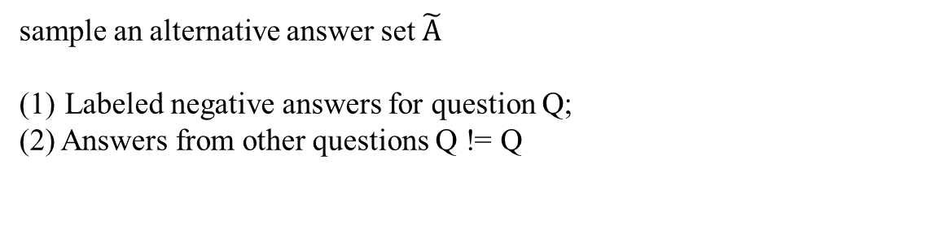
Score function : estimates the relevance between Q and A
sample an alternative answer set $\tilde{A}$
Labeled negative answers for question Q;
(2) Answers from other questions Q != Q
Policy gradient:

Slide 32




Multi-scale Matching Model
Word and Ngram Embeddings
Use pretrained word embeddings from GloVe
CNN(a convolution layer, BN, rectified linear unit, max-pooling layer)

Slide 33




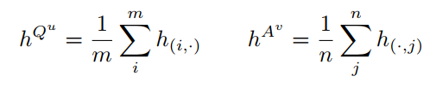
Multi-scale Matching and Aggregating
Matching function:
Non-linear function(two-layer feed-forward neural network)
Element max pooling:

Slide 34



Defined matching function as
Based on matching function, score function can be defined as
With G a real-value function implemented by a two-layer feed-forward neural network
A simpler way

Slide 35
Thanks for listening ☺

