Slide 1
Deep Learning: convergence
闵泽平
数学科学学院
1901110041

Slide 2
Outline
Introduction: Convergence analysis; 1 hiden layer Neural Networks ;
distribution of Input Gaussian distribution; Non-gaussian distribution
spurious local minimizer

Slide 3
Part I: convergence analysis
Sec 1 :Convergence Analysis with Gaussian input & ReLU activation
Assume
Gaussian input
1 hiden layer structure
skip-one-layer identity mapping
ReLU activations

Slide 4
Show that SGD converges to optimal in “two phases”: In phase I, the gradient points to the wrong direction, however, a potential function g gradually decreases. Then in phase II, SGD enters a nice one point convex region and converges. We also show that the identity mapping is necessary for convergence, as it moves the initial point to a better place for optimization.

Slide 5

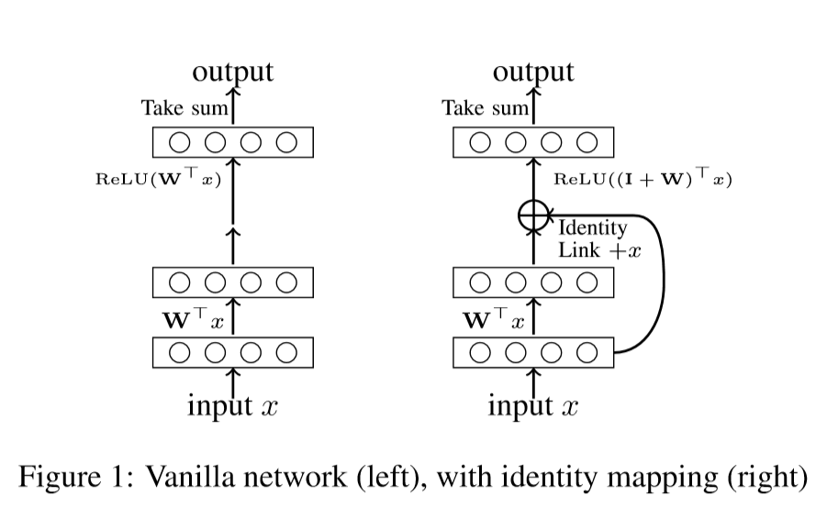
skip-one-layer identity mapping
the skip-one-layer identity mapping already brings signiﬁcant improvement to vanilla networks.
Written as

Slide 6


Preliminaries
Loss function
And write as
We get
Updating rule

Slide 7
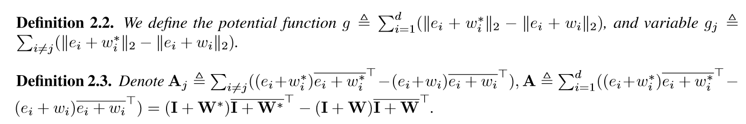
Potential function
One point strongly convexity

Slide 8
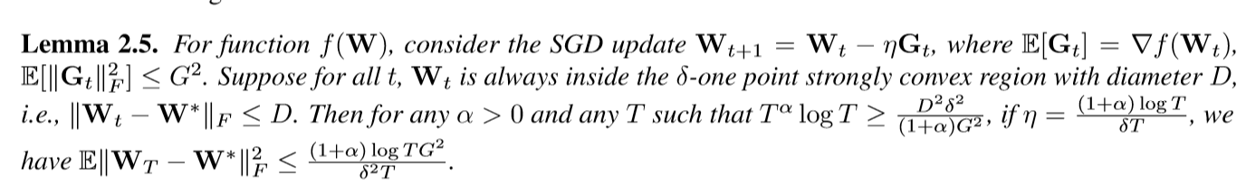
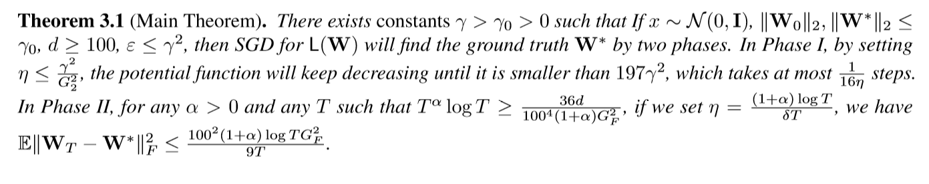
Main Theory
Lemma for main theory
Main Theorem

Slide 9
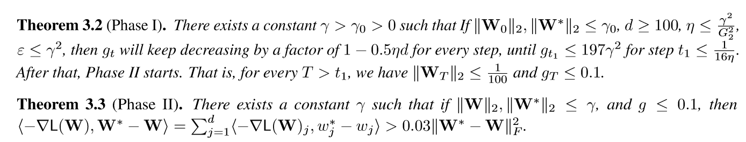
We split the main theory to following two theorems

Slide 10
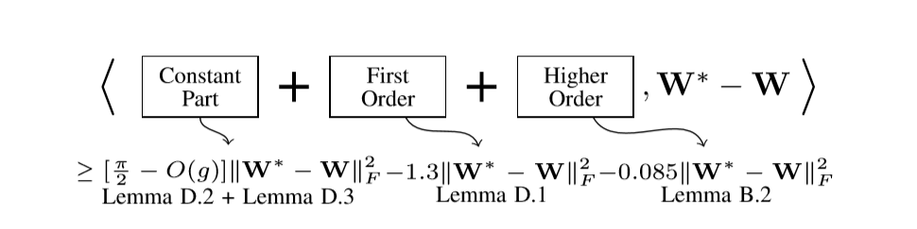
Frame work

Slide 11
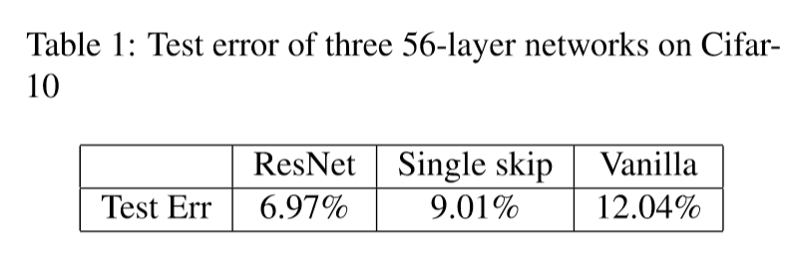
Experiment
Identity matters

Slide 12
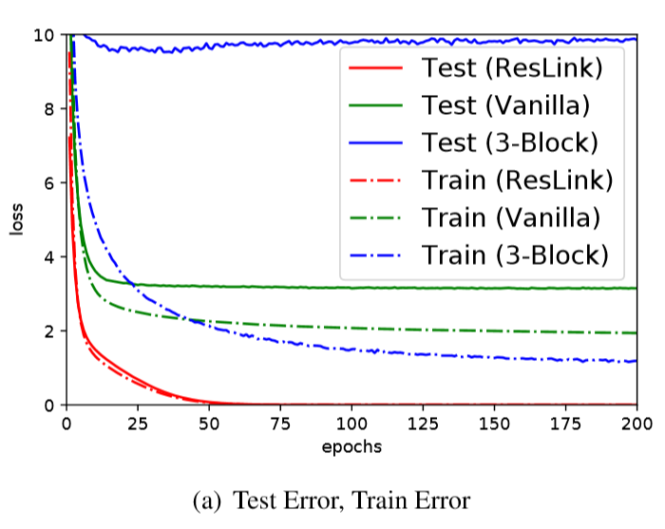
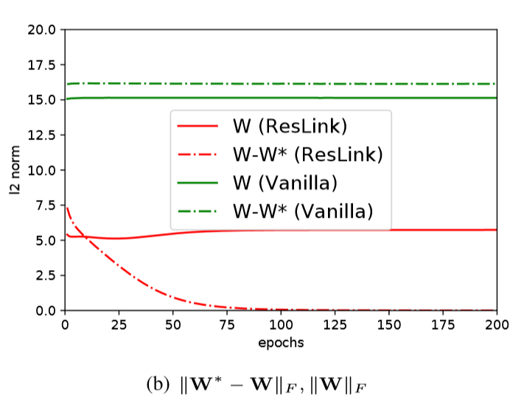
Global minimum convergence

Slide 13
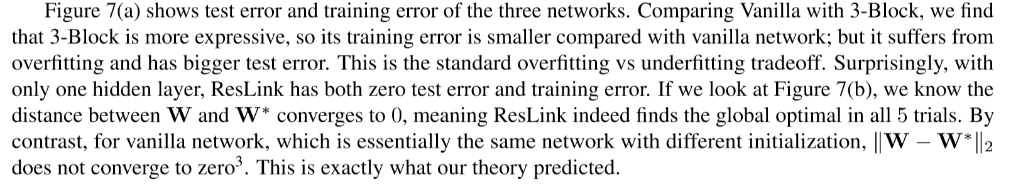
Global minimum convergence

Slide 14
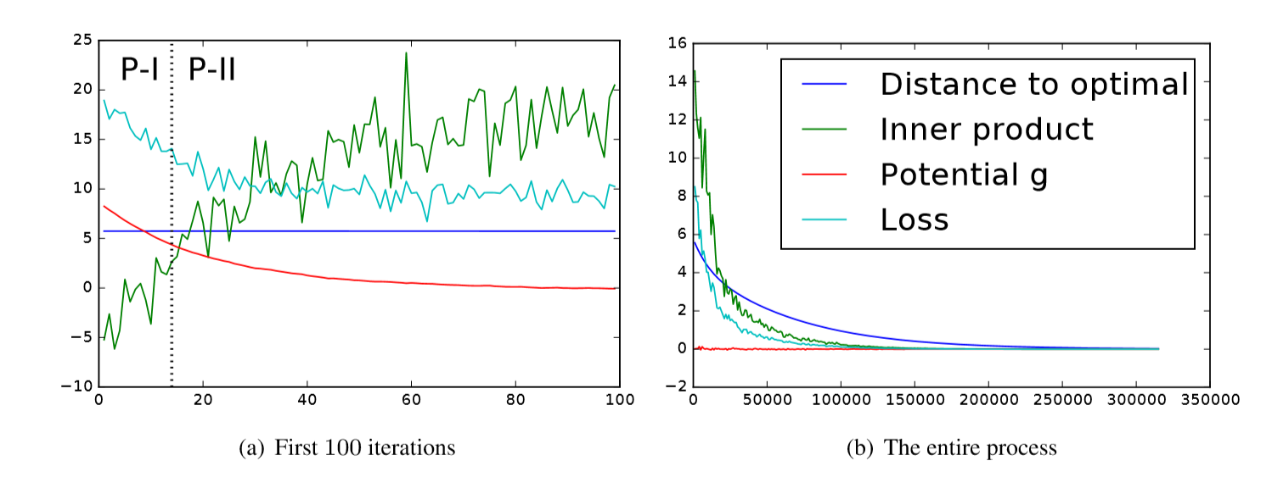
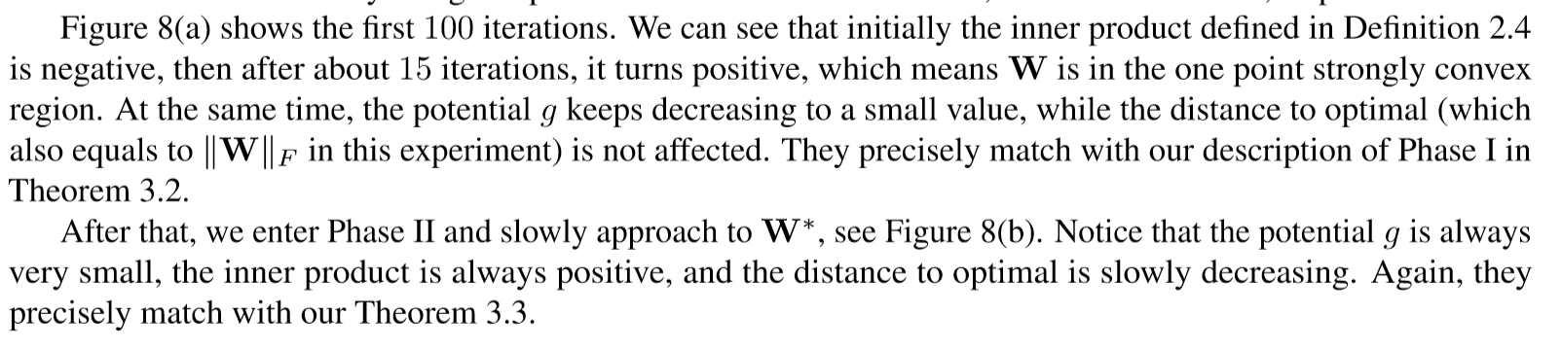
Verify the dynamics

Slide 15
Part I: convergence analysis
Sec 2 : convergence analysis with Gaussian input & homogeneous activation
Homogeneous activation and convergence
Tensor methods
1 hidden layer structure
Sample complexity and computational complexity
Linear in the input dimension and logarithmic in the precision.

Slide 16
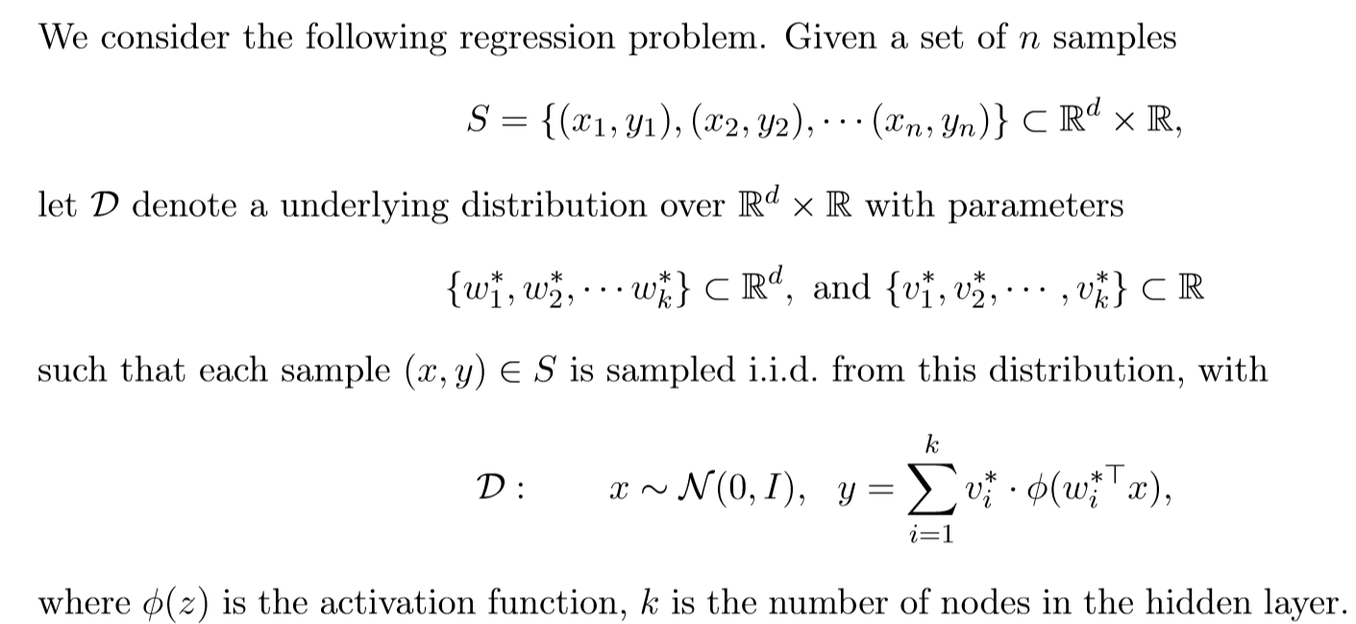
Problem Formulation

Slide 17
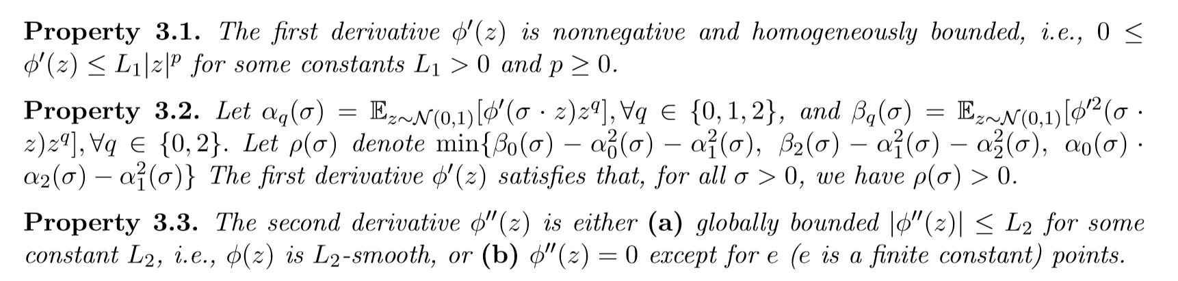
Activation function properties

Slide 18
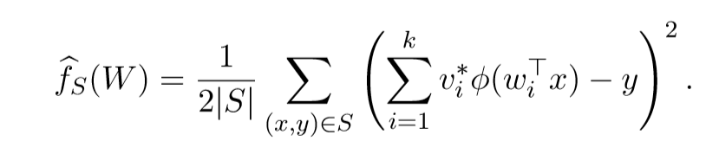
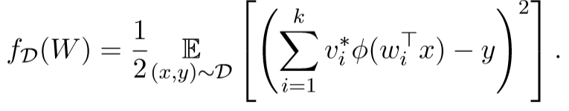
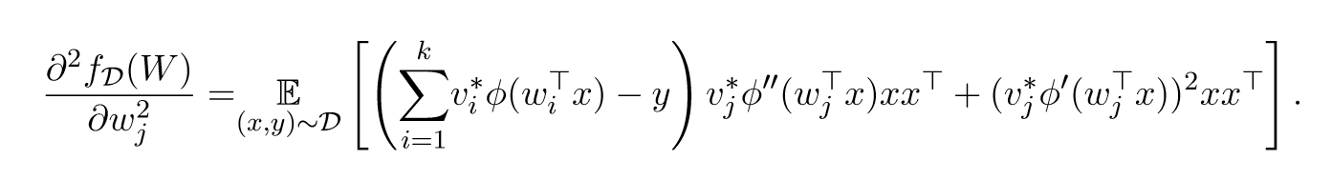
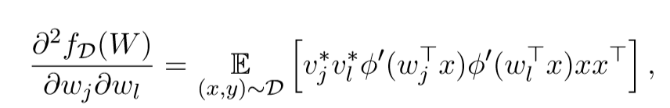

Positive deﬁniteness of the Hessian
Empirical Risk
Expected Risk
Then
$j ≠l,$

Slide 19
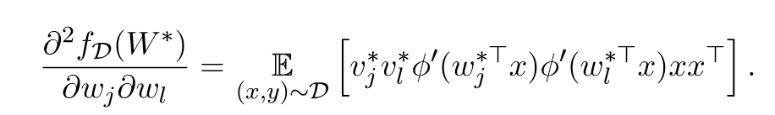
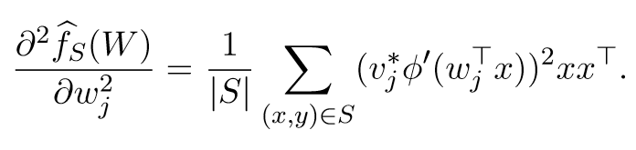

$W=W^{∗}$
If property 3.3(b) hold

Slide 20
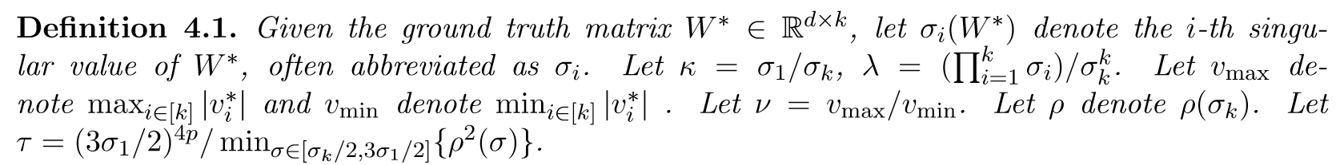
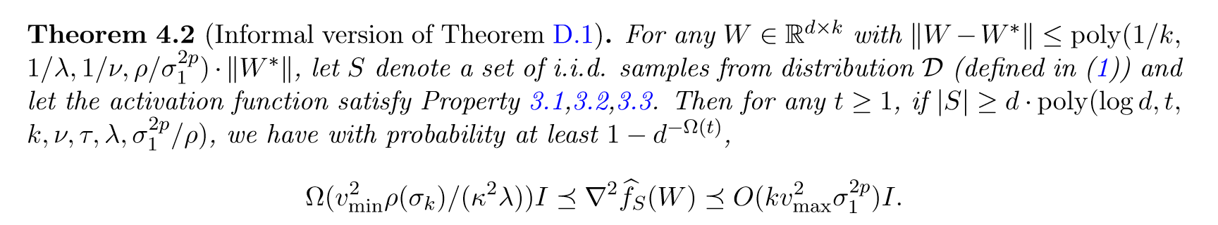
Show positive definite

Slide 21
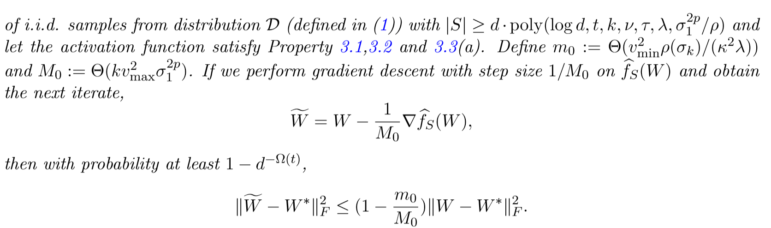
Linear convergence of gradient descent

Slide 22
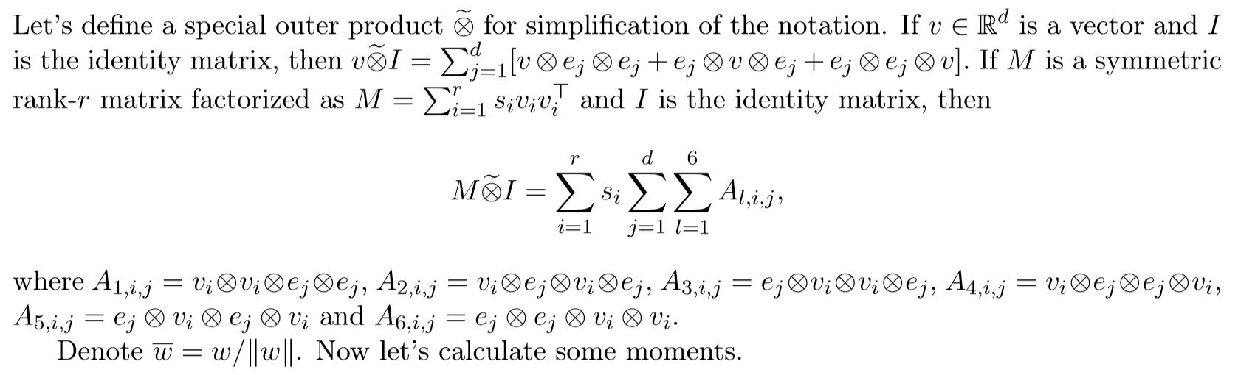
Tensor method
Preliminary

Slide 23
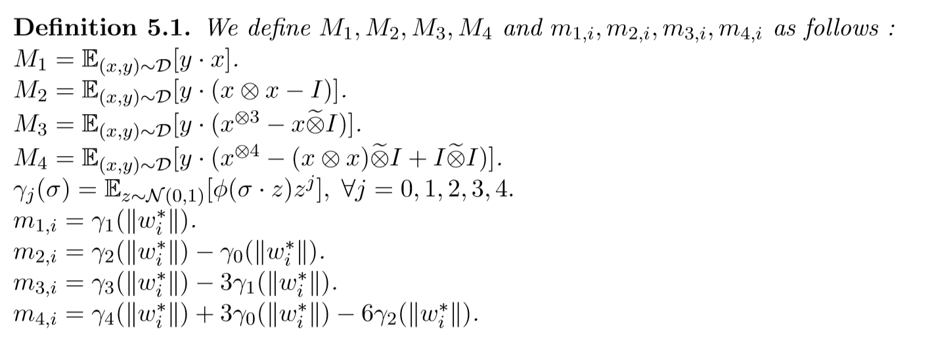
Claim

Slide 24
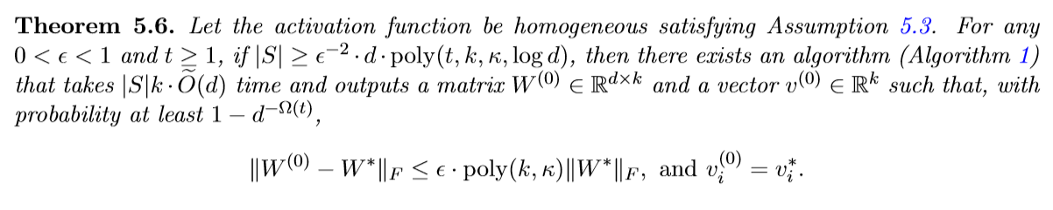
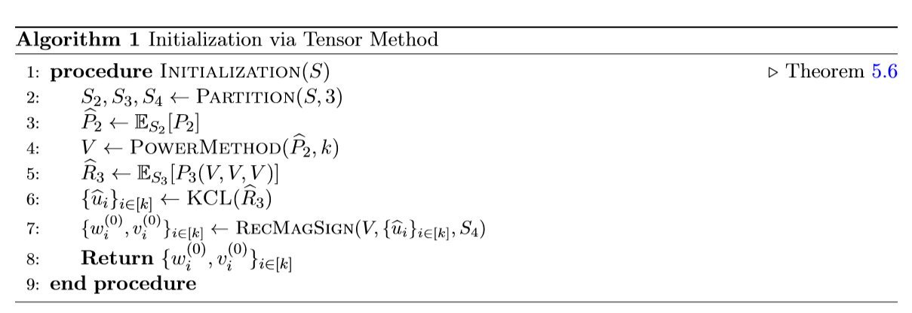
Theory
Algorithm

Slide 25
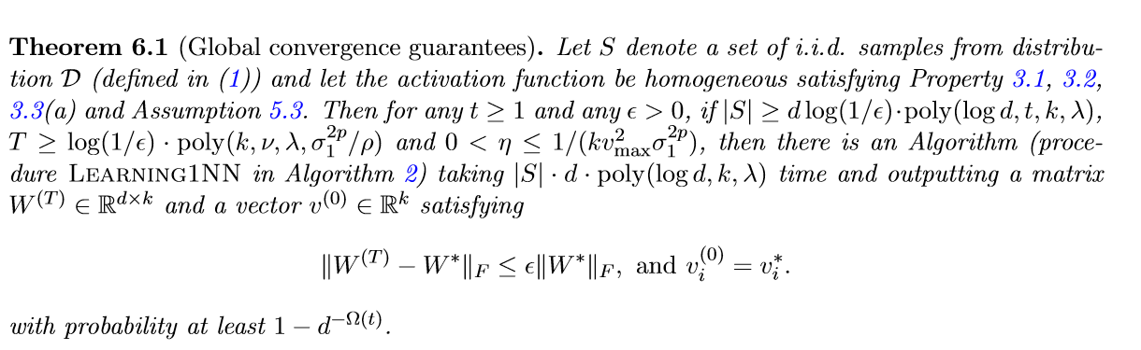
Global Convergence
Theory

Slide 26
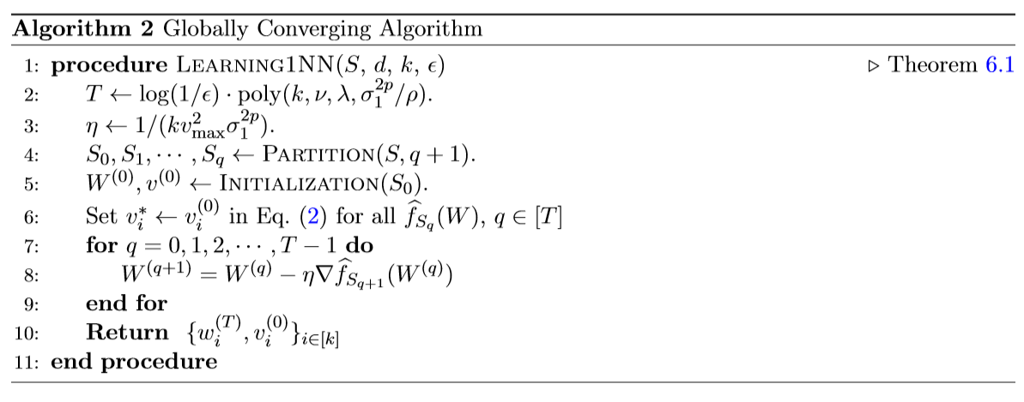
Algorithm

Slide 27
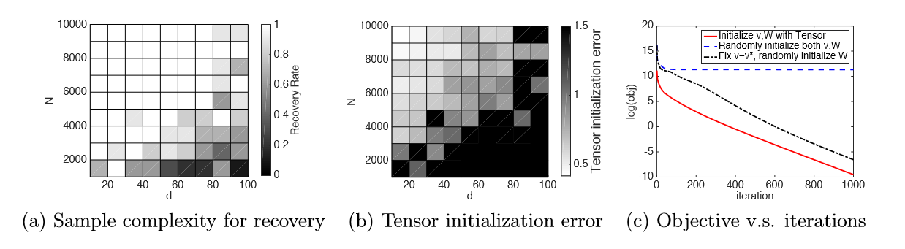
Experiment
number of samples required to recover the parameters for diﬀerent dimensions
test the tensor initialization
compare diﬀerent initialization methods for gradient descent

Slide 28
Part I: convergence analysis
Sec 3 : convergence analysis with non-Gaussion & ReLU activation
Assume
Non-gaussion distribution convergence analysis
Rely on ReLU activation function
Conclusion
learn the convolutional ﬁlter in polynomial time
convergence rate depends on the smoothness of the input distribution and the closeness of patches

Slide 29
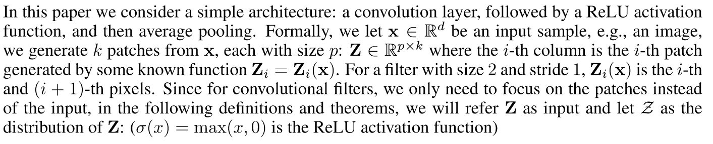
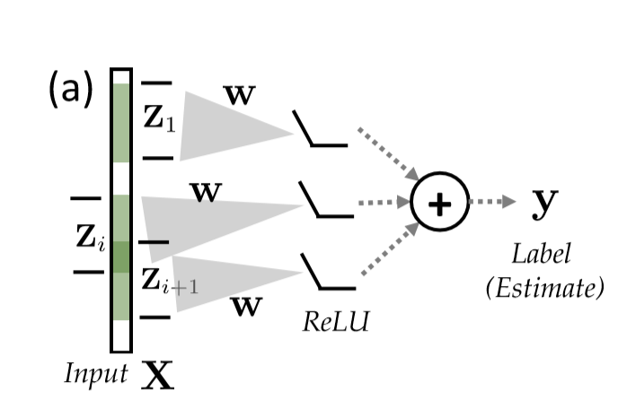
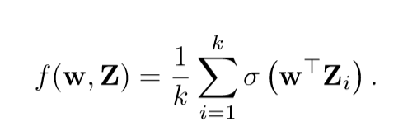
Architecture
Write as

Slide 30

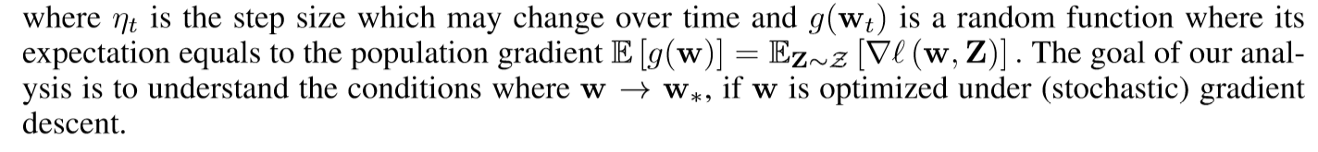
Loss function
SGD

Slide 31
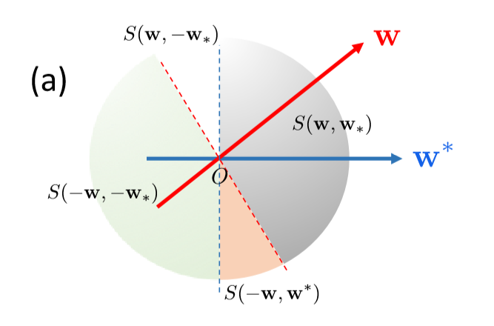
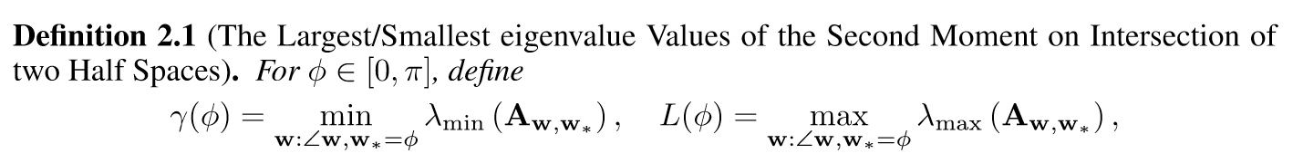
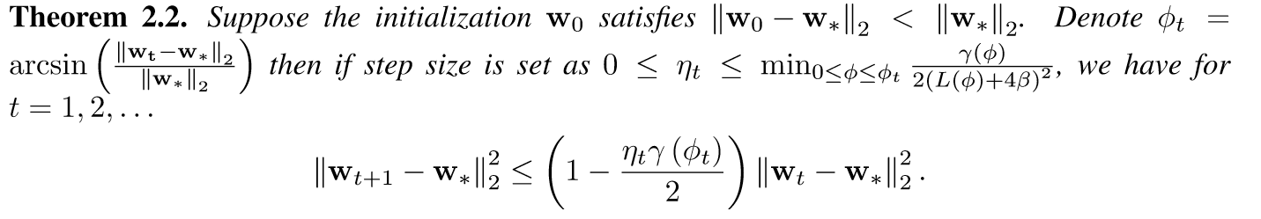
one-layer one-neuron model

Slide 32
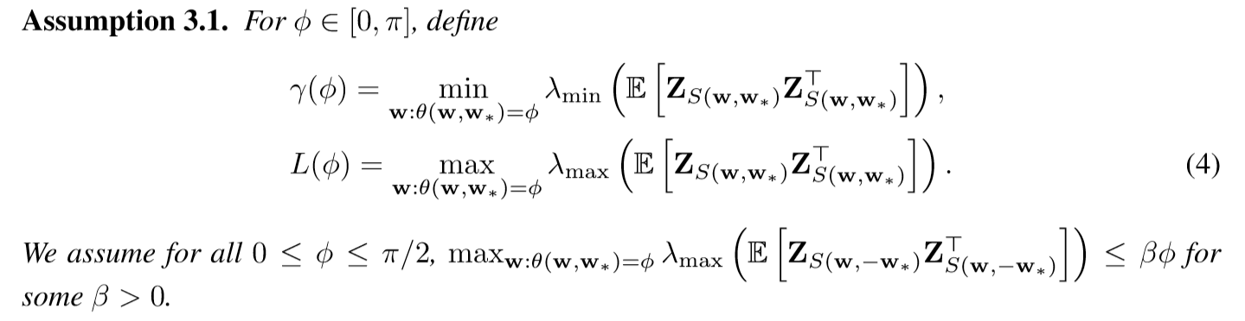
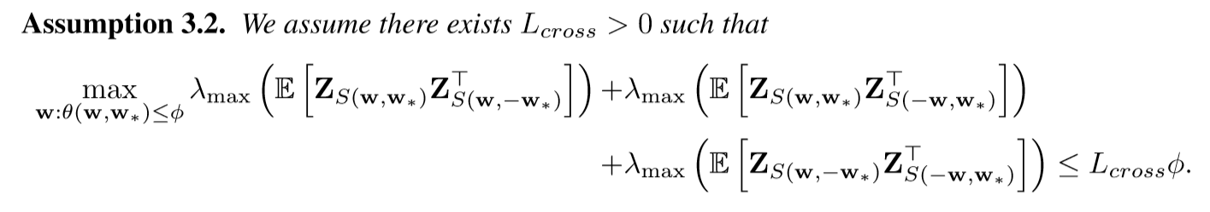
Convolutional filter

Slide 33
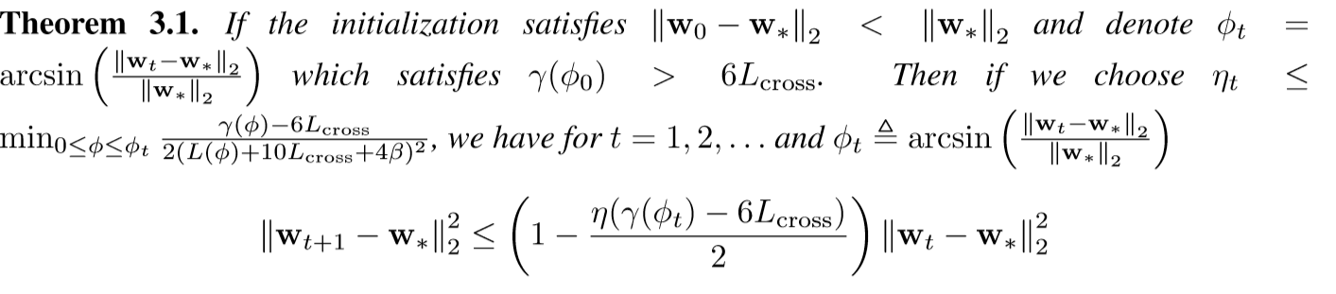
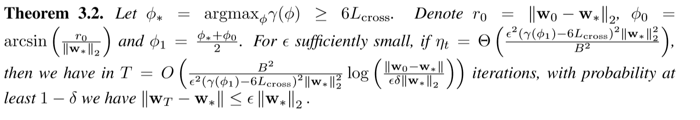
The main difference between the simple one-layer one-neuron network and the convolution ﬁlter is two patches may appear in different regions

Slide 34
Part II: spurious local minimizer
Assume
Gaussian input
ReLU activation
Conclusion
Gradient descent can recover the true parameters with constant probability
Converge to the spurious local minimum with constant probability

Slide 35
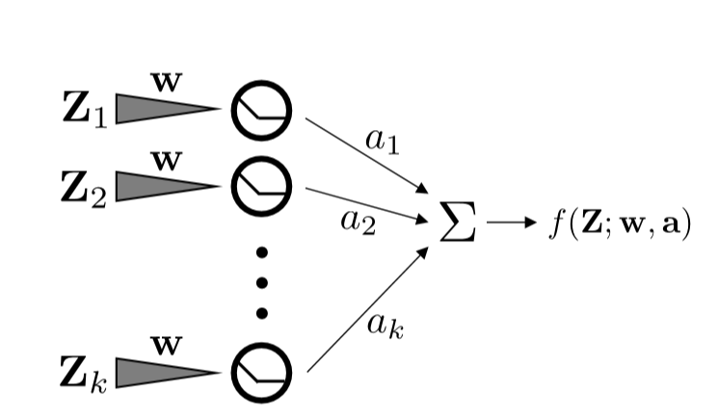
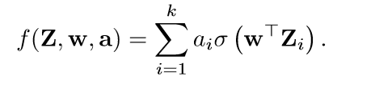


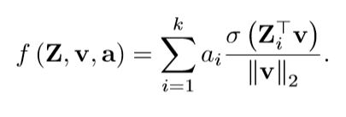

Formulation
Net form
Loss function
We re-parametrize the ﬁrst layer as
Then

Slide 36
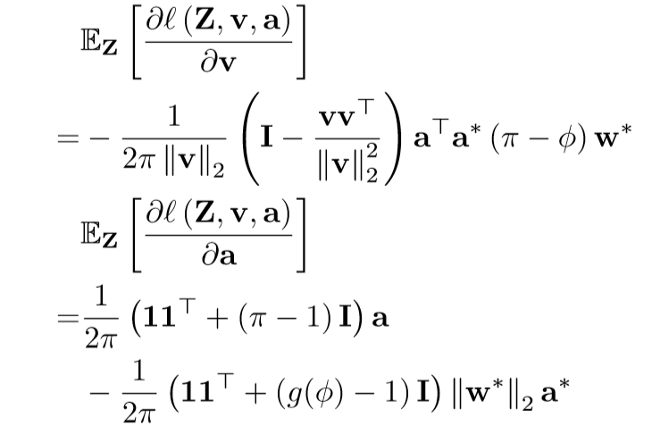
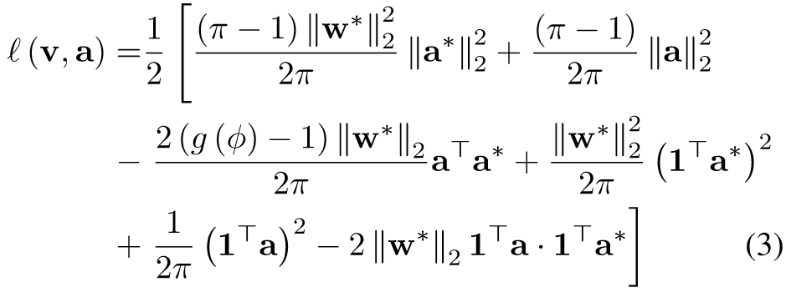

Preliminaries
Assume every patch $Z_{i}$ is vector of i.i.d Gaussian random variables
We have population loss and expected gradient of $w$ and $a$

Slide 37
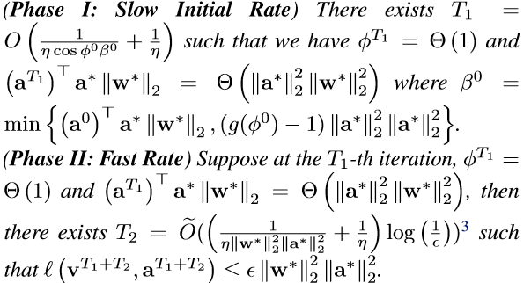
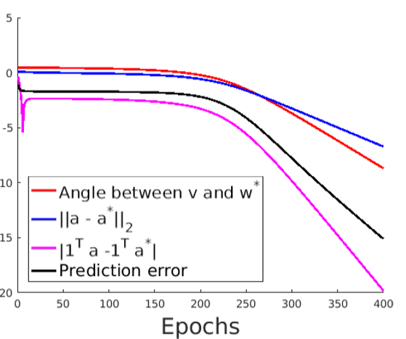
Main theory
the convergence of gradient descent has two phases.

Slide 38




Slide 39
Papers & Reference
Convergence Analysis of Two-layer Neural Networks with ReLU Activation(2017)
Recovery Guarantees for One-hidden-layer Neural Networks(2017)
Learning One-hidden-layer Neural Networks with Landscape Design(2017)
When is a convolutional filter easy to learn? (2018)
Gradient Descent Learns One-hidden-layer CNN: Don’t be Afraid of Spurious Local Minima (2018)
Fine-Grained Analysis of Optimization and Generalization for Overparameterized Two-Layer Neural Networks(2019)

