Slide 1
Graph Autoencoders
By Tian Guiyu
2020.5.26

Slide 2
Outline
Network embedding
Multilayer perceptron
GCN
Recurrent way
Graph generation
NetGAN
Graph RNN

Slide 3
Network Embedding
Network Embedding aims to represent node in a low dimension space while keeping the topology relationship.
The input to the downstream tasks, like link prediction, node recognition.
Traditional method:
Spectral Clustering
DeepWalk
…

Slide 4
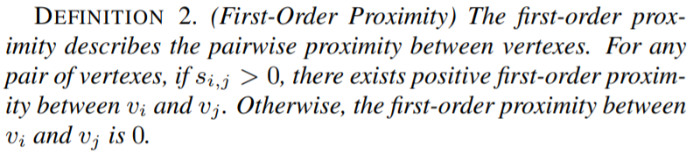
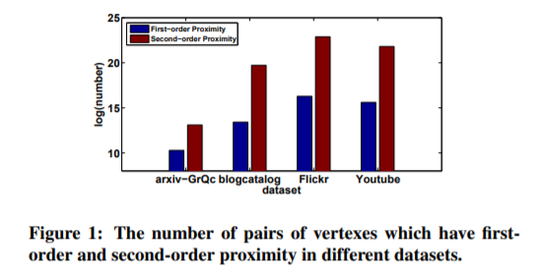
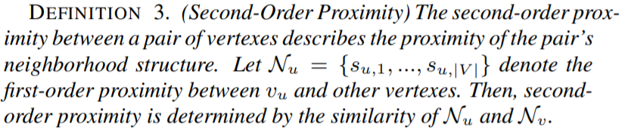
MLP as Encoder
Structural Deep Network Embedding, KDD2016

Slide 5
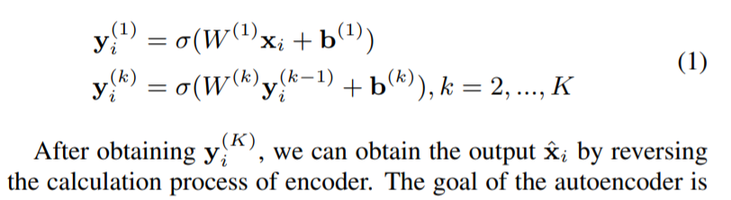
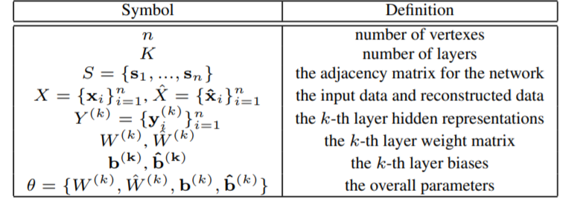
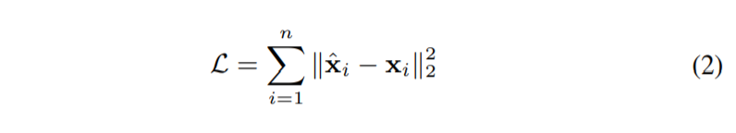

MLP as Encoder
Encode the input feature
Node feature $x_{i}$is defined as it adjacency information $s_{i}$
Reconstruction Loss
Structural Deep Network Embedding, KDD2016

Slide 6
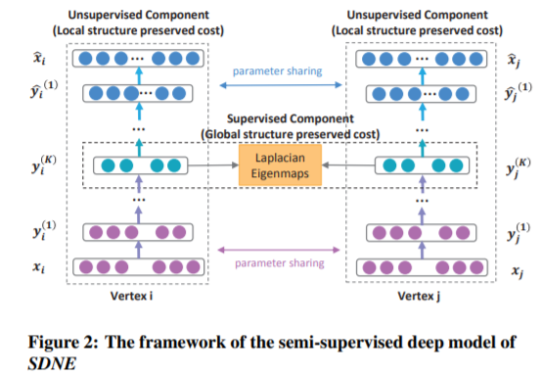
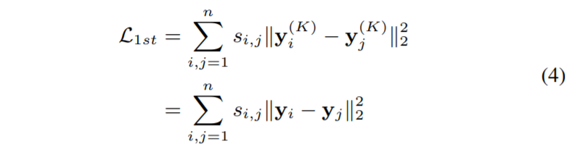
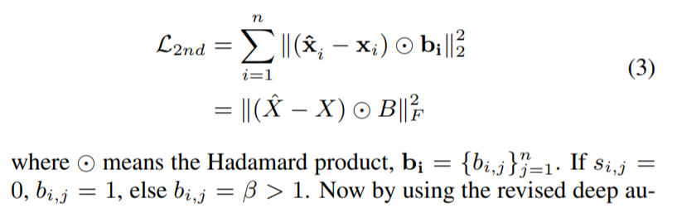
1 st-order and 2 nd-order prximity
Structural Deep Network Embedding, KDD2016

Slide 7

Variational graph autoencoder
$GCN$as Encoder (two layer)
$GCN_{u}$and $GCN_{σ}$ share the parameters of the first layer.
“Variational graph auto-encoders, NIPS 2016 workshop

Slide 8
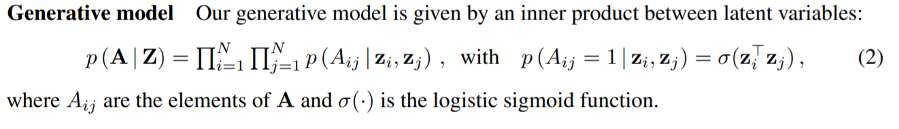
Variational graph autoencoder
“Variational graph auto-encoders, NIPS 2016 workshop

Slide 9
Variational graph autoencoder
“Variational graph auto-encoders, NIPS 2016 workshop

Slide 10
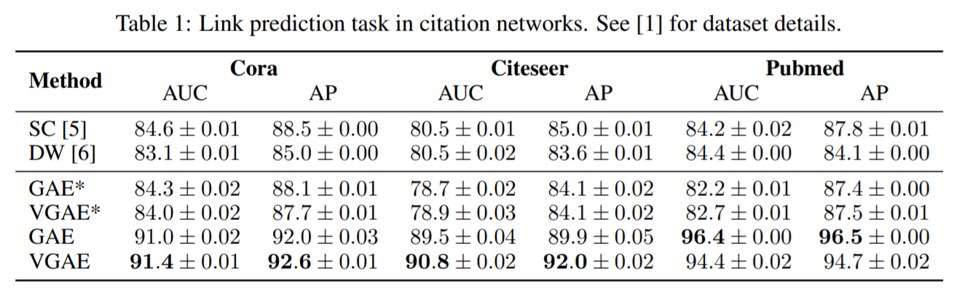
GCN as Encoder
“Variational graph auto-encoders, NIPS 2016 workshop

Slide 11
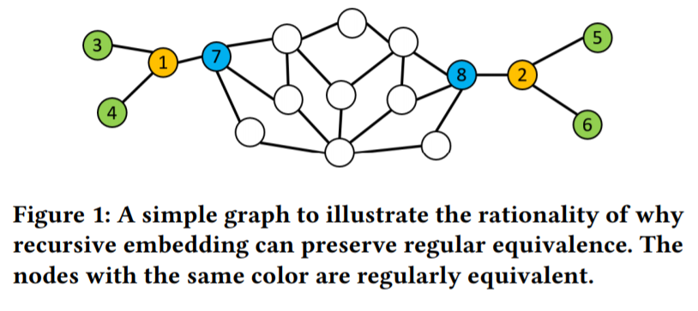
RNN as Encoder
1 and 2 are regular equivalent though they are neither connected nor have common neighbors. (Structural equivalence fails)
Deep recursive network embedding with regular equivalence, KDD 2018

Slide 12
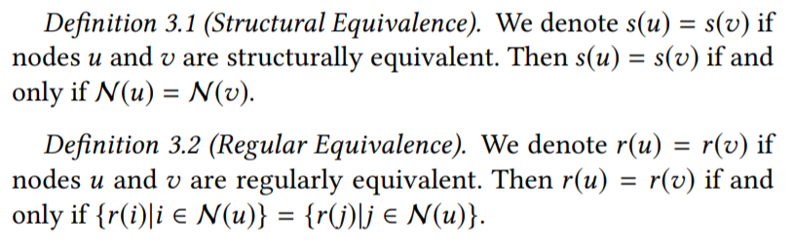
RNN as Encoder
Deep recursive network embedding with regular equivalence, KDD 2018

Slide 13
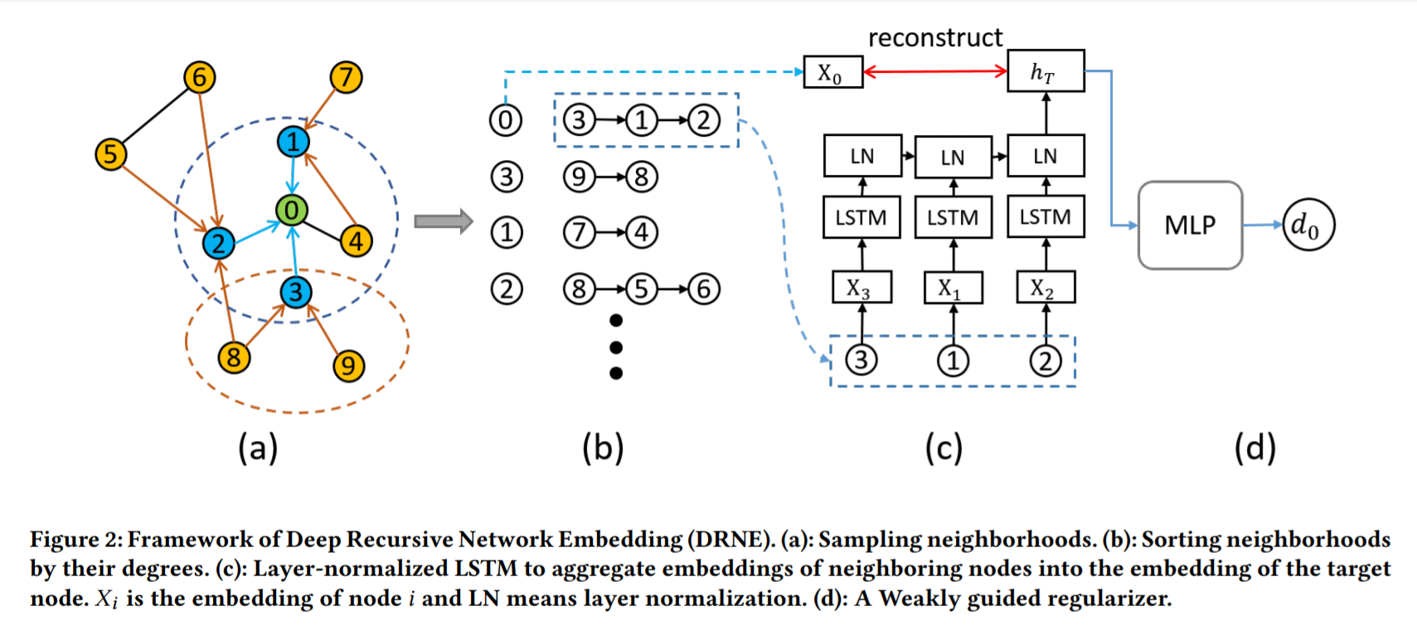
RNN as Encoder
Deep recursive network embedding with regular equivalence, KDD 2018

Slide 14


RNN as Encoder
Deep recursive network embedding with regular equivalence, KDD 2018

Slide 15
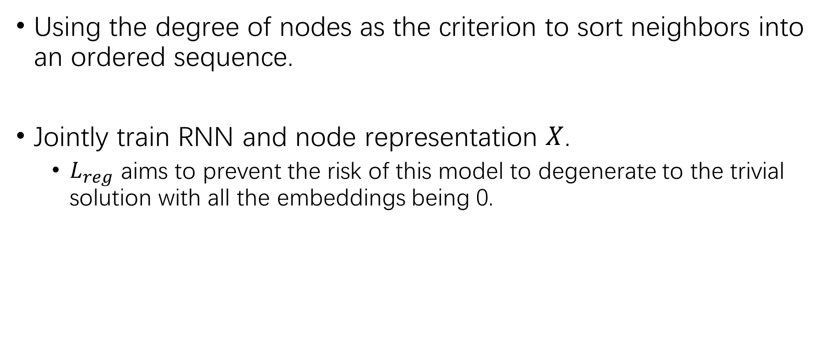
RNN as Encoder
Using the degree of nodes as the criterion to sort neighbors into an ordered sequence.
Jointly train RNN and node representation $X$.
$L_{reg}$ aims to prevent the risk of this model to degenerate to the trivial solution with all the embeddings being 0.
Deep recursive network embedding with regular equivalence, KDD 2018

Slide 16
Graph Generation
NetGAN: Generating Graphs via Random Walks, ICML 2018
GraphRNN: Generating Realistic Graphs with Deep Auto-regressive Models, ICML 2018

Slide 17
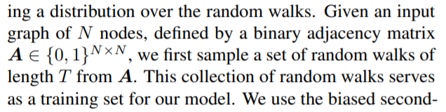
Graph generation via Random Walk
NetGAN: Generating Graphs via Random Walks, ICML 2018

Slide 18
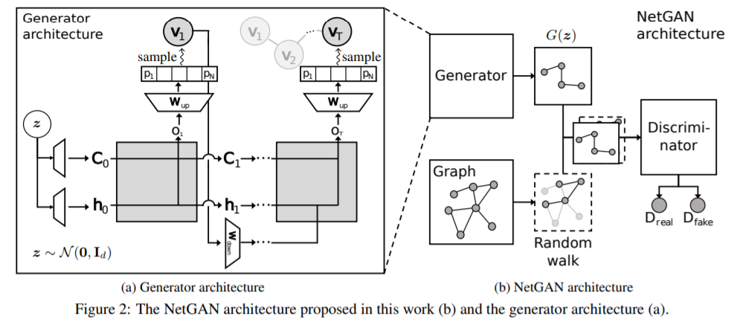
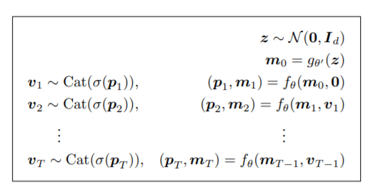
Graph generation via Random Walk
Generator to produce plausible random walks through an LSTM network.
Discriminator to identify fake random walks from the real ones.
NetGAN: Generating Graphs via Random Walks, ICML 2018

Slide 19
Graph generation via Random Walk
How to generate new graph?
A new graph is derived by normalizing a co-occurrence matrix of nodes computed based on random walks produced by the generator.
NetGAN: Generating Graphs via Random Walks, ICML 2018

Slide 20
Graph generation via Random Walk
Shortage:
Fixed size of graph
Training on single graph
NetGAN: Generating Graphs via Random Walks, ICML 2018

Slide 21



Graph generation via RNN
Model Graphs as Sequences
$π$ denotes a node ordering.
$S^{π}$ denotes the corresponding adjacent matrix
GraphRNN: Generating Realistic Graphs with Deep Auto-regressive Models, ICML 2018

Slide 22
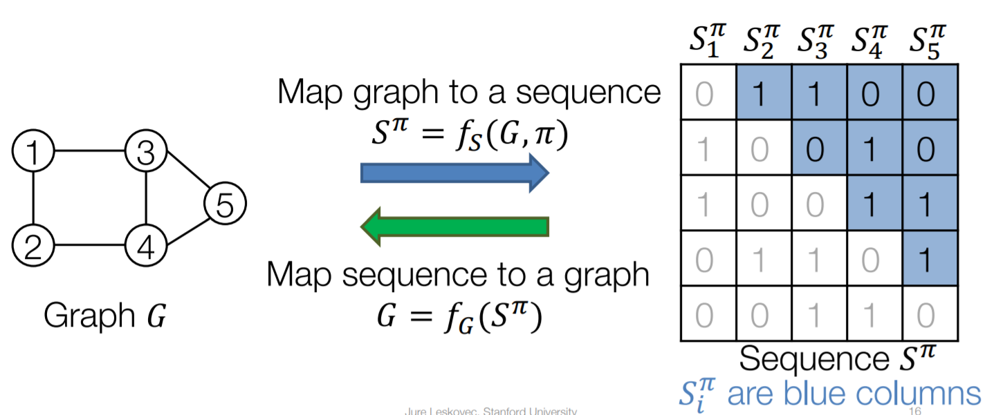
Graph generation via RNN
GraphRNN: Generating Realistic Graphs with Deep Auto-regressive Models, ICML 2018

Slide 23
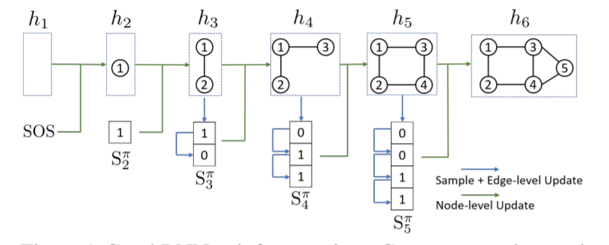
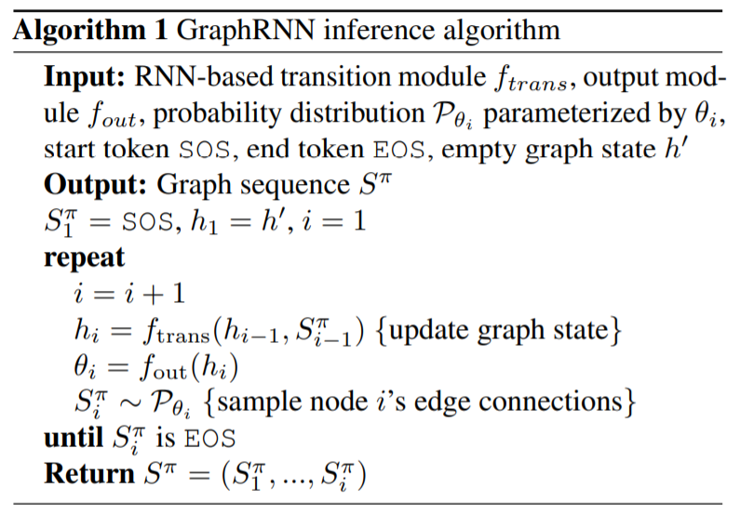
Graph generation via RNN
GraphRNN: Generating Realistic Graphs with Deep Auto-regressive Models, ICML 2018

Slide 24
Graph generation via RNN
Any node can connect to any prior node
High complexity.
Use BFS to prune possible node ordering.
GraphRNN: Generating Realistic Graphs with Deep Auto-regressive Models, ICML 2018

Slide 25
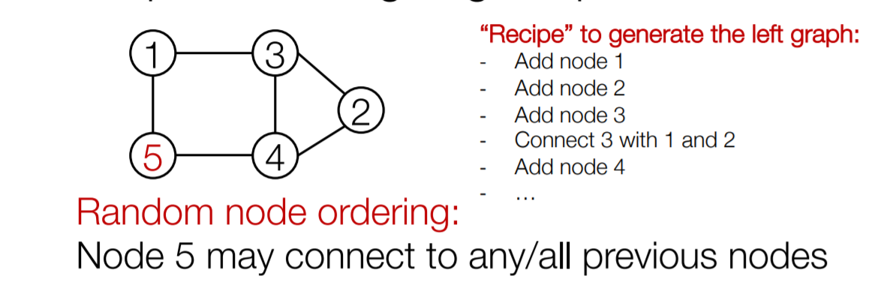
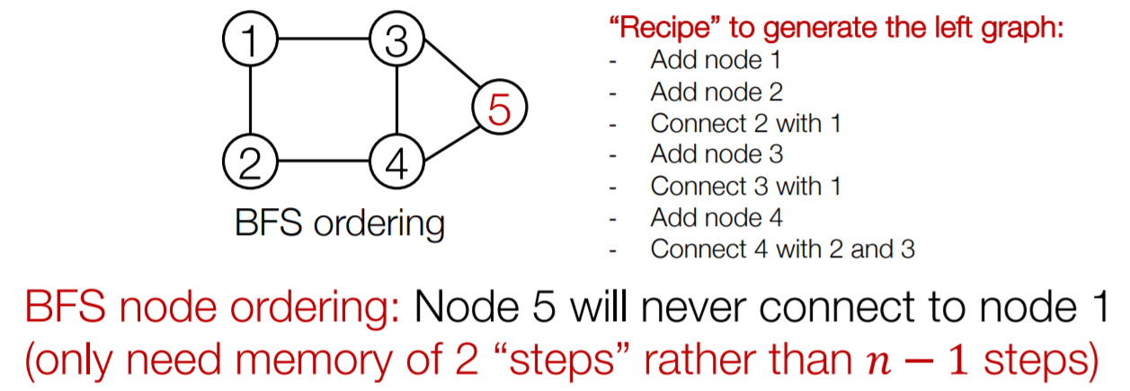
Graph generation via RNN
GraphRNN: Generating Realistic Graphs with Deep Auto-regressive Models, ICML 2018

Slide 26
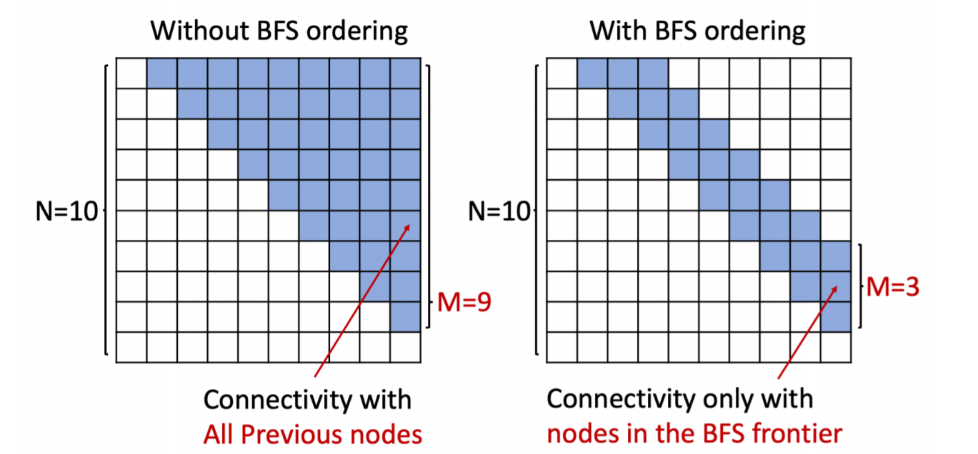
BFS to prune possible permutation
GraphRNN: Generating Realistic Graphs with Deep Auto-regressive Models, ICML 2018

Slide 27
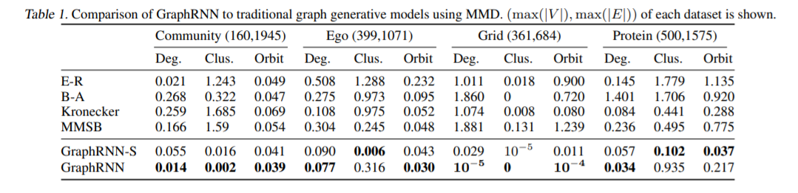
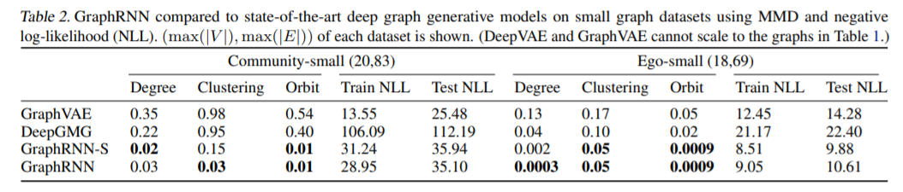
Experiment
GraphRNN: Generating Realistic Graphs with Deep Auto-regressive Models, ICML 2018

Slide 28
Thanks for listening.

Slide 29
Reference
Structural Deep Network Embedding, KDD2016
Variational graph auto-encoders, NIPS 2016 workshop
Deep recursive network embedding with regular equivalence, KDD 2018
NetGAN: Generating Graphs via Random Walks, ICML 2018
GraphRNN: Generating Realistic Graphs with Deep Auto-regressive Models, ICML 2018
A Comprehensive Survey on Graph Neural Networks, CoRR abs/1901.00596 (2019)
Deep Learning on Graphs: A Survey. CoRR abs/1812.04202 (2018)
Graph Neural Networks: A Review of Methods and Applications. CoRR abs/1812.08434 (2018)

