Slide 1
Graph Neural Network
Xue Xiaoyong

Slide 2
intro
Why graph neural network
Irregular structures of graphs
images, audio, and text have a clear grid structure
graphs have irregular structures
hard to generalize some of the basic mathematical operations to graphs,
convolution, pooling
Large scale graph
Millions or billions of nodes and edges
Need to be scalable
Application
e-commerce networks, biology networks, traffic networks
Notes:
Domain specific knowledge

Slide 3
intro
Level of graph analytics tasks
Node level
Graph level
Edge level
Training framework
Semi-supervised learning for node-level classification
Supervised learning for graph-level classification
Unsupervised learning for graph embedding

Slide 4
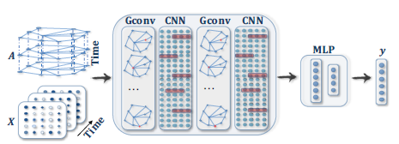
intro
Taxonomy of GNN
Recurrent graph neural network
Convolutional graph neural network
Spectral
spatial
Graph auto-encoder, generative model
Spatial-temporal graph neural networks, attention mechanism

Slide 5

RecGNN
Encode graph structural information. each node is represented by a low-dimensional state vector.
State vector can be used in classic
machine learning methods.
Attach a state to each node that is
based on the information contained in the neighborhood
Node level and graph level

Slide 6



GNN*
Propagation
The definition of the hidden state x_{n}, f_{w} is the transition function, o_{w} is the output function
Different notions of neighborhood can be adopted, e.g. l_{ne[n]} can be omitted
Can be used on both directed graph and undirected graph
All transition function and output function share the same implementation
For nonpositional graph, use the right function
to get the hidden states.
Notes:
L for label, co[n] for edges related to n, ne[n] for nodes that are in n’s neighbor
Positional, nonpositional

Slide 7
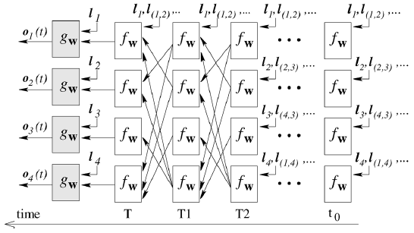

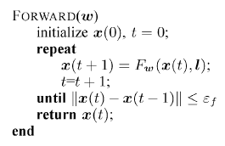
GNN*
State computation
Iterating
F_{w} need to be a contraction map
According to Banach’s fixed point theorem, x(t) will
converge to a solution for any initial value.
Each node stores a state. Simultaneous and
repeated activation of the units produce the
behavior.
Notes:
When fw and gw are feed forward network, this is a recurrent neural network
The internal connectivity is determined by the neural network architecture used to implement the unit. The external connectivity depends on the edges of the processed graph

Slide 8


GNN*
Transition and output function implementation
Consider the model described with
Linear GNN
restrictions on A to ensure a contraction map
Nonlinear GNN
h_{w} is realized by a multilayered feed forward network
not all parameters w can be used, f_{w} need to be a contraction map
change the loss function
Notes:
Gw is a multilayered feed forward network
Can not ensure corresponding transition function fw is a contraction map L(y) = (y-u)^2, if y>u else 0

Slide 9

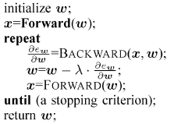


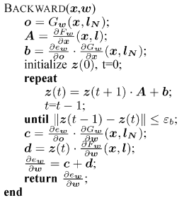

GNN*
Learning
Learning data set
Loss function
Learning algorithm is based on a gradient-descent strategy
Backpropagation
in which
Notes:
Qi is the number of supervised nodes in G z(t) converge as Fw is a contraction map

Slide 10
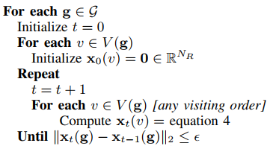



GraphESN
reservoir layer for the encoding process, readout layer
Reservoir layer
Hidden states computation
Iterative version
Global state transition function
W_{v} is obtained by arranging Wn and a number of |V(g)|-k zero matraix
Notes:
Graph echo state network
reservoir layer is nonlinear, readout layer is linear
Wn’s shape is Nr*kNr, Wv’s shape is Nr*|V(g)|Nr

Slide 11
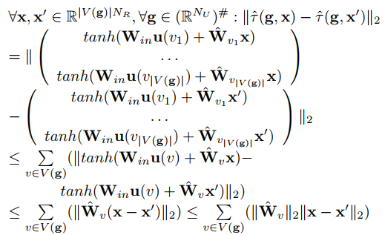

GraphESN
Contractivity
Requirement
contraction coefficient
randomly initialize W_{in} and W_{n}, then
re-scale W_{n} such that σ<1 holds
this part is left untrained

Slide 12



GraphESN
Readout layer
Node level. Apply local output function to each vertex
Graph level. Use state mapping function
supersource state mapping
define a super source, use the state of supersource.
mean state mapping
readout
train the output layer

Slide 13
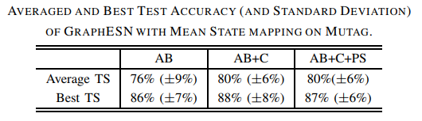
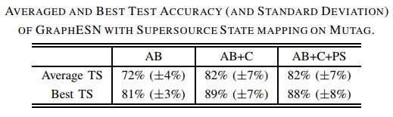

GraphESN
Experiment
analysis of toxicity of chemical compounds

Slide 14
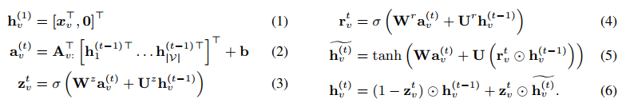
GG-NN
use Gated Recurrent Units
Propagation
unroll the recurrence for a fixed number of steps T
Use node annotations for initializing (not important in GNN*), problem specific
Use back-propagation through time to learn model parameters
Requires more memory. Problem for large model.
Notes:
Gated graph neural network
Mixed information from the past iteration and this iteration

Slide 15
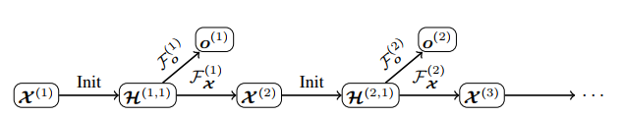
GGS-NN
several GG-NNs operate in sequence to produce an output sequence
use two GG-NNs
F_{o}^{k} for predicting o^{k} from X^{k}
F_{x}^{k} for predicting the next annotation
this two GG-NNs can share a single propagation model
Sequence outputs with observed annotations
decompose into single step prediction tasks, trained as separate GG-NNs
Sequence outputs with latent annotations
intermediate node annotations as hidden units, train the whole model
Notes:
X for annotations, o for output, H for the first hidden state
Each prediction is a part of the graph, it is needed to ensure predict an output for each part of the graph exactly once
a small number of annotations are sufficient to capture the state of the output procedure
Attention sum

Slide 16

SSE
Find steady state
Iterate according to the steady-state equation
Use a a two-layer neural network
Sample some node from v to update
the embeddings are updated in an asynchronous fashion (not updating the whole graph
Only consider 1-hop
Notes:
Stochastic steady-state embedding
Learning embedding and output
1 hop local neighborhood information

Slide 17
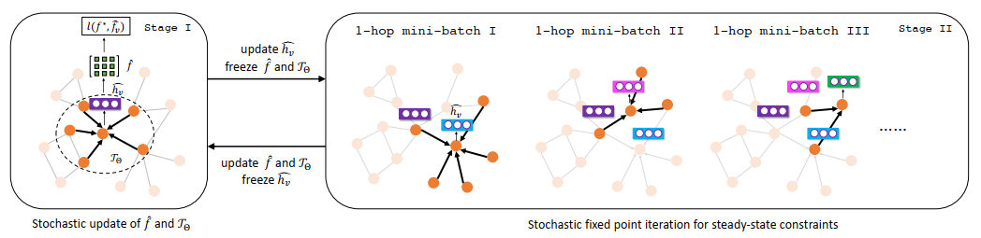
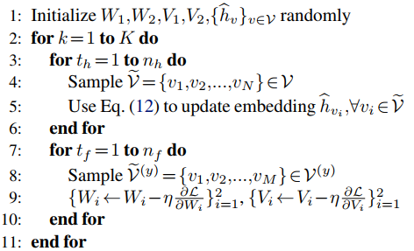
SSE
Learning algorithm- Stochastic Fixed Point Iteration
samples a batch of nodes for state update and a batch of nodes for gradient computation
Update embedding
Stops when converge or run K steps
Effective on large graphs with 1e8 nodes
Not ensure the convergence in embedding
computation
Notes:
V for output

Slide 18

Graph convolution network
Mimic CNN. learn the common local and global structural patterns of graphs
Use fixed number of layers with
different weights in each layer
Spectral based
introducing filters from graph signal processing
Number of neighbors varies.
Spatial based
define graph convolutions by information propagation
Considering node neighborhood
Notes:
Similar to recGNN
Two part can connect, hard for a finite kernel

Slide 19


Spectral convolution
How to do convolution
normalized graph Laplacian matrix
A is adjacent matrix.
Property of L. L is real symmetric positive semidefinite
U is the matrix of eigenvectors. U is orthonormal
Graph Fourier transform
Inverse graph Fourier transform
Graph convolution with a filter g
Simplify
Notes:
Using graph signal processing
A may be weight adjacent matrix
X is the feature vector of nodes, x_i is the value of node i

Slide 20


Spectral GNN
the filter is a diagonal matrix with set of learnable parameters
Convolution layer
limitations
High complexity
eigen-decomposition O(n³), forward O(n²)
perturbation to a graph results in a change of eigenbasis
the filters depend on the eigenbasis of the graph, and can’t apply to a graph with different structure
Notes:
Choice of filter
H is the input signal, k is the layer index, fk-1 is the number of input channel, fk is the number of output channel
Not local information, but global

Slide 21



ChebNet
The Fourier basis U cause the high computation complexity
Use L instead. L is sparse.
Use Chebyshev polynomial for filter
Convolution layer
Consider
consider nodes that are at maximum K steps away from the central node
Notes:
Lambda_max is the max of eigenvalue
T(x) is a polynomial
L^k is k-neighbor

Slide 22
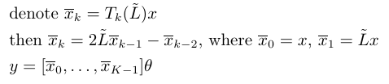
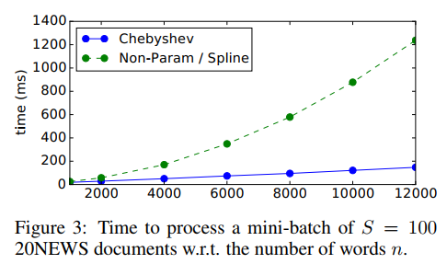
ChebNet
computation trick
computation complexity is O(K|E|)

Slide 23

GCN
First order approximation
set K=1 in ChebNet. Linear with respect to L
approximate
consider only 1 parameter
Connect spectral convolution with spatial convolution
Nodes are affected only by their immediate neighbors in each convolutional layer
Notes:
Linear for A
Similar with GNN

Slide 24


GCN
Renormalization trick
alleviate numerical instabilities and exploding/vanishing gradients
Multi-channels input and output
Notes:
numerical instabilities and exploding/vanishing gradients X is the input with C channels. Z is the output with F channels. Size of theta is C*F

Slide 25
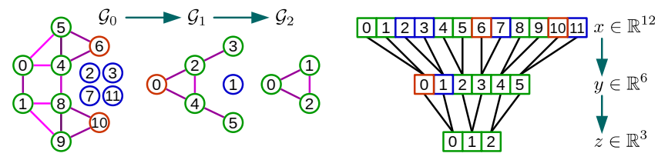
Pooling
Coarsening
similar vertices are clustered together
greedy rule, for node i, neighbor j, maximize
Pooing
create a balanced binary tree
rearrange the vertices
use fake node
Notes:
In chebnet
Pooling size 4, or 2 pooling 2
2 real,

Slide 26
References
A Comprehensive Survey on Graph Neural Networks
Deep learning on graphs: A survey
The neural graph model
Graph echo state networks
Gated graph sequence neural networks
Learning steady-states of iterative algorithms over graphs
Spectral Networks and Deep Locally Connected
Convolutional neural networks on graphs with fast localized spectral filtering
Semi-supervised classification with graph convolutional networks

