Slide 1
Application of GNN
Yuxuan Xi
1901210535

Slide 2
Applications of graph neural networks.
Text
Text classification, Sequence Labeling, Sentiment classification, Semantic role labeling
Neural machine translation, Relation extraction, Event extraction, AMR to text generation, Multi-hop reading comprehension, Relational reasoning
Image
Social Relationship Understanding, Image classification, Visual Question Answering, Object Detection, Interaction Detection, Region Classification, Semantic Segmentation
Science
Physics Systems, Molecular Fingerprints, Protein Interface Prediction, Side Effects Prediction, Disease Classification
Knowledge Graph
KB Completion, KG Alignment
Combinatorial Optimization, Graph Generation, etc.

Slide 3
Link Prediction Based on Graph Neural Networks(NIPS 2018)
develop a novel γ-decaying heuristic theory for link prediction.
unifies a wide range of heuristics in a single framework
proves that all these heuristics can be well approximated from local subgraphs
results show that local subgraphs reserve rich information related to link existence
based on the γ-decaying theory, proposed a new method to learn heuristics from local subgraphs using a graph neural network (GNN)
Its experimental results show unprecedented performance, working consistently well on a wide range of problems.
Link Prediction Based on Graph Neural Networks
Notes:
Applications: friend recommendation, movie recommendation, knowledge graph completion, metabolic network reconstruction

Slide 4
Link prediction heuristics
use some score functions, such as common neighbors and Katz index, to measure the likelihood of links.
can be categorized based on the maximum hop of neighbors needed to calculate the score. (h-order)
first-order: common neighbors (CN) and preferential attachment (PA)
second-order: Adamic-Adar (AA) and resource allocation (RA)
high-order(require knowing the entire network):Katz, rooted PageRank (PR)
obtained wide practical uses due to their simplicity, interpretability, and for some of them, scalability.
have strong assumptions on when links may exist
the common neighbor heuristic assumes that two nodes are more likely to connect if they have many common neighbors.
Link Prediction Based on Graph Neural Networks
Notes:
protein-protein interaction (PPI) networks

Slide 5
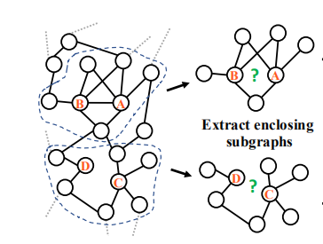
do we really need a large h to learn high-order heuristics?
Weisfeiler-Lehman Neural Machine (WLNM)
extract local enclosing subgraphs around links as the training data
use a fully-connected neural network to learn which enclosing subgraphs correspond to link existence.
high-order heuristics such as rooted PageRank and Katz often have much better performance than first and second-order ones
unaffordable time and memory consumption for most practical networks.
Link Prediction Based on Graph Neural Networks

Slide 6
γ-decaying theory
most high-order heuristics can be unified by a γ-decaying theory
under mild conditions, any γ-decaying heuristic can be effectively approximated from an h-hop enclosing subgraph, where the approximation error decreases at least exponentially with h.
“effective order” of these high-order heuristics is not that high
link prediction framework, SEAL
a graph neural network (GNN) is used to replace the fully-connected neural network in WLNM
permits learning from not only subgraph structures, but also latent and explicit node features, thus absorbing multiple types of information
much improved performance
Link Prediction Based on Graph Neural Networks
Notes:
do not necessarily need a very large h to learn high-order graph structure features.

Slide 7
A theory for unifying link prediction heuristics
Link Prediction Based on Graph Neural Networks

Slide 8
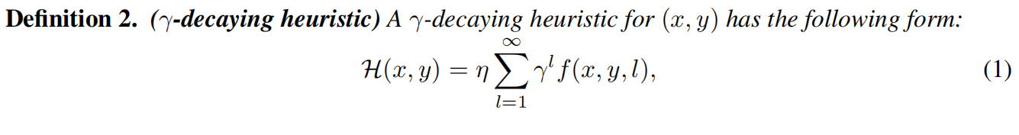
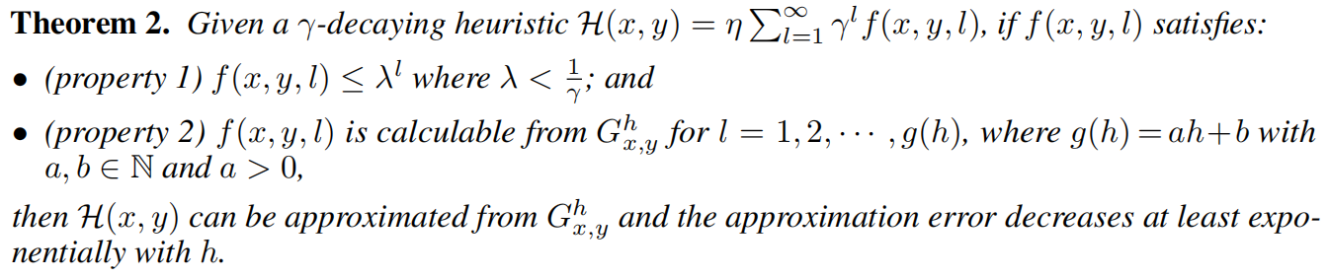
Link Prediction Based on Graph Neural Networks
Notes:
where γ is a decaying factor between 0 and 1, η（eta） is a positive constant or a positive function of γ that
is upper bounded by a constant, f is a nonnegative function of x, y, l, under the the given network.

Slide 9
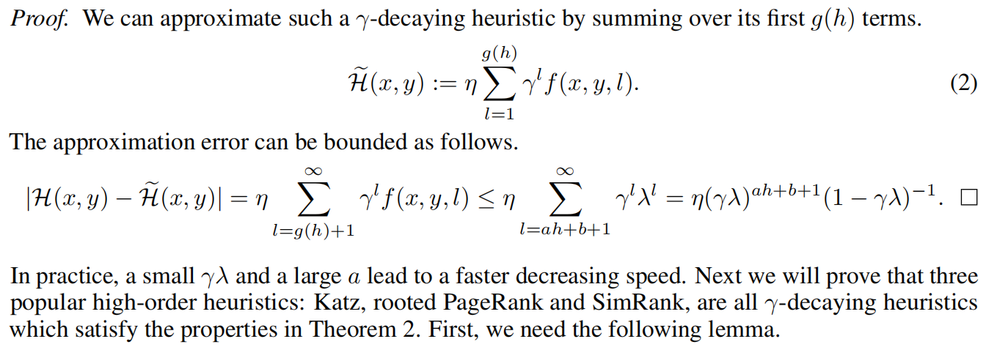
Link Prediction Based on Graph Neural Networks
Notes:
do not necessarily need a very large h to learn high-order graph structure features.

Slide 10
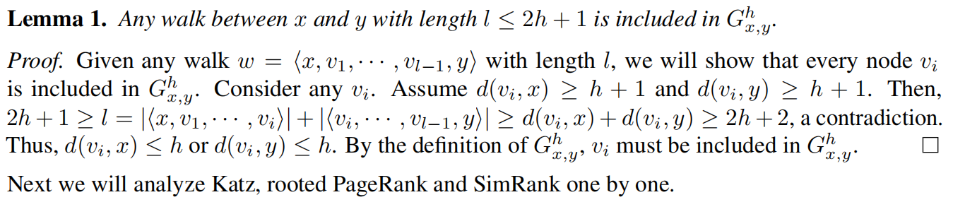
Link Prediction Based on Graph Neural Networks
Notes:
do not necessarily need a very large h to learn high-order graph structure features.

Slide 11
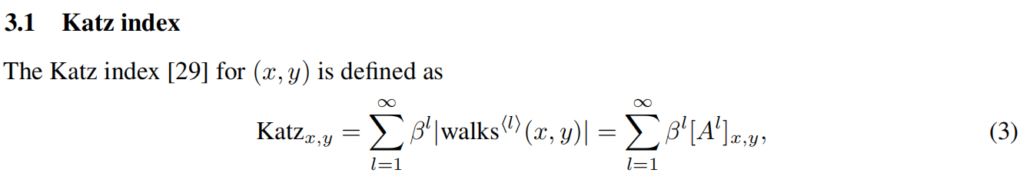
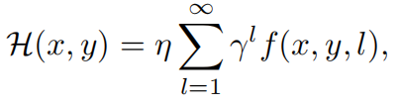
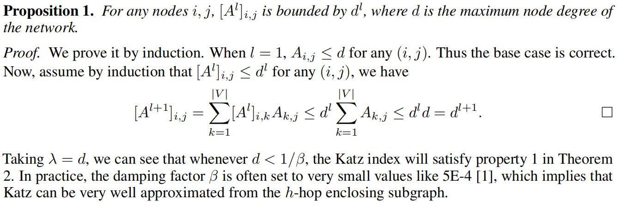
Link Prediction Based on Graph Neural Networks
Notes:
where γ is a decaying factor between 0 and 1, η（eta） is a positive constant or a positive function of γ that
is upper bounded by a constant, f is a nonnegative function of x, y, l under the the given network.

Slide 12
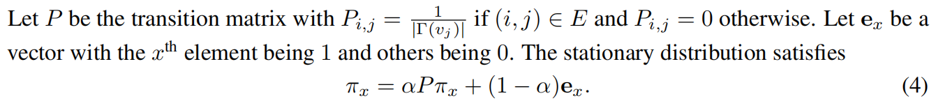
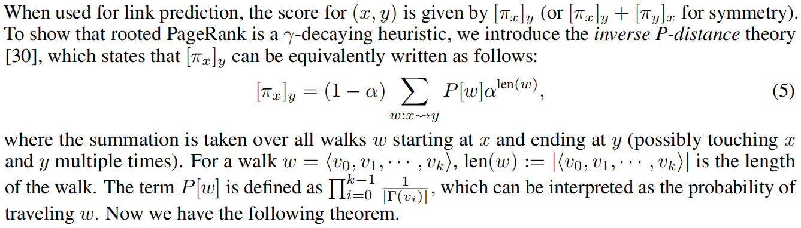
rooted PageRank
Link Prediction Based on Graph Neural Networks
Notes:
where the summation is taken over all walks w starting at x and ending at y. W is the walk path len(w) is the length, P(w) is the probability traveling w

Slide 13
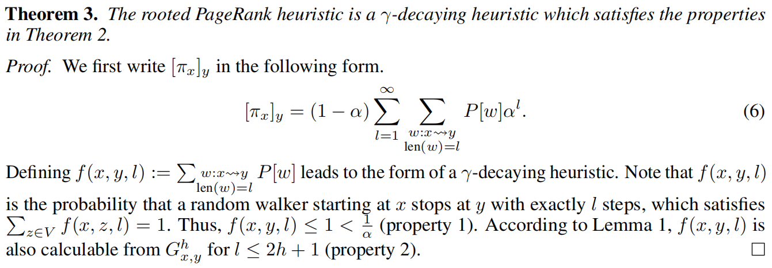
Link Prediction Based on Graph Neural Networks

Slide 14
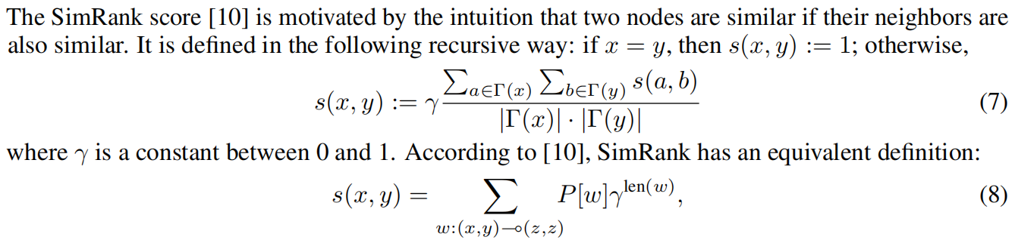
SimRank
Link Prediction Based on Graph Neural Networks
Notes:
W表示所有模拟的walk，一个从x开始，另一个从y开始，并且第一次在z相遇

Slide 15
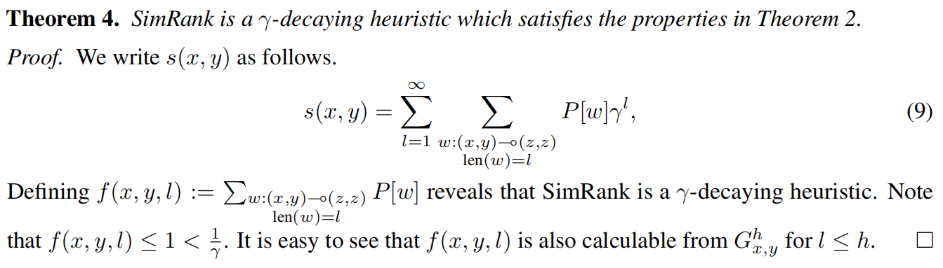
Link Prediction Based on Graph Neural Networks

Slide 16
Discussion
most high-order heuristics inherently share the same γ-decaying heuristic form, and thus can be effectively approximated from an h-hop enclosing subgraph with exponentially smaller approximation error
the ubiquity of γ-decaying heuristics is not by accident -- a successful link prediction heuristic is better to put exponentially smaller weight on structures far away from the target, as remote parts of the network intuitively make little contribution to link existence.
Link Prediction Based on Graph Neural Networks

Slide 17
SEAL: An implementation of the theory using GNN
enclosing subgraph extraction
node information matrix construction
GNN learning
Link Prediction Based on Graph Neural Networks
Notes:
A GNN typically takes (A, X) as input,X 是 node information matrix ，节点信息矩阵

Slide 18
node information matrix X in the enclosing subgraph
Node labeling
Double-Radius Node Labeling (DRNL)
use their one-hot encoding vectors to construct X
Incorporating latent and explicit features
concatenate each node’s embedding/attribute vector to its corresponding row in X
temporally add En into E, and generate the embeddings on G0 = (V,E UEn).（negative injection）
Link Prediction Based on Graph Neural Networks
Notes:
h (d(i, x), d(i, y)) = (1, 1), assign label fl(i)=2. Nodes with radius (1, 2) or (2, 1) get label 3. Nodes with radius (1, 3) or (3, 1) get 4. Nodes with (2, 2) get 5. Nodes with (1, 4) or (4, 1) get 6. Nodes with (2, 3) or (3, 2) get 7.
For nodes with d(i, x) = 无穷 or d(i, y) = 无穷, we give them a null label 0.
a set of sampled positive training links Ep 属于E, and a set of sampled negative training links En with En 不属于 E ，直接在G上进行embedding,会将训练数据中存在的link record进去，这样泛化效果不好

Slide 19
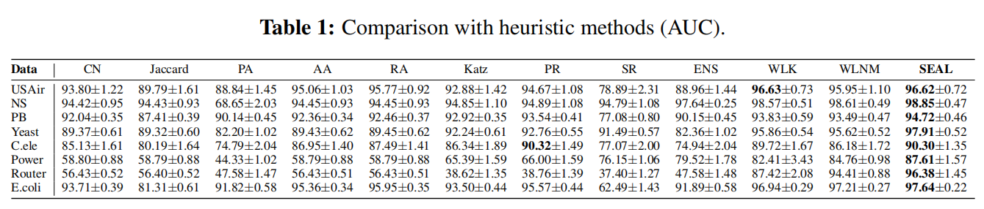
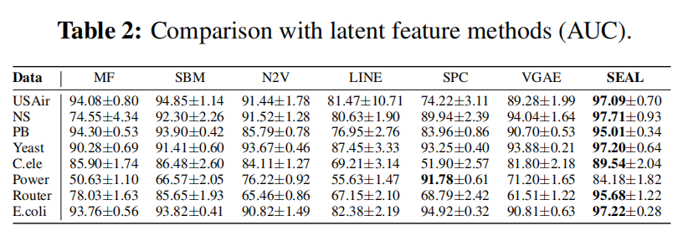
Experimental results
without node2vec embeddings
predefined heuristics
learn from enclosing subgraphs
with node2vec embeddings
Link Prediction Based on Graph Neural Networks
Notes:
Tabe1: methods which learn from enclosing subgraphs (WLK, WLNM and SEAL) generally perform much better than predefined heuristics
Table2:SEAL表现超过其他模型原因是同时学习图结构和隐特征，SEAL with node2vec embeddings outperforms pure node2vec by large margins，network embeddings alone may not be able to capture the most useful link prediction information located in the local structures. compared to SEAL without node2vec embeddings (Table 1), joint learning does not always improve the performance.

Slide 20
DIFFUSION CONVOLUTIONAL RECURRENT NEURAL NETWORK: DATA-DRIVEN TRAFFIC FORECASTING（ICLR 2018 ）
propose to model the traffic flow as a diffusion process on a directed graph
introduce Diffusion Convolutional Recurrent Neural Network (DCRNN)， a deep learning framework for traffic forecasting
incorporates both spatial and temporal dependency in the traffic flow
captures the spatial dependency using bidirectional random walks on the graph
captures the temporal dependency using the encoder-decoder architecture with scheduled sampling
consistent improvement of 12% - 15% over state-of-the-art baselines
DIFFUSION CONVOLUTIONAL RECURRENT NEURAL NETWORK: DATA-DRIVEN TRAFFICFORECASTING

Slide 21
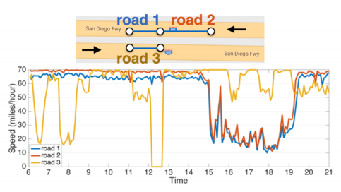
traffic forecasting
predict the future traffic speeds of a sensor network given historic traffic speeds and the underlying road networks.
complex spatiotemporal dependencies
traffic time series demonstrate strong temporal dynamics.
sensors on the road network contain complex yet unique spatial correlations.
future traffic speed is influenced more by the downstream traffic than the upstream one.(spatial structure in traffic is nonEuclidean and directional).
inherent difficulty in the long term forecasting
Knowledge-driven approach
data-driven approach
simple time series models(e.g. ARIMA)
deep learning models
Bruna et al. :graph convolution only for undirected graphs.
rely on the stationarity assumption
DIFFUSION CONVOLUTIONAL RECURRENT NEURAL NETWORK: DATA-DRIVEN TRAFFICFORECASTING
Notes:
road 1 and road 3 are close in the Euclidean space, they demonstrate very different behaviors.

Slide 22


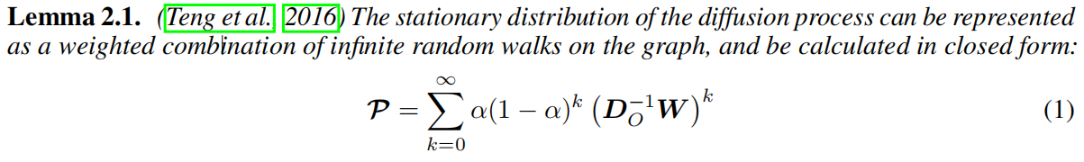
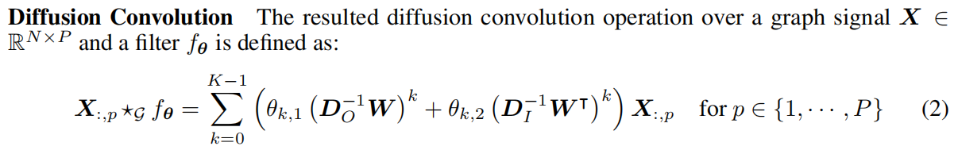
methodology
表示节点邻近程度的加权邻接矩阵
graph signal observed at time t
Random walk
restart probability
diffusion step
state transition matrix
stationary distribution
out-degree diagonal matrix
bidirectional graph random walk
Signal out
Signal in
filter
In-degree diagonal matrix
DIFFUSION CONVOLUTIONAL RECURRENT NEURAL NETWORK: DATA-DRIVEN TRAFFICFORECASTING

Slide 23
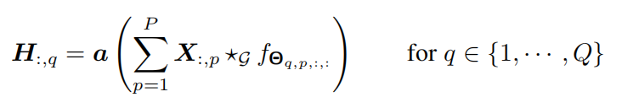

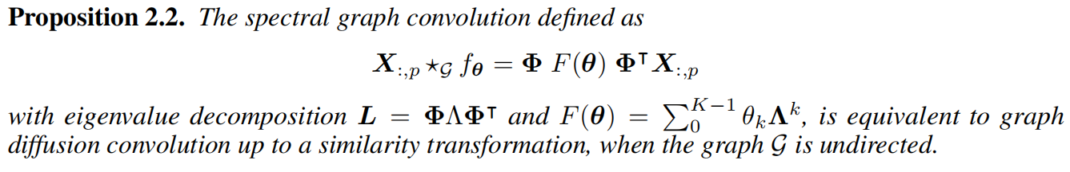
Diffusion Convolutional Layer
parameterizes the convolutional filter for the pth input and the qth output
activation function
maps P-dimensional features to Q-dimensional outputs
learns the representations for graph structured data
Relation with Spectral Graph Convolution
a special case of diffusion convolution
DIFFUSION CONVOLUTIONAL RECURRENT NEURAL NETWORK: DATA-DRIVEN TRAFFICFORECASTING
Notes:
many existing graph structured convolutional operations including the popular spectral graph convolution, i.e., ChebNet (Defferrard et al., 2016), can be considered as a special case of diffusion convolution(up to a similarity transformation)

Slide 24
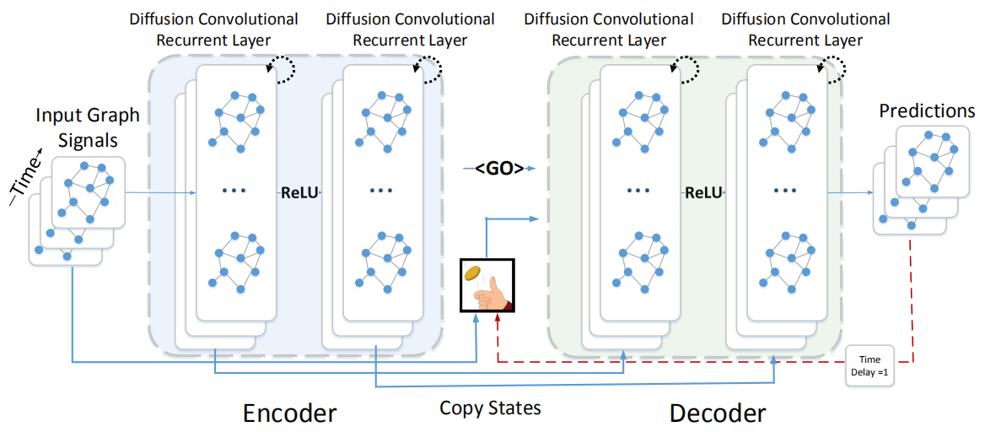
temporal dynamics modeling
Diffusion Convolutional Gated Recurrent Unit (DCGRU)
reset gate at time t
update gate at time t
parameters for the corresponding filters
scheduled sampling
1-ε
ε
DIFFUSION CONVOLUTIONAL RECURRENT NEURAL NETWORK: DATA-DRIVEN TRAFFICFORECASTING
Notes:
训练阶段：将历史时间序列送入encoder,将最终的状态送入decoder 中将其初始化，decoder根据历史的真实观测值得到预测值
测试阶段：真实观测值换成模型本身产生的预测值
scheduled sampling: 训练数据分布和测试数据分布之间的差距会影响泛化效果，ε的概率输入ground truth observation，1-ε的概率输入模型本身的预测

Slide 25
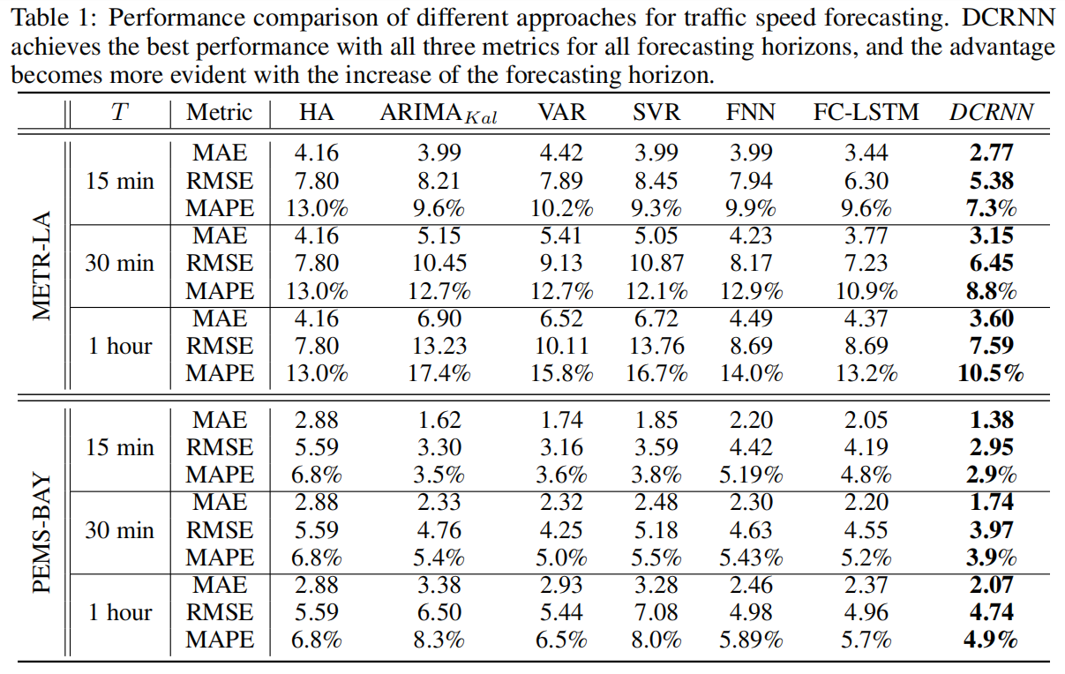
DIFFUSION CONVOLUTIONAL RECURRENT NEURAL NETWORK: DATA-DRIVEN TRAFFICFORECASTING

Slide 26
Spatio-Temporal Graph Convolutional Networks: A Deep Learning Framework for Traffic Forecasting
model the traffic network by a general graph instead of treating it separately (e.g. grids or segments).
employ a fully convolutional structure on time axis to handle the inherent deficiencies of recurrent networks（difficult to train and computationally heavy）
propose a novel deep learning architecture, the spatio-temporal graph convolutional networks, for traffic forecasting tasks
first time that to apply purely convolutional structures to extract spatio-temporal features simultaneously from graph-structured time series in a traffic study
Spatio-Temporal Graph Convolutional Networks: A Deep Learning Framework for Traffic Forecasting

Slide 27
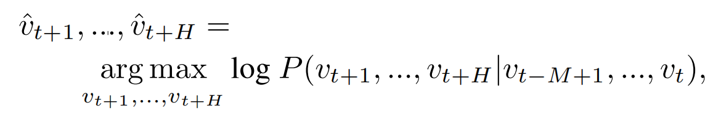
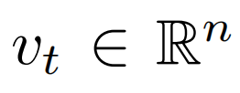
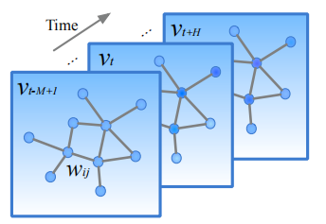
Preliminary
Traffic Prediction on Road Graphs
Convolutions on Graphs
previous M traffic observations
most likely traffic measurements in the next H time steps
observation vector of n road segments at time step t
diagonal degree matrix
Normalized graph Laplacian
matrix of eigenvector
graph signal
Spatio-Temporal Graph Convolutional Networks: A Deep Learning Framework for Traffic Forecasting
Notes:
predicting the most likely traffic measurements (e.g. speed or traffic flow) in the next H time steps given the previous M traffic observations

Slide 28
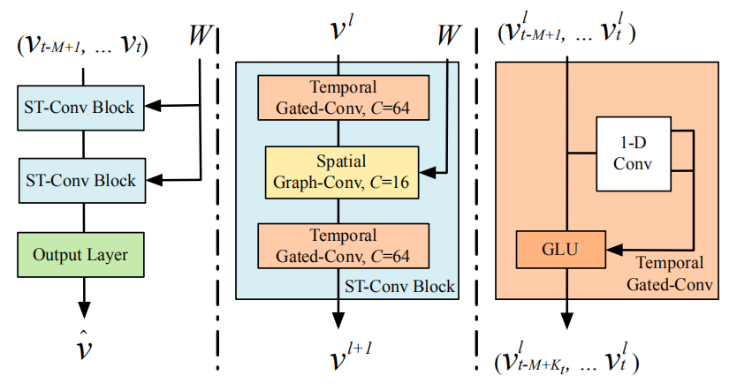
Proposed Model
spatio-temporal graph convolutional networks (STGCN)
explore spatial and temporal dependencies
bottleneck
residual connection
fully-connected
. integrate Comprehensive features
“sandwich” structure
Spatio-Temporal Graph Convolutional Networks: A Deep Learning Framework for Traffic Forecasting
Notes:
The input vt- M+1, ..., vt is uniformly processed by ST-Conv blocks to explore spatial and temporal dependencies coherently. Comprehensive features are integrated by an output layer
to generate the final prediction vˆ.

Slide 29


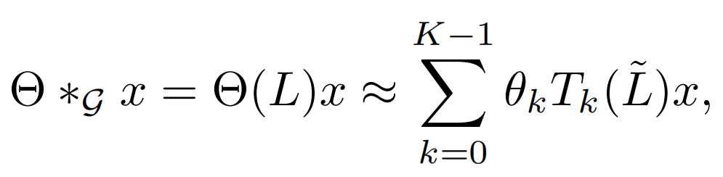



Graph CNNs for Extracting Spatial Features
the computation of kernel Θ in graph convolution can be expensive
Chebyshev Polynomials Approximation
O(n2) multiplications with graph Fourier basis
rescale
Chebyshev polynomial
Spatio-Temporal Graph Convolutional Networks: A Deep Learning Framework for Traffic Forecasting
Notes:
这个卷积计算的复杂度是非常高的，涉及到求laplacian矩阵的特征向量，和大量的矩阵计算

Slide 30
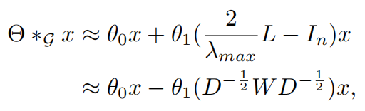
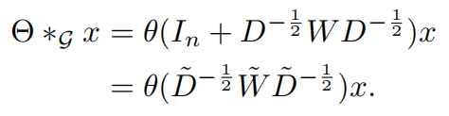
1st-order Approximation
a deeper architecture can be constructed to recover spatial information in depth without being limited to the explicit parameterization given by the polynomials
Assume λmax ≈ 2(scaling and normalization in neural networks)
Spatio-Temporal Graph Convolutional Networks: A Deep Learning Framework for Traffic Forecasting
Notes:
将一层的K-1阶变为K层卷积能达到同样的效果

Slide 31
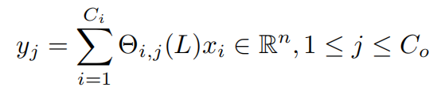
Generalization of Graph Convolutions
extend to multi-dimensional tensors
the size of input of the feature maps
the size of output of the feature maps
signal with Ci channels
the input of traffic prediction is composed of M frame of road Graphs. For each time step t of M, the equal graph convolution operation with the same kernel Θ is imposed on Xt ∈Rn×Ci in parallel. Thus, the graph convolution can be further generalized in 3-D variables
Spatio-Temporal Graph Convolutional Networks: A Deep Learning Framework for Traffic Forecasting

Slide 32
Gated CNNs for Extracting Temporal Features
recurrent networks
time-consuming iterations, complex gate mechanisms, and slow response to dynamic changes
CNNs
fast training, simple structures, and no dependency constraints to previous steps
employ entire convolutional structures on time axis to capture temporal dynamic behaviors of traffic flows
GLU as a non-linearity
without padding
the temporal gated convolution
input Y
output element [P Q]
Spatio-Temporal Graph Convolutional Networks: A Deep Learning Framework for Traffic Forecasting
Notes:
The sigmoid gate σ(Q)
controls which input P of the current states are relevant for discovering compositional structure and dynamic variances in time series. The non-linearity gates contribute to the exploiting of the full input fifiled through stacked temporal layers as well.

Slide 33
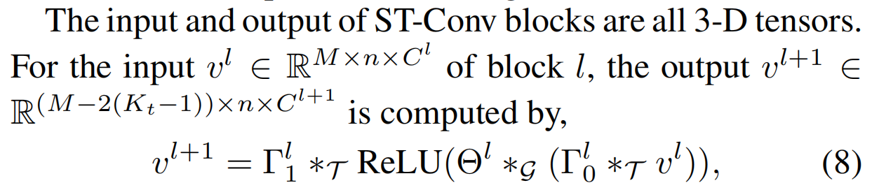

Spatio-temporal Convolutional Block
apply bottleneck strategy to achieve scale compression and feature squeezing by downscaling and upscaling of channels C through the graph convolutional layer.
layer normalization is utilized within every ST-Conv block to prevent overfitting
loss function
Spatio-Temporal Graph Convolutional Networks: A Deep Learning Framework for Traffic Forecasting

Slide 34
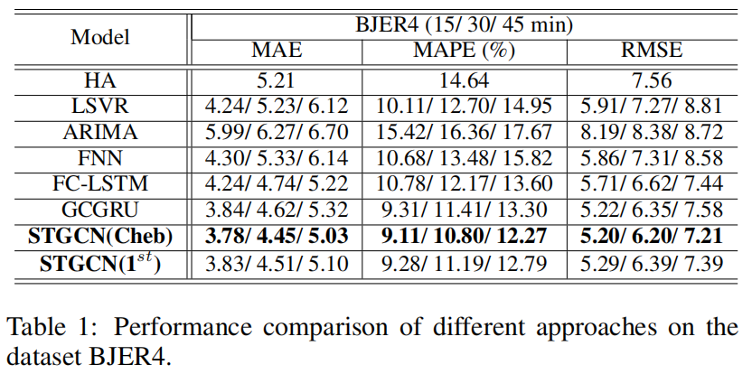
Spatio-Temporal Graph Convolutional Networks: A Deep Learning Framework for Traffic Forecasting
Notes:
STGCN(Cheb) with the Chebyshev polynomials approximation, while the K is set to 1 in the model STGCN(1st) with the 1st-order approximation.

Slide 35
Few-Shot Learning with Graph Neural Networks
cast few-shot learning as a supervised message passing task which is trained end-to-end using graph neural networks
match state-of-the-art performance on Omniglot and Mini-Imagenet tasks with fewer parameters.
extend the model in the semi-supervised and active learning regimes
FEW-SHOT LEARNING WITH GRAPH NEURAL NETWORKS

Slide 36
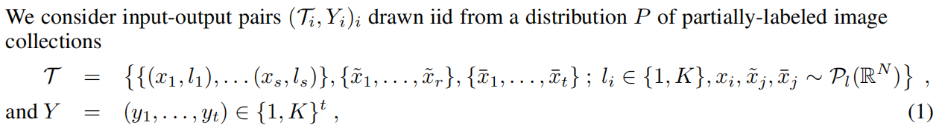
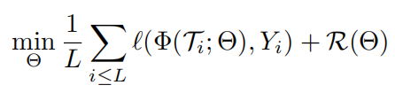

problem set-up
labeled samples
unlabeled samples
samples to classify
number of classes
focus in the case t = 1
image categories of samples to classify
the standard supervised learning objective
a standard regularization objective
model
FEW-SHOT LEARNING WITH GRAPH NEURAL NETWORKS

Slide 37
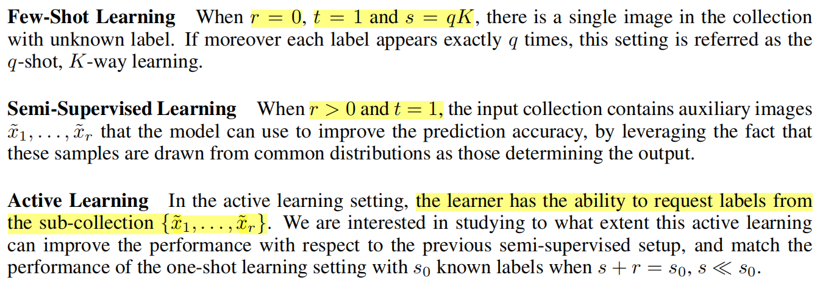
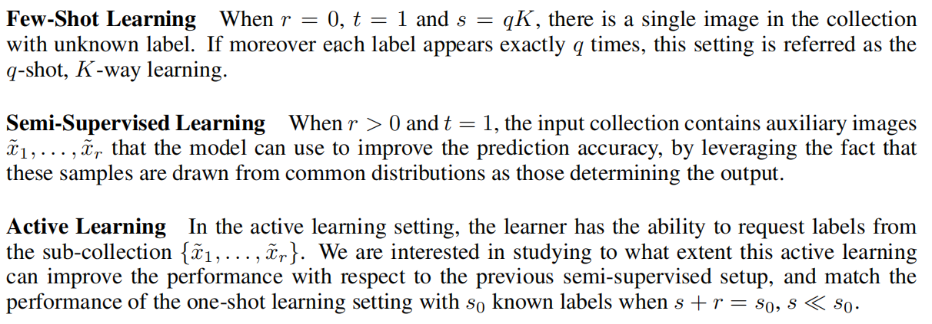
FEW-SHOT LEARNING WITH GRAPH NEURAL NETWORKS

Slide 38
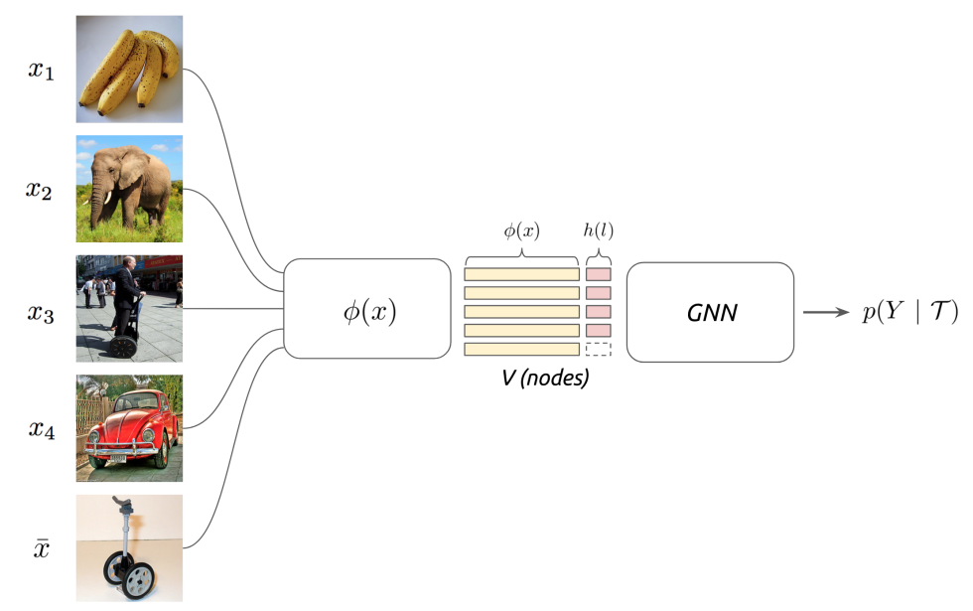
model
set and graph input representations
The input T contains a collection of images, both labeled and unlabeled. The goal of few-shot learning is to propagate label information from labeled samples towards the unlabeled query image.
posterior inference
GT = (V, E) where nodes va ∈ V correspond to the
images present in T (both labeled and unlabeled)
T
FEW-SHOT LEARNING WITH GRAPH NEURAL NETWORKS

Slide 39



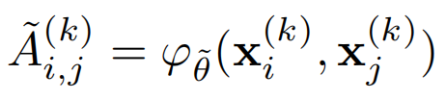
graph neural networks
GNN layer
point-wise non-linearity
trainable parameters
graph intrinsic linear operators
learn edge features from the current node hidden representation:
FEW-SHOT LEARNING WITH GRAPH NEURAL NETWORKS

Slide 40
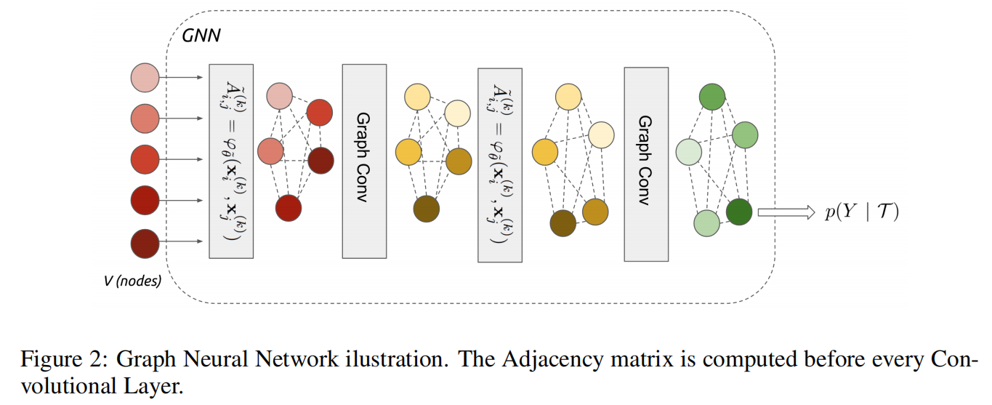




normalized
symmetric function
Adjacency learning
Convolutional neural network
For images with unknown label
Initial Node Features
uniform distribution over the K-simplex
one-hot encoding of the label
FEW-SHOT LEARNING WITH GRAPH NEURAL NETWORKS
Notes:
The trainable adjacency is then normalized to a stochastic kernel by using a softmax along each row.
K-simplex：K维单纯形？

Slide 41




training
few-shot and semi-supervised learning
active learning
The network will learn to ask for the most informative label in order to classify the sample ∈ T
The querying is done after the first layer of the GNN by using a Softmax attention over the unlabeled nodes of the graph.
FEW-SHOT LEARNING WITH GRAPH NEURAL NETWORKS
Notes:
The semi-supervised setting is trained identically — the only difference is that the initial label fields of the node will be filled with the uniform distribution on nodes corresponding to unknown label samples. In order to query only one sample, we set all elements from the Attention ∈ R vector to 0 except for one. At test time we keep the maximum value, at train time we randomly sample one value based on its multinomial probability.

Slide 42
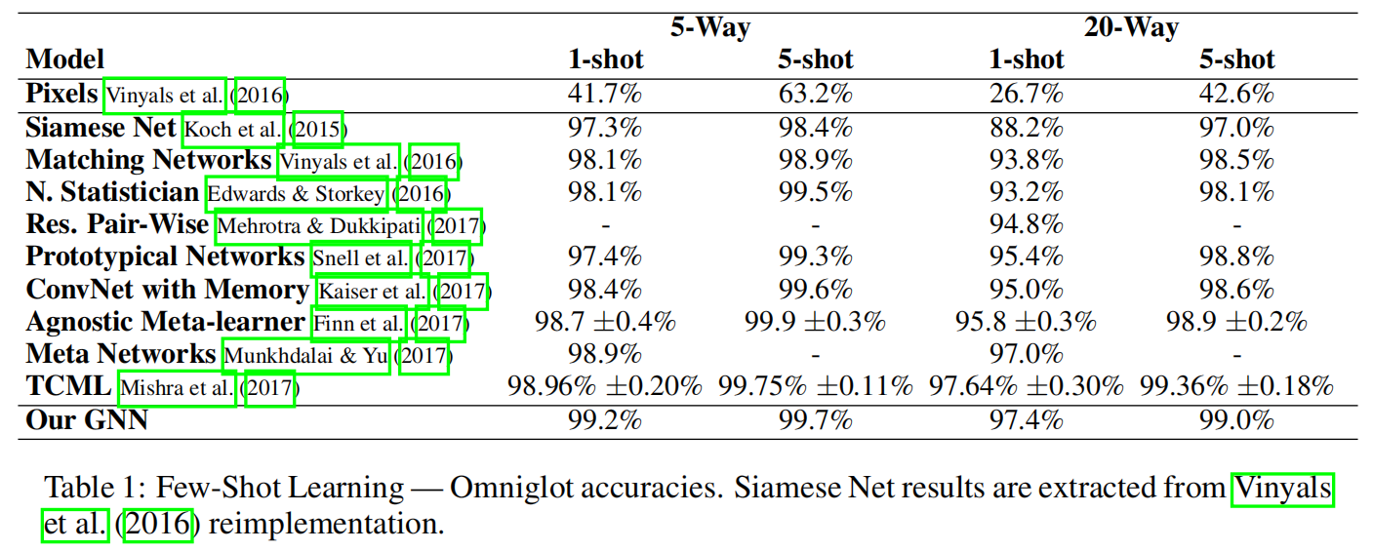
FEW-SHOT LEARNING WITH GRAPH NEURAL NETWORKS

Slide 43
Reference
[1] Graph Neural Networks: A Review of Methods and Applications
[2] Link Prediction Based on Graph Neural Networks
[3] Diffusion Convolutional Recurrent Neural Network: Data-Driven Traffic Forecasting
[4] Spatio-Temporal Graph Convolutional Networks: A Deep Learning Framework for Traffic Forecasting
[5] Few-shot Learning With Graph Neural Networks

