Slide 1
Semi-supervised learning
元培学院
刘奕好
1700017801

Slide 2
Problem define
Dataset: consist of labeled & unlabeled data
Aim: learn a good(accurate & robust) individual classifier
Basic Assumptions:
+ same cluster belong to same class
+ decision boundary lies in low-density region

Slide 3
Content
GAN:
Dong et al. MarginGAN: Adversarial Training in Semi-Supervised Learning
Kumar et al. Semi-supervised Learning with GANs
Form a good target:
‘Teacher’ model:
Non-Parametric:
Zhuang et al. local label propagation for large scale supervised learning
Parametric:
Sajjadi et al. П-model
L&A temporal ensembling for semi-supervised learning
T&V mean teacher
Cicek et al. SaaS:Speed as a Supervisor
Augmentation:
Miyato et al. Virtual adversarial training
(Park et al. Adversarial Dropout for Supervised and Semi-supervised Learning)
Berthelot et al. Mixmatch: A holistic approach to semi-supervised learning
(Berthelot et al. remixmatch & Li et al. dividemix)

Slide 4
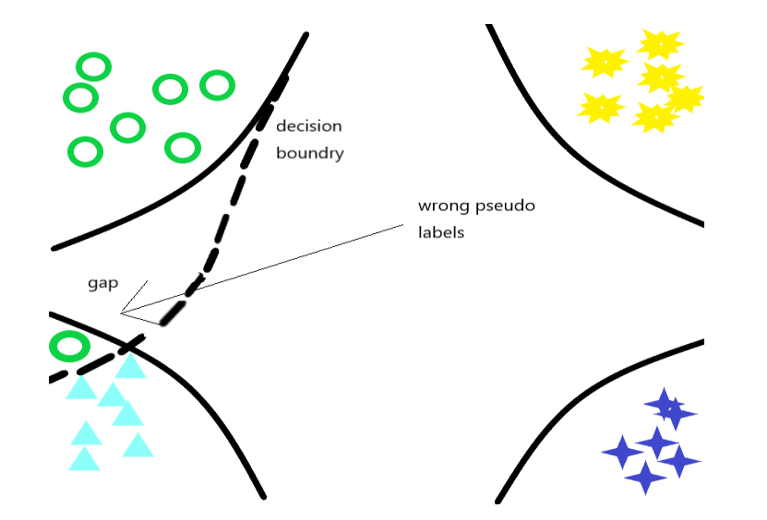
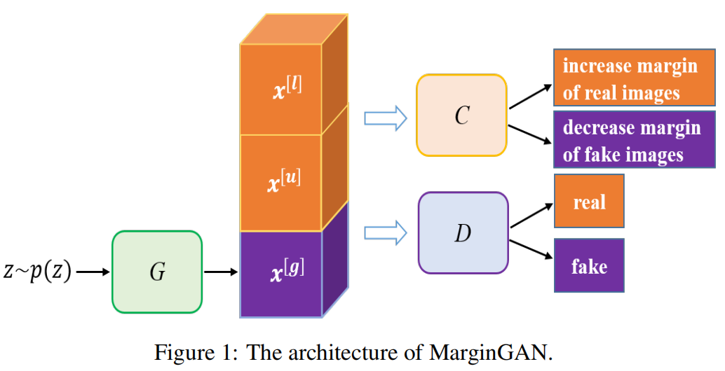
GAN MarginGAN: Adversarial Training in Semi-Supervised Learning
Idea: Wrong pseudo label may cause decision boundary cross gap of two classes. A large margin classifier can disregard those wrong labels and generalize better
Discriminator: (as the origin GAN)
Classifier: entropy regularization(l & u) & inverse entropy regularization(g)
Large margin on unlabeled data small margin on generated data
Generator: fool C & D
Generate large-margin(fool C) and looks real(fool D) samples

Slide 5

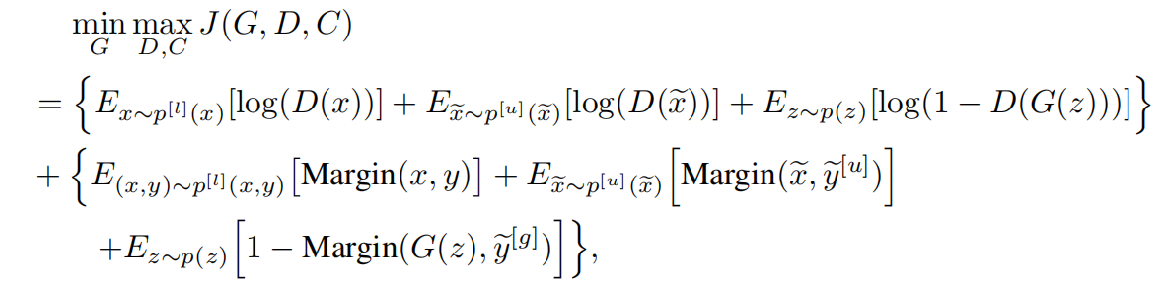
GAN MarginGAN: Adversarial Training in Semi-Supervised Learning
Define:
Min-Max: fix two and optimize the other

Slide 6
GAN Semi-supervised Learning with GANs
Idea: 1)Learn a smooth latent representation z from input x.
(encoder) h: x z
2)Estimate tangent space
3)Consistent on tangent space and in small neighborhood
Method: 1) x & g(h(x)) z & h(g(z)) (decouple training & BiGAN …)
2) computing Jacobian
3) consistent regularization
Discriminator discriminate and classify

Slide 7
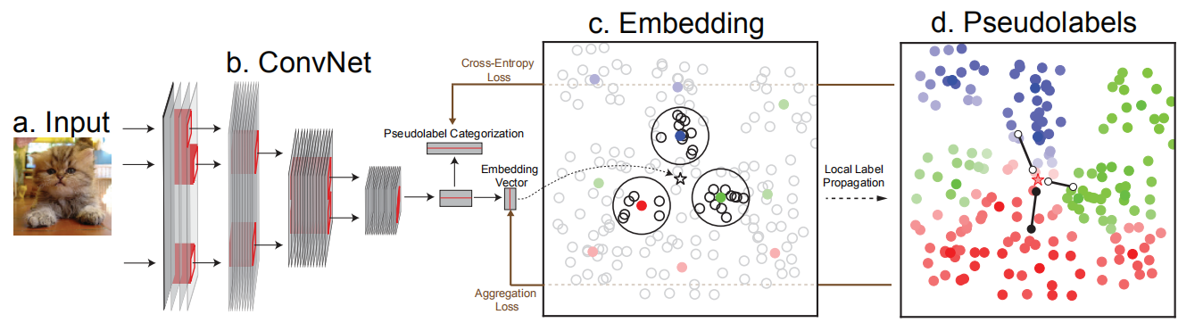

A good teacher non-parametric local label propagation
Idea: use unsupervised method to give pseudo label to unlabeled data – local label propagation
Overview:
· Representation learning: learn a low-dim representation v
C is confidence(labeled is 1) classification loss + same pseudo label ‘nearer’ in the embedding
· Label propagation: weighted KNN

Slide 8
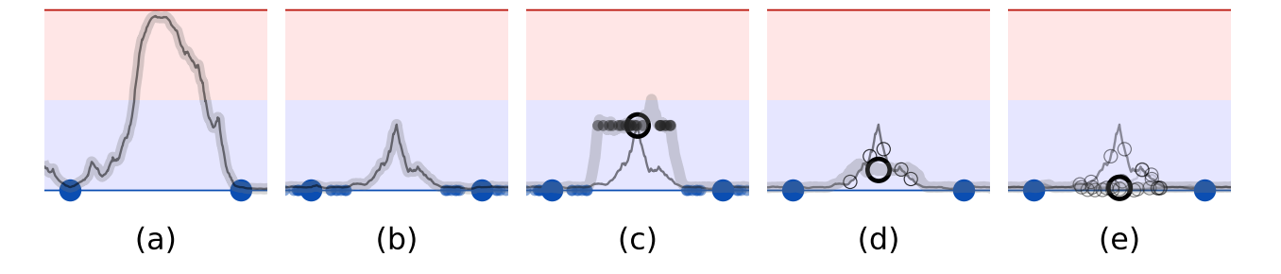
A good teacher parametric
Binary classification (2 labeled &1 unlabeled)
Teacher model function V.S. student model function
Labeled data Target for unlabeled data
a Origin fitted function (overfit)
b With noise consistent around labeled data
c With noise consistent around unlabeled data (confirmation bias)
d Noisy teacher reduce target variance
e Ensemble of teacher model

Slide 9


A good teacher parametric
Idea: use ‘teacher’ model to generate a good target for unlabeled data
(weights Ɵ and noise η )
Several method:
П-model : η is stochastic but specific augmentation
Temporal ensembling: approximate with a weighted average of successive predictions
Mean teacher: weight of teacher model is the exponential moving average of student
SaaS: approximate with a posterior distribution of data that maximize
the learning speed

Slide 10
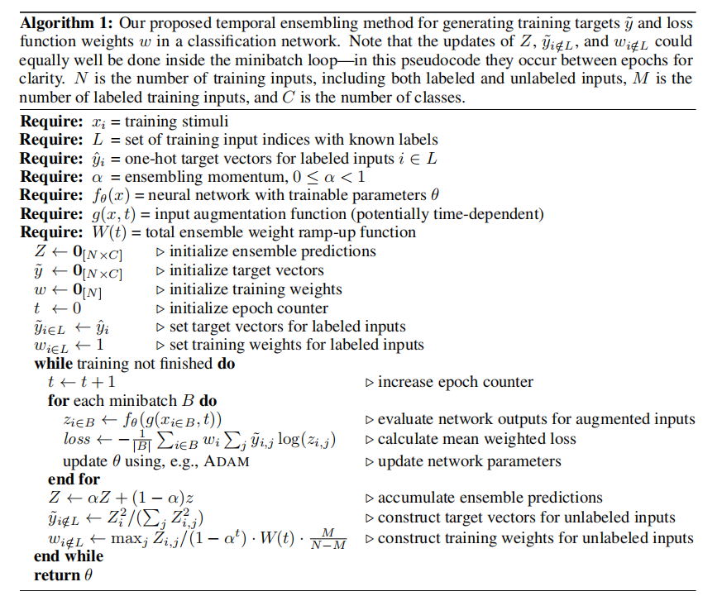
A good teacher parametric temporal ensembling
Idea: reach into history, the target of each sample is a exponential moving average of the predictions in history
Targets: the more recent prediction
has bigger weight
Loss: each sample has a weight
higher confident sample weight more

Slide 11
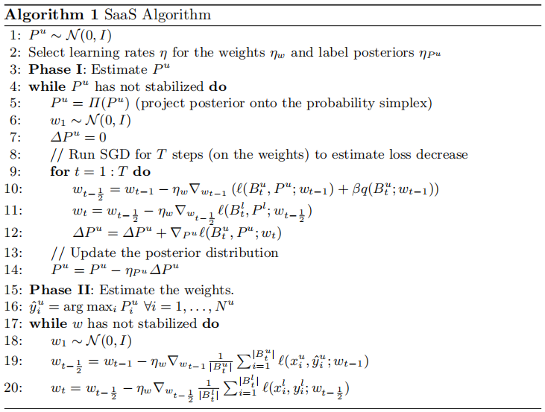
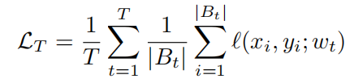

A good teacher parametric SaaS: speed as a supervisor
Idea: model tends to learn ‘easier’ samples quicker and learn ‘hard’ samples slow (curriculum training) , thus, learn a posterior distribution of data that maximize learning speed
Method:
Estimate $P^{u}$
Outer loop: update $P^{u}$
Inner loop: do SGD T times
to calculate the speed
Update model param.
Use $P^{u}$ to give pseudo-label
Train both on labeled and
unlabeled

Slide 12
Augmentation
Idea: classification stays consistent for augmented sample
several methods:
VAT: adversarial perturbation(PGD)
Other adv attack methods
Zhai et al. Adversarially Robust Generalization Just Requires More Unlabeled Data
Raghunathan et al. Adversarial training can hurt generalization
Interpolation Consistency Training: mixup between unlabeled data
Mix-match: mixup between labeled and unlabeled data
Variant of mix-match: remixmatch & dividemix

Slide 13
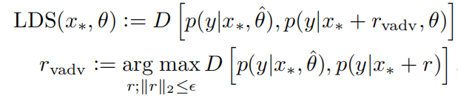


A good augmentation Virtual Adversarial Training
Idea: class remain unchanged when add adversarial perturb (robust)
Method:
Form virtual label from the present model
Perturb the whole dataset (LDS – local smoothness)
Loss: consistence loss + supervised loss
Adversarial training can hurt generalization

Slide 14
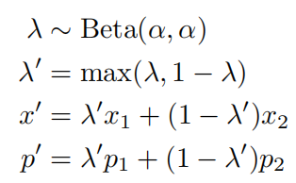
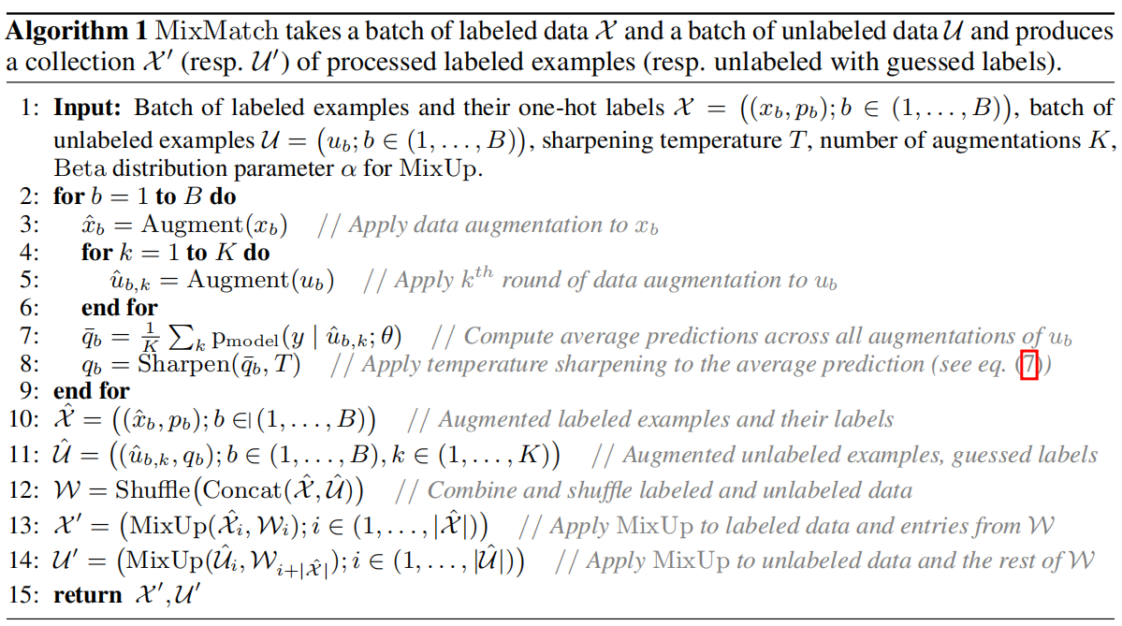
A good augmentation Mix-match
Idea: in contrast to ICT(only unlabeled), mix-match mixup (Zhang et al.) labeled and unlabeled
Method:
Apply one random augment
to labeled data
Apply k augments to unlabeled
and average the prediction
Sharpen the prediction of
unlabeled data
Shuffle labeled & unlabeled
into W
Mixup labeled with W to get
new labeled set
Mixup unlabeled with W to get
new unlabeled set

Slide 15
Reference
GAN
Good Semi-supervised Learning That Requires a Bad GAN
MarginGAN: Adversarial Training in Semi-Supervised Learning
Semi-supervised Learning with GANs: Manifold Invariance with Improved Inference
Non-parametric
local label propagation for large scale supervised learning
Label Propagation for Deep Semi-supervised Learning
Deep metric transfer for label propagation with limited annotated data.
Unsupervised feature learning via non-parametric instance discrimination.
A good ‘teacher’
Semi supervised Learning with Ladder Networks.
Regularization With Stochastic Transformations and Perturbations for Deep Semi-Supervised Learning
Temporal Ensembling for Semi-Supervised Learning
Mean teachers are better role models: Weight-averaged consistency targets improve semi-supervised deep learning results
Deep co-training for semi-supervised image recognition.
A good augmentation
Virtual Adversarial Training: A Regularization Method for Supervised and Semi-Supervised Learning
Interpolation Consistency Training for Semi-Supervised Learning
mixmatch a holistic approch to semi-supervised learning
remixmatch semi supervised learning
Dividemix: learning with noisy labels as semi-supervised learning
SaaS: Speed as a Supervisor for Semi-supervised Learning
Theory
Adversarially Robust Generalization Just Requires More Unlabeled Data
Adversarial training can hurt generalization

