Slide 1
Deep Learning: Advanced topics Optimization Dynamics in Deep Learning ——Batch normalization
王恒睿
元培学院
wanghr1230@pku.edu.cn

Slide 2
Outline
Batch normalization helps training
Internal Covariate Shift (ICS)
Smoothing effect of BN
BN with resnet
Activations and coactivations
Fixup initialization

Slide 3
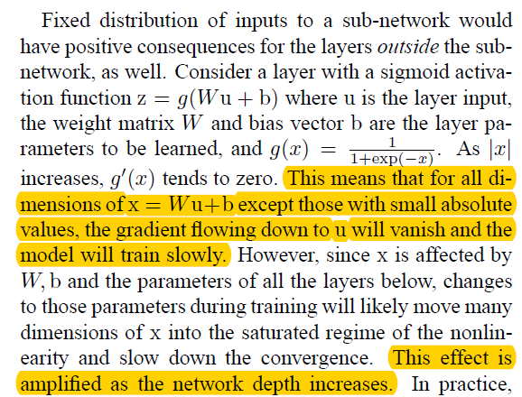
Internal Covariate Shift
We define Internal Covariate Shift as the change in the distribution of network activations due to the change in network parameters during training.

Slide 4
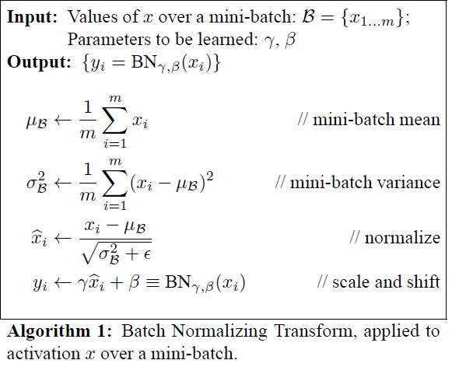
The raise of BN
We refer to the change in the distributions of internal nodes of a deep network, in the course of training, as Internal Covariate Shift. Eliminating it offers a promise of faster training. We propose a new mechanism, which we call Batch Normalization, that takes a step towards reducing internal covariate shift, and in doing so dramatically accelerates the training of deep neural nets.

Slide 5
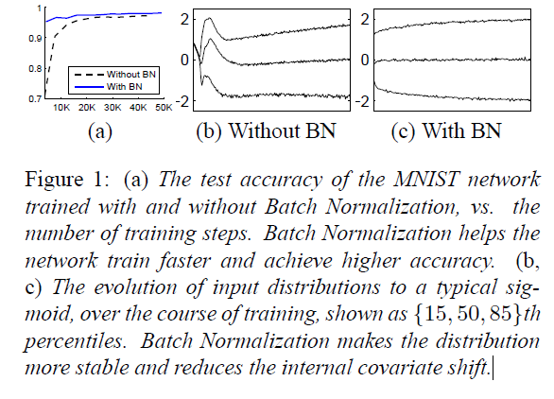
Experiments

Slide 6
Accelerating BN Networks
Simply adding Batch Normalization to a network does not take full advantage of our method. To do so, we further changed the network and its training parameters, as follows:
Increase learning rate
Remove Dropout
Reduce the L2 weight regularization
Accelerate the learning rate decay.
Remove Local Response Normalization
Shuffle training examples more thoroughly
Reduce the photometric distortions.

Slide 7
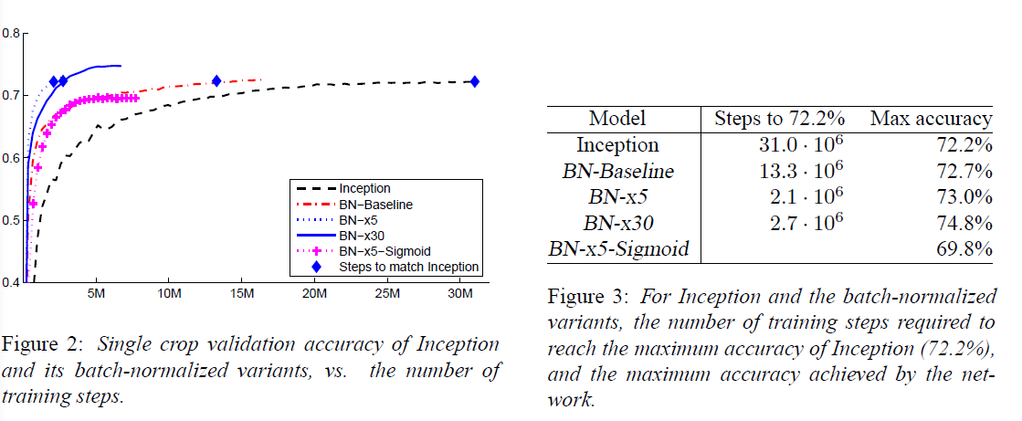
Experiments

Slide 8
Is the effectiveness of BN indeed related to ICS?
We train networks with random noise injected after BatchNorm layers. Specifically, we perturb each activation for each sample in the batch using i.i.d. noise sampled from a non-zero mean and non-unit variance distribution.
Both of these networks perform much better than standard networks. Moreover, the “noisy” BatchNorm network has qualitatively less stable distributions than even the standard, non-BatchNorm network, yet it still performs better in terms of training.

Slide 9
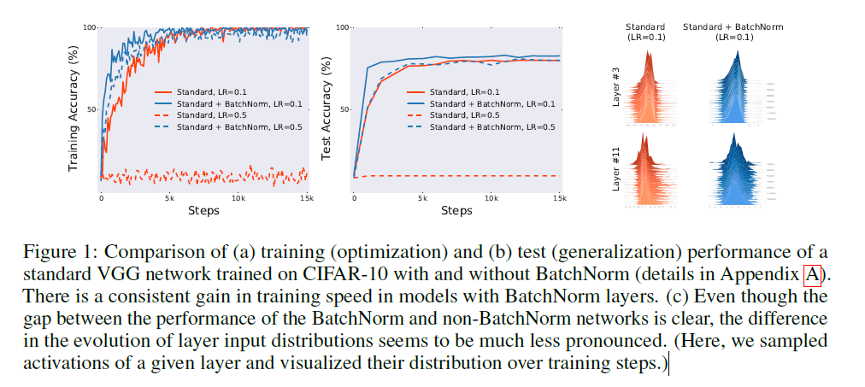

Slide 10
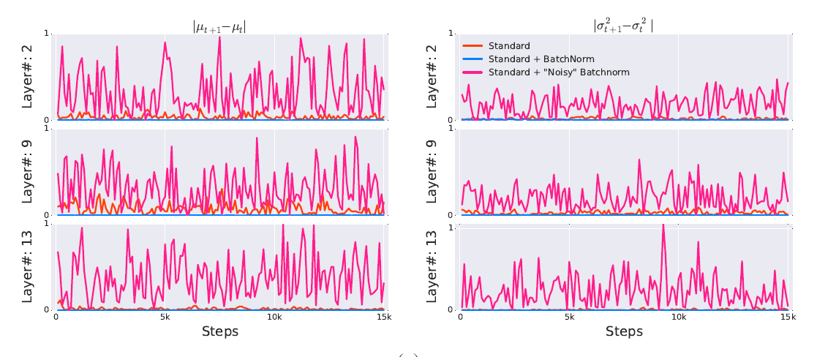
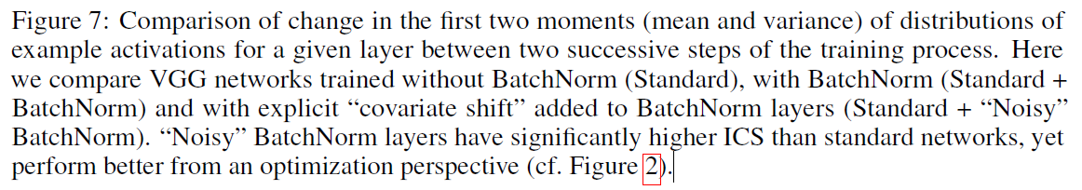

Slide 11
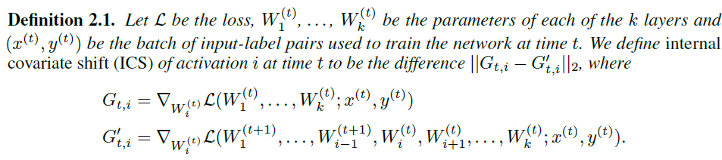
Is BN’s stabilization of layer input distributions even effective in reducing ICS
The difference between and G’ thus G reflects the change in the optimization landscape of Wi caused by the changes to its input. It thus captures precisely the effect of cross-layer dependencies that could be problematic for training.

Slide 12
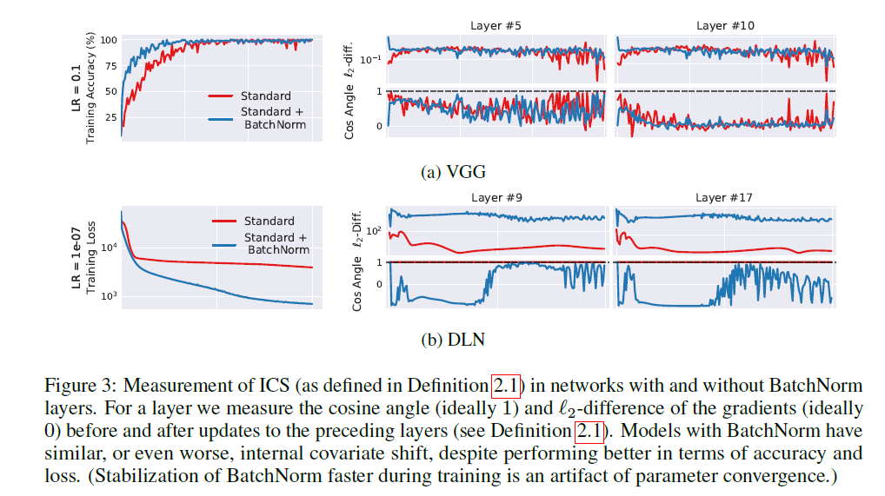

Slide 13
Surprisingly, we observe that networks with BatchNorm often exhibit an increase in ICS (cf. Figure 3).This is particularly striking in the case of DLN.
The stabilization of the BatchNorm VGG network later in training is an artifact of faster convergence.
This evidence suggests that, from optimization point of view BatchNorm might not even reduce the internal covariate shift.

Slide 14
Why does BatchNorm work?
Aside from reducing ICS, Ioffe and Szegedy [10] identify a number of additional properties of BatchNorm. These include prevention of exploding or vanishing gradients, robustness to different settings of hyperparameters such as learning rate and initialization scheme, and keeping most of the activations away from saturation regions of non-linearities. All these properties are clearly beneficial to the training process. But they are fairly simple consequences of the mechanics of BatchNorm and do little to uncover the underlying factors responsible for BatchNorm’s success. Is there a more fundamental phenomenon at play here?

Slide 15
The smoothing effect of BatchNorm
Indeed, we identify the key impact that BatchNorm has on the training process: it reparametrizes the underlying optimization problem to make its landscape significantly more smooth. The first manifestation of this impact is improvement in the Lipschitzness of the loss function. That is, the loss changes at a smaller rate and the magnitudes of the gradients are smaller too. There is, however, an even stronger effect at play. Namely, BatchNorm’s reparametrization makes gradients of the loss more Lipschitz too. In other words, the loss exhibits a significantly better “effective” β-smoothness.

Slide 16
For detailed proof: https://papers.nips.cc/paper/7515-how-does-batch-normalization-help-optimization.pdf

Slide 17
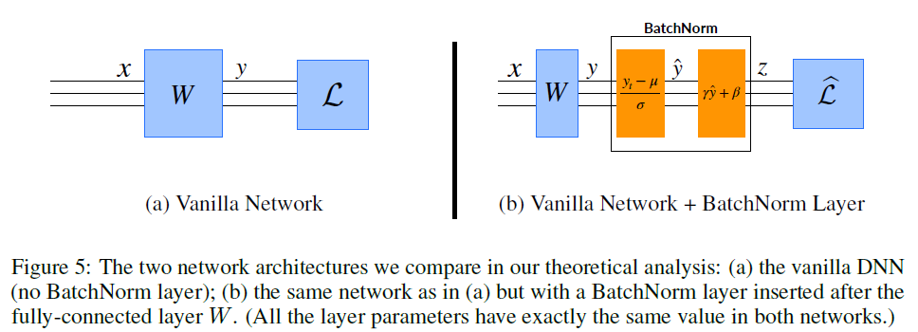
We compare the optimization landscape of the original training problem to the one that results from inserting the BatchNorm layer after the fully-connected layer – normalizing the output of this layer.

Slide 18
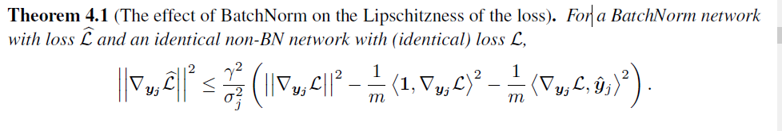
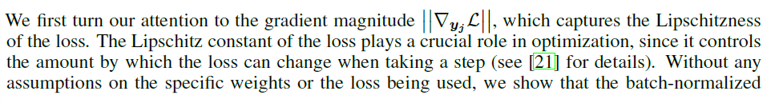
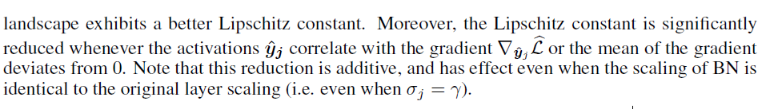
First order properties

Slide 19
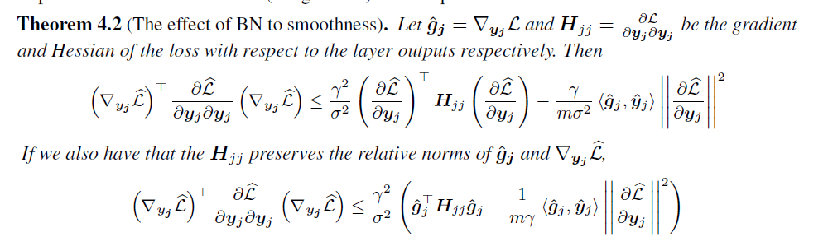
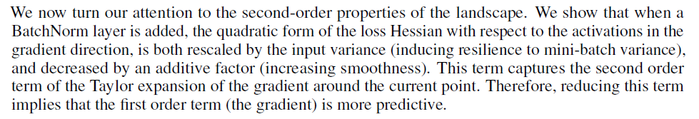
Second order properties

Slide 20
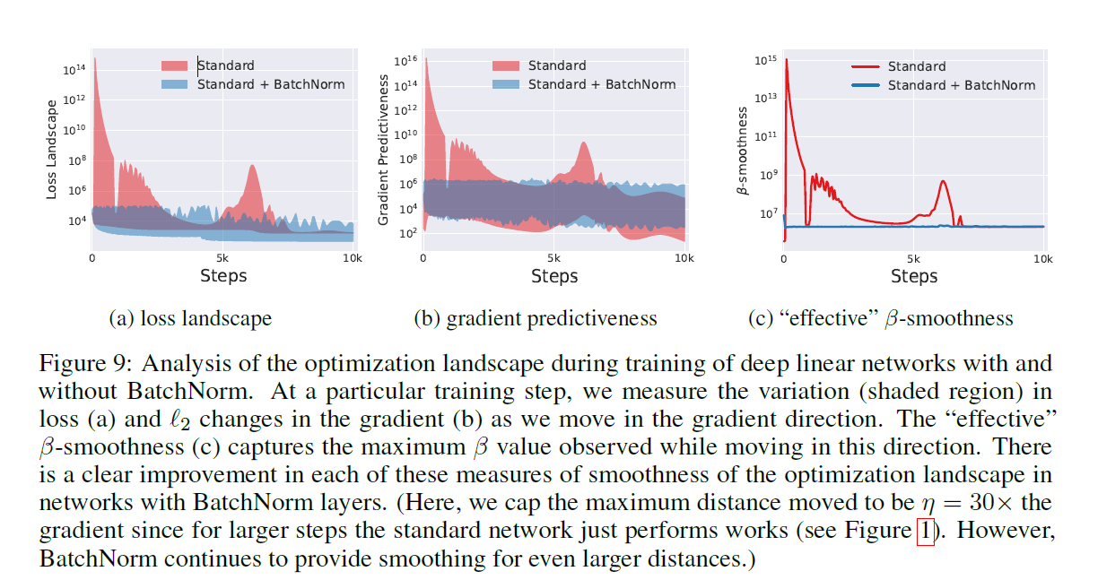

Slide 21
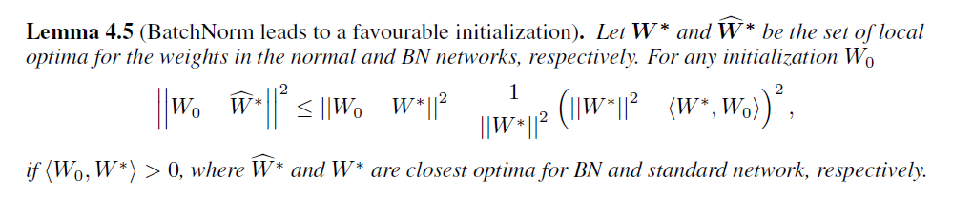
In addition to a desirable landscape, we find that BN also offers an advantage in initialization

Slide 22
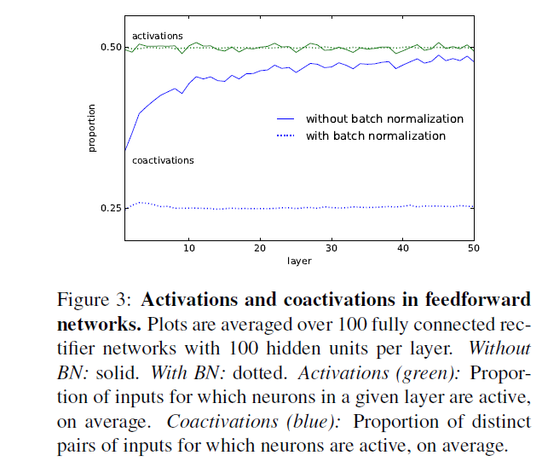
Activations and coactivations
Neurons are active for half their inputs on aver age, with or without batch normalization. With batch normalization, neurons are co-active for 0.25 of distinct pairs of inputs, which is what would happen if activations were decided by unbiased coin flips. Without batch normalization, the co-active proportion climbs with depth, suggesting neuronal responses are increasingly redundant.

Slide 23
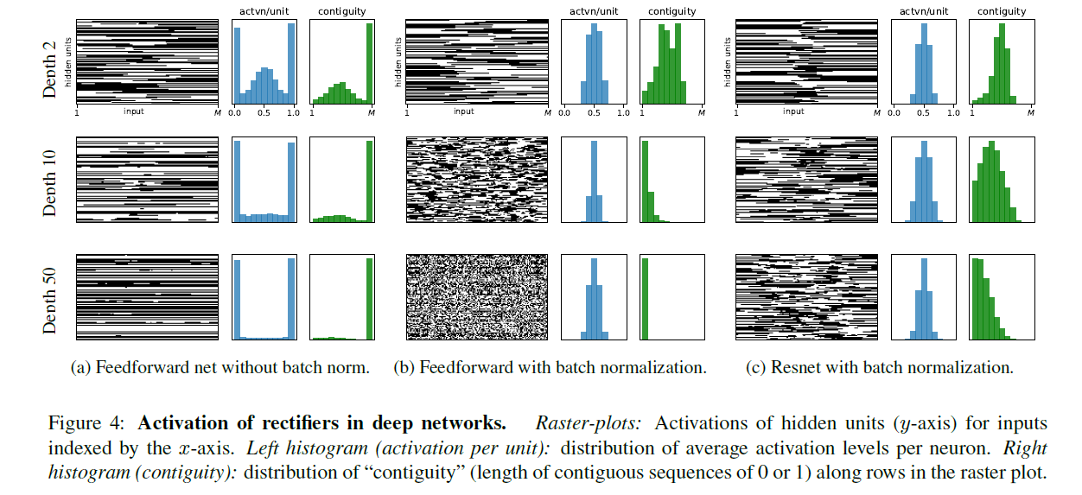

Slide 24
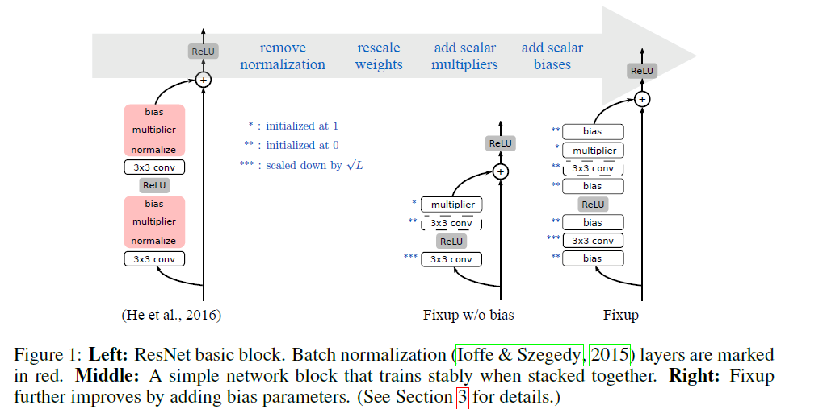
Residual learning without normalization

Slide 25
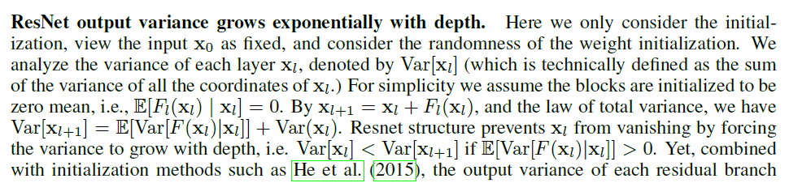
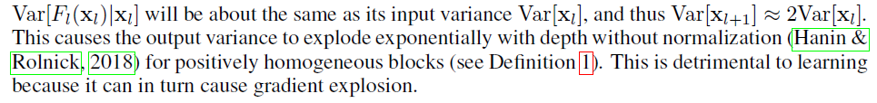
RESNET WITH STANDARD INITIALIZATIONS LEAD TO EXPLODING GRADIENTS

Slide 26
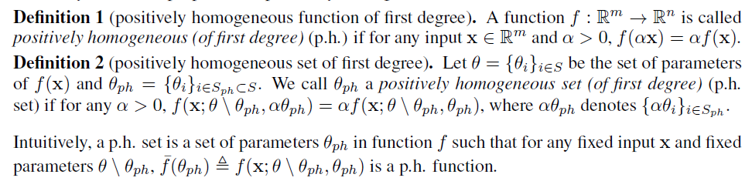

Slide 27
Assumptions
For detailed proof: https://arxiv.org/pdf/1901.09321.pdf

Slide 28
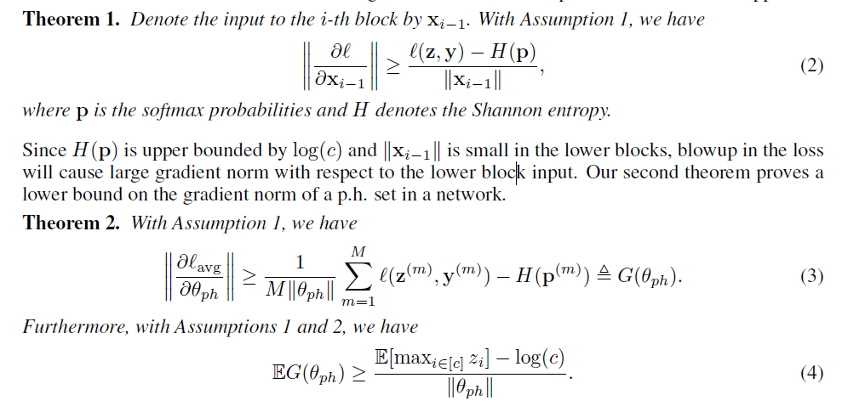
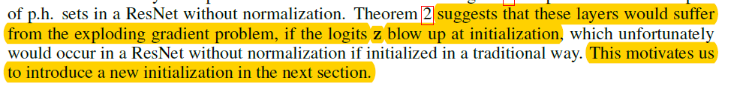

Slide 29
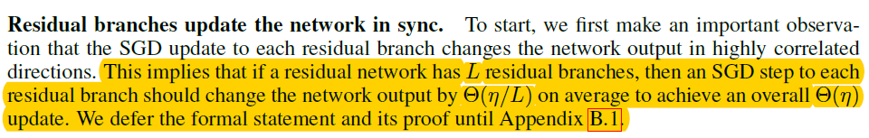
We denote the learning rate by and set our goal.
Observation
Simplify

Slide 30
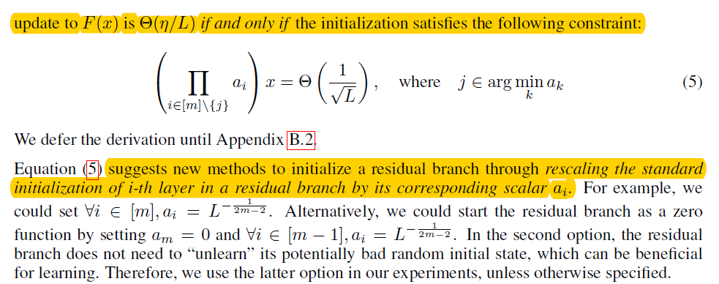
Theory

Slide 31
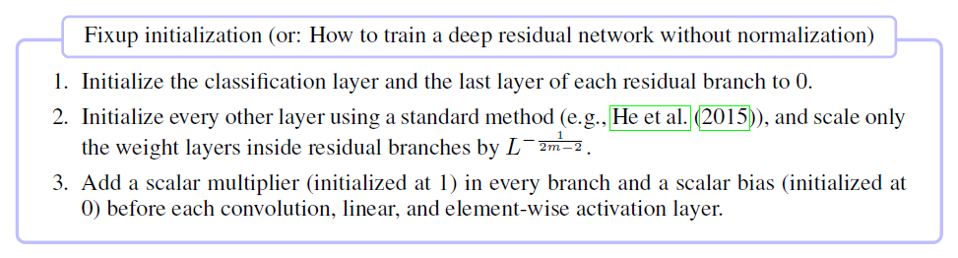
Conclusion

Slide 32
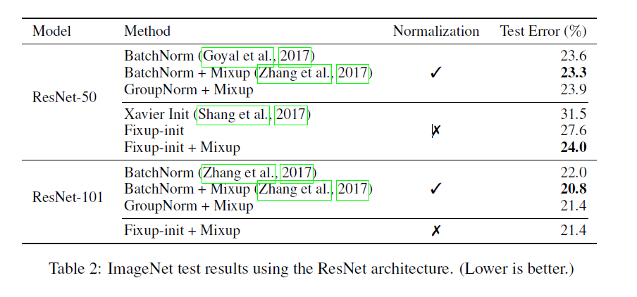
Experiment on Image classification

Slide 33
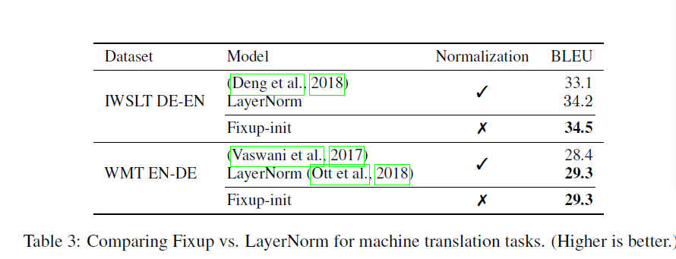
Experiment on Machine translation

Slide 34
Reference:
[Ioffe et al, 2015] Batch Normalization: Accelerating Deep Network Training by Reducing Internal Covariate Shift
[Balduzzi et al, 2017] The Shattered Gradients Problem:If resnets are the answer, then what is the question?
[Santurkar et al., 2018] How Does Batch Normalization Help Optimization?
[Bjorck et al, 2018] Understanding Batch Normalization
[Zhang et al., 2019] FIXUP INITIALIZATION:RESIDUAL LEARNING WITHOUT NORMALIZATION

