Slide 1
Deep Learning: Advanced topics Optimization Dynamics in Deep Learning ——Implicit Regularization
张伊凡
元培学院
yifzhang@pku.edu.cn

Slide 2
Outline
Implicit Regularization on Low-rank Matrix Factorization
Matrix Sensing
NN with Quadratic Activation
Implicit Regularization on Deep Homogeneous Models
Auto-Balancing
Fully Connected NN & CNN
Asymmetric Matrix Factorization
Implicit Regularization on Least Squares
Stochastic Gradient Flow & Ridge Regression

Slide 3
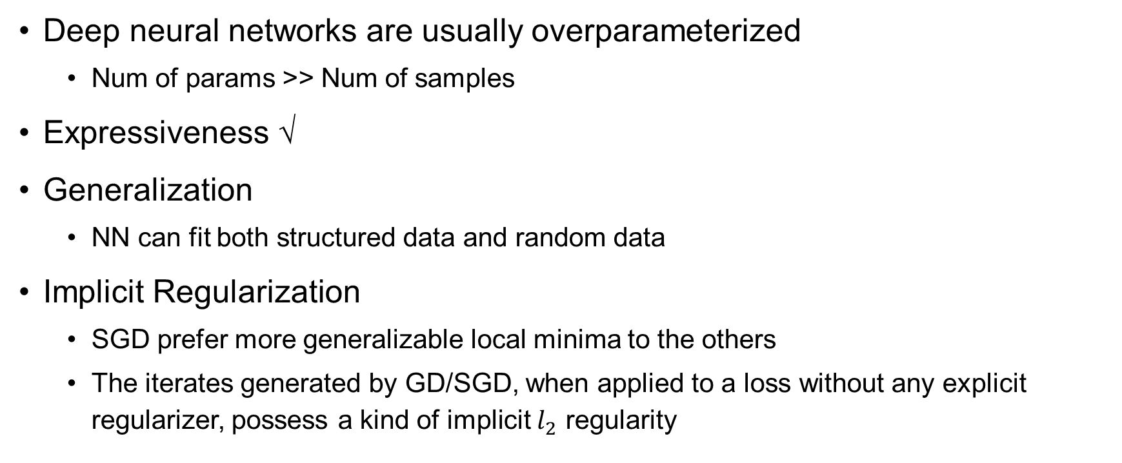
Overparameterization and Implicit Regularization
Deep neural networks are usually overparameterized
Num of params >> Num of samples
Expressiveness √
Generalization
NN can fit both structured data and random data
Implicit Regularization
SGD prefer more generalizable local minima to the others
The iterates generated by GD/SGD, when applied to a loss without any explicit regularizer, possess a kind of implicit $l_{2}$ regularity

Slide 4
Over-parameterized Matrix Sensing
Gunasekar et al. initiates the study of low-rank matrix factorization models with over-parameterization and conjectures that gradient descent prefers small trace norm solution.
Li et al. resolves the conjecture for the matrix sensing problem (under RIP) — recovering a low-rank matrix from linear measurements. With a full-rank factorized parameterization, gradient descent, starting with a small initialization, converges to the true low-rank matrix (which is also the minimum trace norm solution.)
[Yuanzhi Li et al., 2018]

Slide 5
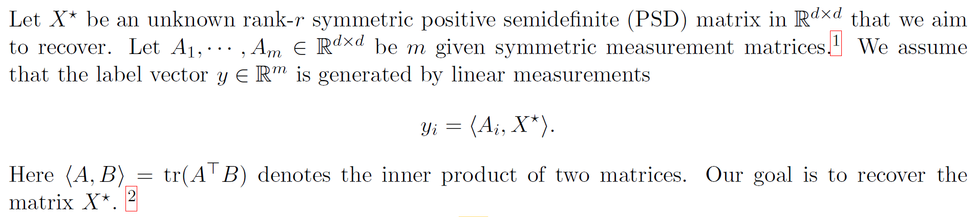
Matrix Sensing
Setup:
[Yuanzhi Li et al., 2018]

Slide 6
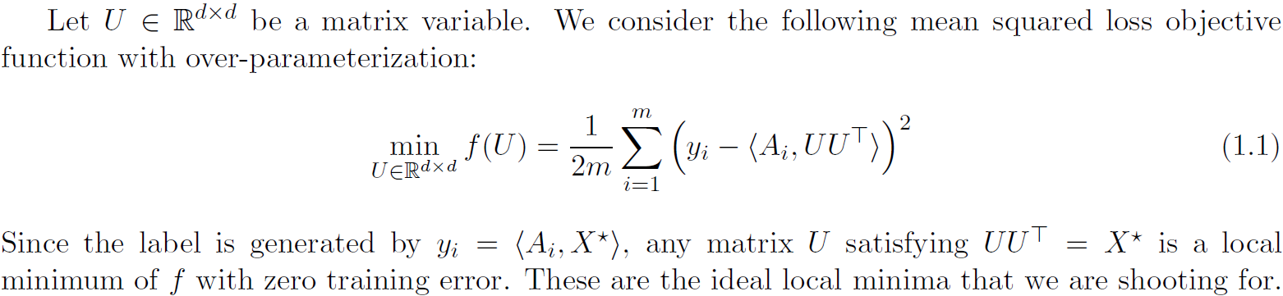
Objective of Matrix Sensing
Objective:

Slide 7

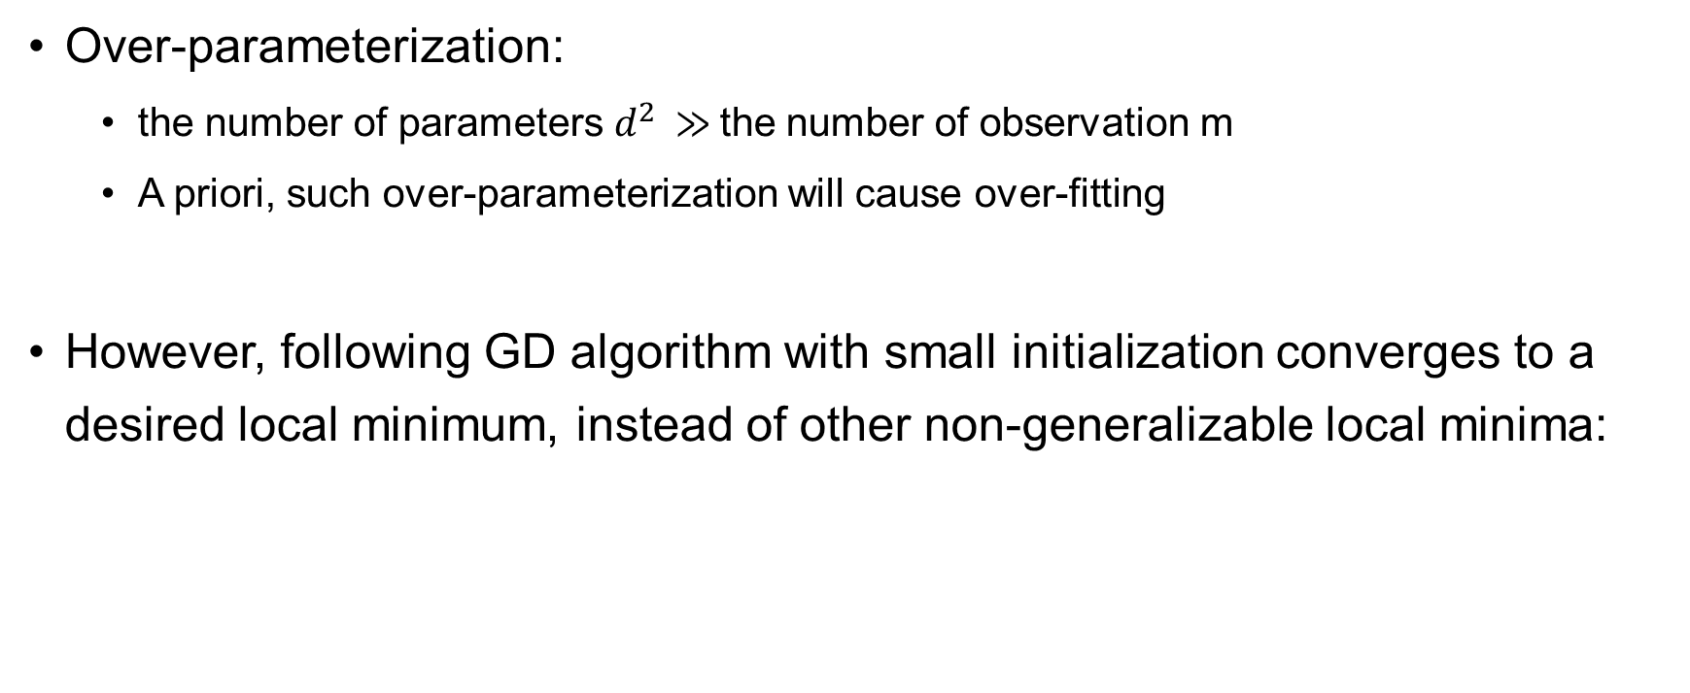
Over-parameterized Matrix Sensing
Over-parameterization:
the number of parameters $d^{2}$ $≫$the number of observation m
A priori, such over-parameterization will cause over-fitting
However, following GD algorithm with small initialization converges to a desired local minimum, instead of other non-generalizable local minima:

Slide 8
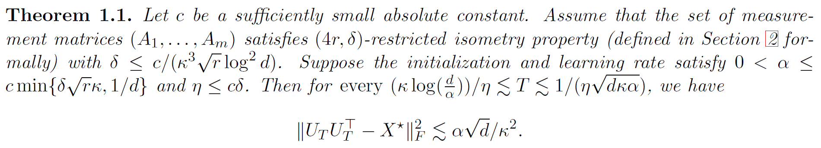
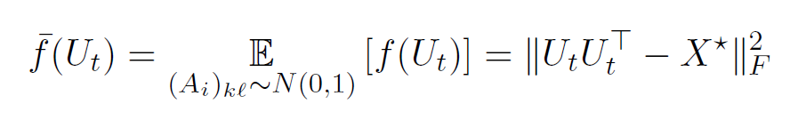

Implicit Regularization on Matrix Sensing
The recovery error can be viewed as test error - the expectation of test error on a fresh measurement $A_{i}$ drawn from normal distribution:

Slide 9
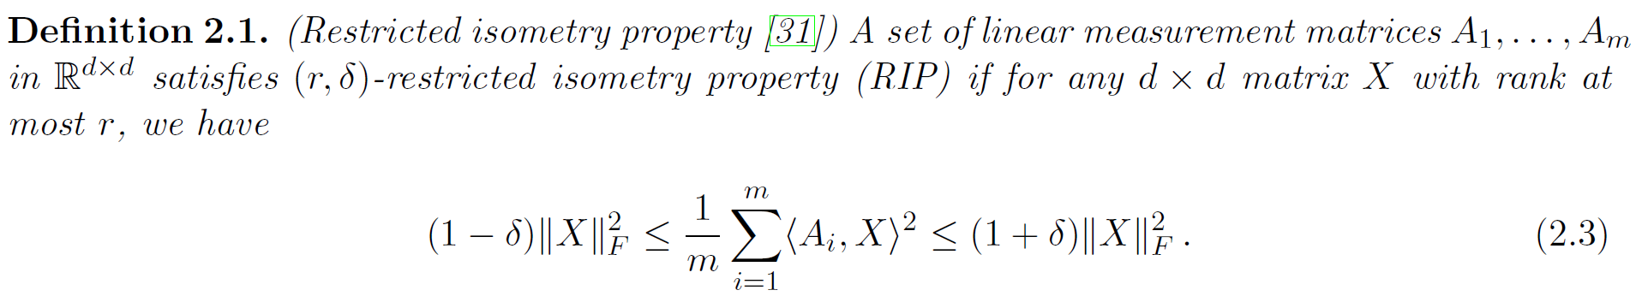
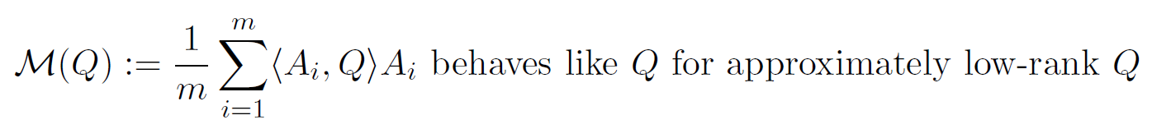
Restricted Isometry Property
A meta statement following RIP is crucial:

Slide 10

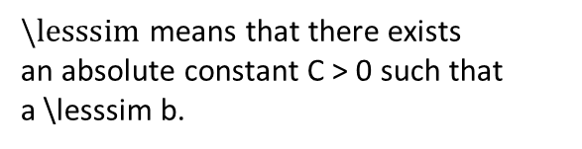
Implicit Regularization on Matrix Sensing
Theorem shows that GD can provide an algorithmic regularization so that the generalization error depends on the size of the initialization $α$
$\backslash lesssim$ means that there exists
an absolute constant C > 0 such that
a \lesssim b.

Slide 11

Implicit Regularization on Matrix Sensing
We can choose small enough $α$ (e.g.,$1/d^{5}$) to get approximately zero generalization error
Moreover, when $α$ is small, gradient descent can run for a long period of time without overfitting the data

Slide 12
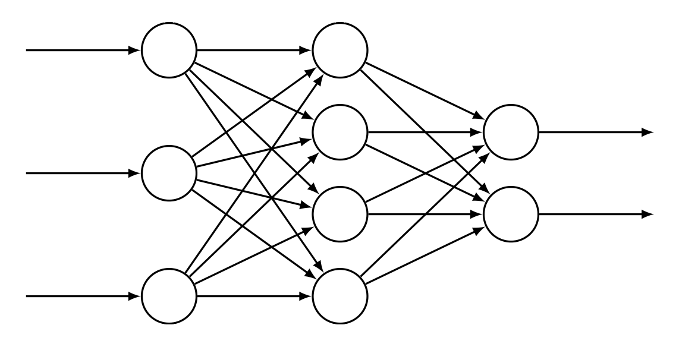
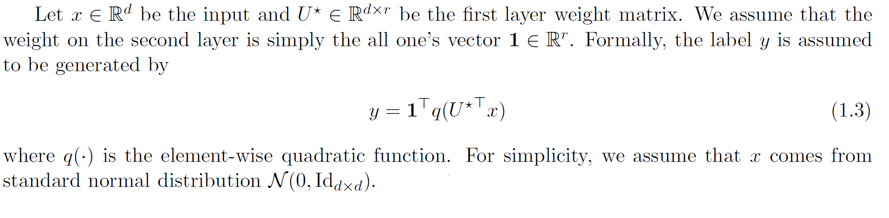
Extensions to Neural Networks with Quadratic Activations
Results above can be extended to learning one-hidden-layer
neural networks with quadratic activations
Setup:
[Yuanzhi Li et al., 2018]

Slide 13

Extensions to Neural Networks with Quadratic Activations
An over-parameterized model with a variable $U∈R^{d×d}$
The prediction $\hat{y}$ is parameterized by $\hat{y}=1^{T}q(U^{T}x)$
Mean squared error as loss function ${\left(y−\hat{y}\right)}^{2}$
[Yuanzh Li et al., 2018]

Slide 14
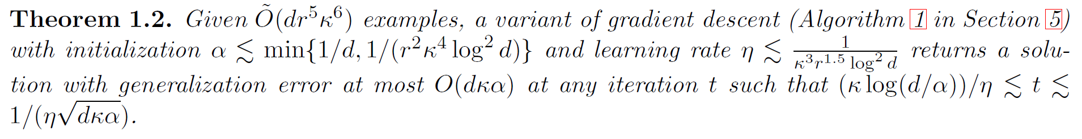
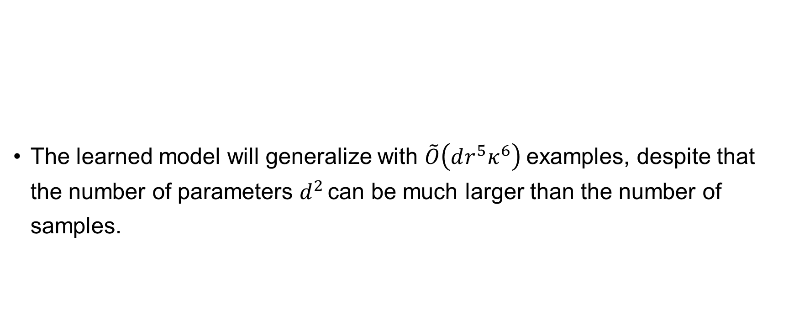

Regularization on Neural Networks
big O tilde notation ignores logarithmic factors
The learned model will generalize with $\tilde{O}\left(dr^{5}κ^{6}\right)$examples, despite that the number of parameters $d^{2}$ can be much larger than the number of samples.
$κ$: condition number of $U^{∗}{U^{∗}}^{T}$

Slide 15
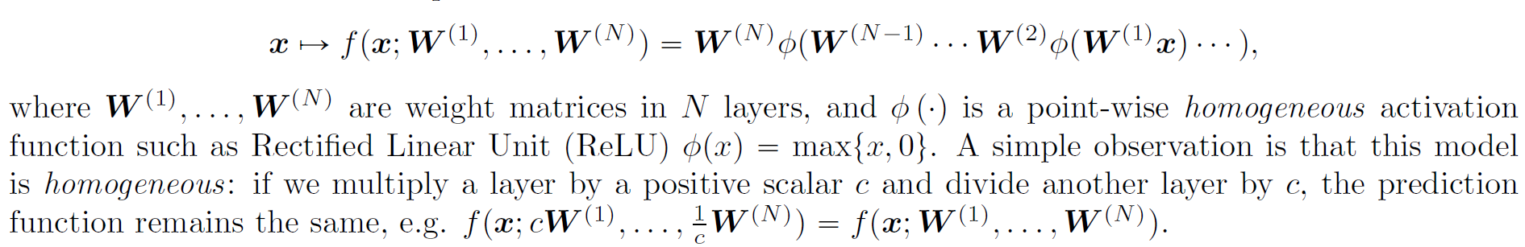

Deep Homogeneous Models
Modern machine learning models often consist of multiple layers, a feed-forward deep neural network that defines a prediction function
Homogeneity $⇒$ a solution can produce small function value while being unbounded (multiply one layer by $M$and divide another layer)
[Du et al., 2018]

Slide 16
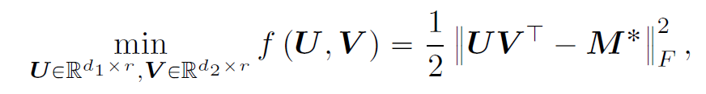
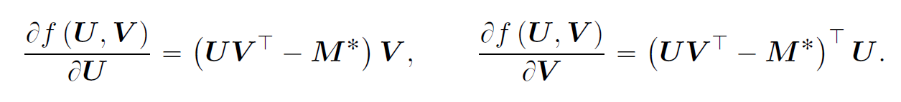

Asymmetric Matrix Factorization
A simple two-layer homogeneous model for factorizing a low-rank matrix:
due to the homogeneity of $f$, it is not smooth even in the neighborhood of a globally optimum point
Consider a global optimum $\left(U,V\right)$, $|\left|U\right||∼ε$, $|\left|V\right||∼1/ε$, then perturbation on U lead to dramatic change on V.

Slide 17
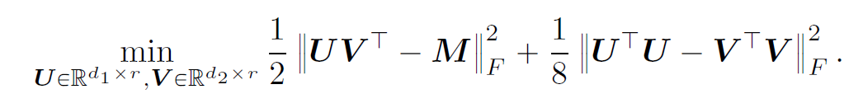
Asymmetric Matrix Factorization
To avoid homogeneity, a regularization term for balancing the two layers is added:

Slide 18
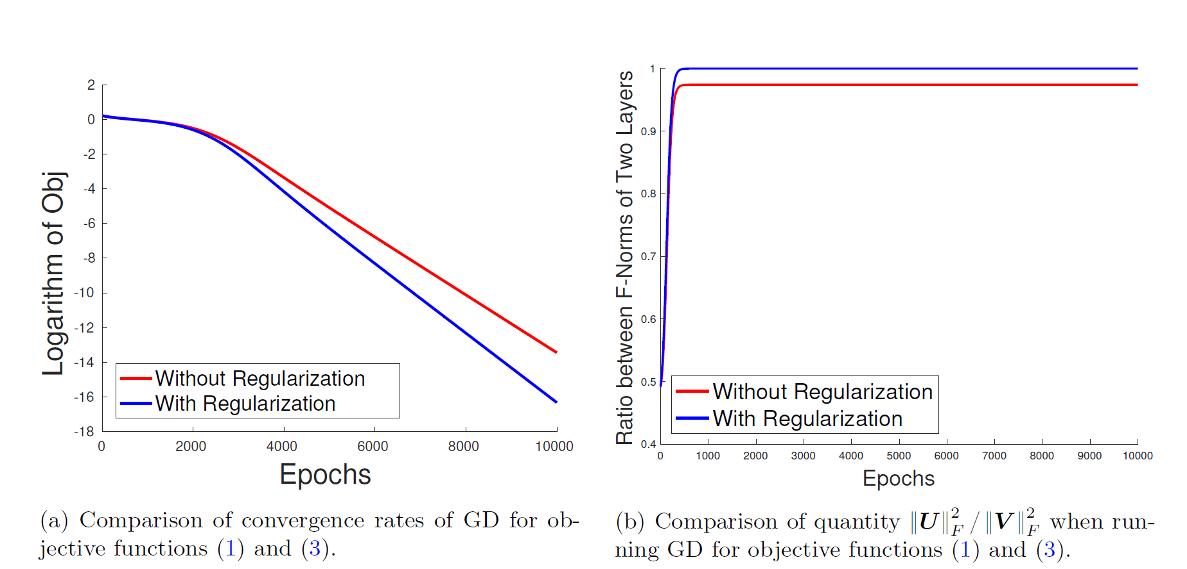
Asymmetric Matrix Factorization
even without regularization term GD with random initialization converges to a global minimum and the convergence rate is also competitive.
the ratio between norms remains a constant in all iterations.
Why?
Why does GD balance multiple layers and converge in learning homogeneous functions?

Slide 19
Auto-Balancing Properties in Neural Networks
Focus on: The implicit regularization imposed by gradient descent with infinitesimal step size (gradient flow) in training deep neural networks
Fully Connected NN: gradient flow automatically balances the incoming and outgoing weights at every neuron, which implies the weights between different layers are balanced
Generalize to CNN

Slide 20

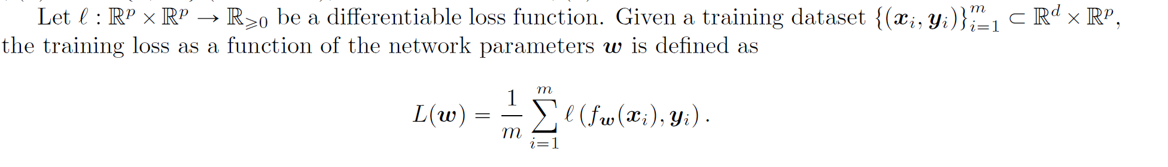
Auto-Balancing Properties in Fully Connected NN
Notations:
Homogeneous activation i.e.

Slide 21
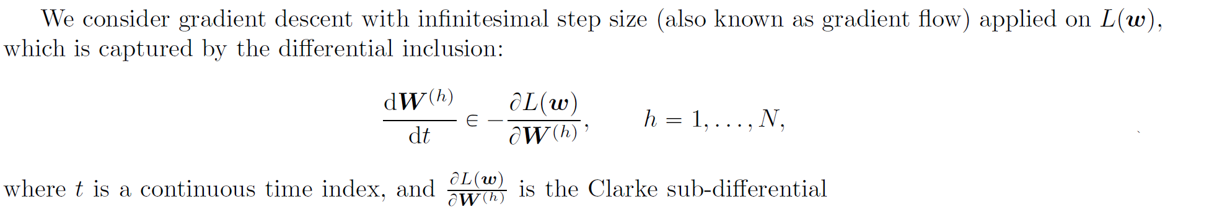
Auto-Balancing Properties in Fully Connected NN
Setup

Slide 22
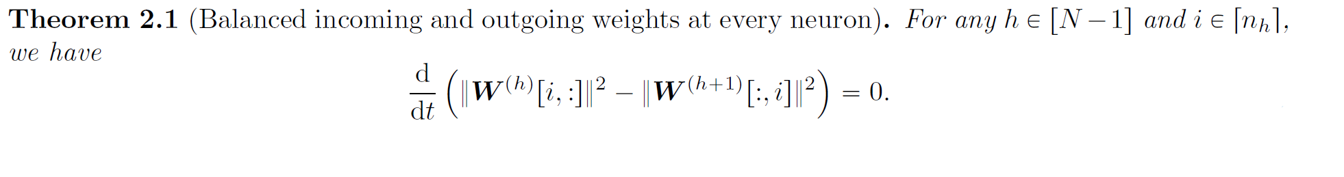

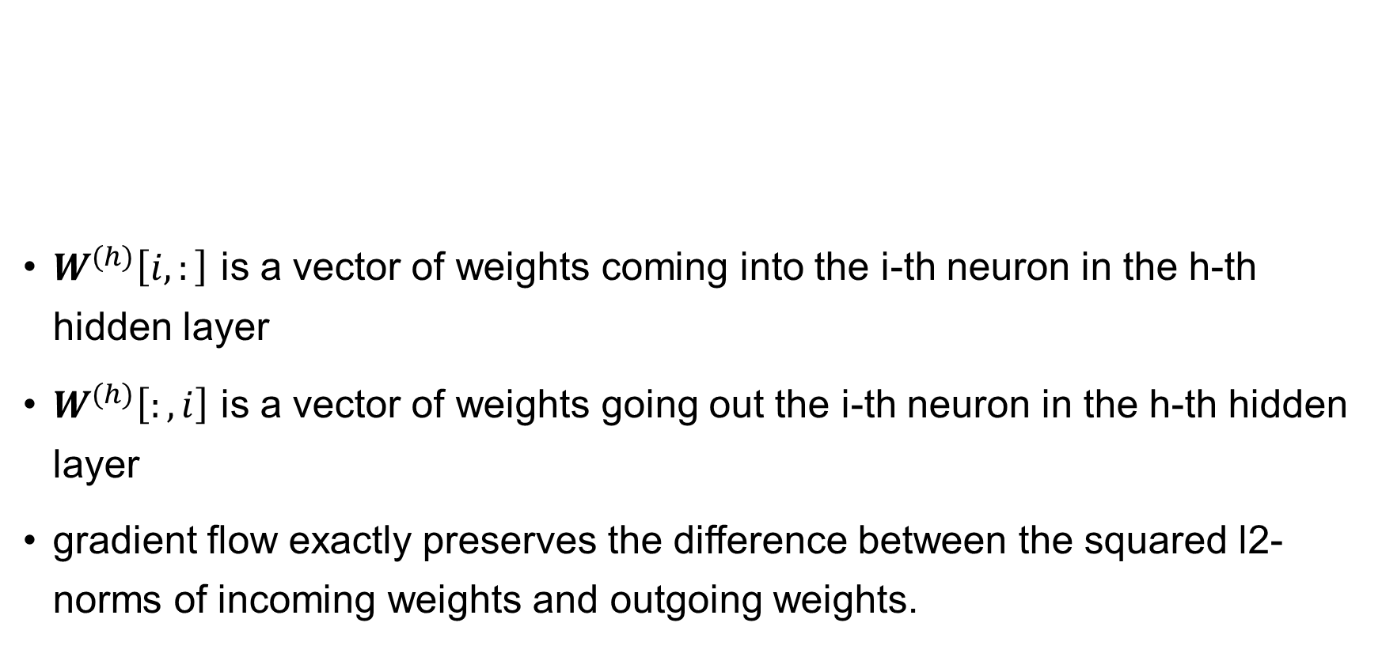
Auto-Balancing Properties in Fully Connected NN
$W^{(h)}\left[i,:\right]$ is a vector of weights coming into the i-th neuron in the h-th hidden layer
$W^{(h)}\left[:,i\right]$ is a vector of weights going out the i-th neuron in the h-th hidden layer
gradient flow exactly preserves the difference between the squared l2-norms of incoming weights and outgoing weights.

Slide 23

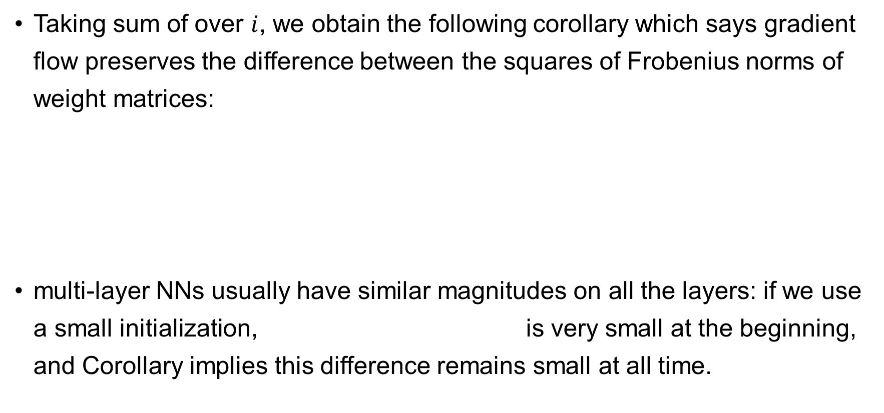
Auto-Balancing Properties in Fully Connected NN
Taking sum of over $i$, we obtain the following corollary which says gradient flow preserves the difference between the squares of Frobenius norms of weight matrices:
multi-layer NNs usually have similar magnitudes on all the layers: if we use a small initialization, is very small at the beginning, and Corollary implies this difference remains small at all time.

Slide 24
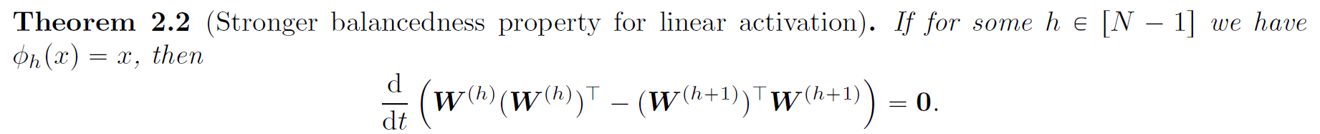
Fully Connected NN with linear activation
For linear activation, we can derive a layer-wise invariance.

Slide 25
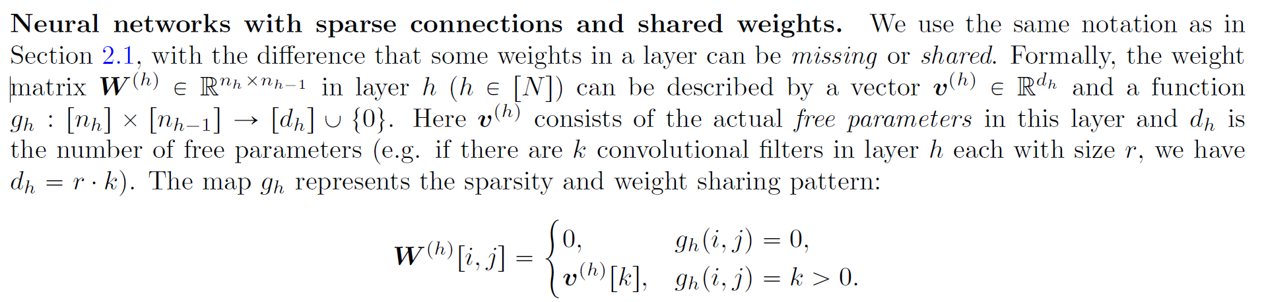
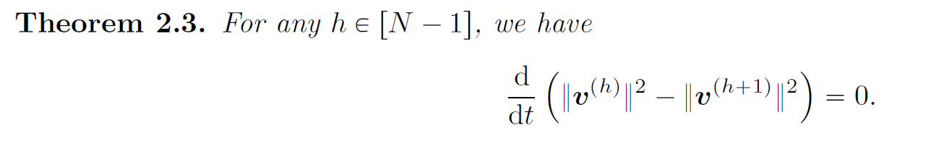
Auto-Balancing Properties in CNN
Notations:
Generalize Corollary 2.1 as:

Slide 26
Asymmetric Matrix Factorization
A simple two-layer homogeneous model for factorizing a low-rank matrix:
Based on auto-balancing properties, Gradient Descent Converges to Global Minimum for Asymmetric Matrix Factorization

Slide 27
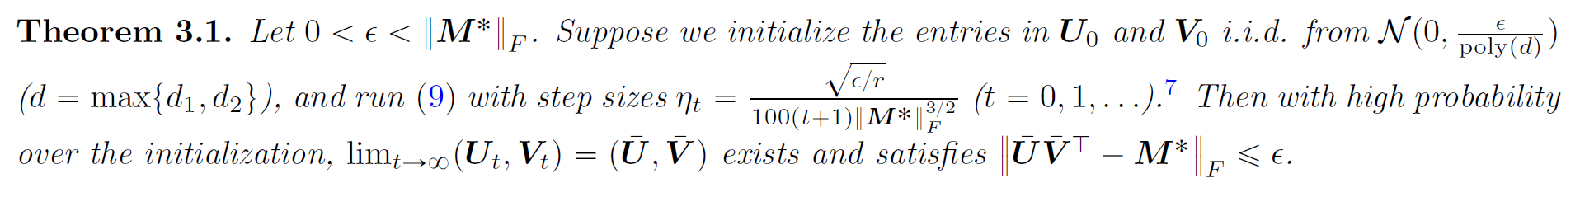
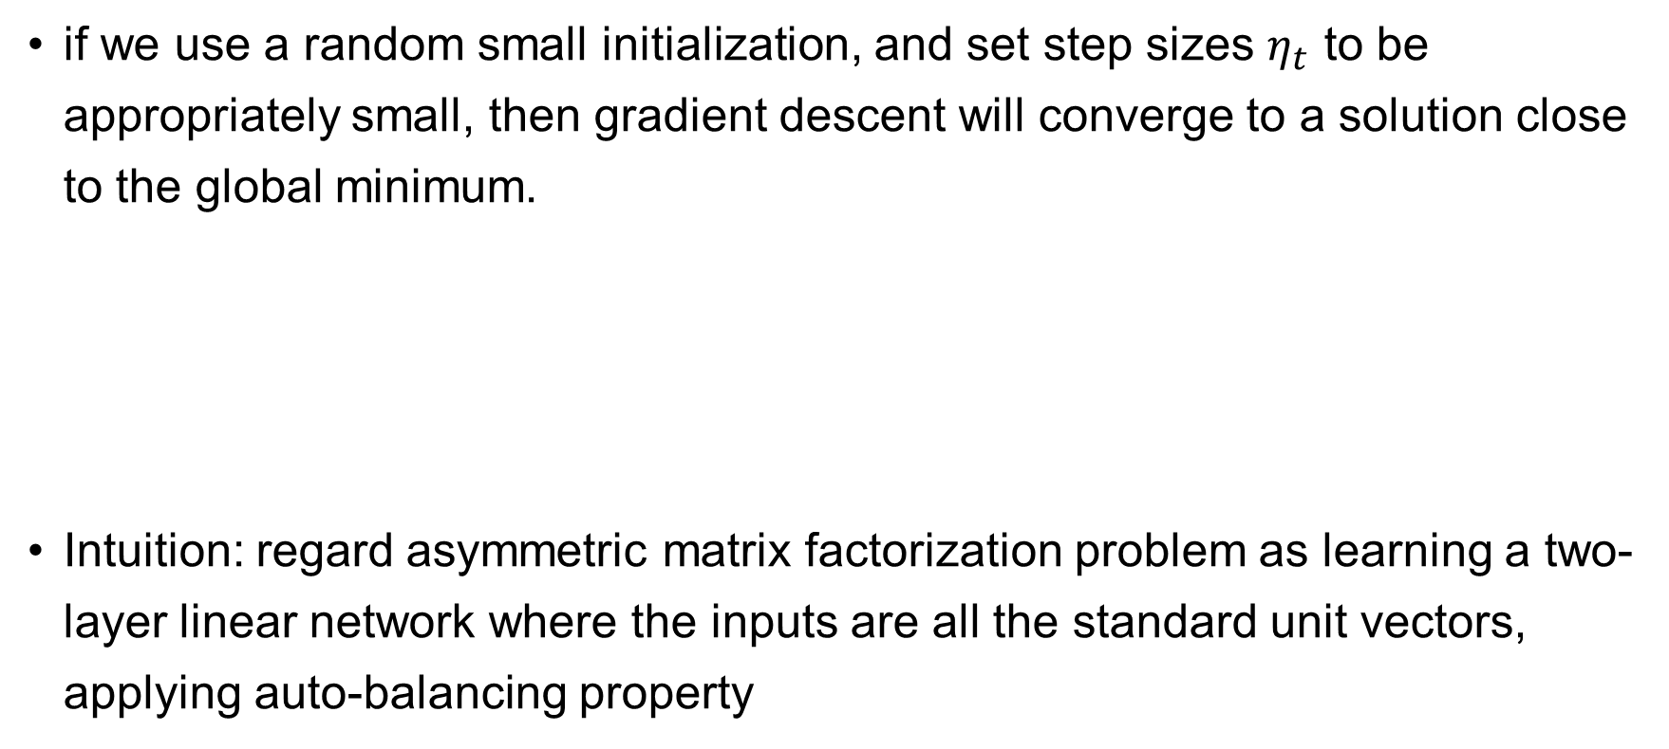
Gradient Descent Converges to Global Minimum
if we use a random small initialization, and set step sizes $η_{t}$ to be appropriately small, then gradient descent will converge to a solution close to the global minimum.
Intuition: regard asymmetric matrix factorization problem as learning a two-layer linear network where the inputs are all the standard unit vectors, applying auto-balancing property

Slide 28
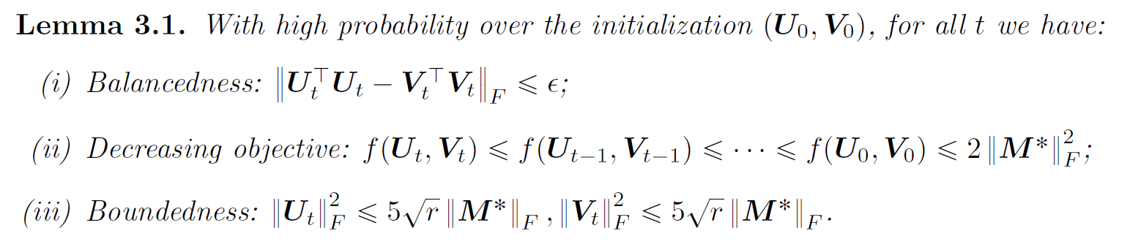

Gradient Descent Converges to Global Minimum
We can prove the balancedness, decreasing objective and boundedness as below:
Now the GD algorithm automatically constrains $\left(U_{t}, V_{t}\right)$ in a bounded region, we can use the smoothness and a standard analysis of GD to show its optimality

Slide 29

GD to SGD: Implicit Regularization on Least Squares
Implicit Regularization ($l_{2}$) of Stochastic Gradient Flow for Least Squares
[Ali et al., 2020]

Slide 30
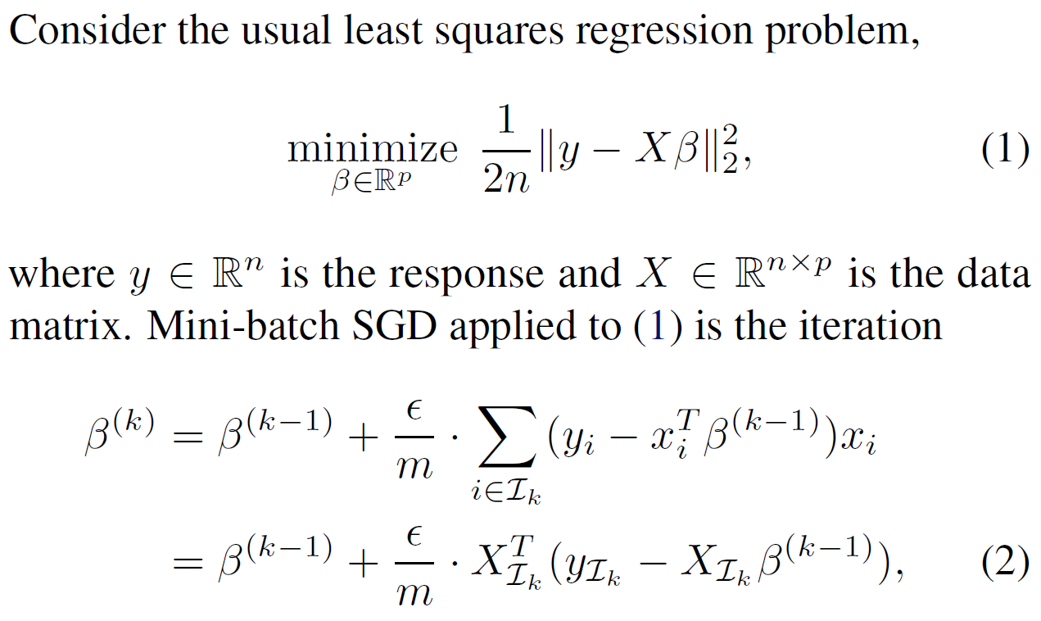


Implicit Regularization ($l_{2}$) of Stochastic Gradient Flow for Least Squares

Slide 31
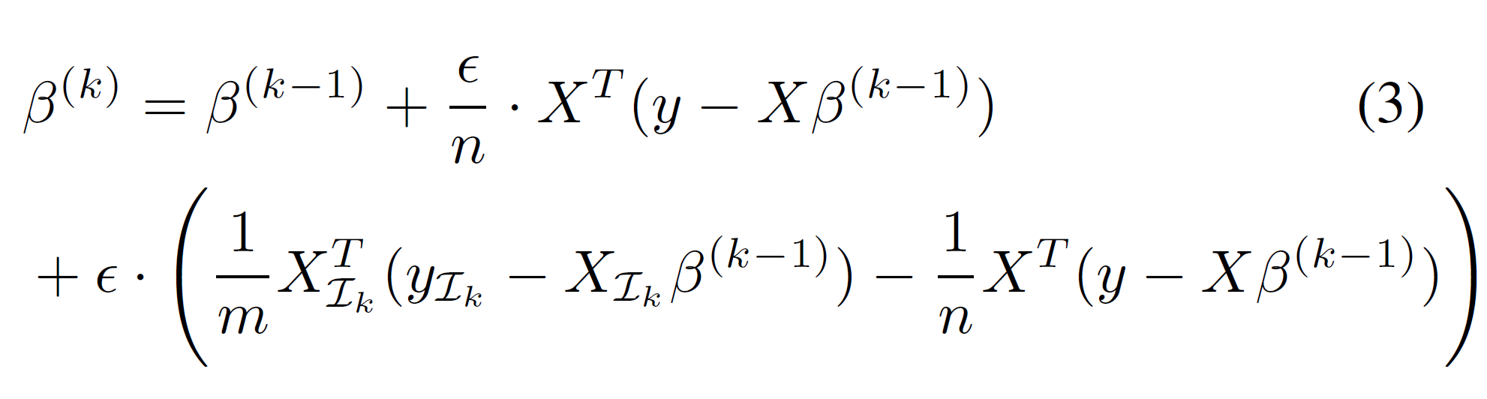
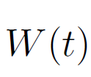
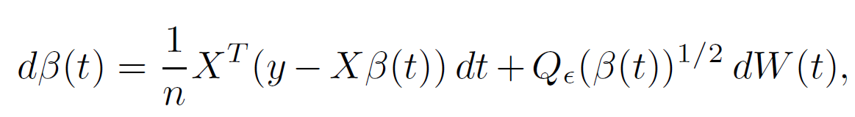

Stochastic Gradient Flow for Least Squares
Adding and subtracting gradient of the loss:
Try to introduce the continuous time dynamics
GD + deviation (between $m$ sample average and their mean)
is Brownian Motion

Slide 32
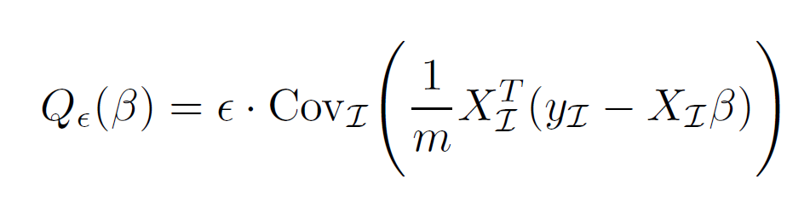
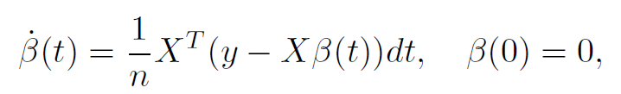
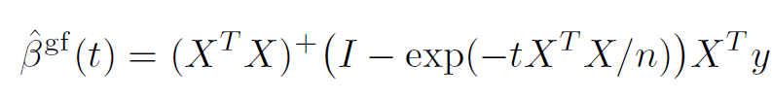
Stochastic Gradient Flow for Least Squares
Continuous time dynamics (Stochastic Gradient Flow):
Diffusion coefficient:
is Brownian Motion
Gradient Flow

Slide 33
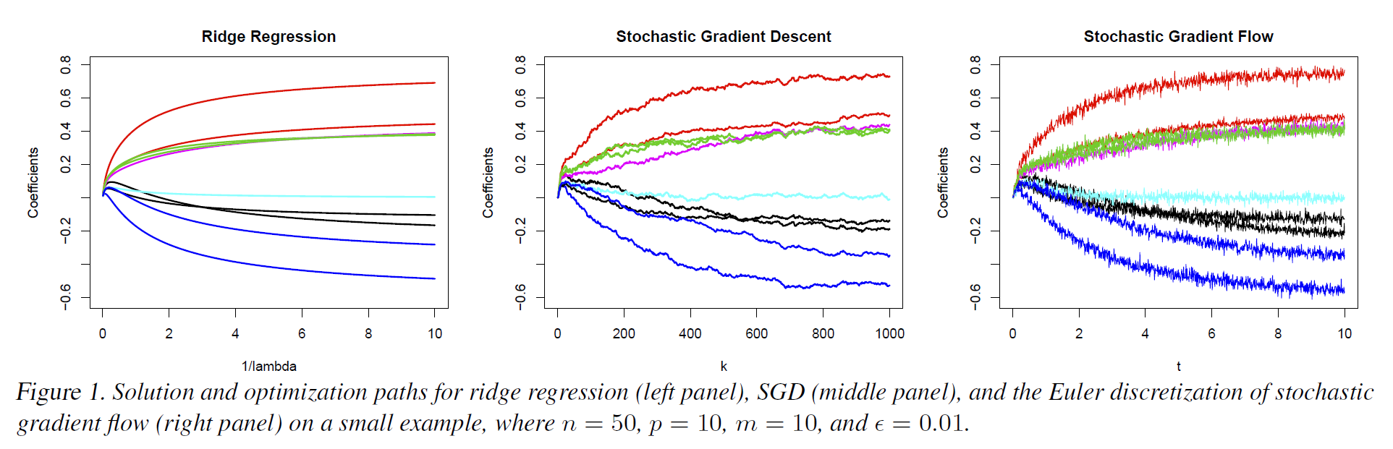

Stochastic Gradient Flow for Least Squares
Comparison between different methods:
$l_{2}$ regularization

Slide 34
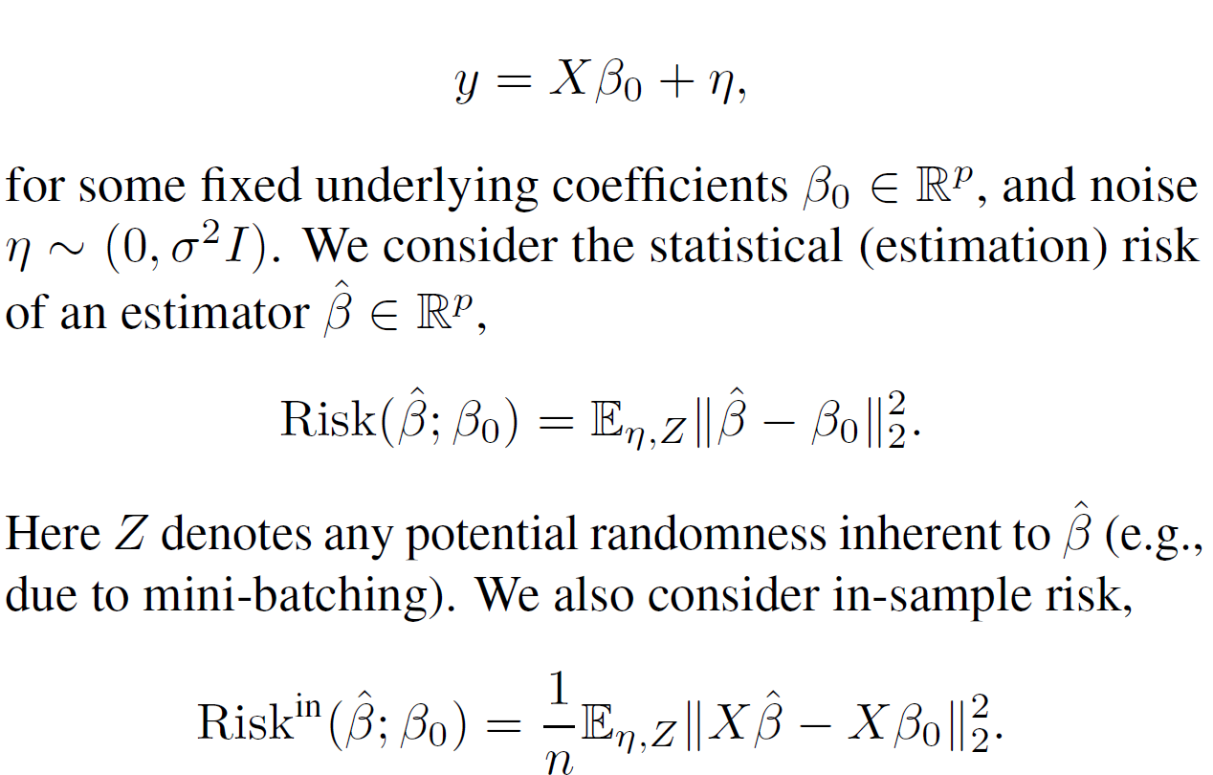
Statistical Risk Bounds
Measures of Risk and Notation

Slide 35
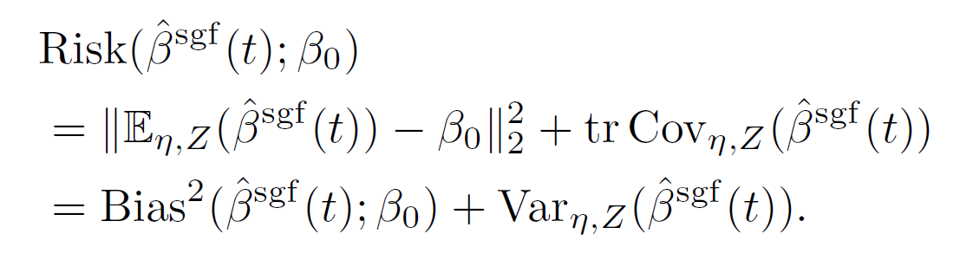
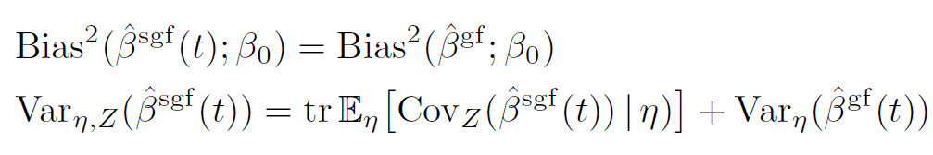
Statistical Risk Bounds
Gradient Flow
bias-variance decomposition for risk
Law of Total Variance
the randomness due to mini-batching contributes to the estimation variance

Slide 36
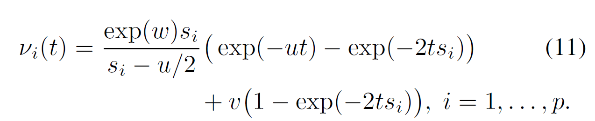

Statistical Risk Bounds

Slide 37


Statistical Risk Bounds
A more interpretable version:
the risk of SGF may be seen as the ridge bias raised to a power strictly less than 1, plus a time-dependent scaling of the ridge variance

Slide 38

Statistical Risk Bounds
Main result: a bound on the excess risk of stochastic gradient flow over ridge
the (scaled) variance of ridge
mini-batching terms
First term is the “price of stochasticity”: it is nonnegative, but vanishes as time grows.
Second term is tied to the limiting optimization error of stochastic gradient flow: it is zero in the overparametrized (interpolating) regime, but is positive

Slide 39
Summary
Implicit Regularization on Low-rank Matrix Factorization
Matrix Sensing
NN with Quadratic Activation
Implicit Regularization on Deep Homogeneous Models
Auto-Balancing
Fully Connected NN & CNN
Asymmetric Matrix Factorization
Implicit Regularization on Least Squares
Stochastic Gradient Flow & Ridge Regression

Slide 40
Reference:
[Sanjeev et al., 2018] Sanjeev A., Nadav C., and Elad H. On the Optimization of Deep Networks: Implicit Acceleration by Overparameterization
[Li et al. 2017] Li, Y., Ma, T., & Zhang, H. Algorithmic regularization in over-parameterized matrix sensing and neural networks with quadratic activations. arXiv preprint arXiv:1712.09203.
[Sun, R. 2019] Optimization for deep learning: theory and algorithms. 1–60. http://arxiv.org/abs/1912.08957
[Du et al. 2018] Du, S. S., Hu, W., & Lee, J. D. Algorithmic regularization in learning deep homogeneous models: Layers are automatically balanced. In Advances in Neural Information Processing Systems (pp. 384-395).

Slide 41
Reference:
[Borji et al. 2019] Borji, A. Lin S. White Noise Analysis of Neural Networks, arXiv preprint arXiv: 1912.12106.
[Ali et al. 2020] Ali, A., Dobriban, E., & Tibshirani, R. J. The Implicit Regularization of Stochastic Gradient Flow for Least Squares. arXiv preprint arXiv:2003.07802.
[Li et al. 2020] Towards Explaining the Regularization Effect of Initial Large Learning Rate in Training Neural Networks
[Zhu et al. 2018] The Anisotropic Noise in Stochastic Gradient Descent: Its Behavior of Escaping from Sharp Minima and Regularization Effects

