Slide 1
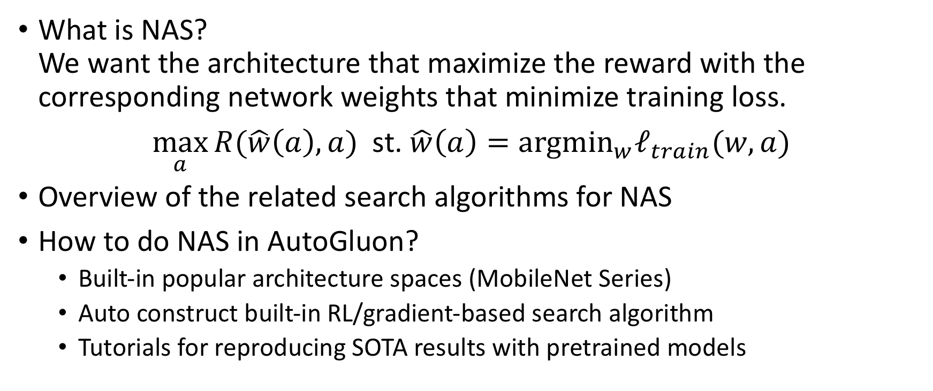
NAS: Neural Architecture Search
What is NAS? We want the architecture that maximize the reward with the corresponding network weights that minimize training loss.
$\max_{a}{R(\hat{w}\left(a\right), a)}$ st. $\hat{w}\left(a\right)={argmin}_{w}ℓ_{train}(w,a)$
Overview of the related search algorithms for NAS
How to do NAS in AutoGluon?
Built-in popular architecture spaces (MobileNet Series)
Auto construct built-in RL/gradient-based search algorithm
Tutorials for reproducing SOTA results with pretrained models
Notes:
A study of the literature mainly on the search strategies, but not comprehensive.
Pure Search Algorithm

Slide 2
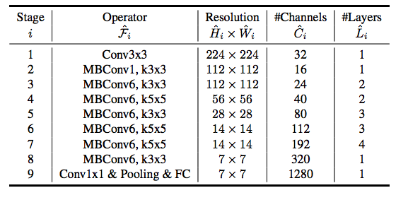

Different Way of Approaching NAS
Brute-force EfficientNet (small enough search space)
Learning to scale up: depth: $α^{φ}$ width: $β^{φ}$ input sizes: $γ^{φ}$ s.t. $α⋅β^{2}⋅γ^{2}=2$
Search at $φ=1$
Tan, Mingxing, and Quoc V. Le. "EfficientNet: Rethinking Model Scaling for Convolutional Neural Networks."

Slide 3
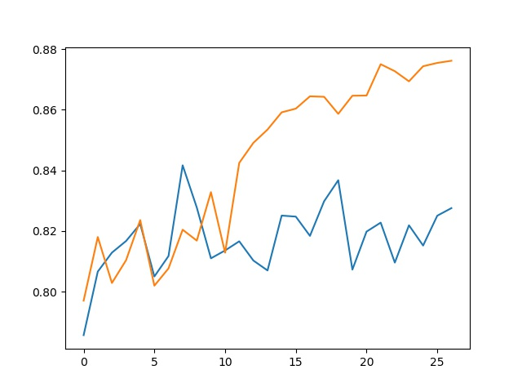
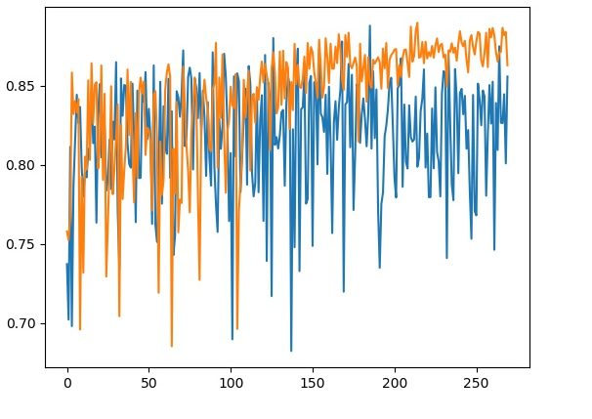
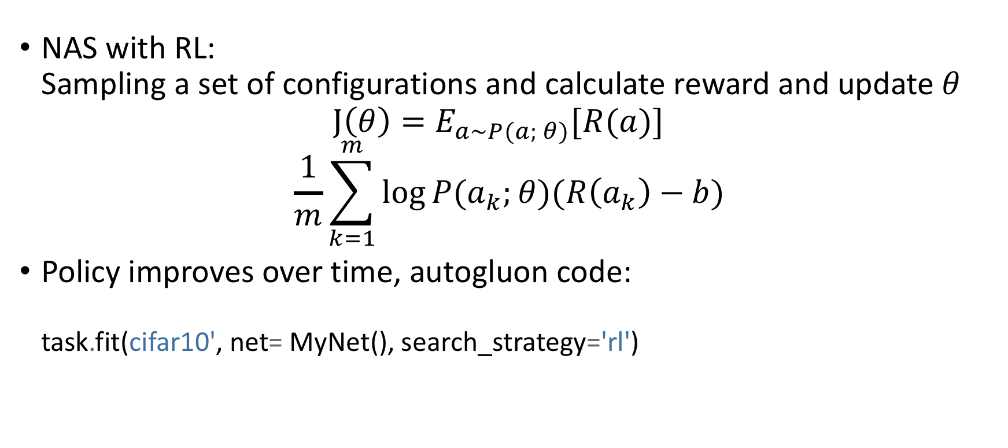
Different Way of Approaching NAS
NAS with RL: Sampling a set of configurations and calculate reward and update $θ$ $J\left(θ\right)=E_{a\sim P(a; θ)}[R(a)]$
$$\frac{1}{m}\sum_{k=1}^{m}{\log{P(a_{k};θ)(R\left(a_{k}\right)−b)}}$$
Policy improves over time, autogluon code: task.fit(cifar10', net= MyNet(), search_strategy='rl')
Zoph, Barret, and Quoc V. Le. "Neural architecture search with reinforcement learning.”
Reinforce Algorithm http://cs231n.stanford.edu/slides/2019/cs231n_2019_lecture14.pdf
NASNet, MobileNetV3, MNASNet, AutoDeepLab
http://autogluon.s3.amazonaws.com/tutorials/course/object.html
Notes:
For RL based approaches, the reward can be anything. Therefore, we can easily optimize the number of params, network latency as a trade-off with accuracy.

Slide 4
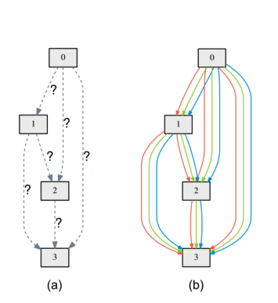

Different Way of Approaching NAS
Differentiable Architecture Search: $J\left(θ\right)=E_{a\sim P(a; θ)}\left[R\left(a\right)\right]≈R(E_{P\left(a;θ\right)}[a])$
Soft combination of different ops: $O\left(x\right)=\sum_{i}{softmax\left(θ_{i}\right)⋅o_{i}(x)}$
$GumbleSoftMax\left(θ_{i}\right)=\frac{\exp\left(θ_{i}+g_{i}\right)/τ}{\sum_{j}{exp⁡(θ_{j}+g_{j})}/τ}$
Difficulties: memory and computation
Liu, Hanxiao, Karen Simonyan, and Yiming Yang. "Darts: Differentiable architecture search.
Xie, Sirui, et al. "SNAS: stochastic neural architecture search.”
Wu, Bichen, et al. "Fbnet: Hardware-aware efficient convnet design via differentiable neural architecture search."
Notes:
During the training process, the operator is formulated as a mixture model
The learning goal is the mixture coefficients (differentiable)
In the end of training, the most likely operator is kept, and the entire network is trained again

Slide 5
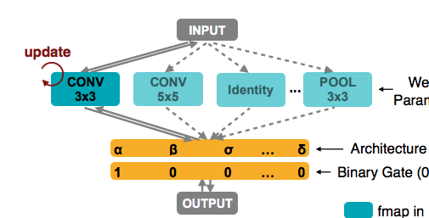
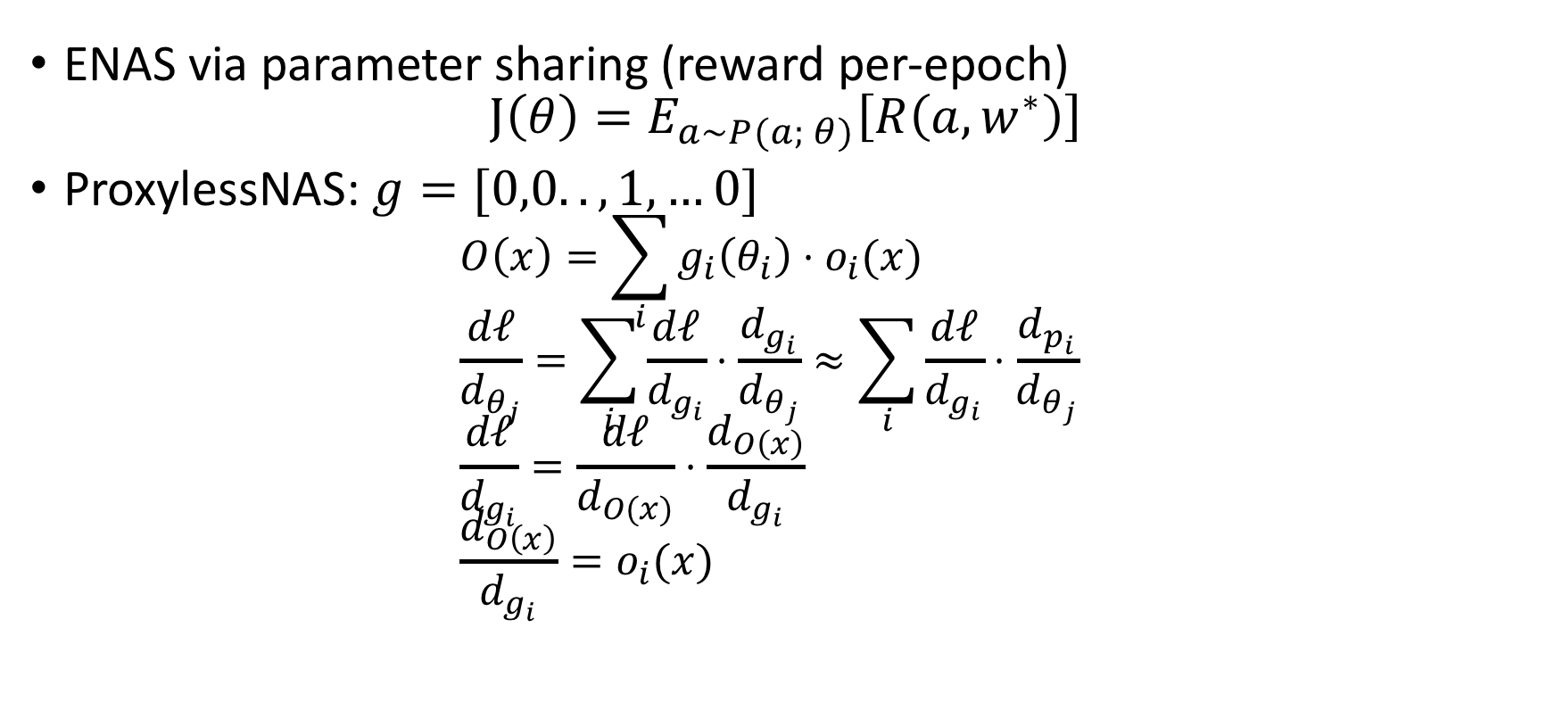
Scalable &Efficient Neural Architecture Search
ENAS via parameter sharing (reward per-epoch) $J\left(θ\right)=E_{a\sim P(a; θ)}\left[R\left(a,w^{∗}\right)\right]$
ProxylessNAS: $g=[0,0..,1,…0]$ $O\left(x\right)=\sum_{i}{g_{i}\left(θ_{i}\right)⋅o_{i}(x)}$ $\frac{dℓ}{d_{θ_{j}}}=\sum_{i}{\frac{dℓ}{d_{g_{i}}}⋅\frac{d_{g_{i}}}{d_{θ_{j}}}≈\sum_{i}{\frac{dℓ}{d_{g_{i}}}⋅\frac{d_{p_{i}}}{d_{θ_{j}}}}}$ $\frac{dℓ}{d_{g_{i}}}=\frac{dℓ}{d_{O(x)}}⋅\frac{d_{O\left(x\right)}}{d_{g_{i}}}$ $\frac{d_{O\left(x\right)}}{d_{g_{i}}}=o_{i}(x)$
x
Pham, Hieu, et al. "Efficient neural architecture search via parameter sharing.”
Cai, Han, Ligeng Zhu, and Song Han. "Proxylessnas: Direct neural architecture search on target task and hardware."

Slide 6
MobileNet Block
Construction 1 layer
layer = ag.nas.MBConvBlock(in_channels=32, channels=32, expand_ratio=1, kernel=3, activation='relu’, input_size=64)
layer.initialize() ag.utils.plot_network(net, (1, 32, 64, 64))
Search Architecture
block_args = []; strides = [1, 2, 2] for i in range(3): block_args.append(mobilenet_block_args( stride=strides[i], kernel=Categorical (3, 5), num_repeat=Categorical (1, 2, 3, 4), channels=Categorical (*[32*i for i in range(1, 6)]), expand_ratio=Categorical (1, 6))
@ag.autogluon_register_args(block_args=ag.Sequence(*block_args)) def nas_train(args): net = EfficientNet(args.block_args)

Slide 7
Reproduce EfficientNet using AutoGluon
import math import autogluon as ag from autogluon import ImageClassification as task @ag.autogluon_object(width_coefficient=ag.Categorical(1.1, 1.2), depth_coefficient=ag.Categorical(1.1, 1.2) ) class EfficientNetB1(ag.nas.EfficientNet): def __init__(self, width_coefficient, depth_coefficient): input_factor = math.sqrt(2.0 / (width_coefficient ** 2) / depth_coefficient) input_size = math.ceil((224 * input_factor) / 32) * 32 super().__init__(width_coefficient=width_coefficient, depth_coefficient=depth_coefficient, input_size=input_size)
task.fit('imagenet', net=EfficientNetB1(), search_strategy='grid’, optimizer=ag.optimizer.SGD(learning_rate=1e-1,momentum=0.9,wd=1e-4))

Slide 8
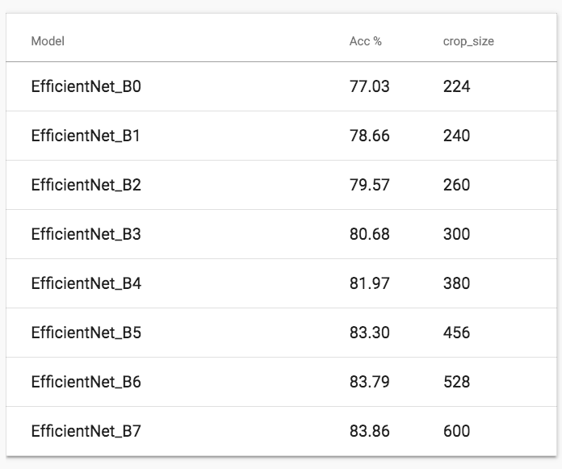
Pre-trained EfficientNet
# get pretrained model efficientnet_b0 = ag.get_model('efficientnet_b0’, pretrained=True)
# test pretrained model from autogluon import ImageClassification as task task.evaluate('imagenet', model='efficientnet_b0’)
>>> accuracy: 0.7703204923273658 : : 366it [01:58, 2.82it/s]
http://autogluon.s3.amazonaws.com/model_zoo/index.html

Slide 9
ENAS in AutoGluon
Scalable and Flexible (Policy Gradient to optimize/trade-off everything)
API (automatically create super network and RL controller):
@enas_unit( kernel=ag.Categorical(3, 5)) class MyBlock(gluon.nn.Block): def __init__(self, kernel): super().__init__() self.block = Conv2D(channels=32, kernel= kernel), self.bn = gluon.nn.BatchNorm() self.relu = gluon.nn.Activation('relu’)
def hybrid_forward(self, F, x): x = self.block(x) return self.relu(self.bn(x))
http://autogluon.s3.amazonaws.com/tutorials/nas/enas_mnist.html

