Slide 1
Auto : An AutoML Toolkit
Hang Zhang
API Doc http://autogluon.s3.amazonaws.com/index.html
Notes:
Not hands-on

Slide 2
Auto
Easy to Use (Fast Prototyping)
Easy to Extend (Diff-level customization, Both User and Developers)
Efficient in Search (BayesOpt, Hyperband, Reinforcement Learning)
Scalable (Distributed Search, AWS Batch, SageMaker Integration*)
State-of-the-art Algorithms (Tabular, Neural Architecture Search)

Slide 3
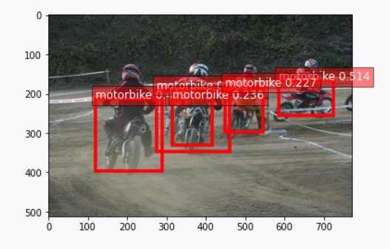
Easy to Use -- FIT API
Quick start using fit on supported applications: from autogluon import ObjectDetection as task dataset = task.Dataset('tiny_motorbike', root='./tiny_motorbike’ ) detector = task.fit(dataset, epochs=30)
Make prediction: image_path = ‘example.jpg’ ind, prob, loc = detector.predict(image_path)
Notes:
Quick review of AutoGluon Fit and introduce new features.

Slide 4
Easy to Extend -- Customization
Change default configurations: import autogluon as ag classifier = task.fit(dataset, nets=Categorical('resnet50_v1b', 'resnet50_v2’), lr_scheduler=Categorical('poly', 'cosine’), epochs=4)
Bring your own network with search space: import gluoncv as gcv @ag.func(multiplier=ag.Categorical(0.25, 1.0)) def get_mobilenet(multiplier): return gcv.model_zoo.MobileNetV2(multiplier=multiplier, classes=4)

Slide 5
Easy to Extend -- Customization
CIFAR ResNet: from gluoncv.model_zoo.cifarresnet import CIFARResNetV1, CIFARBasicBlockV1 net = CIFARResNetV1(CIFARBasicBlockV1, layers = [1, 1, 1], channels = [16, 16, 32, 64]) ag.plot_network(net, (1, 3, 32, 32))
Define a searchable CIFAR ResNet @ag. obj(nstage1=ag.Int(2, 4), nstage2=ag.Int(2, 4)) class MyCifarResNet(CIFARResNetV1): def __init__(self, nstage1, nstage2): nstage3 = 9 - nstage1 - nstage2 layers = [nstage1, nstage2, nstage3] channels = [16, 16, 32, 64] super().__init__(CIFARBasicBlockV1, layers, channels) task.fit('cifar10', net=MyCifarResNet())
https://autogluon.s3.amazonaws.com/tutorials/extend/object.html

Slide 6
Extensibility -- Customization
Allow HPO/NAS on any user-defined training scripts/tasks (in python) automatically generate search algorithm and conduct HPO @ag. args( batch_size=128, lr=ag.Real(1e-4, 1e-2), net= MyCifarResNet(nstage1=ag.Int(1, 4)), ) def train_fn(args, reporter=None): print(args.lr, args.batch_size) net=args.net reporter(epoch=0, accuracy=0.9) myscheduler = ag.scheduler.FIFOScheduler(train_fn, num_trials=25) myscheduler.run()
Not limited to supported tasks. (MobileNetV3, Rekognition Detection)
https://autogluon.s3.amazonaws.com/tutorials/extend/script.html

Slide 7
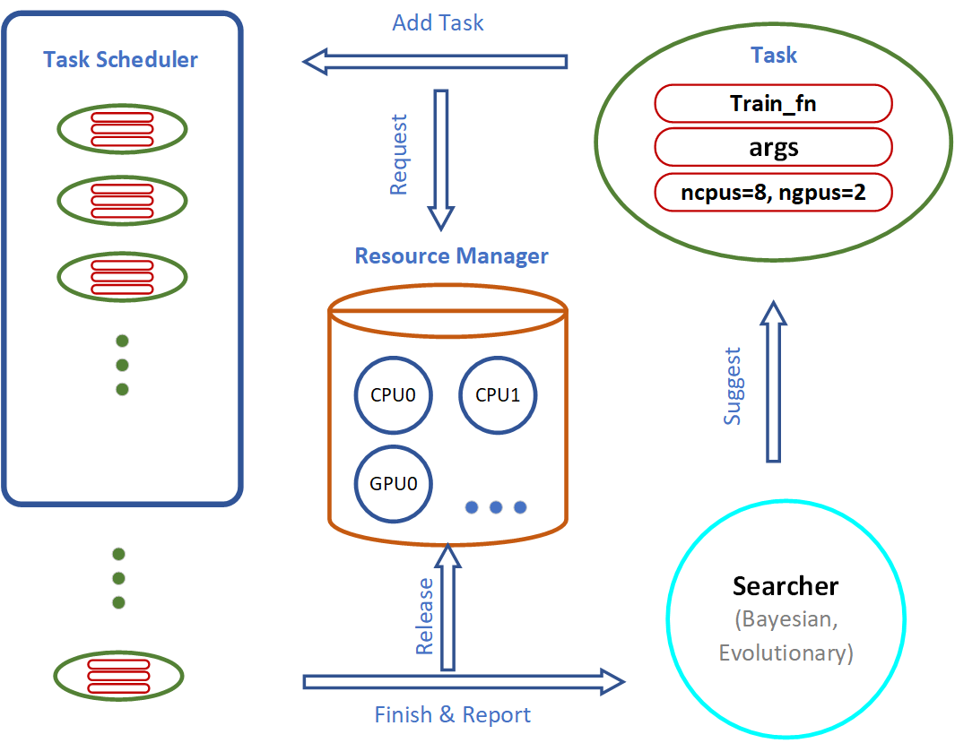
Efficient in Search – Advanced Search Strategies
Searcher: suggests configurations for the next training jobs.
Scheduler: schedules the training job when the computation resources are available.

