Slide 1
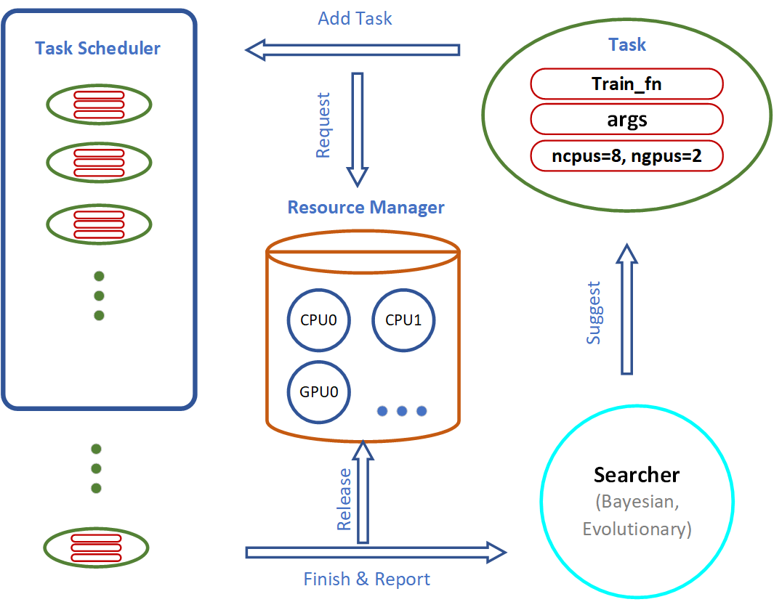
Efficient in Search – Advanced Search Strategies
Searcher: suggests configurations for the next training jobs.
Scheduler: schedules the training job when the computation resources are available.

Slide 2
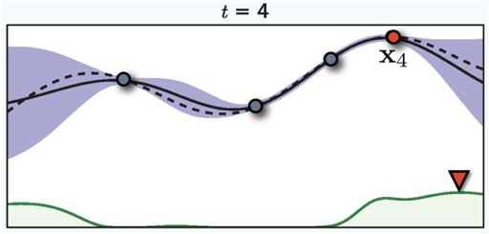
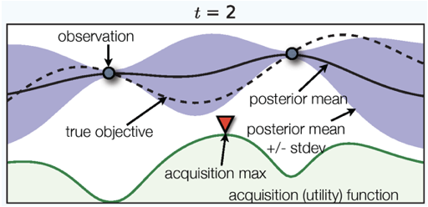
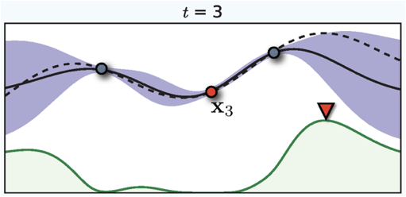
Search Algorithms (SkOpt)
Surrogate Model: reflects the probabilistic beliefs
Acquisition function: which hyperparameter configuration to try next
task.fit(dataset,
search_strategy=‘skopt’)
http://autogluon.s3.amazonaws.com/api/autogluon.searcher.html#skoptsearcher
Notes:
Bayesian Optimization fits a probabilistic *surrogate model* to estimate the function that relates each hyperparameter configuration to the resulting performance of a model trained under this hyperparameter configuration.
This surrogate model can then be used to infer which hyperparameter configurations could plausibly lead to the best predictive performance (ie. those hyperparameter-values that are similar to the top-performing configurations tried so far, as well as the hyperparameter-values that are very dissimilar to all configurations tried so far, since the surrogate model is highly uncertain about their corresponding performance). Within the same time-limit constraints, Bayesian optimization can often produce a superior model compared to random search by making smarter decisions about which hyperparameter configuration to explore next. Although updating the surrogate model takes time, these updates are generally negligible compared with the neural network training time required to execute a single trial.

Slide 3
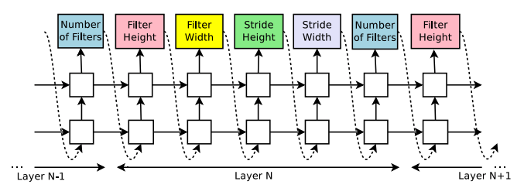
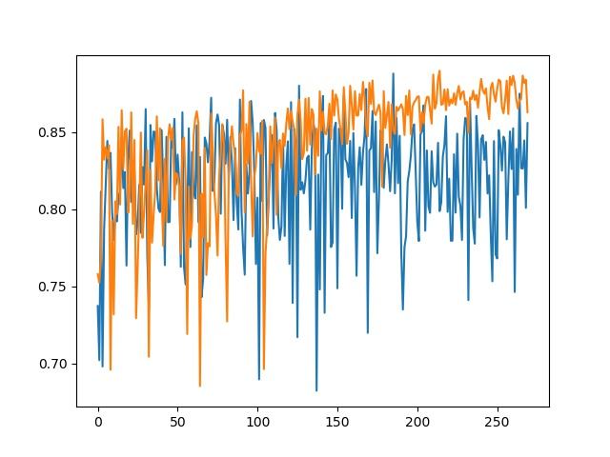
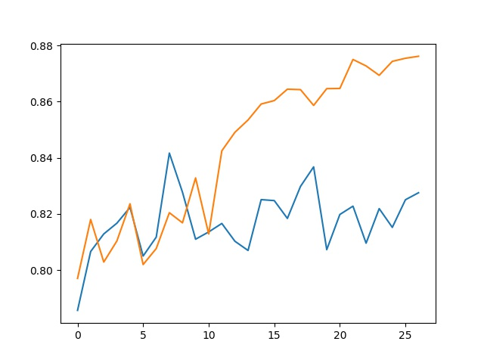
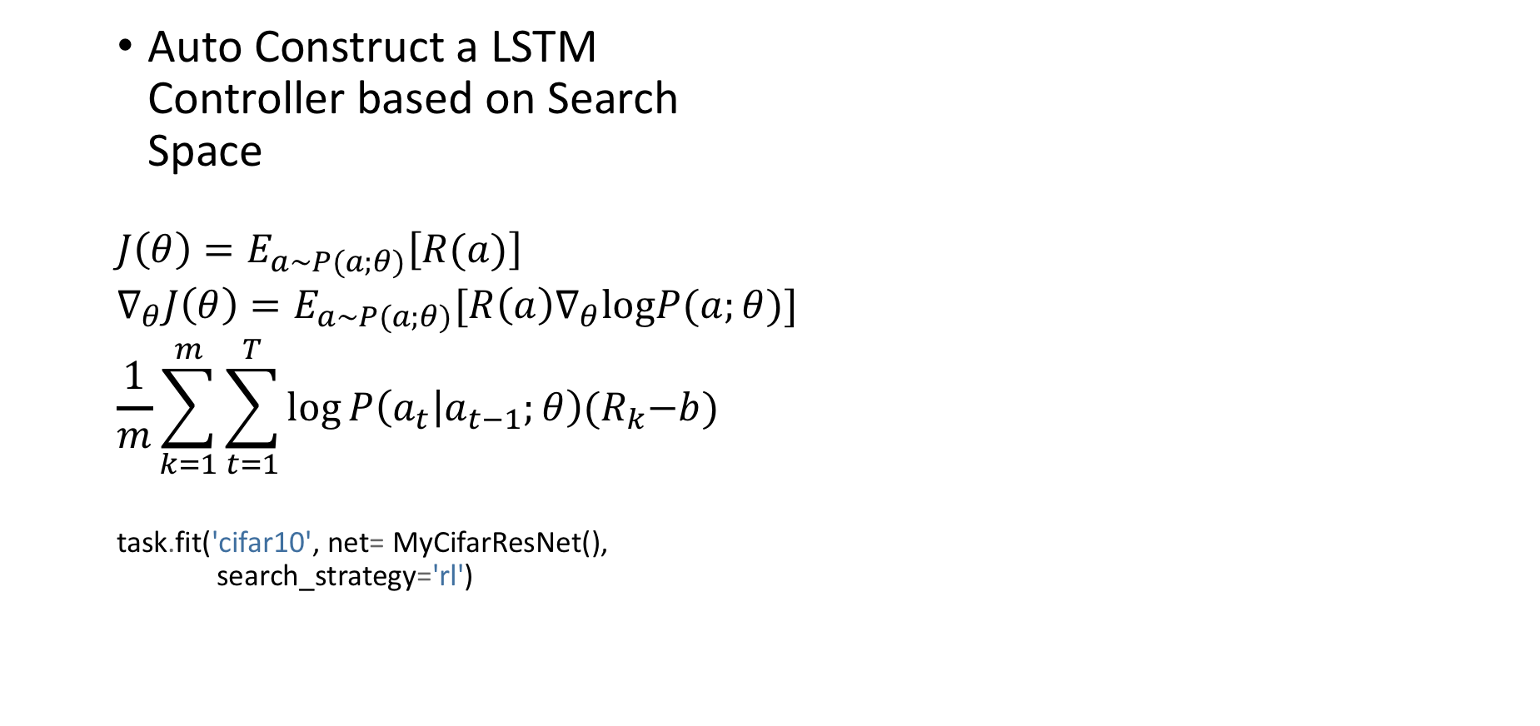
Search Algorithms (RL, Gluon)
Auto Construct a LSTM Controller based on Search Space
$$J\left(θ\right)=E_{a\sim P(a;θ)}\left[R(a)\right]$$
$$∇_{θ}J\left(θ\right)=E_{a\sim P(a;θ)}[R\left(a\right)∇_{θ}logP(a;θ)]$$
$$\frac{1}{m}\sum_{k=1}^{m}{\sum_{t=1}^{T}{\log{P\left(a_{t} | a_{t−1};θ\right){(R}_{k}−b)}}}$$
task.fit('cifar10', net= MyCifarResNet(), search_strategy='rl')
Zoph, Barret, and Quoc V. Le. "Neural architecture search with reinforcement learning.”
Reinforce Algorithm http://cs231n.stanford.edu/slides/2019/cs231n_2019_lecture14.pdf

Slide 4
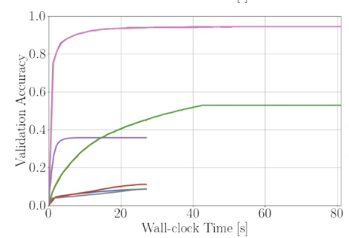
Early Stopping – Succesive Halving
Randomly sample a set of configurations
Evaluate the performances of all currently remaining conﬁgurations
Throw out, the bottom half of the worst configurations
Go back to 2. and repeat until one configuration remains.

Slide 5
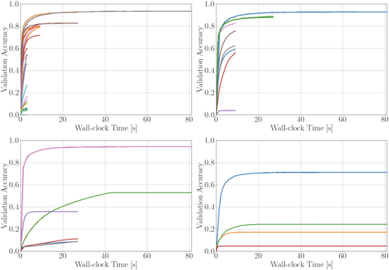
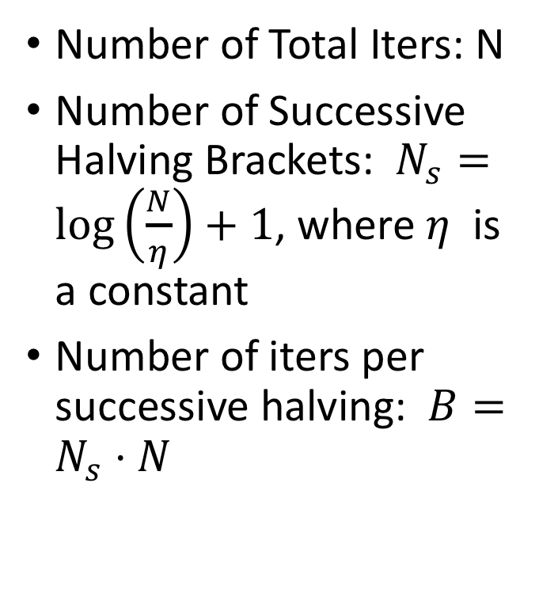
Early Stopping – Hyperband
Number of Total Iters: N
Number of Successive Halving Brackets: $N_{s}=\log\left(\frac{N}{η}\right)+1$, where $η$ is a constant
Number of iters per successive halving: $B=N_{s}⋅N$

