Slide 1
Active Learning, Featurizing, Modeling, and Operationalizing Text at Scale with Azure Machine Learning
Ali-Kazim Zaidi
Robert Horton
Justin Ormont
Siddarth Ramesh
Mario Inchiosa
Tomas Singliar

Slide 2
Provisioning your Data Science VM
For instructions, see README here:
https://github.com/Azure/active-learning-workshop

Slide 3
Outline
Data exploration
Featurization using word embeddings
Active learning from selected cases
Other featurization approaches
Classification
ROC Curves and Utility Maximization
Hyperparameter Tuning using Azure ML and Azure Batch AI
Deployment and consumption of scoring services

Slide 4
Unreasonable Effectiveness of Data and Deep Architectures
performance
neural networks
traditional learners
training data
Revisiting Unreasonable Effectiveness of Data in Deep Learning Era, Google

Slide 5
Deep Learning Success Based on Data Hungry Systems
Image Recognition
ImageNet: 14 million examples
Machine Translation
WMT: Millions of sentence pairs
Game Playing
AlphaGo Zero: hundreds of millions of self-play games
AlphaGo: tens of millions of frames for Atari

Slide 6
Task Specific NLP Datasets
Dataset (English) | Size (# sentences)
NER | 15K (CoNLL 2003)
Coreference Resolution | 75K (OntoNotes)
Parsing | 40k (Penn Treebank)
Q&A | 100K questions (SQuAD)
Textual Entailment | 570K (SNLI)
Sentiment Analysis | 10K (SST)
Worse for non-English, or more domain specific examples

Slide 7
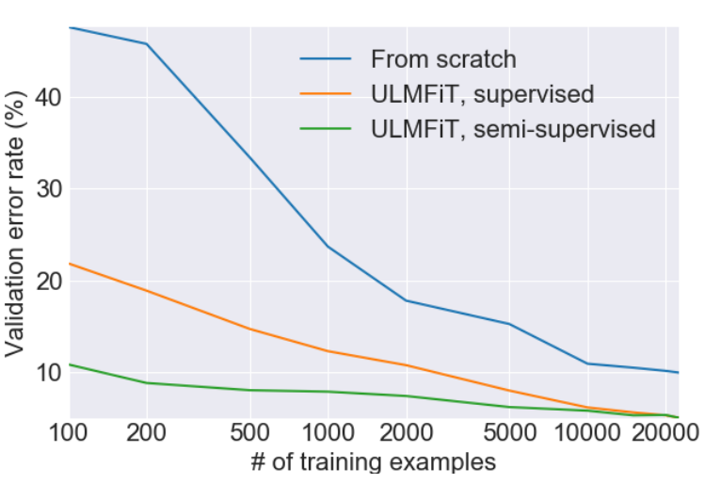
The Advantage of Pre-Training
Howard & Ruder – Universal Language Model Fine-Tuning for Text Classification

Slide 8
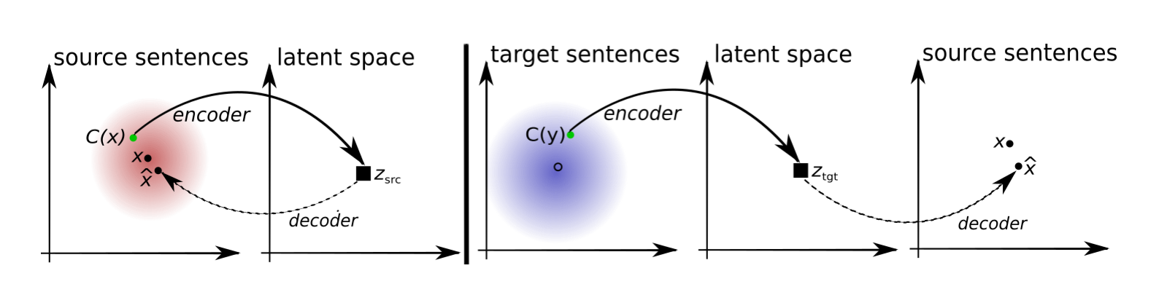
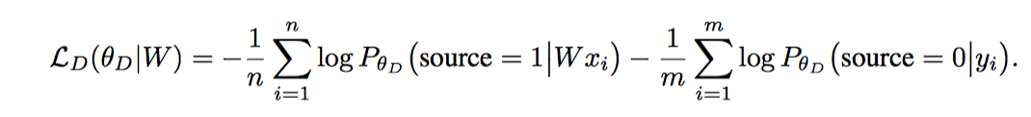
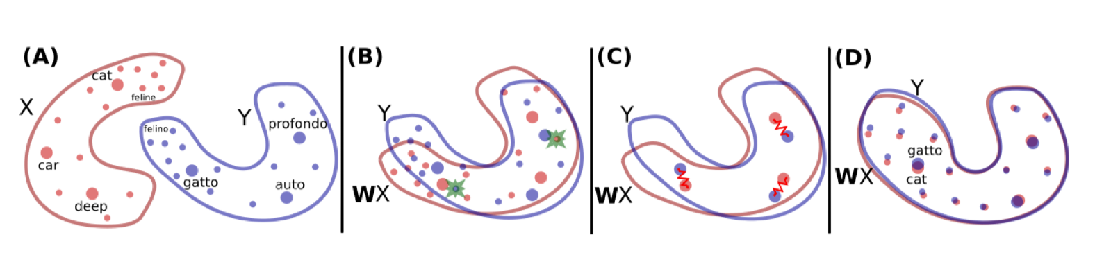
Domain Adaptation / Domain Adversarial Training

Slide 9
Active Learning
I have plenty of data, but getting it labeled is expensive
word embeddings (or more generally, transfer learning) let you generate features that can be used in traditional machine learning approaches.
these features let you use low-complexity models that can learn from small numbers of cases.
active learning lets you take advantage of large sets of unlabeled data to build more accurate classifiers by selecting the most useful additional examples to label for training.

Slide 10
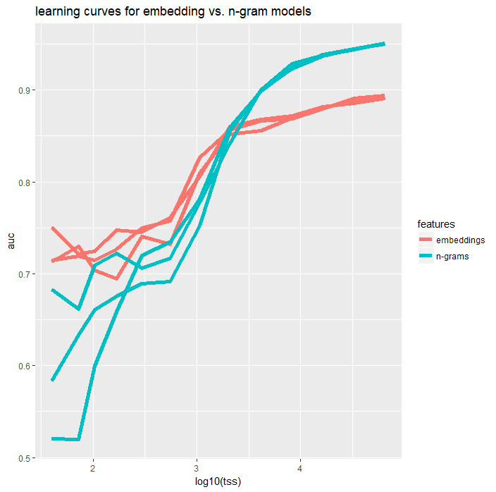

Slide 11
Query strategies[edit]
Algorithms for determining which data points should be labeled can be organized into a number of different categories:^{[1]}
Uncertainty sampling: label those points for which the current model is least certain as to what the correct output should be
Query by committee: a variety of models are trained on the current labeled data, and vote on the output for unlabeled data; label those points for which the "committee" disagrees the most
Expected model change: label those points that would most change the current model
Expected error reduction: label those points that would most reduce the model's generalization error
Variance reduction: label those points that would minimize output variance, which is one of the components of error
Balance exploration and exploitation: the choice of examples to label is seen as a dilemma between the exploration and the exploitation over the data space representation. This strategy manages this compromise by modelling the active learning problem as a contextual bandit problem. For example, Bouneffouf et al.^{[7]} propose a sequential algorithm named Active Thompson Sampling (ATS), which, in each round, assigns a sampling distribution on the pool, samples one point from this distribution, and queries the oracle for this sample point label.
Exponentiated Gradient Exploration for Active Learning:^{[8]} In this paper, the author proposes a sequential algorithm named exponentiated gradient (EG)-active that can improve any active learning algorithm by an optimal random exploration.
Wikipedia: Active learning (machine learning)
https://en.wikipedia.org/w/index.php?title=Active_learning_(machine_learning)

Slide 12

The Practice of Crowdsourcing
Coming this Fall to a bookstore near you!
Omar Alonso

