Slide 1
CUDA小白入门笔记
Notes:
不会涉及很硬核的cuda编程，因为硬核的我也不会。单纯是为了抛砖引玉，希望组里大佬后面有时间可以分享下经验。
目标：不一定要求能用cuda编程，但是可以降低阅读和cuda相关代码时后的门槛，比如OpenMMLab体系中经常用到的各种算子。

Slide 2
目录
1
环境搭建
2
CUDA基本概念
3
C++
4
Python
5
优化方式
Notes:
环境搭建，只提一下windows的环境搭建。Linux下面，大家都有mmcv-full的运行环境，就已经有了。此外，windows下用vs写cuda挺方便的，宇宙最强IDE名不虚传。

Slide 3
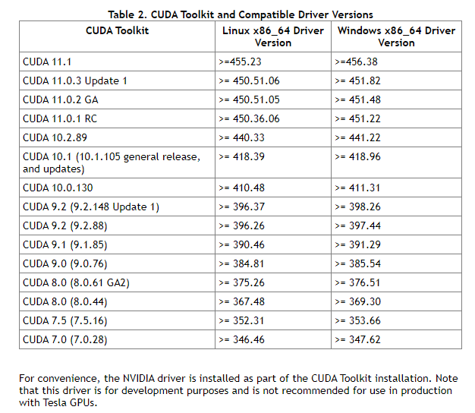
Windows
可以参考CUDA11.0+VS2019+WIN10环境配置配置
Windows下Visual Studio开发环境。
安装Invidia Cuda Driver
安装Invidia Cuda Toolkit
安装Visual Studio，勾选c++相关组件
一般出现配置完环境后编译运行Demo有错，都是CUDA配置有误。先检查驱动和工具包版本，然后卸载CUDA重装一次即可。

Slide 4
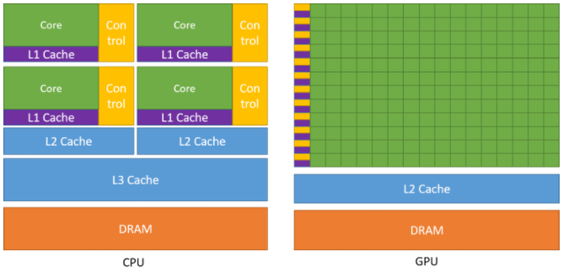
CPU vs GPU
相同点：都有core，control，L1，L2
cache，DRAM
不同点：CPU有三级Cache，GPU只有两级
CPU核心数远少于GPU
GPU一个L1 Cache对应多个核心
Notes:
单独的一个cuda thread的计算能力可能不如一个CPU的thread，但是CUDA多个thread并行计算，最后计算能力远高于CPU。

Slide 5
线程分配：
Thread
Block
Grid
关键字：
__global__
__device__
__host__
__restrict__
__shared__
将涉及的基本概念
运算符：
<<<>>>
编译器：
nvcc
工具：
nvprof
nsight (VS only)
Notes:
将涉及的概念，不是CUDA编程全部涉及到的，每个部分只有个人常用的会列出来。
线程分配，属于套娃。一个Block有多个Thread，一个Grid又有多个Block。当然，有上限，一般一个Block最多1024个Thread。

Slide 6
// Kernel definition
__global__ void VecAdd(float* A, float* B, float* C)
{
int i = threadIdx.x;
C[i] = A[i] + B[i];
}
int main()
{
...
// Kernel invocation with N threads
VecAdd<<<1, N>>>(A, B, C);
...
}
// Kernel definition
__global__ void MatAdd(float A[N][N], float B[N][N],
float C[N][N])
{
int i = threadIdx.x;
int j = threadIdx.y;
C[i][j] = A[i][j] + B[i][j];
}
int main()
{
...
// Kernel invocation with one block of N * N * 1 threads
int numBlocks = 1;
dim3 threadsPerBlock(N, N);
MatAdd<<<numBlocks, threadsPerBlock>>>(A, B, C);
...
}

Slide 7
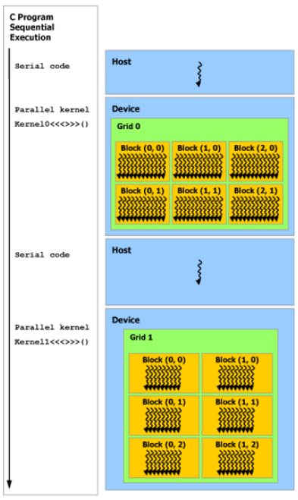
CUDA执行过程
数据拷贝
CPU -> GPU
数据拷贝
GPU -> CPU
分配存储
cudaMalloc
执行核函数
func<<<…>>>
释放存储
cudaFree

Slide 8
int main() {
// Array size of 2^16 (65536 elements)
constexpr int N = 1 << 16;
constexpr size_t bytes = sizeof(int) * N;
// Vectors for holding the host-side (CPU-side) data
std::vector<int> a;
a.reserve(N);
std::vector<int> b;
b.reserve(N);
std::vector<int> c;
c.reserve(N);
// Initialize random numbers in each array
for (int i = 0; i < N; i++) {
a.push_back(rand() % 100);
b.push_back(rand() % 100);
}
// Allocate memory on the device
int *d_a, *d_b, *d_c;
cudaMalloc(&d_a, bytes);
cudaMalloc(&d_b, bytes);
cudaMalloc(&d_c, bytes);
// Copy data from the host to the device (CPU -> GPU)
cudaMemcpy(d_a, a.data(), bytes, cudaMemcpyHostToDevice);
cudaMemcpy(d_b, b.data(), bytes, cudaMemcpyHostToDevice);
// Threads per CTA (1024)
int NUM_THREADS = 1 << 10;
// CTAs per Grid, We need to launch at LEAST as many threads as we have elements
// This equation pads an extra CTA to the grid if N cannot evenly be divided by NUM_THREADS (e.g. N = 1025, NUM_THREADS = 1024)
int NUM_BLOCKS = (N + NUM_THREADS - 1) / NUM_THREADS;
// Launch the kernel on the GPU
// Kernel calls are asynchronous (the CPU program continues execution after call, but no necessarily before the kernel finishes)
vectorAdd<<<NUM_BLOCKS, NUM_THREADS>>>(d_a, d_b, d_c, N);
// Copy sum vector from device to host, cudaMemcpy is a synchronous operation, and waits for the prior kernel launch to complete (both go to the default stream in this case).
// Therefore, this cudaMemcpy acts as both a memcpy and synchronization barrier.
cudaMemcpy(c.data(), d_c, bytes, cudaMemcpyDeviceToHost);
// Check result for errors
verify_result(a, b, c);
// Free memory on device
cudaFree(d_a);
cudaFree(d_b);
cudaFree(d_c);
std::cout << "COMPLETED SUCCESSFULLY\n"; return 0;
}
C++
// This program computes the sum of two vectors of length N
// By: Nick from CoffeeBeforeArch
#include <algorithm>
#include <cassert>
#include <iostream>
#include <vector>
// CUDA kernel for vector addition
// __global__ means this is called from the CPU, and runs on the GPU
__global__ void vectorAdd(const int *__restrict a, const int *__restrict b,
int *__restrict c, int N) {
// Calculate global thread ID
int tid = (blockIdx.x * blockDim.x) + threadIdx.x;
// Boundary check
if (tid < N) c[tid] = a[tid] + b[tid];
}
// Check vector add result
void verify_result(std::vector<int> &a, std::vector<int> &b,
std::vector<int> &c) {
for (int i = 0; i < a.size(); i++) {
assert(c[i] == a[i] + b[i]);
}
}
!=1

Slide 9
Python
三种编译方式
JIT
Setup
Cmake
Notes:
现在深度学习，一般不会绕开python

Slide 10
常用优化方式
优化方式：
tmp
__strict__
cache tile
cublas
stream
Notes:
我了解到的优化方式。

Slide 11
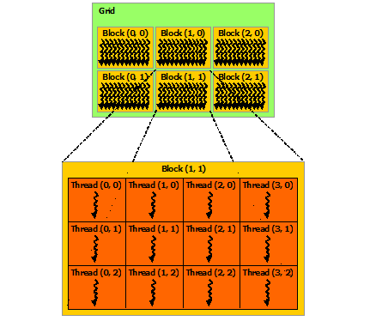
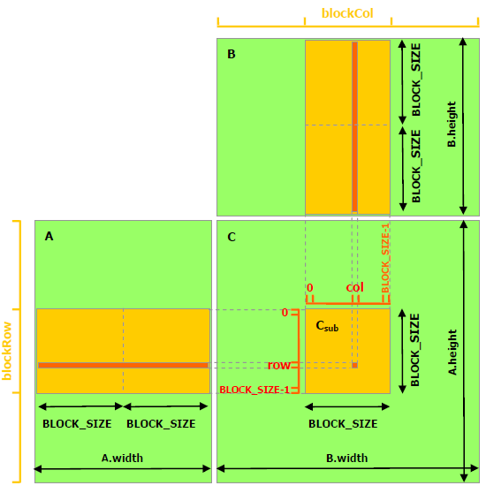
int row = blockIdx.y * blockDim.y + threadIdx.y
int col = blockIdx.x * blockDim.x + threadIdx.x
（col, row）
（x, y）

Slide 12

计算过程
i移动方向
定义张量: $(N,C,H,W)$ 存储数组$M$长度: $N∗C∗H∗W$
张量中某一个点 $ρ$: $(b,c,y,x)$ , $ρ$ 在数组$M$中对应的下标为:
$$b∗C∗H∗W+c∗H∗W+y∗W+x$$
N
N
row = blockIdx.y * blockDim.y + threadIdx.y
col = blockIdx.x * blockDim.x + threadIdx.x
s_a[threadIdx.y * blockDim.x + threadIdx.x]
= a[row * N + (i + threadIdx.x)]
s_b[threadIdx.y * blockDim.x + threadIdx.x]
= b[(i + threadIdx.y) * N + col]
Step = blockDim.x

Slide 13
Reference
cuda-c-programming-guide
NN-CUDA-Example
cuda_programming
Notes:
不要忘了回顾一下讲到的内容。

