Slide 1

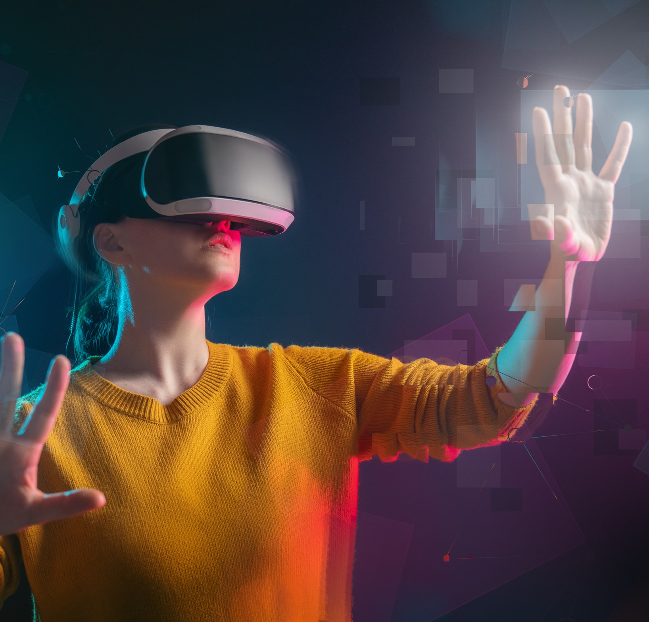
Education in the Metaverse
Dream. Develop. Disrupt
TEAM MEMBERS:
Allen Y
Divina Josy
Gifty Treesa Iju
Alvin Antony K

Slide 2
Agenda Let’s get started
1
Problem Statement
3
Objectives
5
Demonstration
2
Scope of Idea
4
Implementation Stack

Slide 3
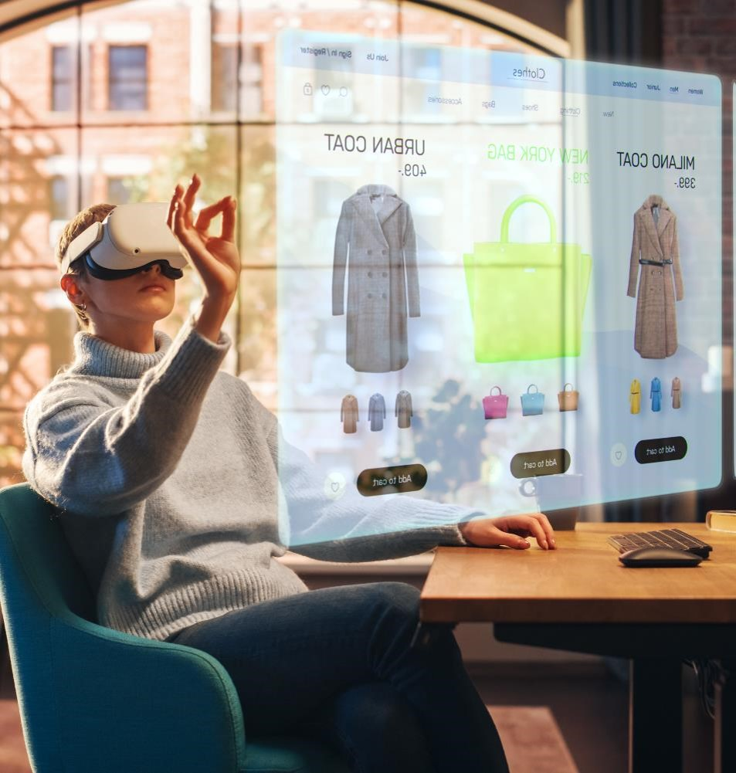
Problem Statement
Dream. Develop. Disrupt
Month 12, 2022
Education in the Metaverse

Slide 4
Problem Statement
The Modern education system in its prevailing state has finally begun to be recognized as outdated and flawed. There is an increasing need for a change in this sphere that incorporates the tremendous technological advances of today.
12 December 2022

Slide 5
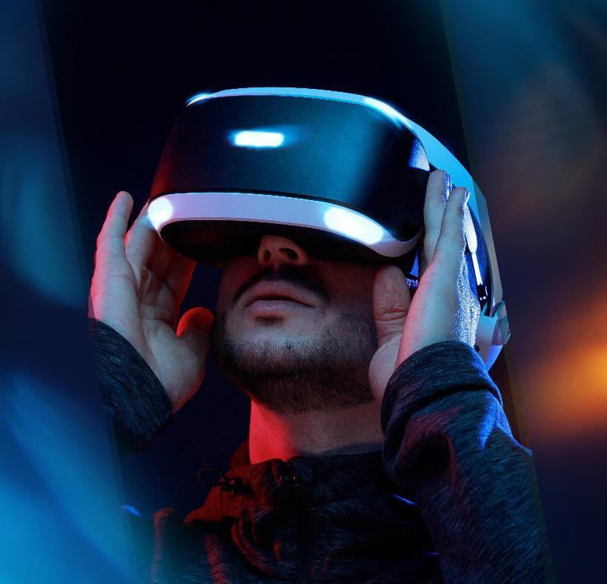
Scope of Idea
Dream. Develop. Disrupt
Month 12, 2022
Education in the Metaverse

Slide 6
Scope Of Idea
The ultimate goal to be achieved from this product is to revolutionize the modern education systems beyond its current limitations, both physical and otherwise.
Remote education can be introduced to rural areas.
Students can be given the opportunity to attend elite institutions, complete with virtual campus experience.
Teachers can detect whether students are attentive and direct classes as necessary.
12 December 2022

Slide 7
Scope Of Idea
Not only that, we can also implement automated solutions for monitoring and assisting teachers and students in any ways required.
Educators can bring in simulations to help students experience what they are learning.
Not every pupil is the same type of learner. Being able to showcase written material in several different mediums can ensure knowledge reaches a larger section of the students.
12 December 2022

Slide 8
Scope Of Idea
Homeschooling becomes an option for physically challenged students - bringing education to you.
Kids hate the dull pacing and static environment of the current online classroom experience. Metaverse can bring great dynamic energy.
Equipment required for different courses are expensive and institutes with less funding may not be able to afford them for students.
Students would get a chance to interact with people from diverse backgrounds from a very young age.
12 December 2022

Slide 9
"Metaverse isn't a thing a company builds. It's the next chapter of the internet overall.".
Mark Zuckerberg, Meta

Slide 10
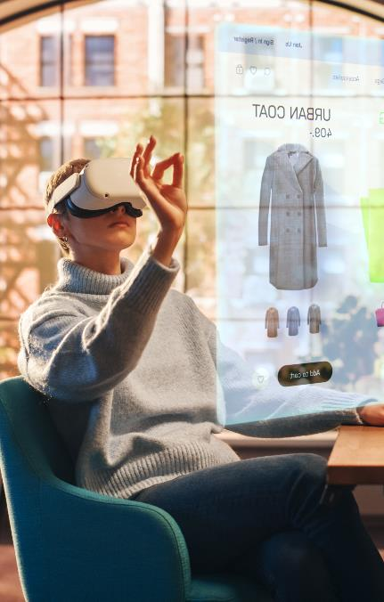
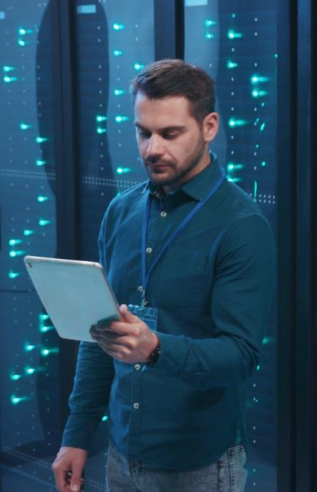

Objectives
Dream. Develop. Disrupt
Month 12, 2022
Education in the Metaverse

Slide 11
Objectives
To create a virtual classroom/school world accessible through the PC or VR headsets.
To incorporates features such as simulations, projections, holograms, etc.
To implement methods for multiple users to log in and interact with others in real-time within the environment.
To implement monitoring systems to watch the students and assist teachers in classroom activities
12 December 2022

Slide 12

Implementation Stack
12 December 2022

Slide 13
Implementation Stack
Three.js
Python
Learning Metaverse
OpenCV
Deep Learning

Slide 14

Demonstration
Dream. Develop. Disrupt
Month 12, 2022
Title

Slide 15
Demonstration
Within the limited time that we were allotted, we created a virtual classroom model along with an avatar that is animated to move through the classroom and can change perspectives as needed.
12 December 2022

