Slide 1
679 Final Project
Prediction For 30 Days Readmissions
Yingmai Chen
Ruicheng Zhang
Yang Xiao

Slide 2
1
OBJECTIVE
2
EDA & Problems
3
MODELS

Slide 3
Data Processing
30 Days Readmission
define return30 (“1”means readmission between 7 to 30 days,“0” means others)
Dealing with ICD code
ICD-10-CM Diagnosis Code Z79*
ICD-10-PCS Procedure Code 3E0*
15 codes

Slide 4
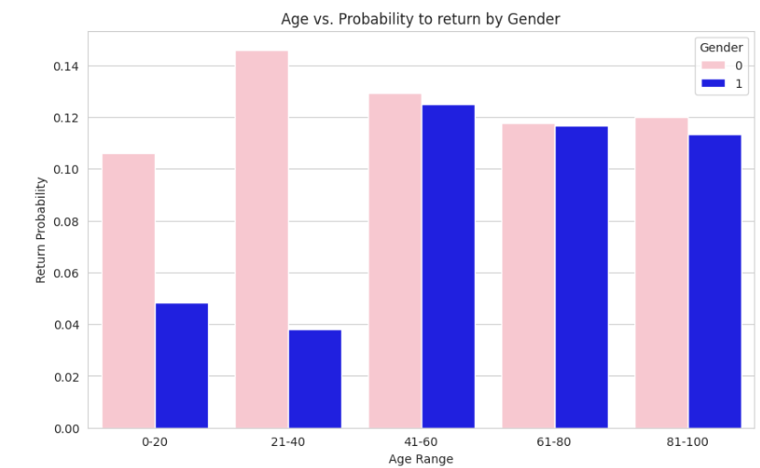
EDA

Slide 5
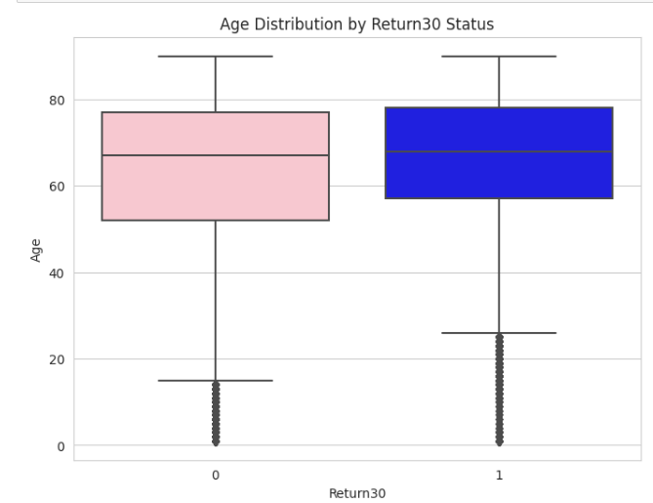
EDA

Slide 6
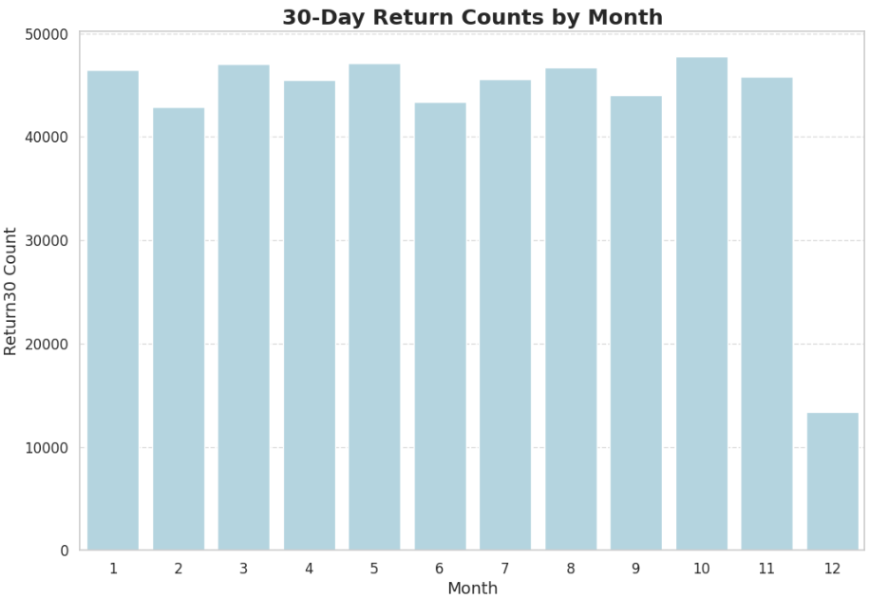
EDA

Slide 7
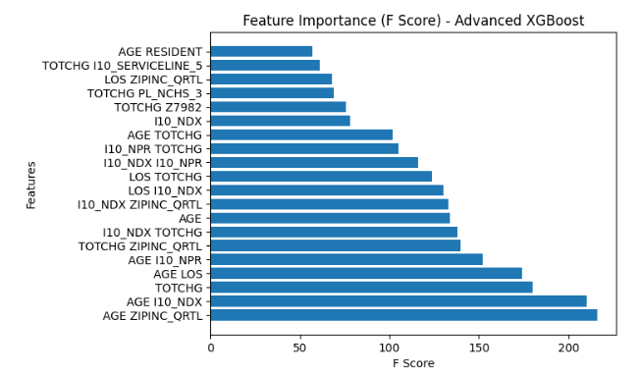
Problems
Solution
Imbalance data
Resampling
About 92% data return30 = 0
randomly select the rows of return30=1 to make the number of return30=1 equals to return30=0.
Overfitting
Feature selection
More than 50 variables

Slide 8
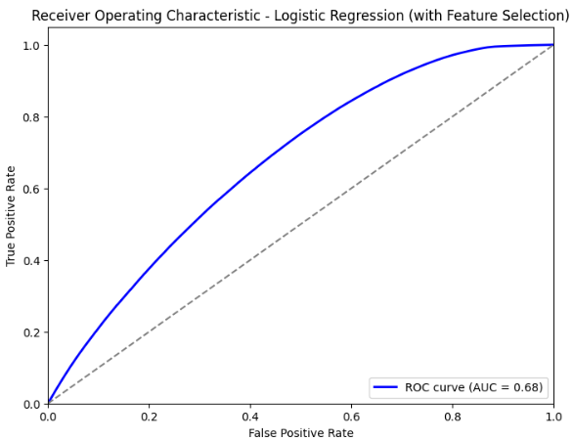
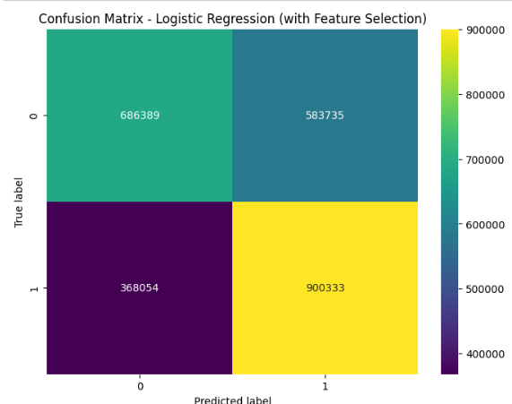
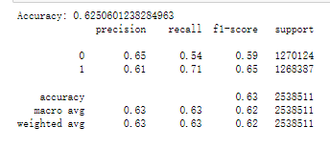
Logistic regression model
Confusion Matrix
ROC, AUC=0.68
Accuracy= 0.63

Slide 9
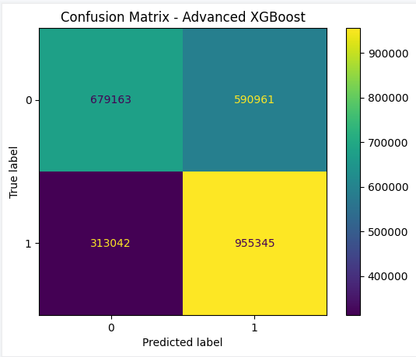
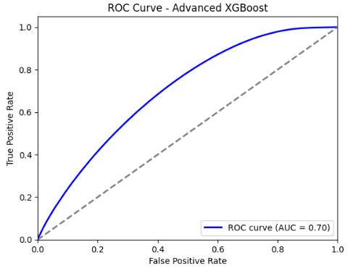
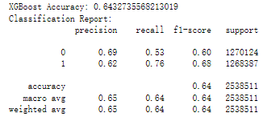
Boosting gradient model
Confusion Matrix
ROC, AUC=0.70
Accuracy= 0.64

Slide 10
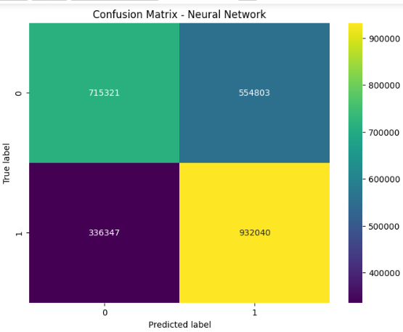
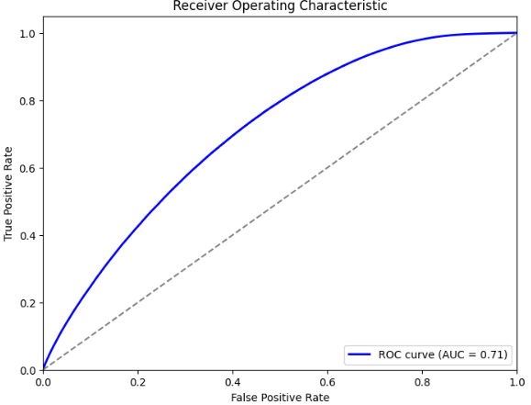
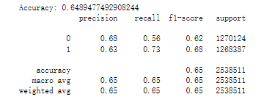
l
Neural Network Model
Neural network model
Confusion Matrix
ROC, AUC=0.71
Accuracy= 0.65

Slide 11
Conclusion
- Gradient Boosting was effective but sensitive to model complexity and overfitting,suggesting a need for careful tuning of parameters.
- Neural Networks provided robust predictive performance but required significant computational resources and careful tuning to balance sensitivity and specificity.
- Logistic Regression, enhanced by feature selection, proved to be a practical tool for identifying high-risk patients, though it also highlighted the challenges of managing trade-offs between model simplicity and predictive power.

Slide 12
Thank you!

