Slide 1
677 Final Project
Yingmai Chen
Ruicheng Zhang
Yang Xiao

Slide 2
Data Cleaning
30 Days Readmission
define return30 (“1”means readmission between 7 to 30 days,“0” means others)
Dealing with ICD code
ICD-10-CM Diagnosis Code Z79*
ICD-10-PCS Procedure Code 3E0*

Slide 3
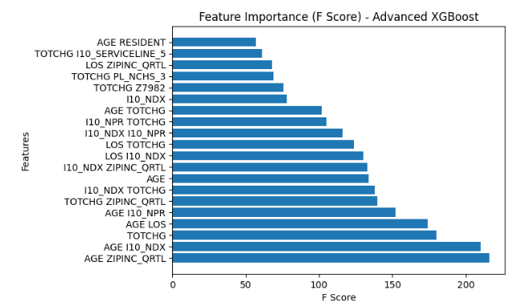
Problems
Solution
Imbalance data
Resampling
About 92% data return30 = 0
randomly select the rows of return30=1 to make the number of return30=1 equals to return30=0.
Overfitting
Feature selection
More than 50 variables

Slide 4
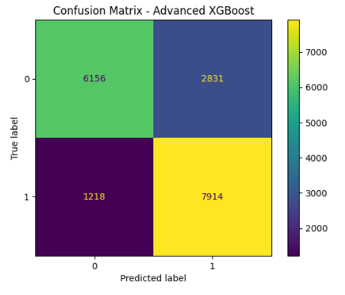
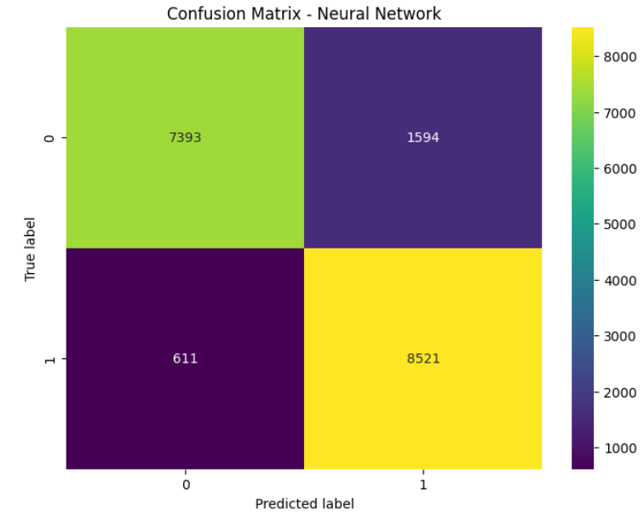
Models
Boosting gradient model
Neural network model

Slide 5
Thank you!

