Slide 1
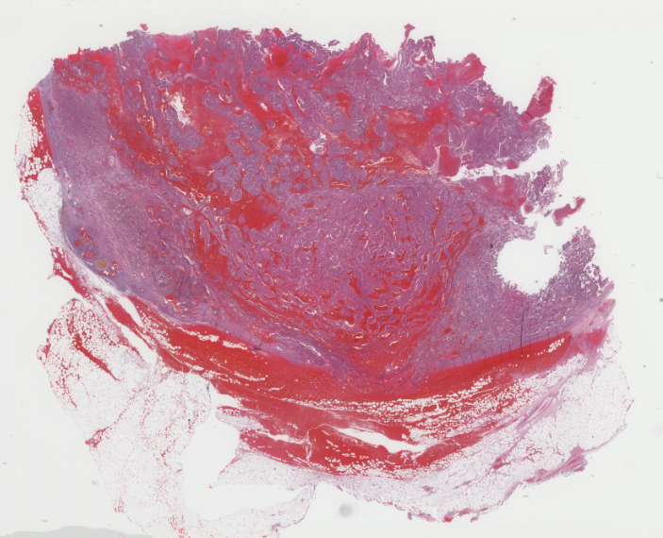
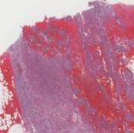
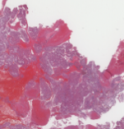
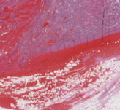
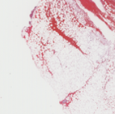
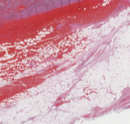
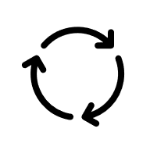
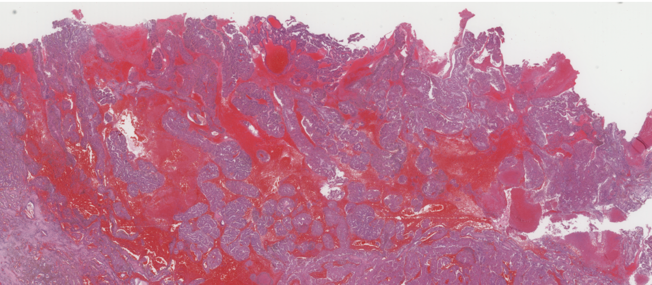
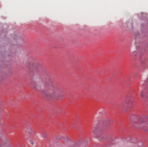
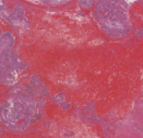
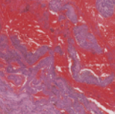
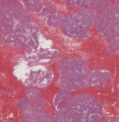
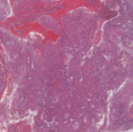
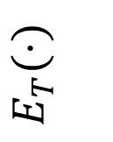


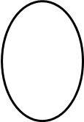



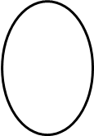




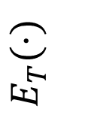
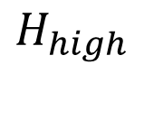








Initial proto
\
5x WSI
$$ℒ_{ortho}$$
5x patches
❄️
$$H_{l}$$
🔥
$$H_{low}$$
Low-scale Prototypes
Visual Attention(weights)
Prototype-Guided Attention
🔥
$$E_{I}(⋅)$$
………
………
Visual Gated Attention
………
🌡️
$$τ$$
Similarity
Low-scale patch features
Semantic Gate(weights)
…
$$∑$$
$$\text{ots}$$
🎓
Irregular solid mass, infiltrative margins, dense stroma...
(low-scale text propmt)
❄️
Global Semantic Anchor($μ$)
$$E_{T}(⋅)$$
………
$$\text{ots}$$
………
Spatial weights
Weighted aggregation
Low logits
Low-scale text features
\Mutual Distillation ($ℒ_{KL}$)
$$D_{l}$$
Cohesive cell clusters, pleomorphic nuclei, mitotic...
(high-scale text prompt)
❄️
Global Semantic Anchor($μ$)
$$E_{T}(⋅)$$
………
$$\text{ots}$$
………
10x WSI
$$D_{h}$$
High-scale text features
Semantic Gate(weights)
Spatial weights
…
$$∑$$
$$\text{ots}$$
🎓
❄️
High-scale patch features
🔥
High logits
………
Prototype-Guided Attention
………
🔥
🌡️
Similarity
$$E_{I}(⋅)$$
Visual Gated Attention
………
$$τ$$
Weighted aggregation
$$H_{h}$$
$$H_{high}$$
High-scale Prototypes
Visual Attention(weights)
10x patches
Initial proto
\
$$ℒ_{ortho}$$

