Slide 1
OBSIDIAN LAB
Linux Synchronization Tools for RTOS
An interactive web app demonstrating mutex, spinlock, semaphores, RW-lock, deadlock and priority inversion — live in the browser.
Real-Time Operating Systems · 2025–2026

Slide 2
MOTIVATION
Why synchronization in RTOS?
In real-time systems, threads share buffers, devices and counters. When two of them touch the same data without coordination, the result is silently wrong, the system deadlocks, or a high-priority task misses its deadline. Linux provides the tools to prevent this — but each comes with trade-offs. This project demonstrates them, side by side, with code you can run.

Slide 3
OVERVIEW
Six interactive demos, one page
01
02
03
Race condition
Mutex vs spinlock
Producer / consumer
Two threads, one counter — with and without a mutex.
Same workload, two locks: sleep vs busy-wait.
Bounded buffer with two semaphores + mutex.
04
05
06
Readers / writers
Deadlock
Priority inversion
Many readers may share access; writers go alone.
Circular wait — and the global lock-order fix.
The bug + the priority-inheritance solution.

Slide 4
ARCHITECTURE
How it fits together
BROWSER
SERVER
Vanilla JS Chart.js Liquid-glass CSS
WebSocket /ws/{demo}
FastAPI + uvicorn threading + sync primitives 6 demo modules
One WebSocket route per demo. Each demo spawns real OS threads, uses real Linux-style sync primitives (mutex, semaphore, RW-lock), and pushes events live to the browser as JSON.

Slide 5
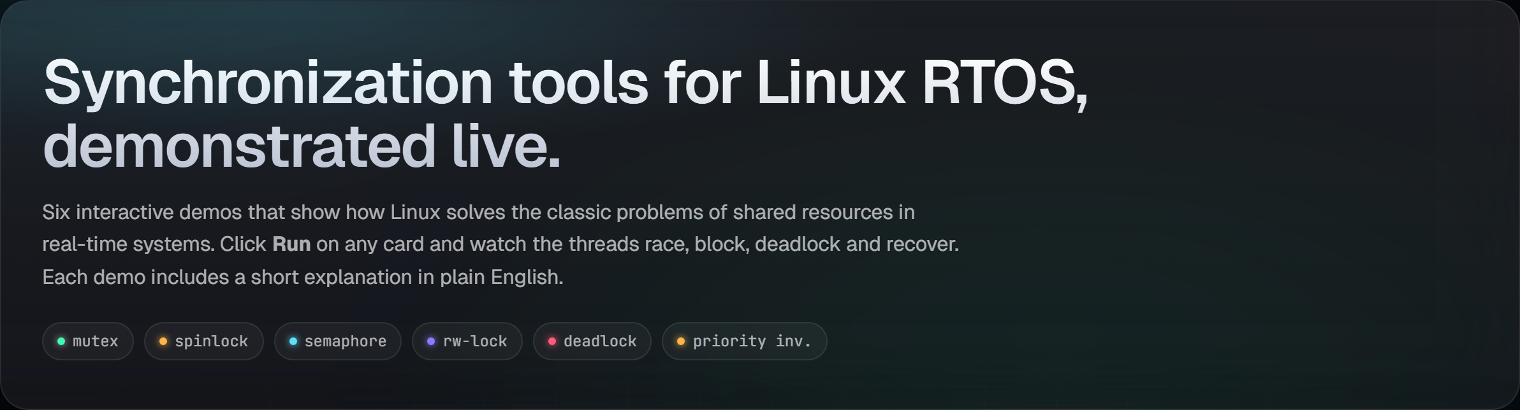
DESIGN
Liquid-glass dark UI
Single-page app, fully responsive for desktop and mobile. Tailwind-inspired tokens, custom CSS (no framework), Geist + JetBrains Mono.

Slide 6
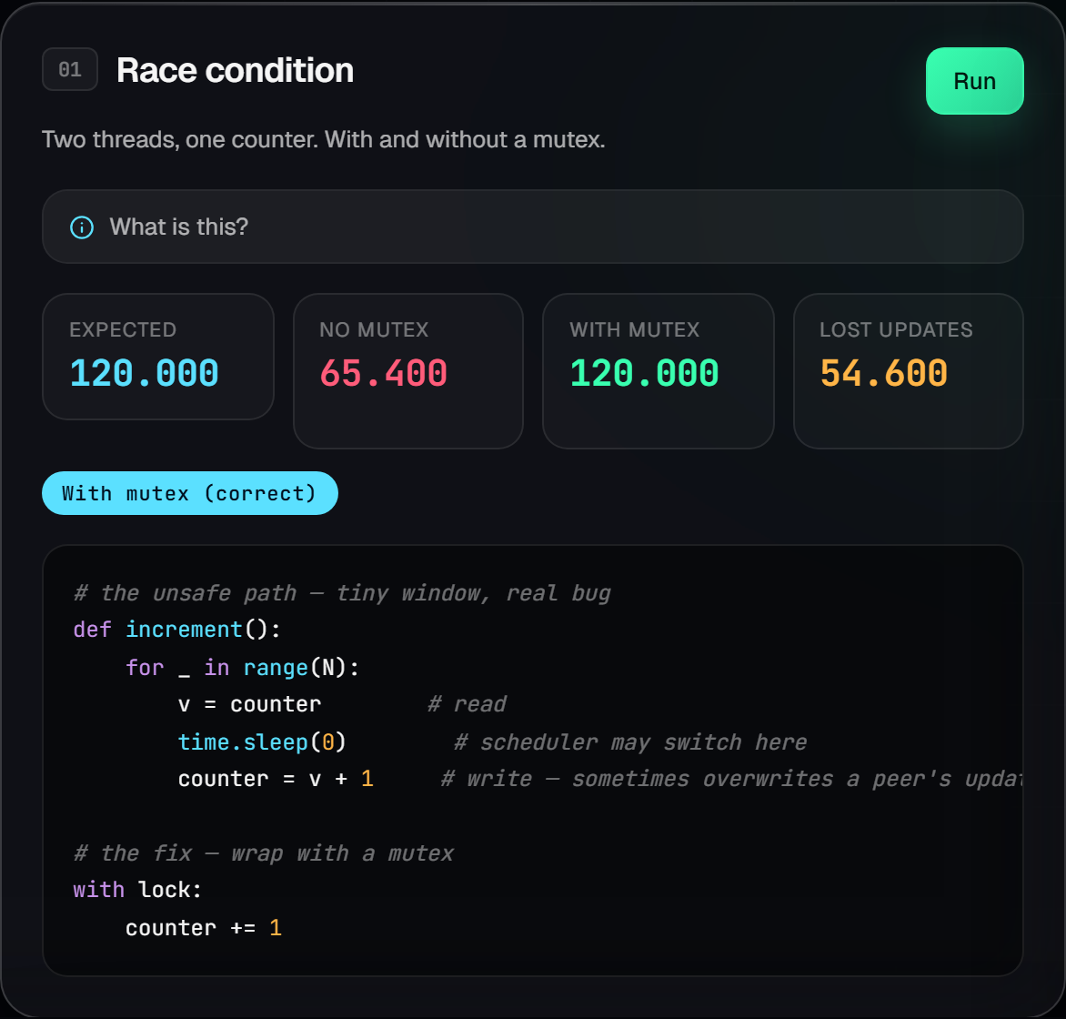
DEMO 01
Race condition
Two threads each increment a shared counter. Without a mutex, updates are lost. With a mutex, the count is exact.
• Real reproduction (not simulated)
• Side-by-side: unsafe vs safe
• Lost updates counted live

Slide 7
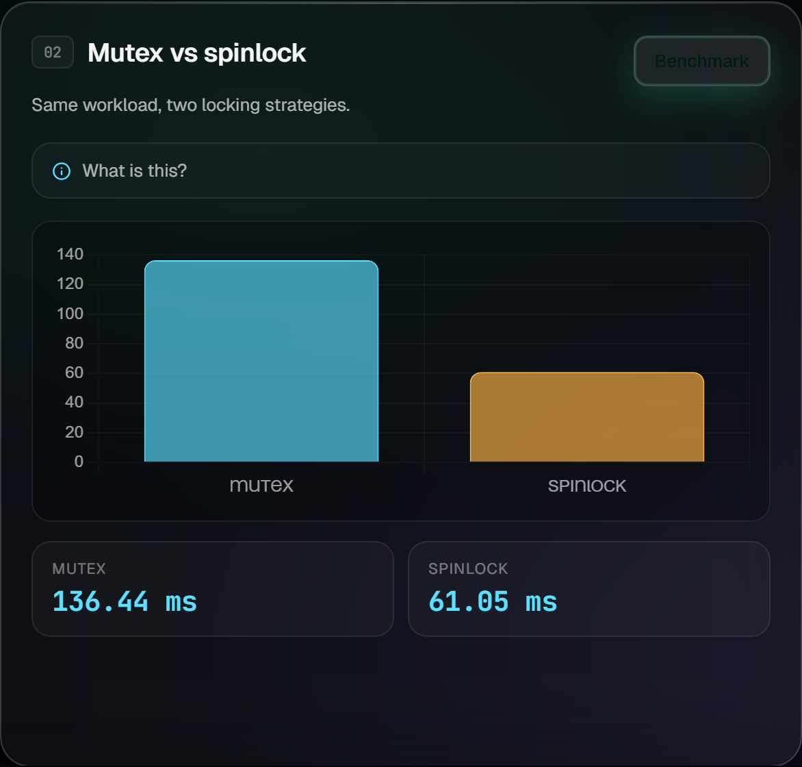
DEMO 02
Mutex vs spinlock
Same workload run with both. Mutex sleeps when blocked. Spinlock burns CPU until free. Linux kernel uses both, depending on the context.

Slide 8
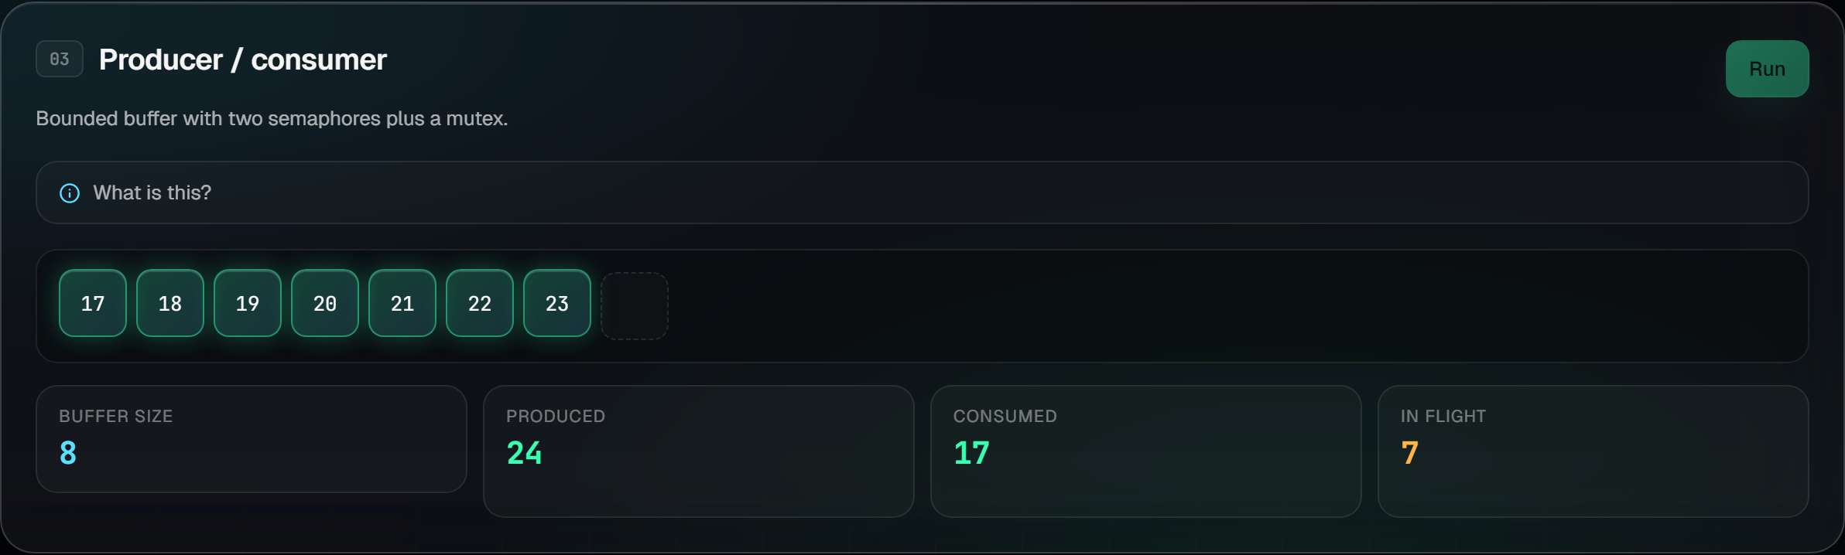
DEMO 03
Producer / consumer
Bounded buffer of 8 slots. Two semaphores (empty + full) plus a mutex protect the buffer. The animation tracks the real buffer state, slot by slot.

Slide 9
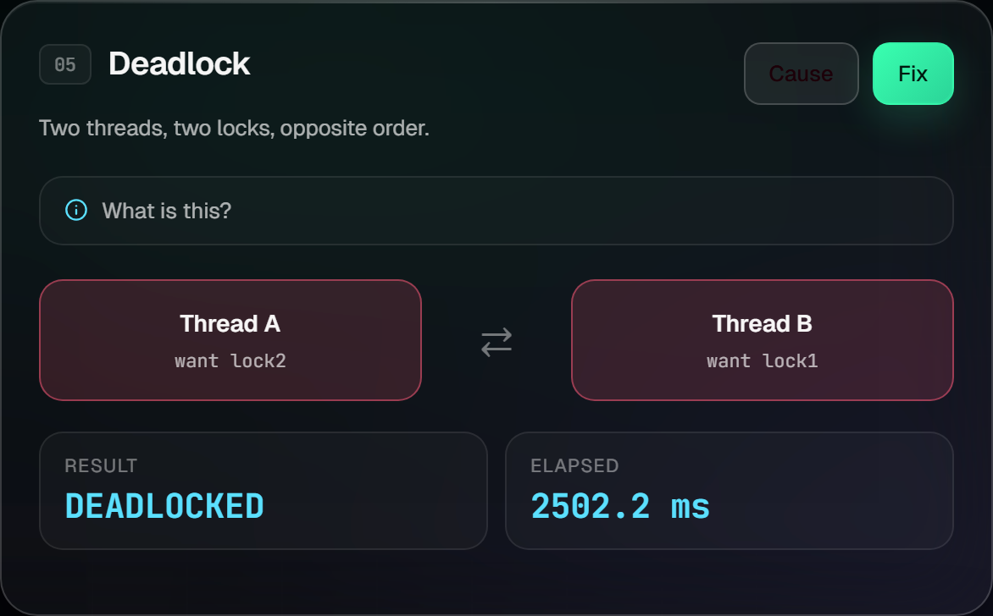
DEMO 05
Deadlock
Two threads grab two locks in opposite order — they wait forever. A 2.5-second watchdog gives up and reports DEADLOCKED. Click "Fix" to apply a global lock order. The cycle disappears.

Slide 10
RESPONSIVE
Designed for mobile too
All six demos stack into a single column on small screens. Reduced blur for performance. Touch targets ≥ 44 px. Respects prefers-reduced-motion.

Slide 11
RUN IT
Three commands
$ pip install -r app/requirements.txt $ uvicorn app.main:app --reload $ open http://localhost:8000
No Node, no build step, no database. Works on Windows, macOS, and Linux.

Slide 12
Thank you.
Questions?
Repository
github.com/AllerSec/OS-PROJECT
Live demo
allersec.github.io/OS-PROJECT

