Slide 1
UI/UX DESIGN THINKING DOCUMENTATION -19/PCSA/117

Slide 2
Introduction: I created survey in google form first to know about the user perspective about womens clothing on online shopping. Then I made wireframe in medium fidelity in pencil tool like a demo for my project UX. I had attached responses and wireframe here:

Slide 3
RESPONSES FOR ONLINE SURVEY FORM ON WOMENS CLOTHING ON ONLINE SHOPPING

Slide 4
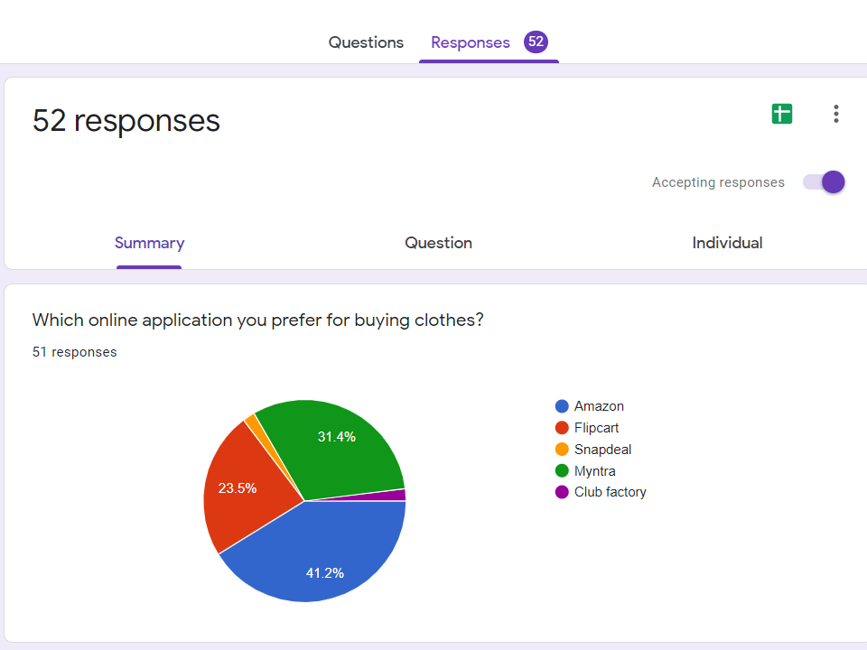

Slide 5
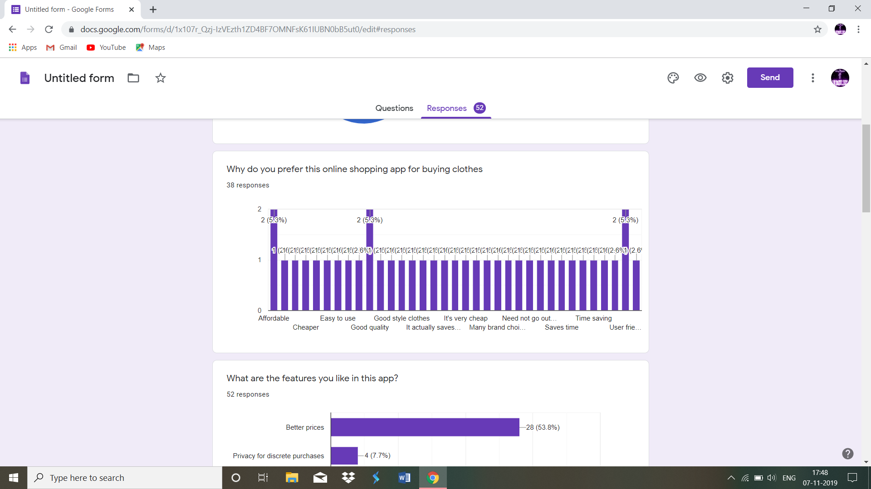

Slide 6
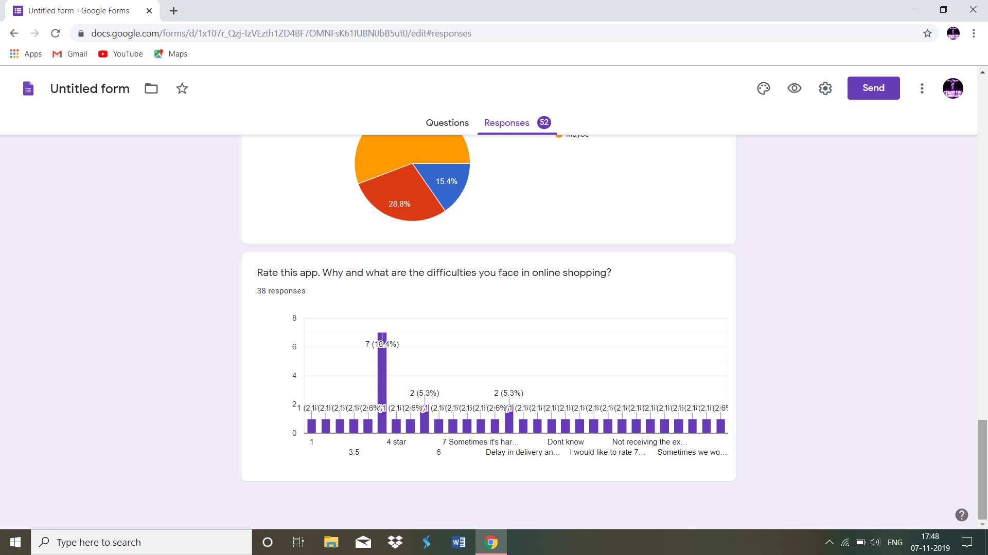

Slide 7
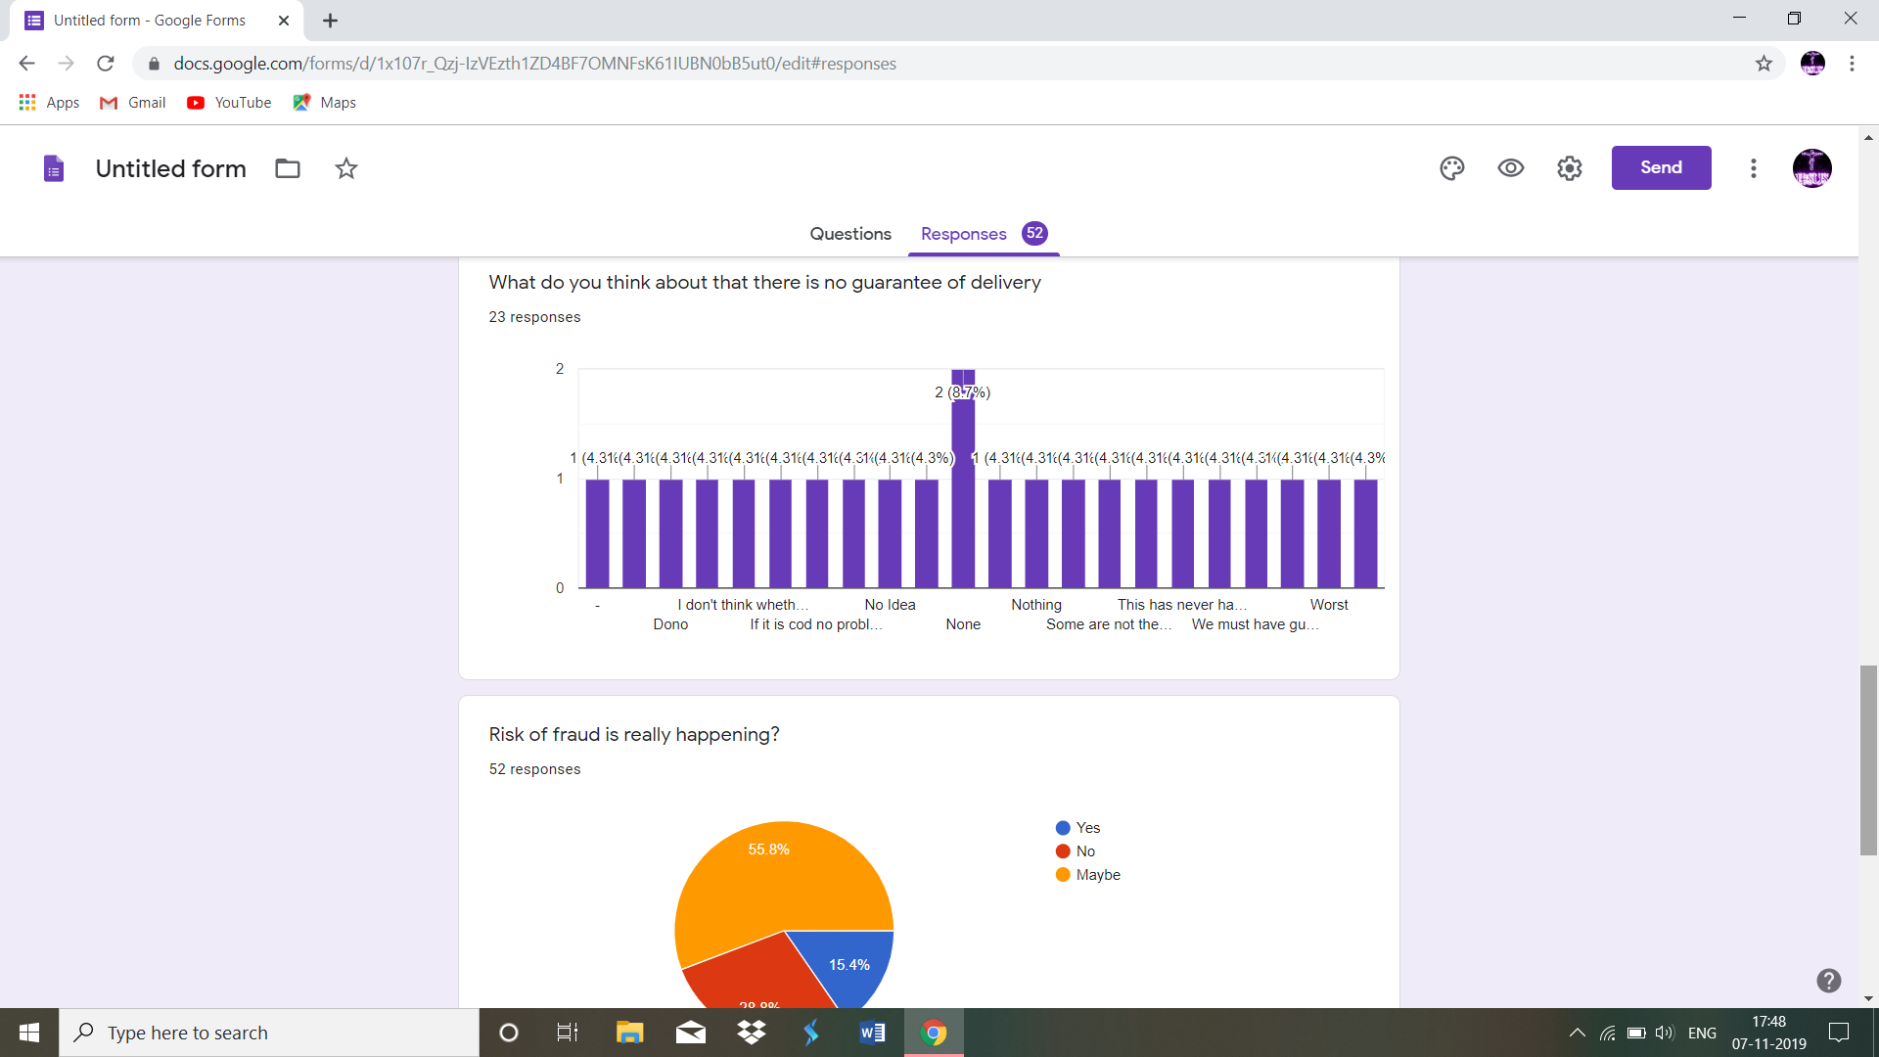

Slide 8
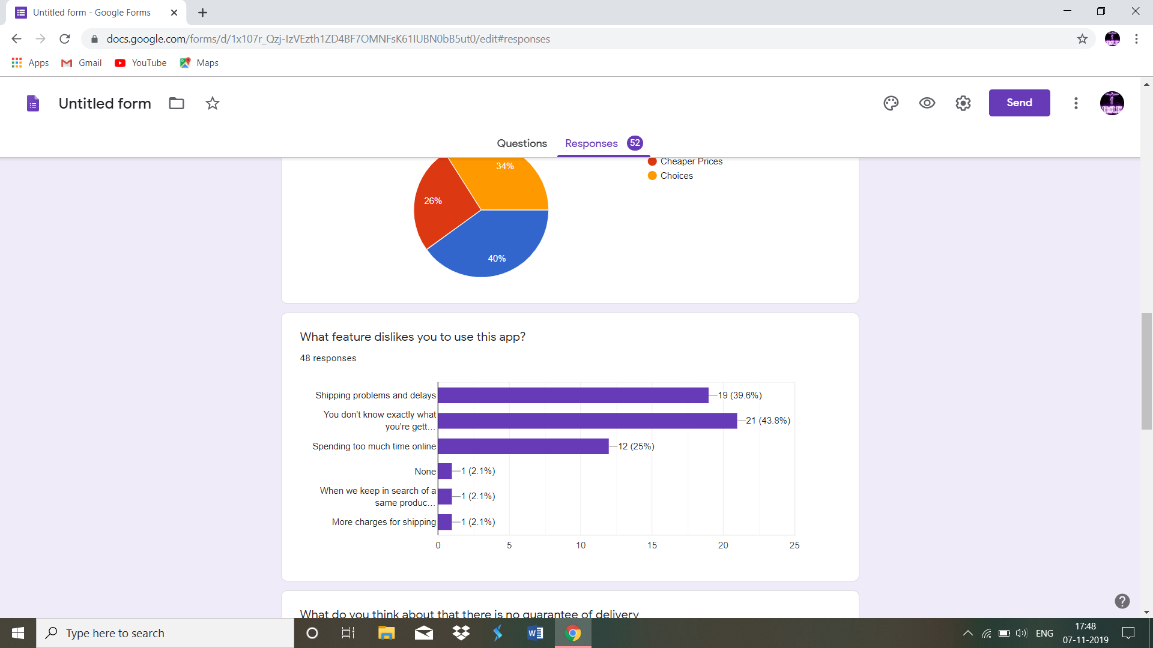

Slide 9
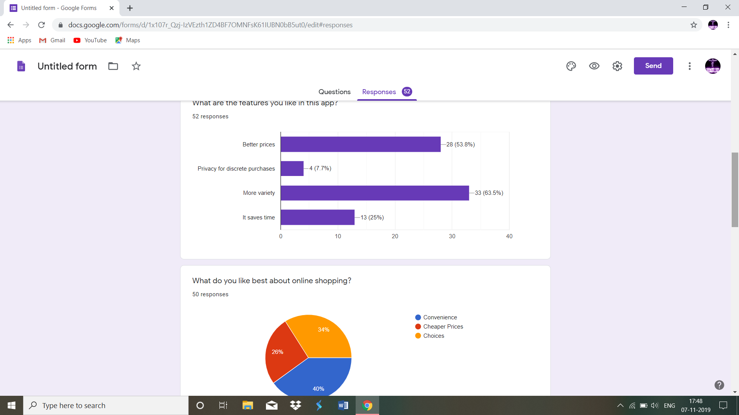

Slide 10
WIREFRAME ON MEDIUM FIDELITY

Slide 11
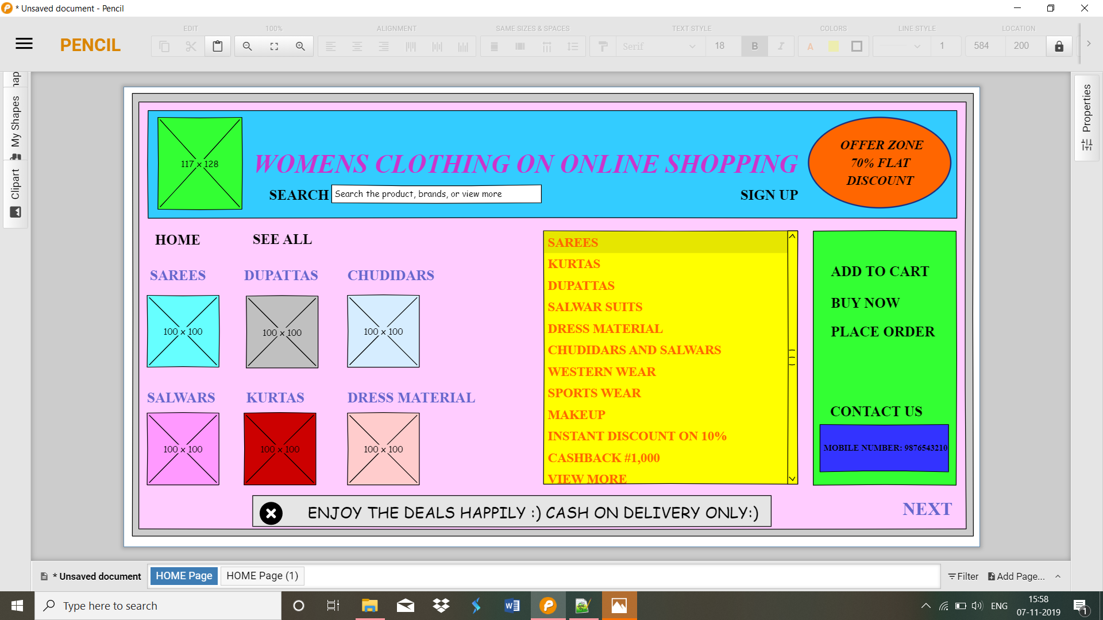

Slide 12
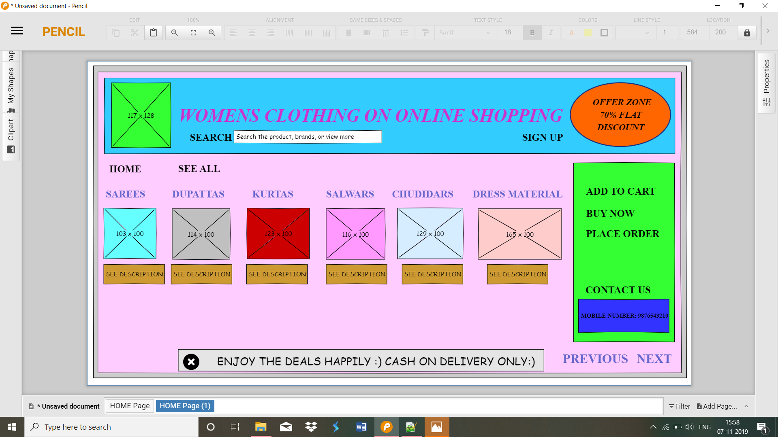

Slide 13
CONCLUSION:
I created survey in Google form first to know about the user perspective about women’s clothing on online shopping. From the response I realized that many frauds happening in online payment. So, I in my website kept only cash on delivery to overcome this problem.

