Slide 1

Redmote
Software Define Networks Application
Prove of Concept

Slide 2
Team
Jorge Alejandro Díaz Sánchez | jadiaz@edu.uag.mx
Erick Ceja Fuentes | erick.ceja@edu.uag.mx
Luis Eduardo Hernández Ayala | lehernandez@edu.uag.mx
Arturo Itzamná Cortés Sánchez | hi@artucorsa.com
Andrés Alejandre Jiménez | andres.alejandre@edu.uag.mx

Slide 3
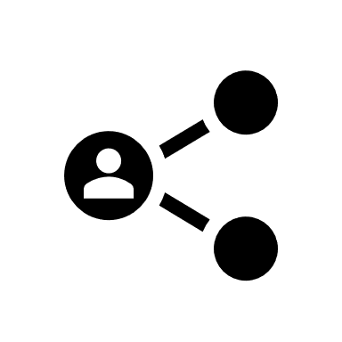
SDN | Software Designed Network
Software-Defined Networks (SDN) are architectures that seek to make networks more agile and flexible. The goal of SDN is to improve network control by helping companies and service providers respond to changes in requirements in a centralized and software-based manner.

Slide 4
Why do we need SDN?
Networks complexity increasing
High scalability requirements
Dependency on providers
Huge data traffic flow
Cloud computing propagation
Big data

Slide 5
Control Plane and Data Plane
Traditional
Control Plane
Control Plane
Control Plane
Data Plane
Data Plane
Data Plane

Slide 6
Control Plane and Data Plane
En SDN
Control Plane
Data Plane
Data Plane
Data Plane

Slide 7
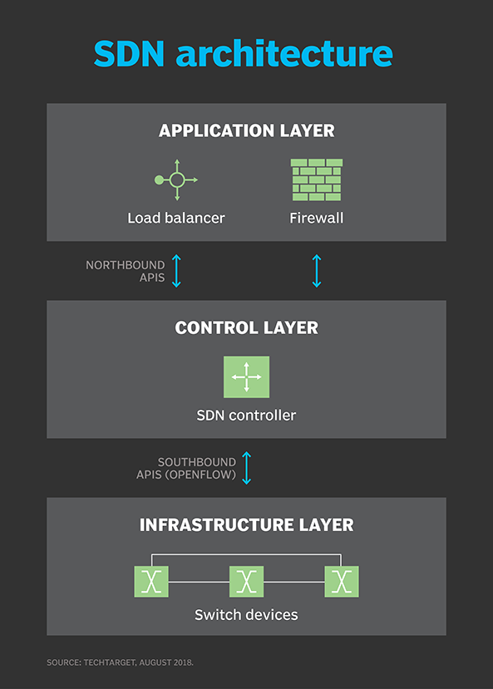
SDN Architecture
CONTROL PLANE
OPENFLOW
DATA PLANE

Slide 8
Redmote Application
bootstrap
DevOps
CSS
python
html
apache2
js
Google Cloud Services
git
curl
ubuntu
json
bash
Mininet
RYU
django

Slide 9
High Level App Architecture
Topology
Controller
Application

Slide 10
High Level App Architecture
Topology
Mininet
Virtual Topology
Running on Ubuntu 16.01
To set this feature run mininet.py
It contains a series of virtual switches with an Openflow interface that we can connect t a controller.
The controller may be either local or remote.
Open VirtualSwitch
OVS
Openflow1.3
Open VirtualSwitch
OVS
Open VirtualSwitch
OVS
Openflow1.3
Openflow1.3
HOST
HOST
HOST
HOST
HOST

Slide 11
High Level App Architecture
Topology
Mininet
Virtual Topology
Running on Ubuntu 16.01
To set this feature run mininet.py
It contains a series of virtual switches with an Openflow interface that we can connect t a controller.
The controller may be either local or remote.

Slide 12
High Level App Architecture
Topology
Controller
Application

Slide 13
High Level App Architecture
Controller
RYU
South Bridge:
Openflow
North Bridge:
REST API
L2
L3
Controller
Layer 2 Configs
Layer 3 Configs

Slide 14
High Level App Architecture
Controller
RYU
RYU communicates with Mininet OVSs through OpenFlow. (South Bridge)
RYU has applications to run simple L2 and L3 switches
RYU offers an RESTFUL API to communicate with other applications (Northbridge)
Run Python scripts: rest_ofctl.py (L2) and rest_router.py(L3)

Slide 15
High Level App Architecture
Topology
Controller
Application

Slide 16
High Level App Architecture
Application
Django
Python Scripts
Google Cloud Services
User Interface
Django Framework
WEBSITE

Slide 17
High Level App Architecture
Application
Django
Django Framework
The WEBSITE is mounted over a VM in Google Cloud Services
It comunicates with RYU through Python scripts running in localhost.
It offers internet Access to the Project.
git repository: https://github.com/Allexds/RedmoteSDN

Slide 18

High Level App Architecture
Topology
Controller
Application
Openflow
Python
WEB UI

Slide 19
Redmote
Device Software / Hardware information
Layer 2 Port Information
Layer 3 Address and Static Routes

Slide 20
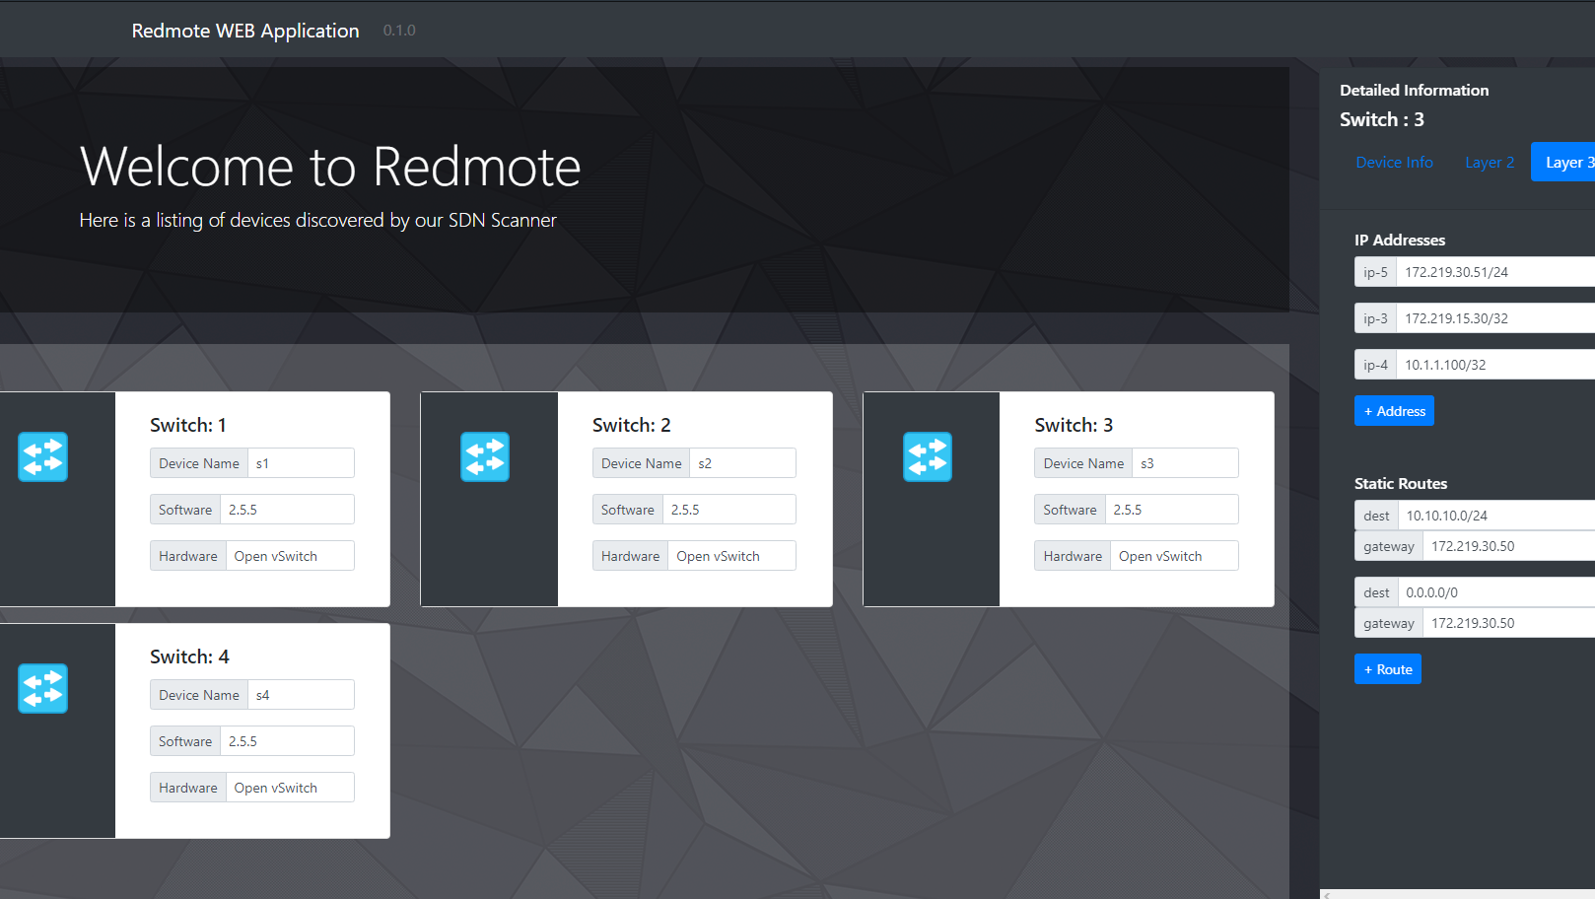
GO TO REDMOTE!
Redmote WEB UI

