Slide 1
COMP 311: Software Testing and Quality Assurance JUnit EE Sample presentation for Test tools assignment by ****** & ******
Notes:
Instructions:
Customize the black text. Be sure to include the names of all team members.

Slide 2
What is JUnitEE
JUnit EE is an extension of JUnit for performing unit tests in a Java Enterprise Edition environment
Test cases can run within an Java EE enterprise server
Used to test Web applications (servlets and JSPs) and enterprise applications based on EJBs
Test runner is a serlvet that acts as the entry point into test cases
The need:
JUnit is designed for a client-side or Java Standard Edition applications
Test runners use Java GUI or command line interface
Cannot run in an application server, or very difficult to set up
Cannot produce HTML output
Notes:
Instructions:
On the first page say what the tool is and what it does → high level definition.
What kind of testing does the tool do or what problem does the tool solve?
Who uses the tool. For example, it is for testers, the test managers, project managers, developers …?
You can add other notes such as the following to any page.
These are things you may say while presenting, but do not want to include in body of the slides.
This presentation assumes the reader is familiar with JUnit and Java EE concepts.
The test runner is the driver or the piece of code that launches the test

Slide 3
How to acquire JunitEE
Web site: http://www.junitee.org
Download JUnitEE from sourceforge.net
http://sourceforge.net/projects/junitee/files/
License: Public Domain
Free software available under GNU General Public License (GPL)
Requires:
Java Web container as provided by Java EE Web and application servers
Tomcat, WebSphere, WebLogic, Orion and more
Notes:
Instructions:
Use a page to say who owns or distributes the tool
How to download or get it
What are the licensing conditions if open source
What does it costs if commercial software
URL for the tool or owning company, URL for download, URL for tutorial …

Slide 4
How JunitEE works
JUnitEE provides a Test Runner that:
Outputs HTML for tester to control and view tests
Outputs a servlet that acts as entry point to run test cases
Basic test mode
Test Runner executes set of test suites that are defined manually
Smart test mode
Test Runner finds test suites in JARs included in target WAR and let you chose which to run
Notes:
Instructions: A slide to capture the nature of the tool
Give a general discussion of what the tool does. This could be:
A list of features
A list of strengths and weaknesses
How it relates to other tools, the runtime environment
Use in the test process more general software development process
…
You can take images from the Web, User’s Guides and similar documents.

Slide 5
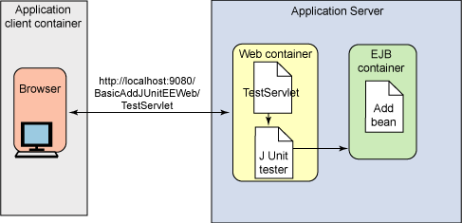
Using JunitEE to test EJBs
Notes:
Instructions:
Add whatever makes sense for your topic.
An architecture diagram or graphic of where the tool fits in the test process is often good.
You may find something in the marketing literature or Web page for the tool.

Slide 6
Installation and overview of use
Download the JUnitEE zip file, and unzip
Create a Web application at contains the JUnitEE test servlet and test classes
A minimal WAR deployment descriptor is provided
Declares JunitEE servlet
Specifies servlet mapping
Make sure junitee.jar and junit.jar are on the class path of the Web application
Put them in folder WEB_INF/lib
Configure the test servlet, by editing deployment descriptor, to:
Specify where test classes are and some other factors
Deploy the test war to the server
Run by enter URL for test servlet
Notes:
Instructions:
If relevant add a page on how to install and use the tool

Slide 7
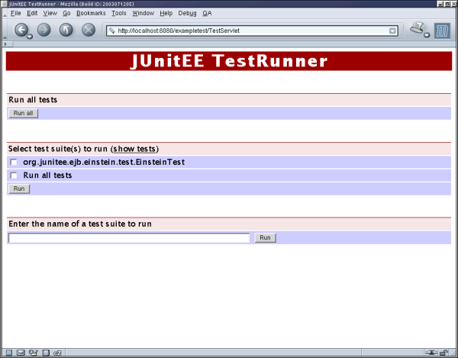
The servlet generates HTML
Notes:
Instructions:
If relevant and possible show screen shots of use. Best of all, give a live demo.
You can take images from the Web, User’s Guides and similar documents.

Slide 8
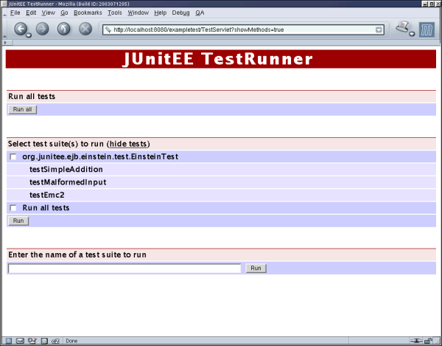
Selecting what tests to run
Notes:
Instructions:
Include whatever is relevant for your tool. For example, you may list the tests that a static analysis code analyzer does or diagrams of how a source course code control system creates new tracks or streams of versions of files.

Slide 9
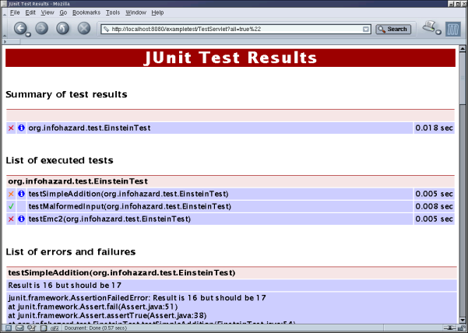
Running JUnitEE – results page
Notes:
Instructions:
Include as much graphic information, diagrams and the like as possible.

Slide 10
Similar tools - Cactus
Cactus from apache also tests components in a Java EE application server
Also for integration unit testing
Cactus also uses and extends JUnit
Cactus can do some things JUnitEE can’t:
Some Cactus features run on the client side
Cactus can run directly from ANT commands
Some prefer Cactus for automated testing and JUnitEE for manual testing
Advantages for using JUnitEE
All class files are in same place
The container on the application server classpath
All tests run inside the container
Use can mix tests with JUnit tests
Notes:
Instructions: Discuss whatever is relevant for your choice of tool.
For example, in this case it makes sense to mention the related tool Cactus

