Slide 1
COMP 311: Software Testing and Quality Assurance Selenium Grid by: Brandon Occhiuzzi Shane Stroud Alley Chaggar
Notes:
Instructions:
Customize the black text. Be sure to include the names of all team members.

Slide 2
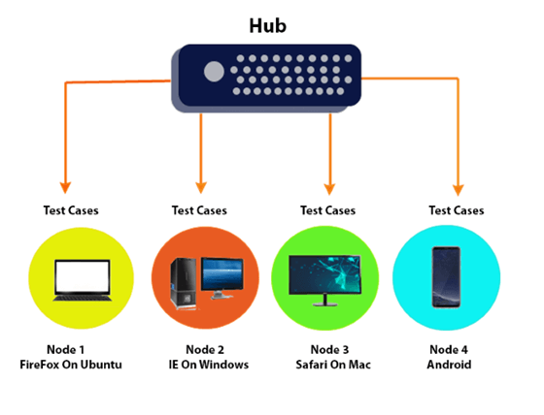
What is Selenium Grid
Selenium Grid is a smart proxy server that makes it easy to run tests in parallel on multiple machines and browsers.
Allows multi-browser testing
Allows multi-OS testing
The need:
Testers use Selenium Grid to run tests
Saves test execution time
Multiple browsers
Different devices
Different operating systems
Notes:
Script:
Selenium grid is one out of 4 components in the selenium suite. Selenium is bluh bluh bluh….
IT CAN ONLY DO PARALLEL TESTING WHEN WITH TESTNG
Parallel testing refers to a software technique or process that leverages automation testing capabilities to execute the same tests simultaneously in multiple environments, real devices, and browser configurations, which significantly reduces the time and efforts of testing.
Instructions:
On the first page say what the tool is and what it does → high level definition.
What kind of testing does the tool do or what problem does the tool solve?
Who uses the tool. For example, it is for testers, the test managers, project managers, developers …?
You can add other notes such as the following to any page.
These are things you may say while presenting, but do not want to include in body of the slides.
This presentation assumes the reader is familiar with JUnit and Java EE concepts.
The test runner is the driver or the piece of code that launches the test

Slide 3
How to acquire Selenium Grid
Web site: https://www.selenium.dev/
Download Selenium Server
https://www.selenium.dev/downloads/
License: Public Domain
Free software available under Apache 2.0 Licence
Copyright holder: Software Freedom Conservancy
Requires:
Java 11 or higher
Browser(s) Installed
Browser(s) drivers
Selenium Server file (Jar)
Notes:
Instructions:
Use a page to say who owns or distributes the tool
How to download or get it
What are the licensing conditions if open source
What does it costs if commercial software
URL for the tool or owning company, URL for download, URL for tutorial …

Slide 4
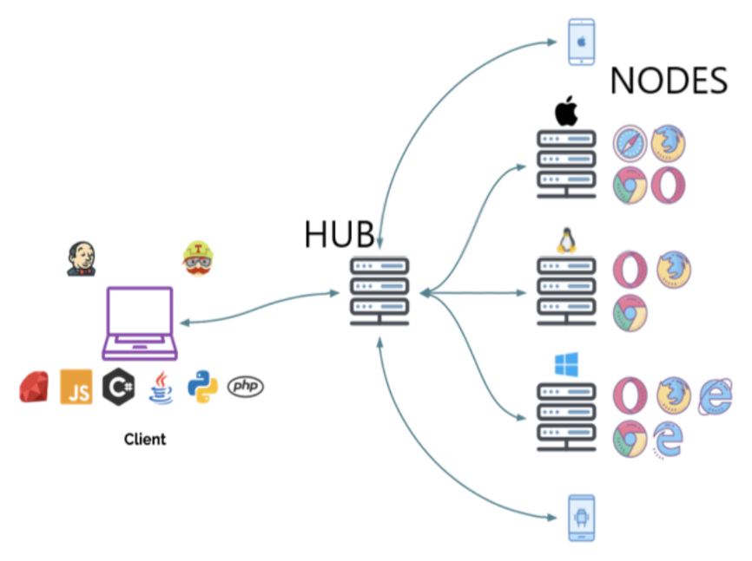
How Selenium Grid works
Two major components of the architecture
Hub
Is a server
Accepts the access requests from the WebDriver client
Takes instructions from the client and executes them remotely on the various nodes in parallel
Node
Remote device
Receives requests from the hub in the form of JSON test commands
Executes using WebDriver
Strengths
Community
Multiple different programming language
Limits
Testing only web-based applications
Doesn’t support mobile application testing
Notes:
Instructions: A slide to capture the nature of the tool
Give a general discussion of what the tool does. This could be:
A list of features
A list of strengths and weaknesses
How it relates to other tools, the runtime environment
Use in the test process more general software development process
…
You can take images from the Web, User’s Guides and similar documents.

Slide 5
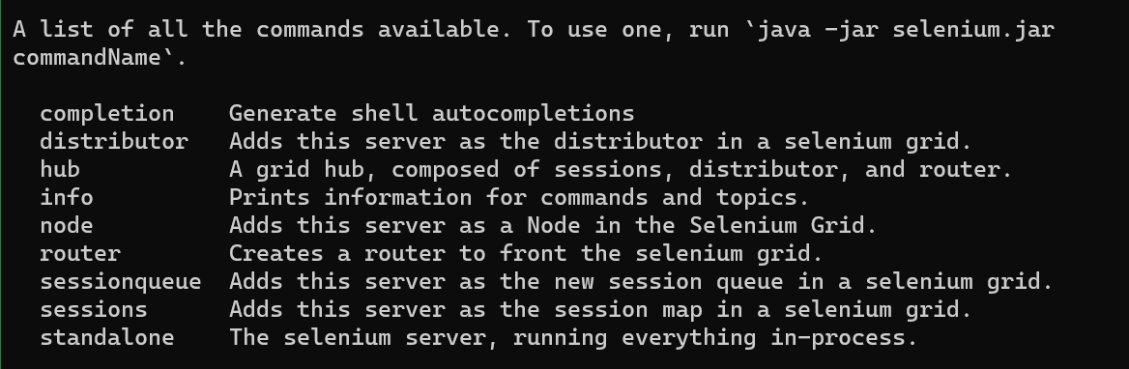
Installation and overview of use
Download the Selenium Server
Jar file
Make sure perquisites are download
Command-Line
java –jar selenium-server <Version>.jar
Shows list of selenium server commands
Notes:
Instructions:
If relevant add a page on how to install and use the tool

Slide 6
Process of Selenium Grid
Install
Set up server and nodes
Create tests
Run your tests
View test results
How to run in parallel
https://www.youtube.com/watch?v=l5XmzfzFNKk
Notes:
Instructions:
Add whatever makes sense for your topic.
An architecture diagram or graphic of where the tool fits in the test process is often good.
You may find something in the marketing literature or Web page for the tool.

Slide 7





Who uses Selenium Grid?
GEICO
FreeWire Technologies
Vail Systems
JPMorgan Chase
Foundation medicine
Cigna Insurance
Grid is used in many industries including, but not limited to, the finance, insurance, medical, and manufacturing industries.
Notes:
Instructions:
Include as much graphic information, diagrams and the like as possible.

Slide 8
Similar Tools - cont
Endtest – Cloud platform that allows the creation, management, and execution of automated tests. Endtest is faster than selenium and offers all of the additional components needed to manage automation.
Playwright – Node.js library developed my Microsoft, usefulf or chromium based browsers and firefox but there is no advantage over Selenium.
Watir – open source Ruby library, basically a BDD (behaviour dev design) wrapper around Selenium. Easier API to use but less popular than Selenium.

Slide 9
Resources
https://www.browserstack.com/guide/selenium-grid-tutorial
https://www.selenium.dev/documentation/grid/
https://discovery.hgdata.com/product/selenium-grid

