Slide 1
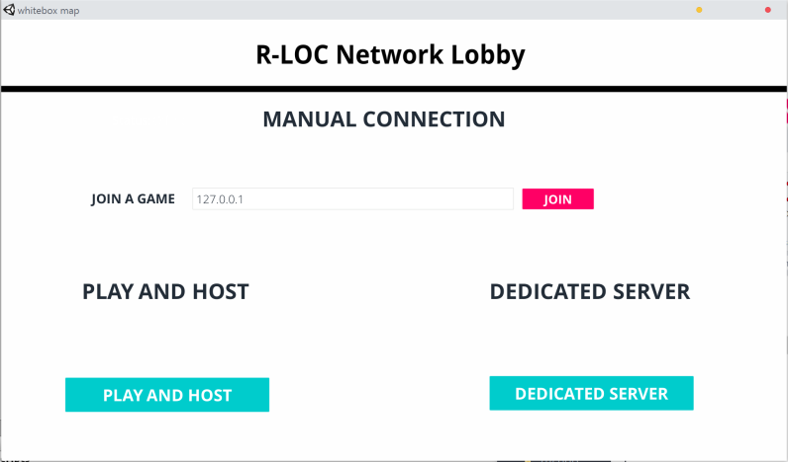
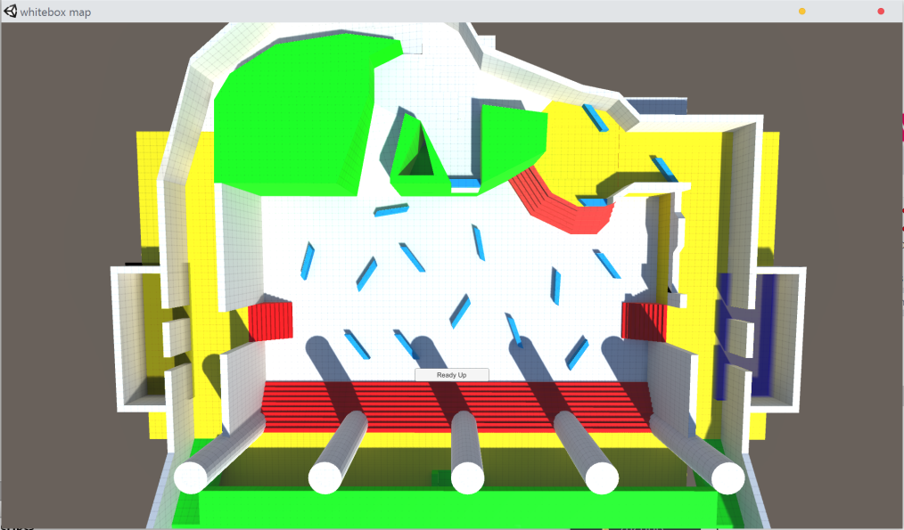
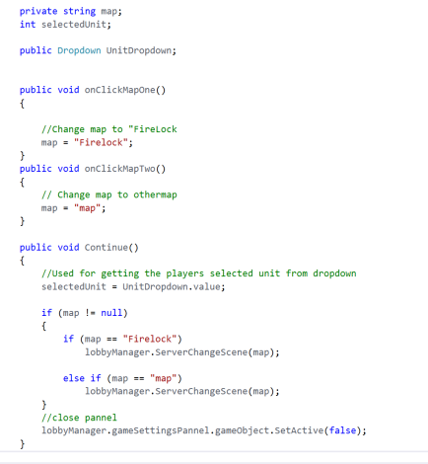
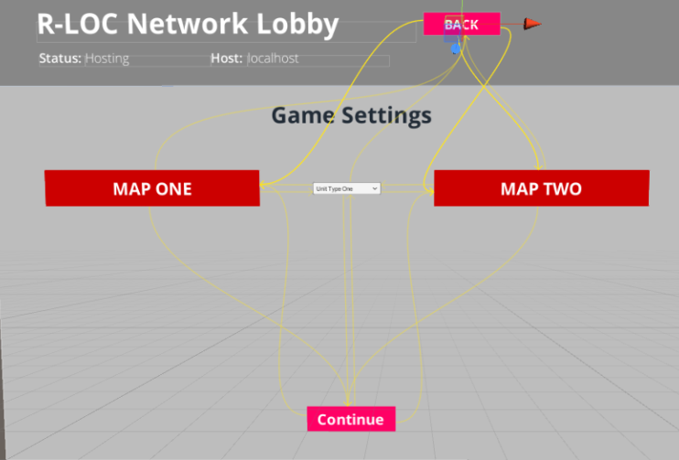
R-LOC NETWORK LOBBY
Introduction
For my project I worked on integrating a lobby into the game Firelock being developed R-LOC studios.
The lobby system builds upon the existing free network lobby system that was created by unity.
For my contribution I worked on creating a game Settings class that controlled what the game settings are when in the lobby, and then when the game starts it uses those settings.
This is a small bit of code that I wrote that controls what map loads in unity based on what the user chooses.
The above image shows how the UI is linked together, so the user has to select a map in order for the continue button to work.

