Slide 1
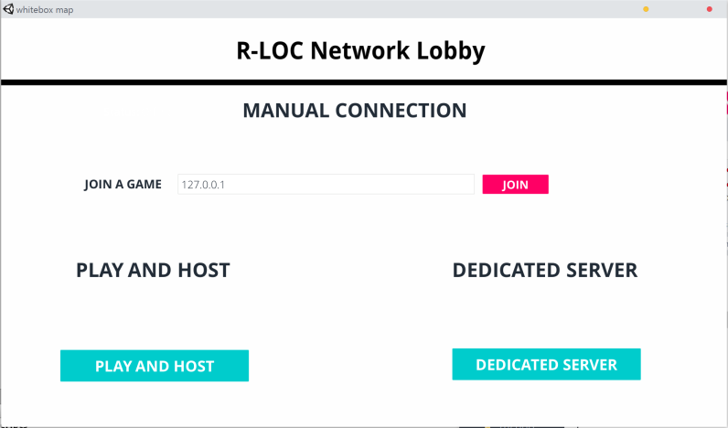
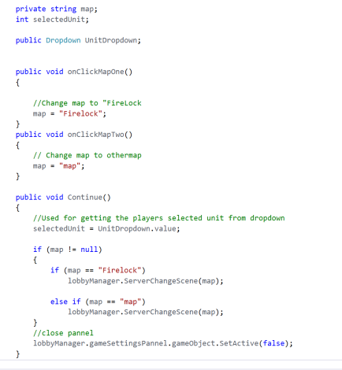
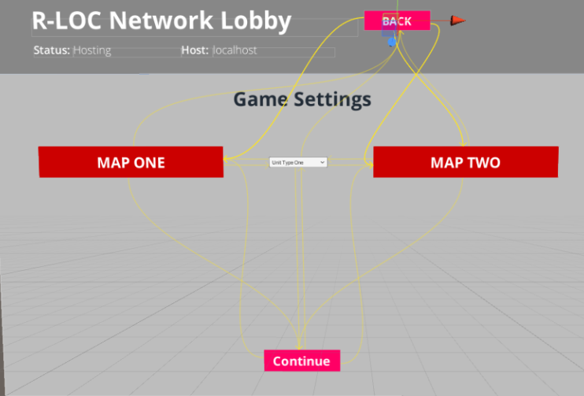
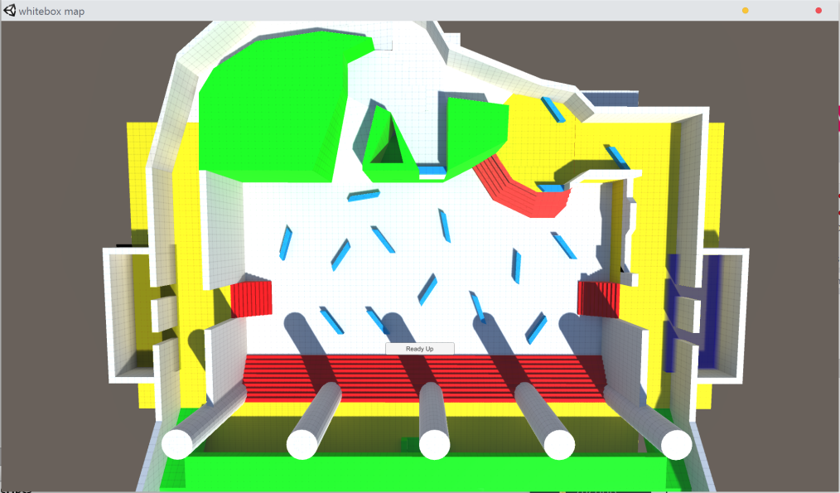
R-LOC NETWORK LOBBY PROTOTYPE
Introduction
For my project I worked on integrating a lobby into the game Firelock being developed R-LOC studios.
The lobby system builds extends the functionality of the existing free network lobby system that was created by unity.
This is a product that can be fairly easily attached to most unity projects to create a lobby for.
Development
For my contribution I worked on creating a game settings class that controlled what the game settings are when in the lobby, and then when the game starts it uses those settings.
One of the most challenging problems I faced when creating this product was not the actual networking but the UI that managed the lobby as it’s a bit of a maze to create linked Uis in unity.
This is a small bit of code that I wrote that controls what map loads in unity based on what the user chooses.
The above image shows how the UI is linked together, so the user has to select a map in order for the continue button to work.
Final Product
There was a lot of features that were cut for this project due to time constraints.
However in the final product allows the host client to choose one of two maps and then the host becomes an top down overview (like the picture to the right) which you can then view the connected clients in the game fight.

