Slide 1
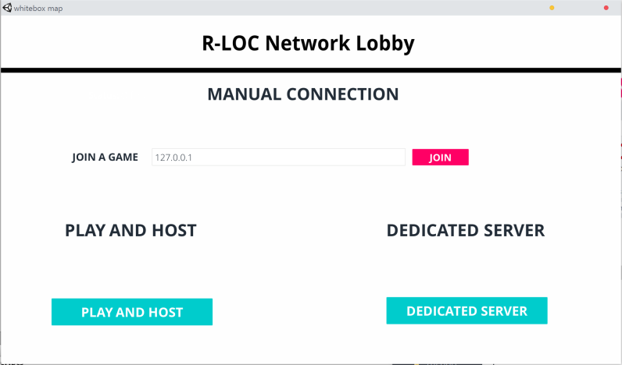
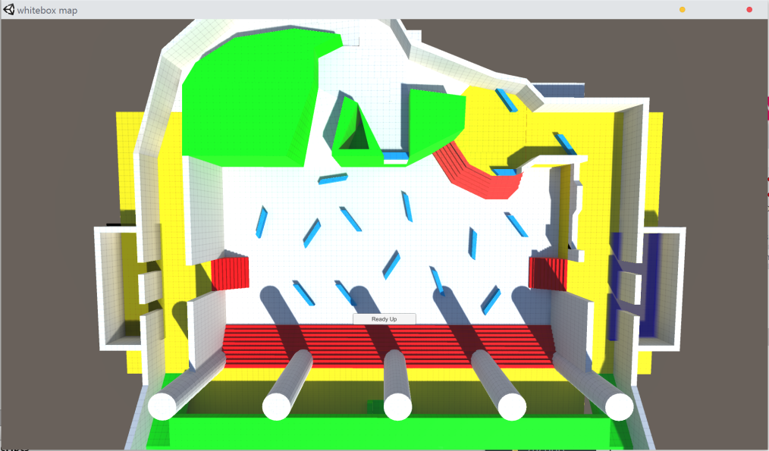
R-LOC NETWORK LOBBY
For my project I worked on integrating a lobby into the game Firelock being developed R-LOC studios.
The lobby system builds upon the existing free network lobby system that was created by unity.
For my contribution I worked on creating a game Settings class that controlled what the game settings are when in the lobby, and then when the game starts it uses those settings.

