Slide 1
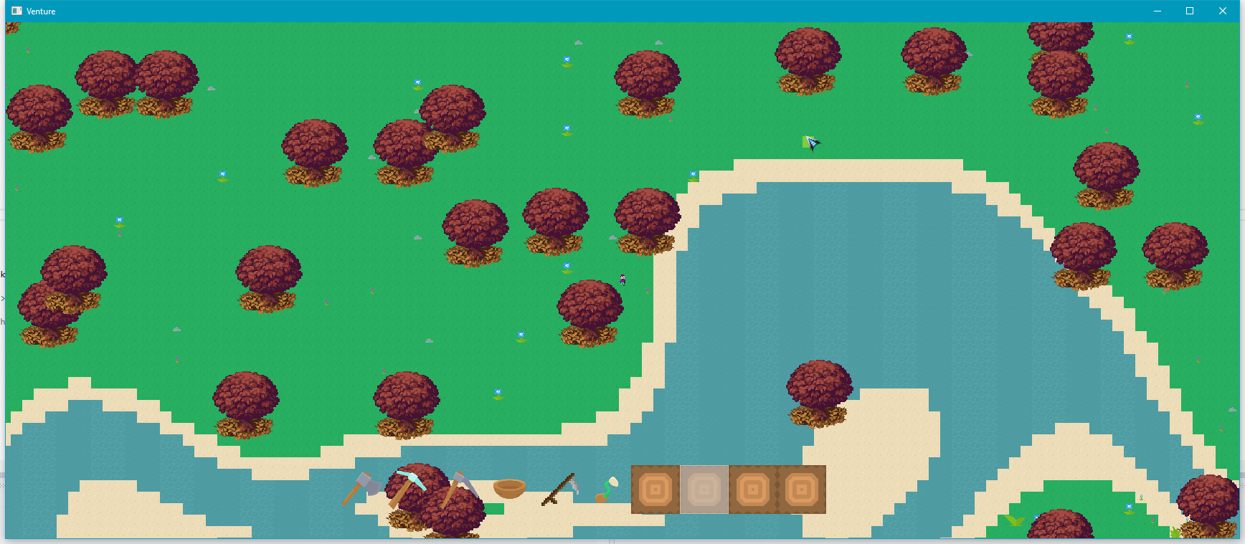
Project:
For this optimisation and porting task I will be using a game I was working on over the summer.
The game is a top down open world multiplayer farming game called Venture.
The game is getting roughly 20-30FPS in debug build, which isn’t much considering the content in the game, and in release build the game runs better, but there is memory issues when explore the world.
Engine:
The game was developed in C++ with SDL and used the boost::asio library for the networking. However, for the scope of this project and to ease the port to PS4 I will be removing the networking from the game, and focus on the single player optimisations. Furthermore depending on the support for SDL on the PS4 I may be looking into converting to the PhyreEngine for the rendering as that will also improve the performance.
Profiling Tools:
Visual Studio profiler is a very useful tool within visual studio that can profile the CPU, memory and GPU (only using the directX).
RenderDoc may be useful for if I decide to overhaul the SDL rendering and use openGL instead, this will be able to help profile the openGL rendering pipeline.
MemTrack is a library for C++ which replaces the standard operator new with a special version that records information about each memory allocation, which may be helpful when debugging and profiling memory related issues.
Remotery is a Realtime profiler for CPU and GPU, which supports a variety of graphics APIs, including openGL.
MTuner is another C++ memory profiler, however this one has support for the PlayStation 4 and 3.

Slide 2
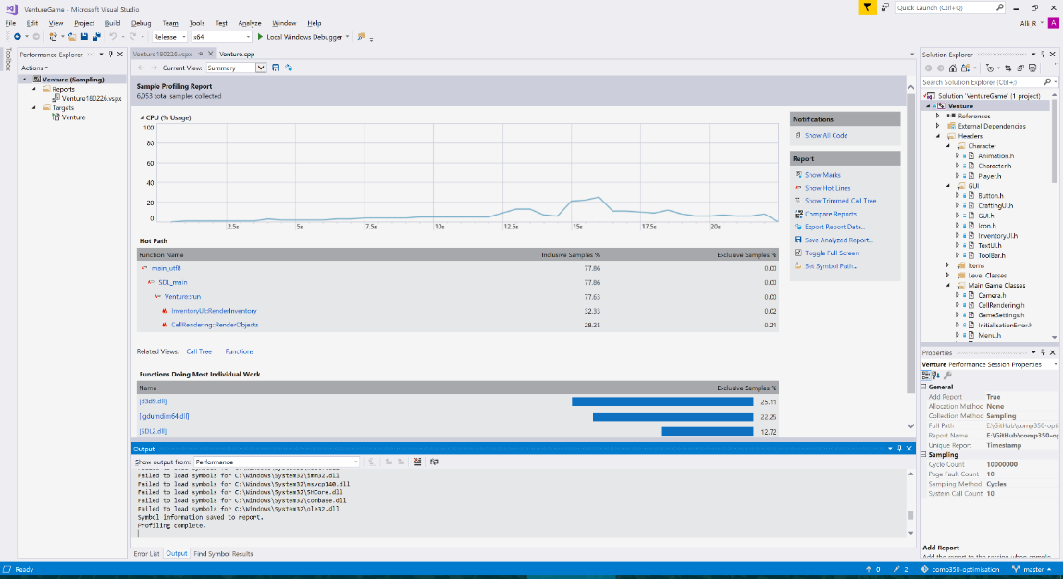
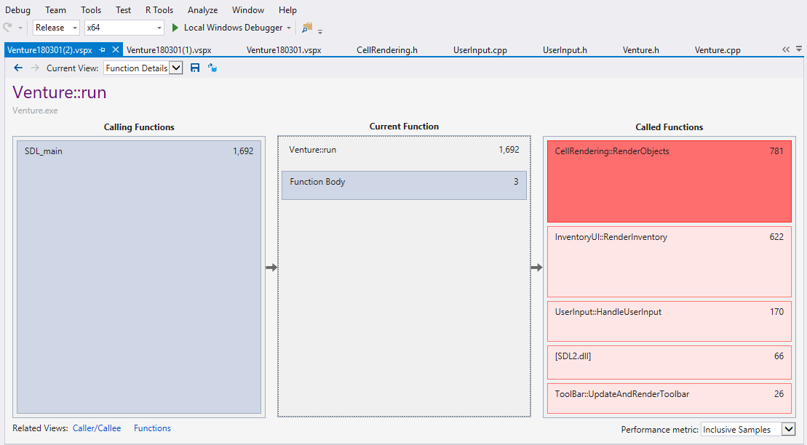
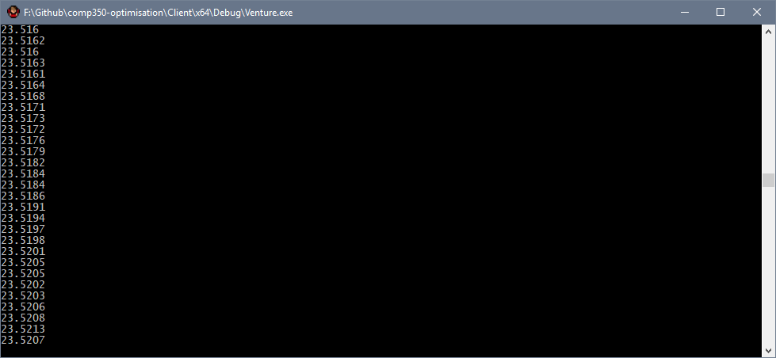
Benchmark:
Measure:
To benchmark I ran started with the visual studio profiler, this highlighted what functions where using most of the resources.
There is a clear spike where I had opened the players inventory.
The key functions that are affecting the performance the most is RenderObjects, which renders the levels cells.
I will start by looking at how the rendering, to see why this is an issue.
I also implemented a way to check the time it takes to render a frame,
however this only works in debug, where I have access to the console.
<- This is the FPS I am getting when idle in debug.

Slide 3
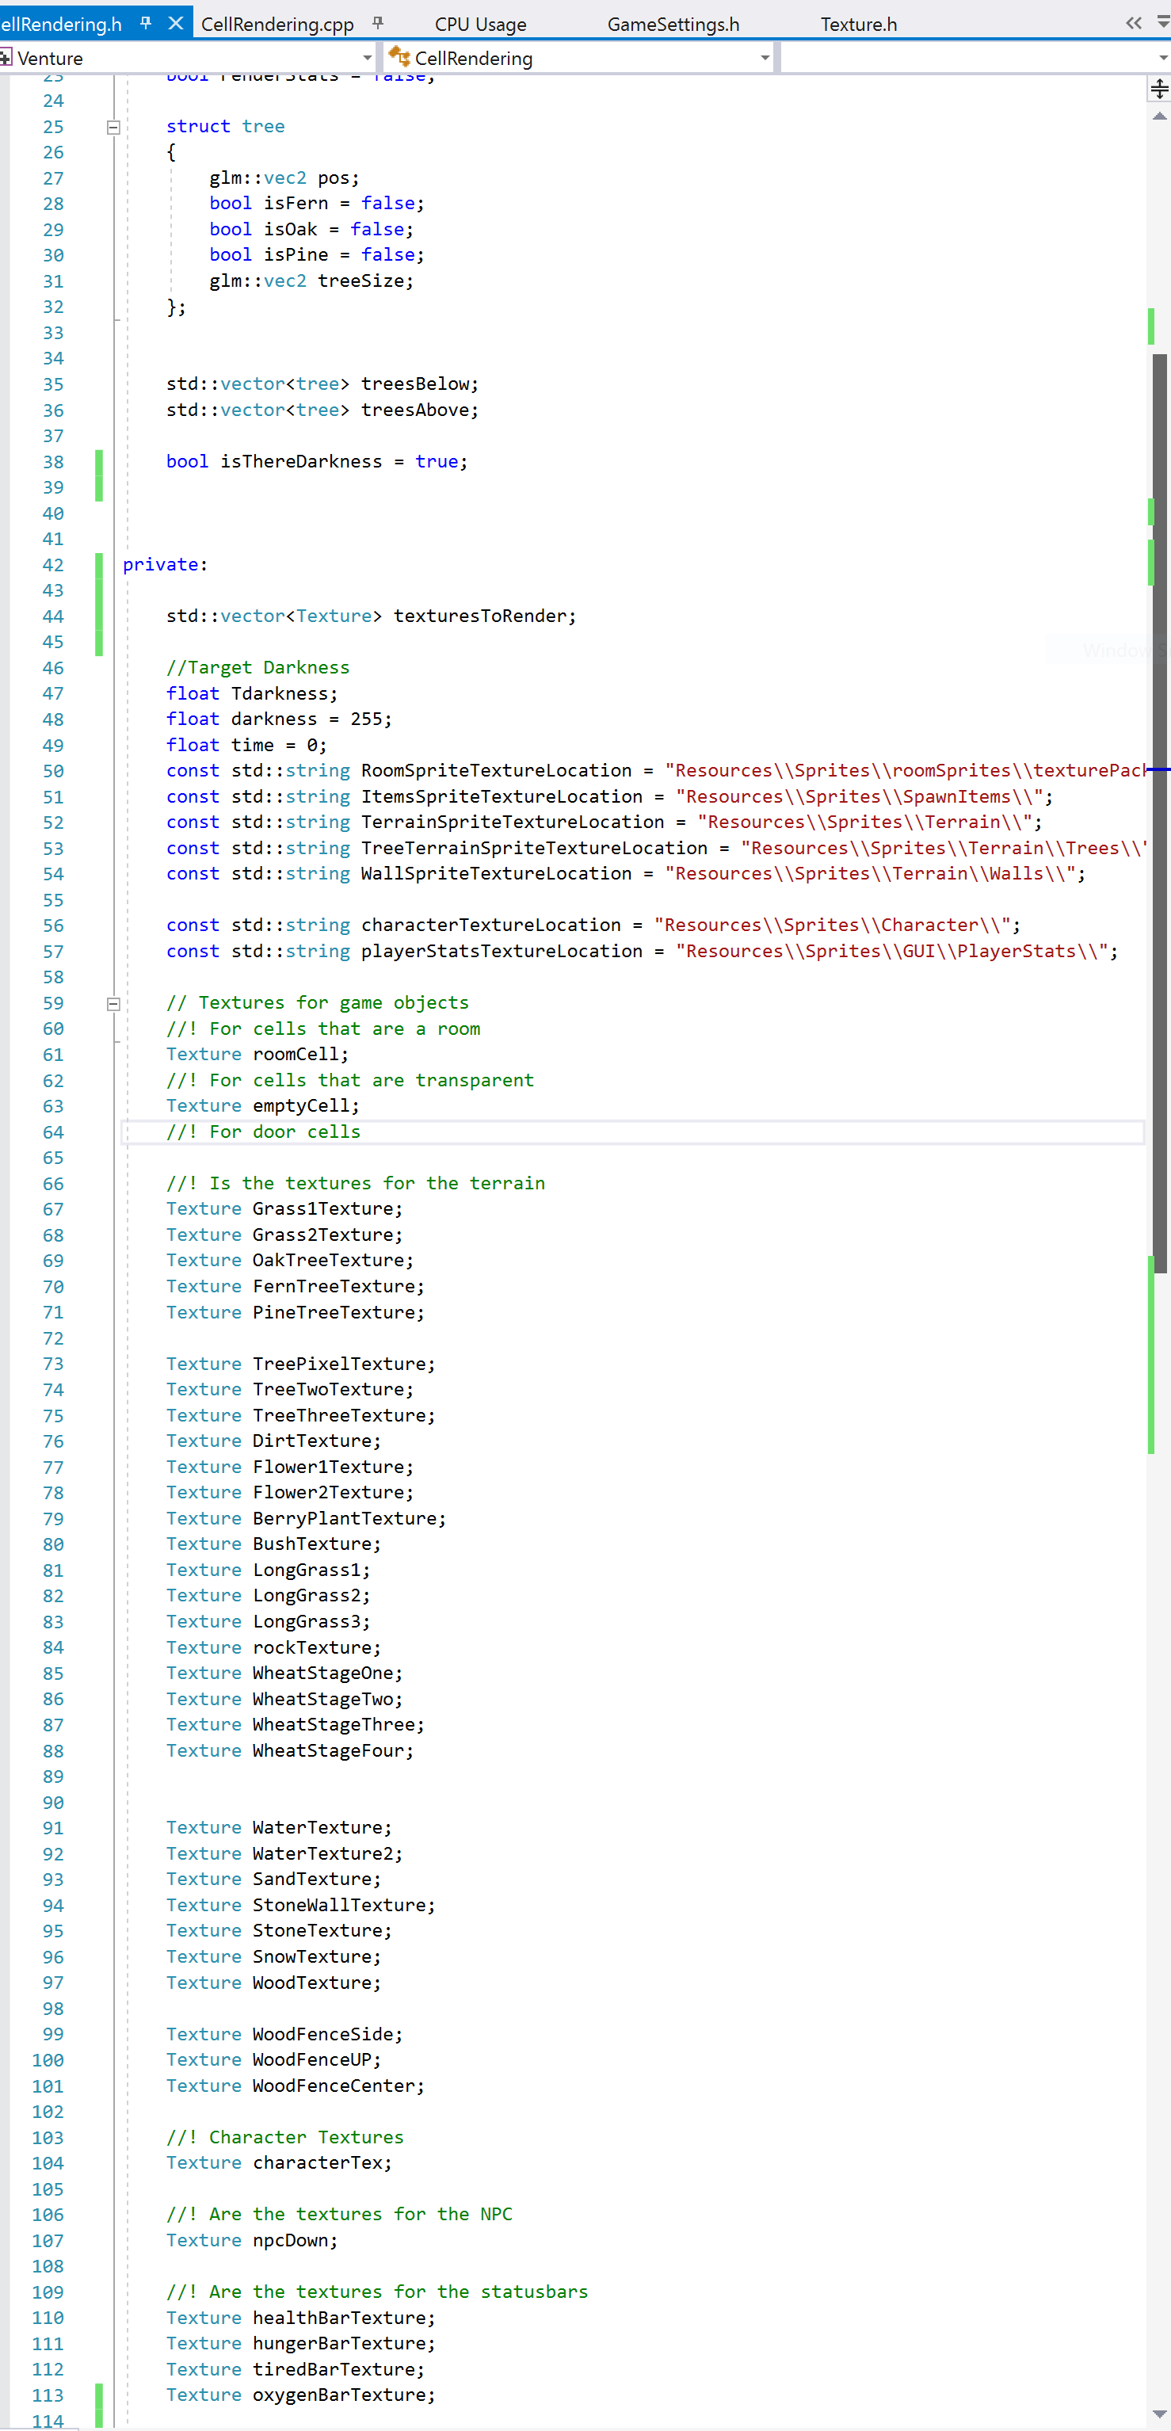
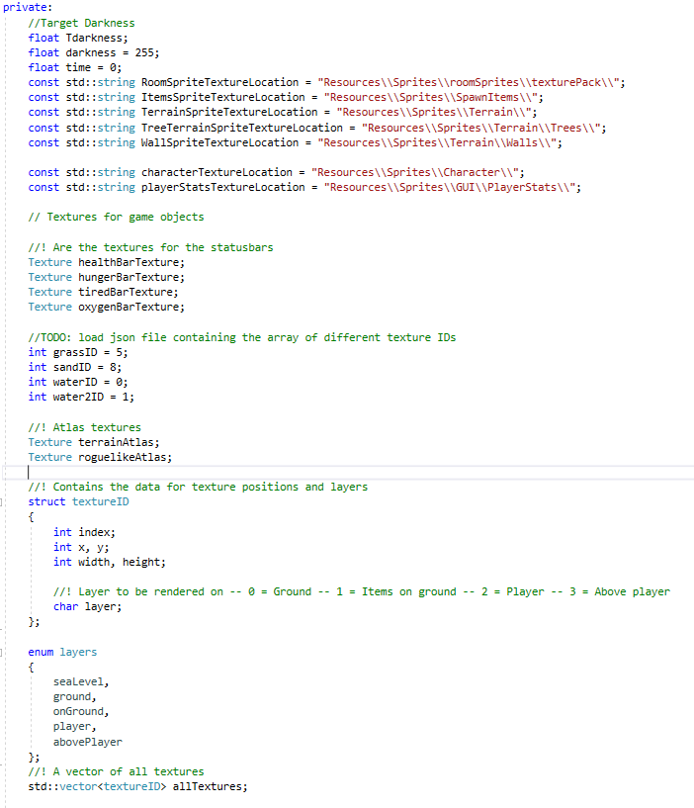
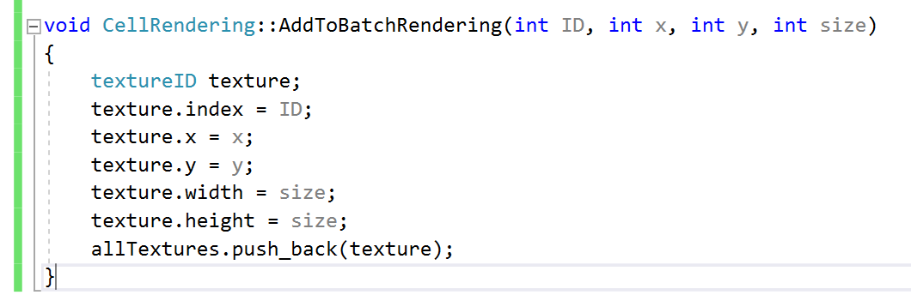
Detect:
Solve:
The way the textures get loaded into the game is I created a texture class that loads each texture as a separate image, and it does this for every tile generated.
To Solve this issue, I created a struct that contained the location of the sprite, the atlas index number and the layer.
I also created a vector of all the textures, so that I could batch render all the textures at the end of the frame.
So each texture loaded in meant that as you explored the world the memory usage will gradually increase and performance would decrease.
I also removed the rendering of the trees issue, by removing the two vectors of trees. Instead I used an enum to store the layer of each sprite, and that decides when the texture will be rendered.
This method also meant I had to do a few hacks to get the trees rendering properly.
The image to the left shows I had two vectors, one that contained the trees that were to be rendered above the player, and another that was to be rendered below.
This could be avoided by creating a batch renderer.

Slide 4
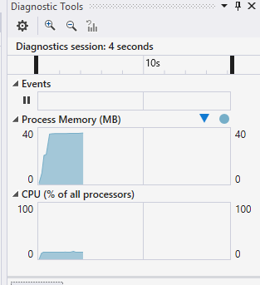
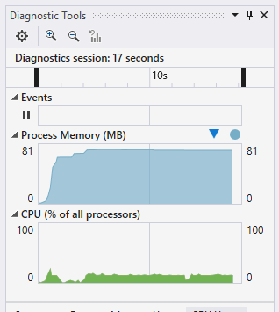
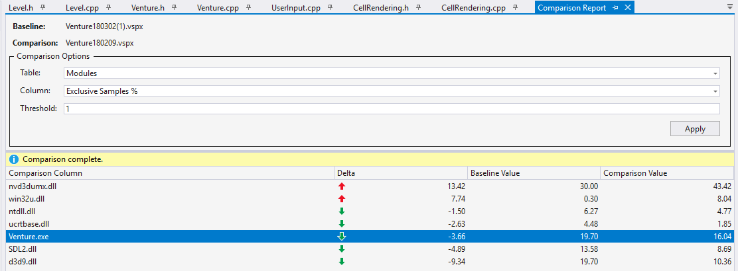
Check:
This means that now the game doesn’t create a new texture for each cell as the player explores the level, which results in a much lower memory footprint.
NEW OLD
When comparing the profiler to a previous run, the overall application has a negative delta, which I believe means it ran faster. However this is not a great overall improvement, compared to what I was expecting.

Slide 5
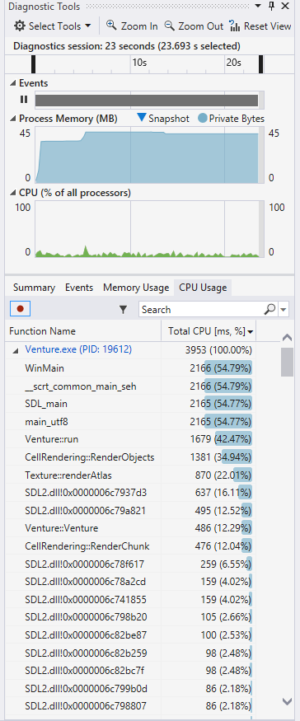
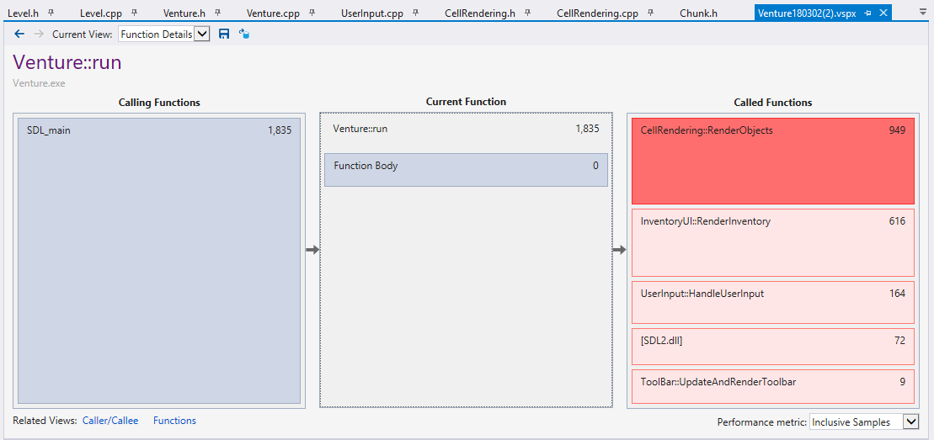
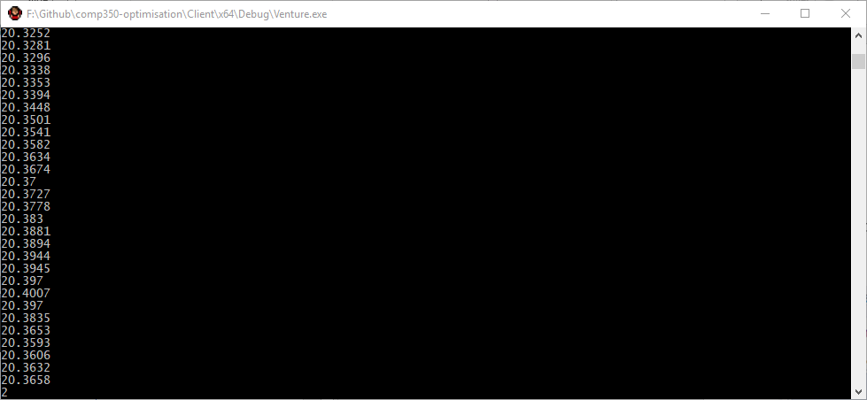
Benchmark:
Measure:
When I ran the test again I still found that render objects is sill using a considerable amount of CPU utilisation.
RenderObjects is still using roughly 35% of the processes CPU usage, even though the total CPU usage of the game is very low still, it’ll be worth going into depth to try and optimise RenderObjects further, as this is the main cause of the slow performance at the moment.
The frame rate in debug is still not optimal, only getting about 20 FPS.

Slide 6
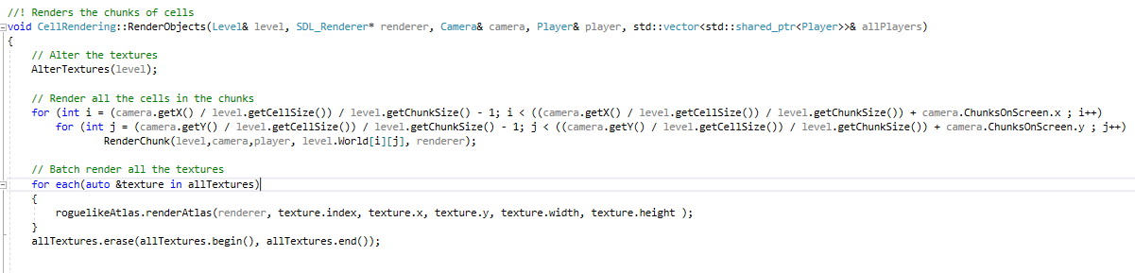
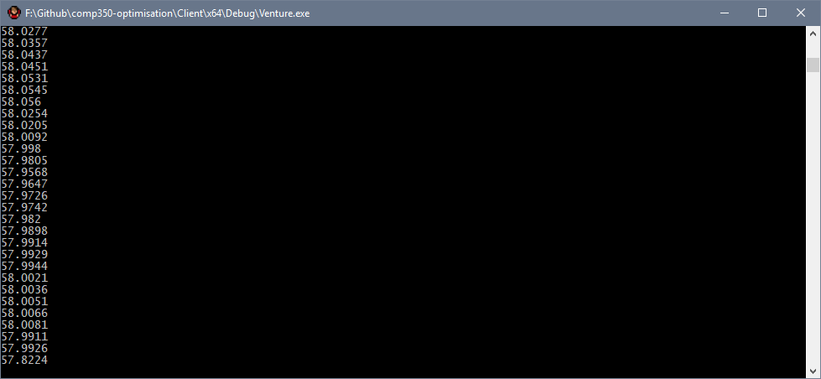
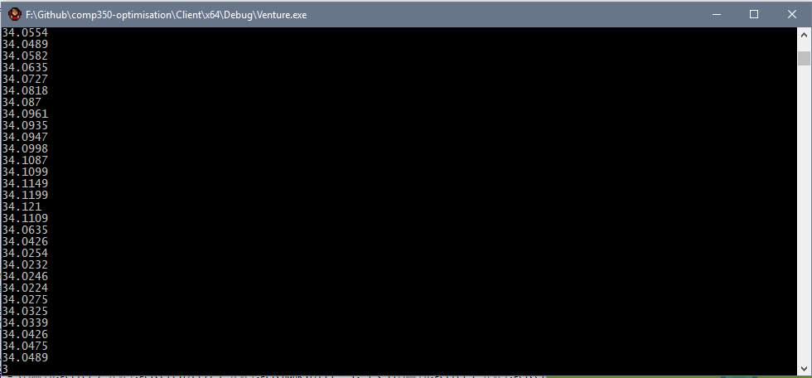
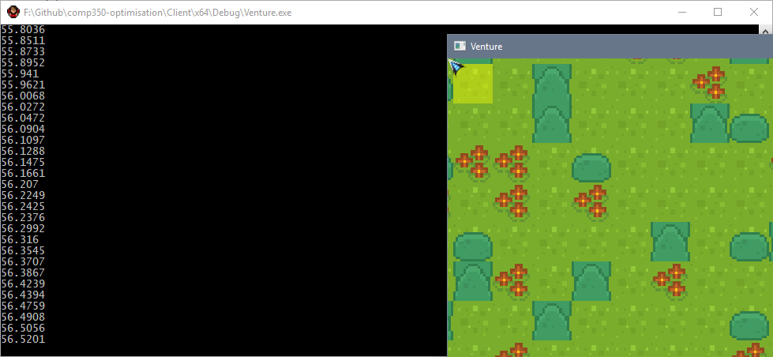
Detect:
Solve:
The main cause of the lag is this small bit of code below, which renders the chunks that are around the camera position. I remember writing this code very late at night so I will go over it and see if there is any areas that can be optimised.
The next thing I did was try to cull as much as possible from outside the players view, to do this I decreased the chunk size, this was extremely surprising.
Previously the chunk size has always been 16, which is 16x16 cells in a chunk. Just to see I reduced the chunk size by half, this gave a huge boost to frame rate.
After playing round with the chunk rendering code, I found that it was actually rendering a lot more cells off screen, that I will be able to cull.
By simply changing the chunk size from 16 to 8 gave an almost 2x change in frame rate!
I tried changing the chunk size by half again, but this actually decreased performance slightly, so the sweet spot seems to be around 8x8 cells per chunk.
All I did was removed 1 from the x and y chunks that were being rendered, and this instantly gave an extra 10+ frames per second.

Slide 7
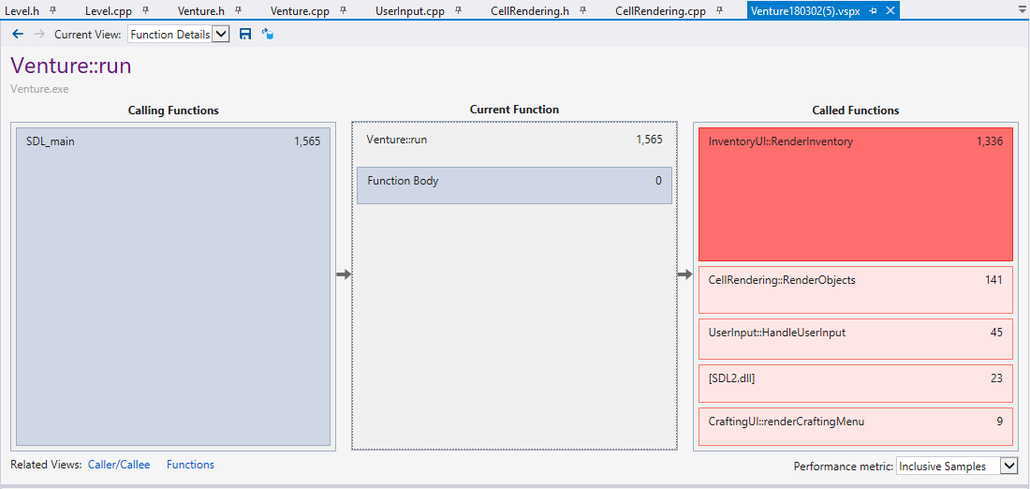
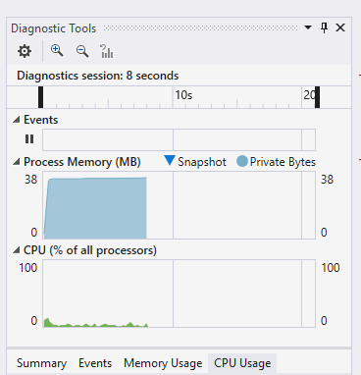
Check:
Changing the chunk size seems to have made such a difference to performance that, the RenderObjects function is no longer the top called function, and was only called 141 times.
That is quite a drastic change from such a small fix, previously the RenderObjects function was being called roughly 1000+ times, where as it is only being called ~150 times now.

Slide 8
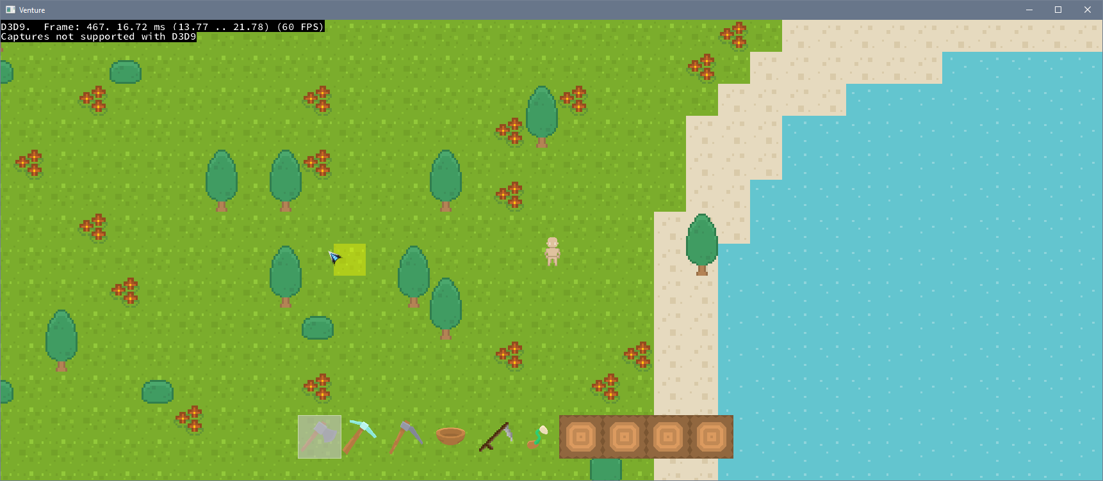
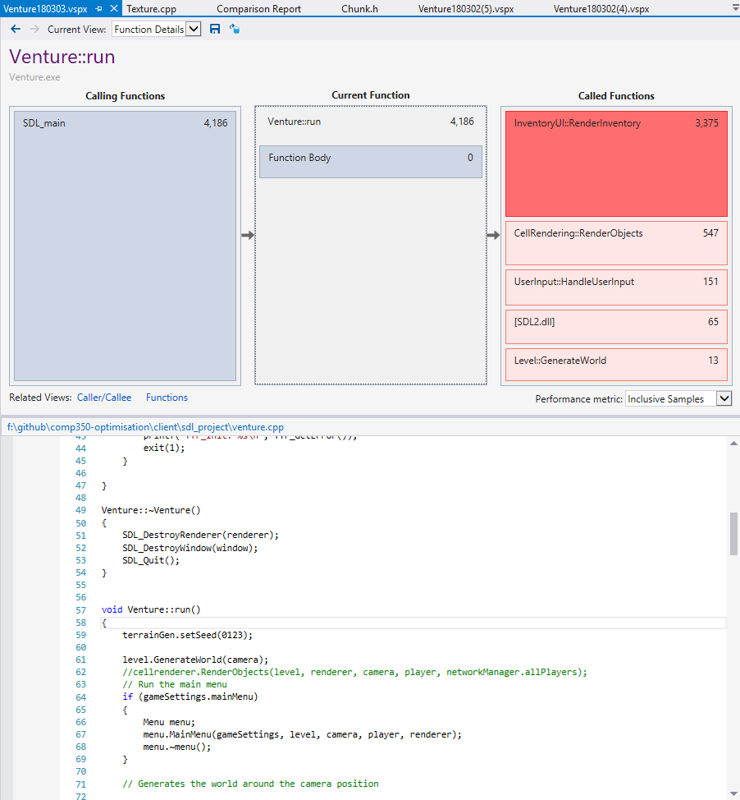
Benchmark:
Measure:
This is now the current version of the game, and in this game I opened the inventory a few times, and this shows that there is some optimising to be done with the RenderInventory function.
RenderDoc now shows I am getting a reliable 60FPS when the game is not being zoomed out.
However this does start to dip when I open the players Inventory. The first thing I will start to implement is a time out for the inventory, because currently the inventory window flashes open and closed when you hold the button down.
Furthermore every time the inventory window is opened it has to refresh the icons in the window, so to start of I will just create a time out for the inventory, so it can only be opened every half a second or something.

