Slide 1
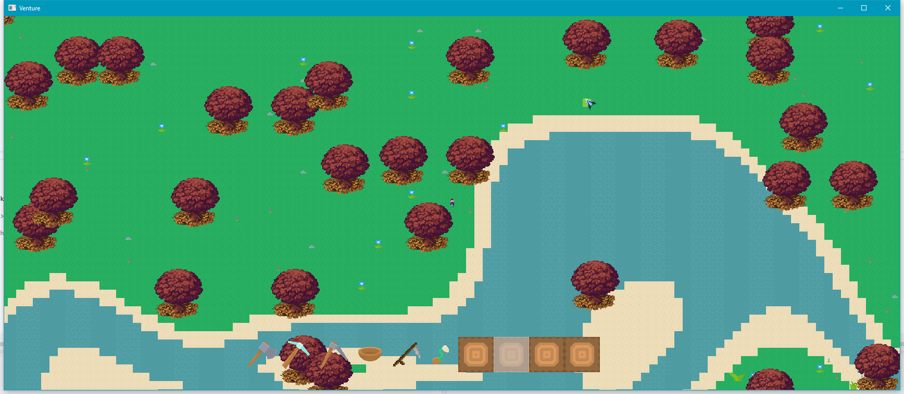
Project:
For this optimisation and porting task I will be using a game I was working on over the summer.
The game is a top down open world multiplayer farming game called Venture.
The game is getting roughly 20-30FPS in debug build, which isn’t much considering the content in the game, and in release build the game runs better, but there is memory issues when explore the world.
Engine:
The game was developed in C++ with SDL and used the boost::asio library for the networking. However, for the scope of this project and to ease the port to PS4 I will be removing the networking from the game, and focus on the single player optimisations. Furthermore depending on the support for SDL on the PS4 I may be looking into converting to the PhyreEngine for the rendering as that will also improve the performance.
Profiling Tools:
Visual Studio profiler is a very useful tool within visual studio that can profile the CPU, memory and GPU (only using the directX).
RenderDoc may be useful for if I decide to overhaul the SDL rendering and use openGL instead, this will be able to help profile the openGL rendering pipeline.
MemTrack is a library for C++ which replaces the standard operator new with a special version that records information about each memory allocation, which may be helpful when debugging and profiling memory related issues.
Remotery is a Realtime profiler for CPU and GPU, which supports a variety of graphics APIs, including openGL.
MTuner is another C++ memory profiler, however this one has support for the PlayStation 4 and 3.

Slide 2
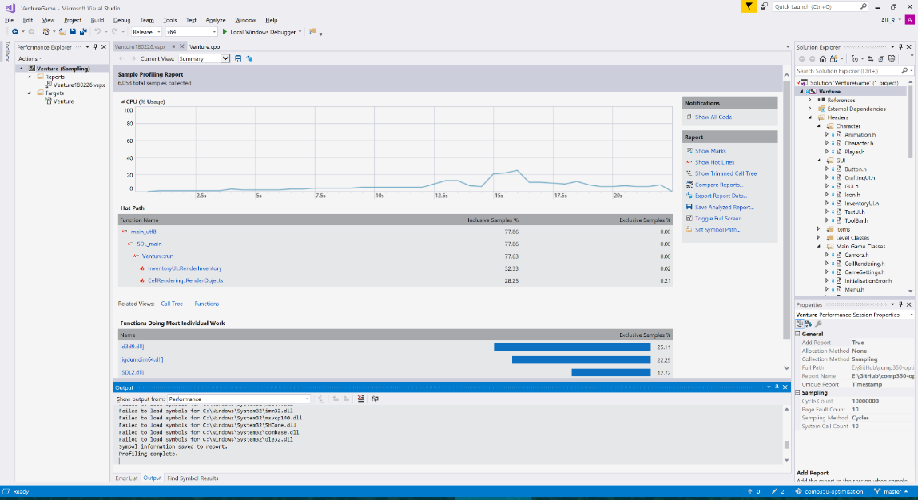
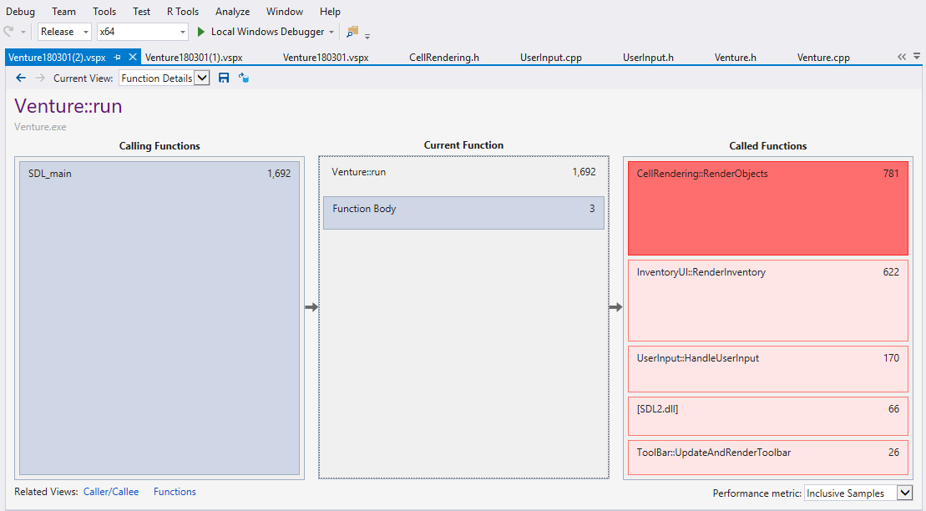
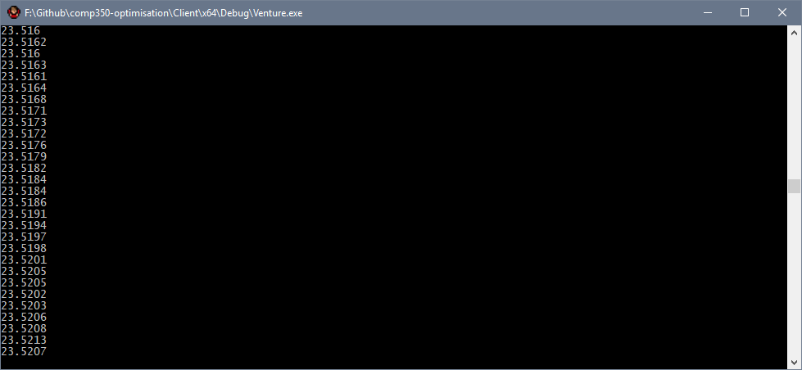
Benchmark:
Measure:
To benchmark I ran started with the visual studio profiler, this highlighted what functions where using most of the resources.
There is a clear spike where I had opened the players inventory.
The key functions that are affecting the performance the most is RenderObjects, which renders the levels cells. The other big problem is RenderInventory, which only renders what the player is carrying,
this should not be using much resource at all.
I will start by looking at how the rendering, to see why this is an issue.
I also implemented a way to check the time it takes to render a frame,
however this only works in debug, where I have access to the console.
<- This is the FPS I am getting when idle in debug.

Slide 3
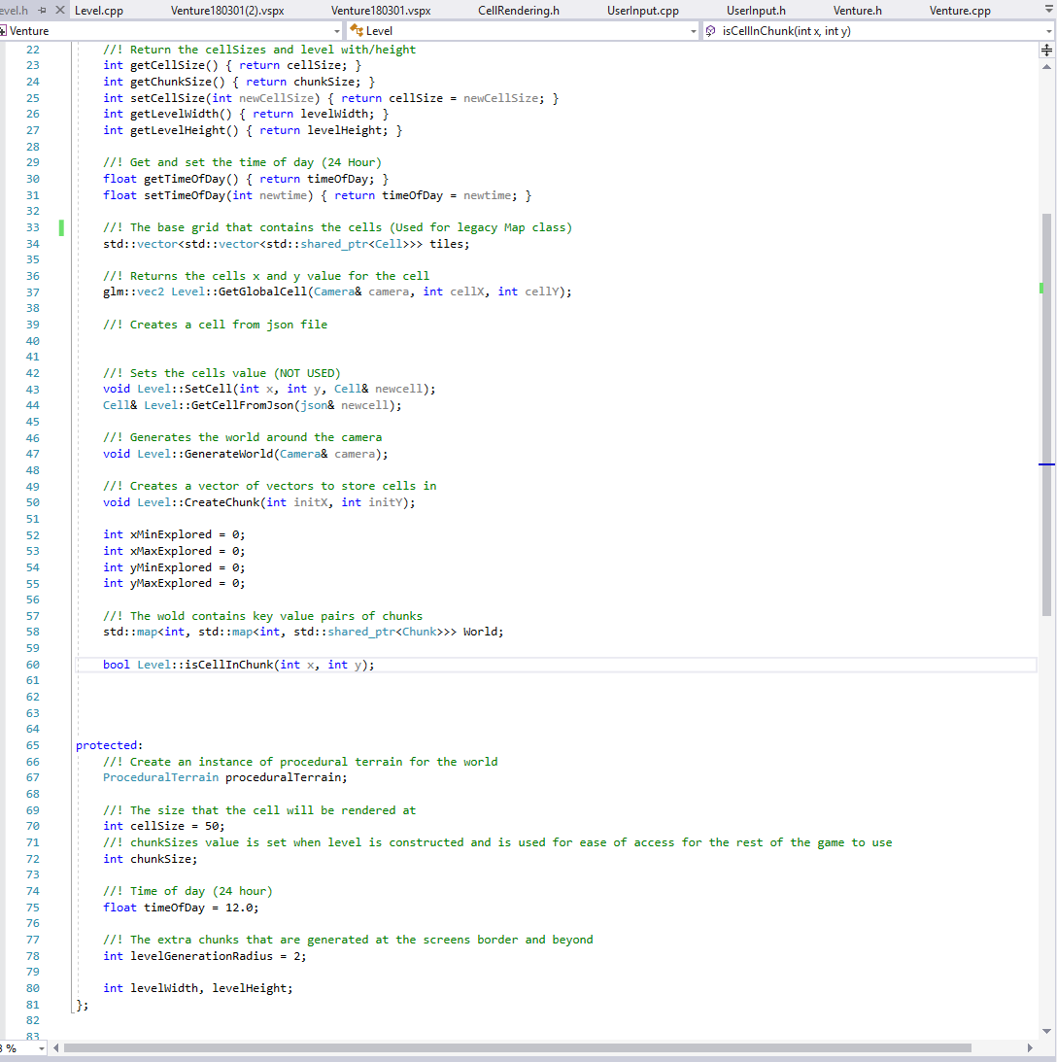
Detect:
Solve:
The first thing I noticed was that when I created the level system, I used the std::map container for the first time,
and I used it the same way I would use std::vector.
The problem I made was that I put a std::map within another std::map, as shown below.
The first optimisation I will do is create a point class, which will contain the x and y values for the chunk, rather than have a map of int, then another map within that, which contains the chunk.

Slide 4
Solve:
Check:

