Slide 1
Assisted Living Recommender
Team: Alli, deb, & sam

Slide 2
Hospital Proximity & Quality
A current study from The Econometrics workshop: The life‐saving effect of hospital proximity
“The evidence indicates that every additional kilometer [away one is from the hospital] decreases the probability of survival because it causes an injured individual to become a more serious case. She or he will arrive at the hospital in worse condition as the time to reach the emergency room increases. Assessing whether proximity is more or less relevant conditional on the quality or performance of the nearest hospital is an empirical question. Both high‐ and low‐quality hospitals can save both easy and serious cases, but we could expect that, on average, high‐quality hospitals tend to save more of both.”
Their findings stress that “…poor emergency care services, and low‐quality hospitals increase the importance of hospital proximity.”
We chose to look at both proximity and quality.
Aging populations tend to have increasing rates of morbidity, mortality, and long-term sequelae due to delays in treatment such as stroke, organ failure, or heart attack.
For this reason, it is an advantage for a person looking for a suitable community to move to due to aging to consider nearby hospital availability and quality.
We chose 5 Miles as a radius defining “nearby” medical facilities for the purposes of our inquiry because we are in the United States, and we chose the Google ratings for each facility as a short-term proxy for hospital quality.
* Note: We extended the radius of South Austin to 10 miles in some searches, as we were getting no data.

Slide 3

Questions:
Where in Austin is the best place to live if one is looking for Assisted Living based on proximity to hospitals and emergency rooms?
Where in Austin is the best place to live if one is looking for Assisted Living based on quality of living situation?
Where in Austin is the best place to live if one is looking for Assisted Living based on quality of care?
Our Recommender: Where in Austin is the best place to live if one is looking for Assisted Living?

Slide 4


Data to Research
Average rating for Hospitals and ALFs
Locations for Hospitals and ALFs

Slide 5
Data Retrieval & Analysis
Break it Down
Zones: Get an Overview & split the 20 Mi radius into 5 separate 5 Mi radii
Specify
Queries: Google Places API for 20 Mi and 5 Mi from specific coordinates
Results: names, addresses, lat & long, and ratings for Hospitals & ALFs
Viz

Slide 6
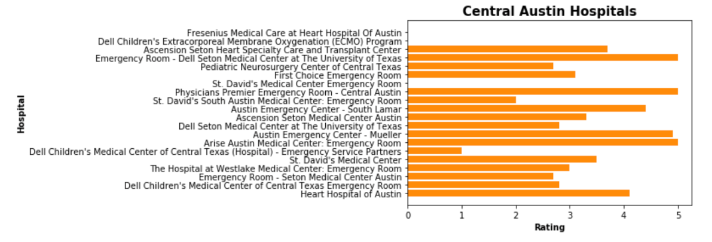
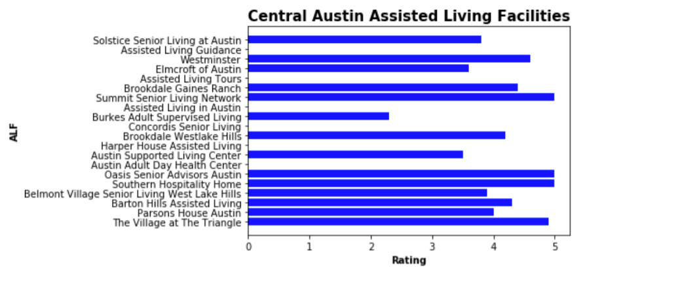
Central Zone

Slide 7
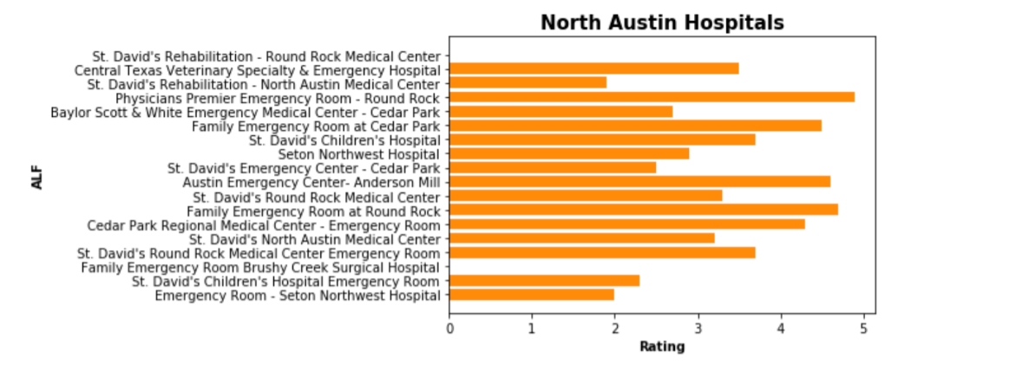
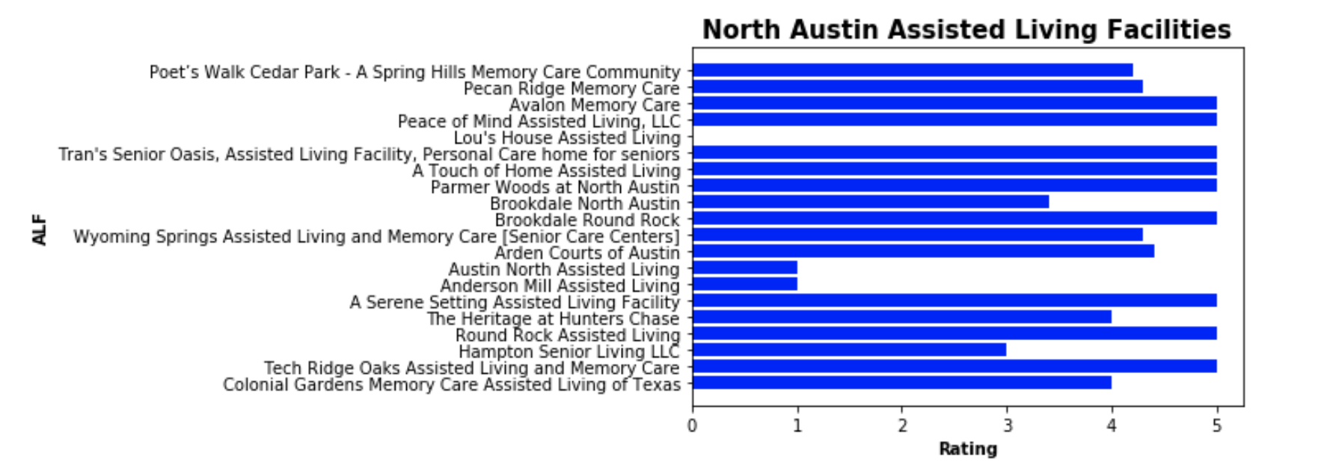
Northern Zone

Slide 8
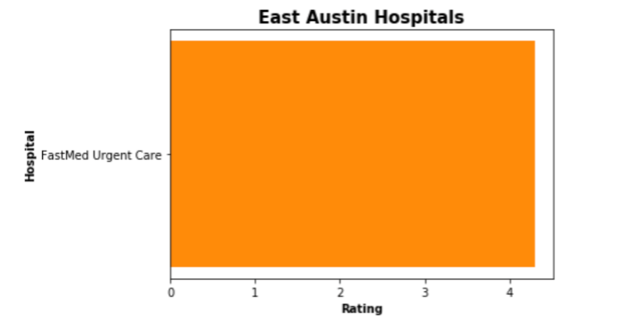

Eastern Zone

Slide 9
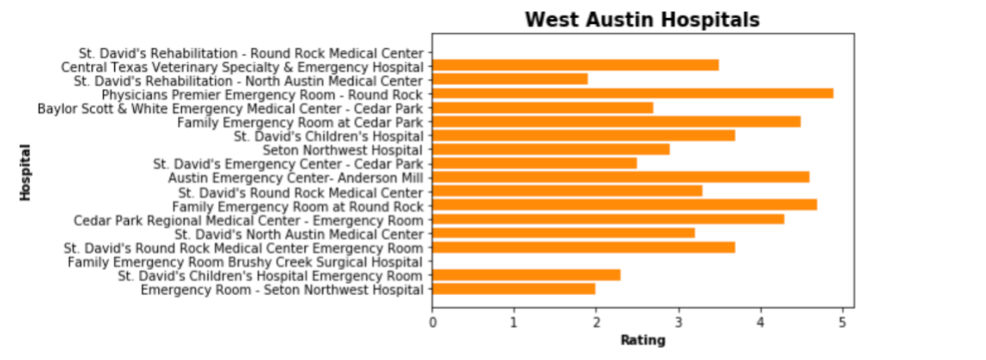
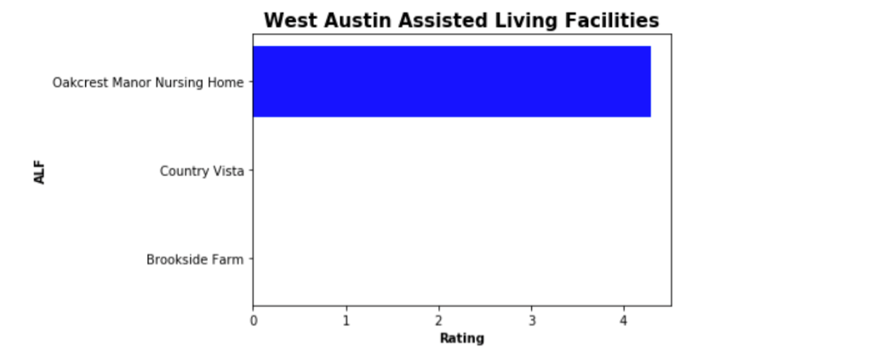
Western Zone

Slide 10
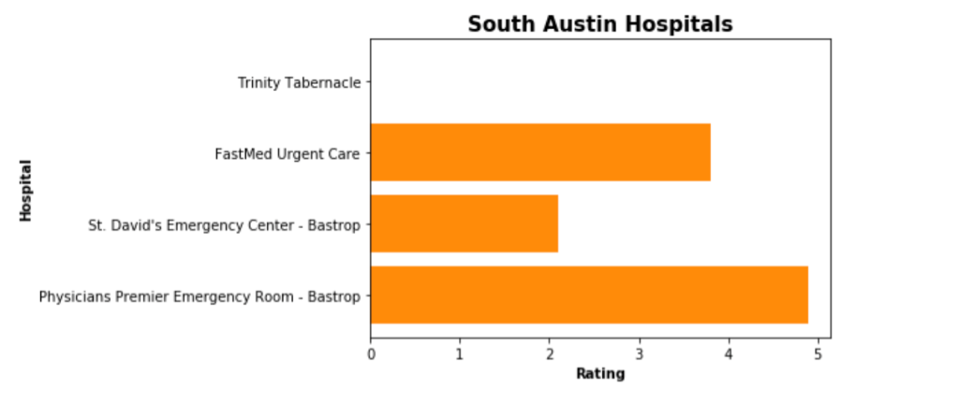
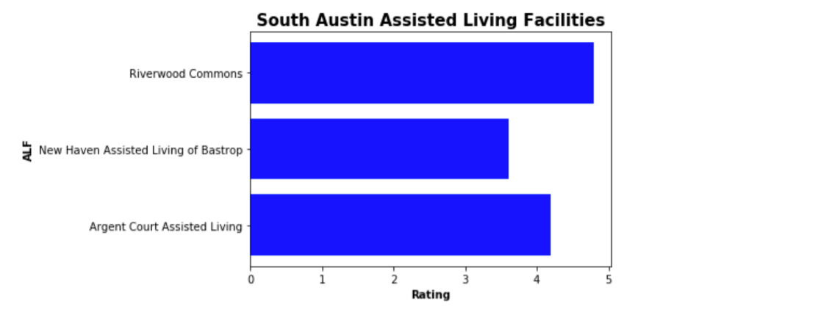
Southern Zone*

Slide 11
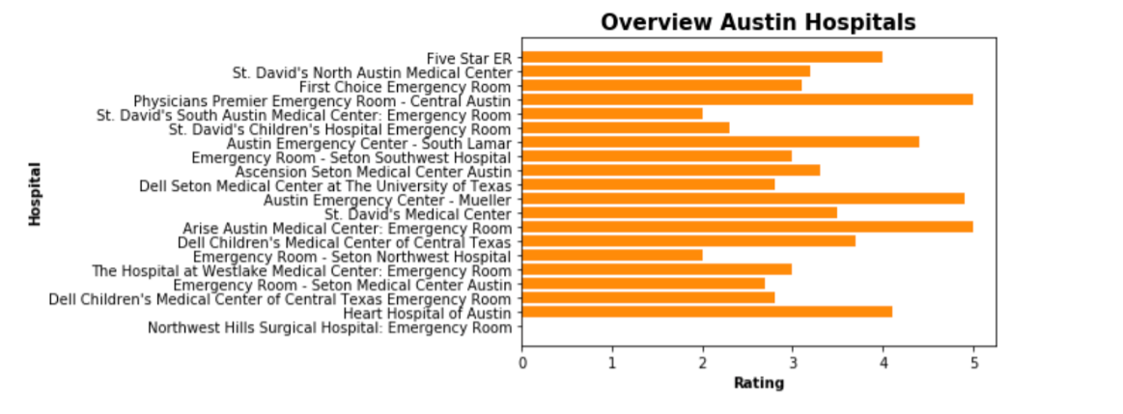
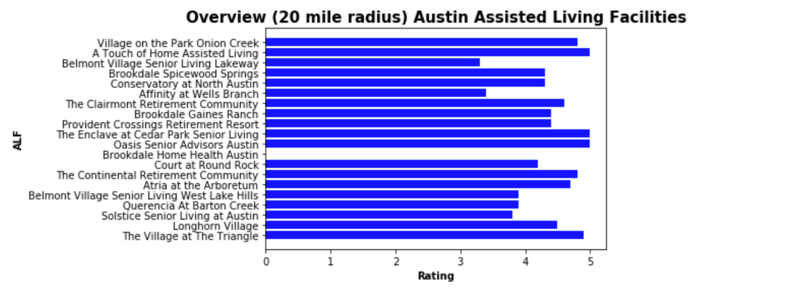
Overview - All zones

Slide 12
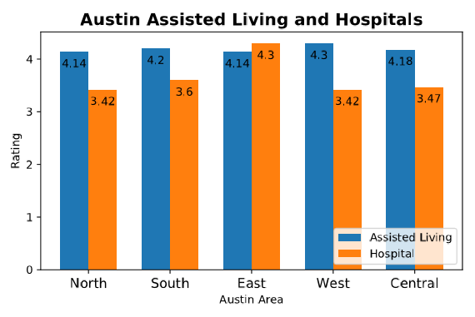
Total Zone Comparison

Slide 13
Conclusion
The best place to live if looking for great care + commute to Hospital
East Austin
The worst place to live if looking for great care + commute to Hospital
North Austin
Highest concentration of Hospitals and ALFs
Central Austin
Best Hospital + Best ALF
Physician’s Premier Emergency Room (Central Austin)
A Touch of Home Assisted Living (East Austin)

Slide 14
Limitations & Next Steps
Some limitations to our project included:
Not calculating actual distances between the locations and the facilities. (haversine)
Needing more investigation of the relevance of a Hospital ER. ( Dell Children’s was frequent, but not actually as relevant fro our purposes)
Some ratings missing
Some next steps we might take:
Add a filter for relevance based on keywords
Calculate actual distances
Possibly compensate for missing ratings or exclude
Thank you to Manuel, Dylan and Billy for their academic support and to our families for their moral support in this project.

