Slide 1
Assisted Living Recommender
Alli Vaughn | deb Steinman | sam Bender

Slide 2
Hospital Proximity & Quality
A current study from The Econometrics workshop: The life‐saving effect of hospital proximity
“The evidence indicates that every additional kilometer [away one is from the hospital] decreases the probability of survival because it causes an injured individual to become a more serious case. She or he will arrive at the hospital in worse condition as the time to reach the emergency room increases. Assessing whether proximity is more or less relevant conditional on the quality or performance of the nearest hospital is an empirical question. Both high‐ and low‐quality hospitals can save both easy and serious cases, but we could expect that, on average, high‐quality hospitals tend to save more of both.”
Their findings stress that “…poor emergency care services, and low‐quality hospitals increase the importance of hospital proximity.”
We chose to look at both proximity and quality.
Aging populations tend to have increasing rates of morbidity, mortality, and long-term sequelae due to delays in treatment such as stroke, organ failure, or heart attack.
For this reason, it is an advantage for a person looking for a suitable community to move to due to aging to consider nearby hospital availability and quality.
We chose 5 Miles as a radius defining “nearby” medical facilities for the purposes of our inquiry because we are in the United States, and we chose the Google ratings for each facility as a short-term proxy for hospital quality.
* Note: We extended the radius of South Austin to 10 miles in some searches, as we were getting no data.

Slide 3

Questions:
Where in Austin is the best place to live if one is looking for Assisted Living based on proximity to hospitals and emergency rooms?
Where in Austin is the best place to live if one is looking for Assisted Living based on quality of living situation?
Where in Austin is the best place to live if one is looking for Assisted Living based on quality of care?
Our Recommender: Where in Austin is the best place to live if one is looking for Assisted Living?

Slide 4


Data to Research
Average rating for Hospitals and ALFs
Locations for Hospitals and ALFs

Slide 5
Data Retrieval & Analysis
Break it Down
Zones: Get an Overview & split the 20 Mi radius into 5 separate 5 Mi radii
Queries: Google Places API for 20 Mi and 5 Mi from specific coordinates
Specify
Data/Viz
Results: names, addresses, lat & long, and ratings for Hospitals & ALFs

Slide 6
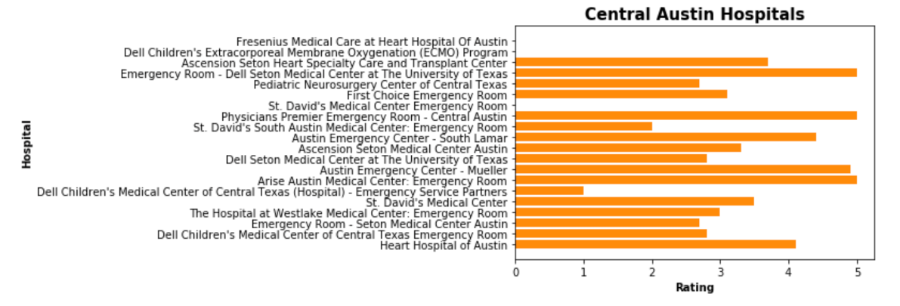
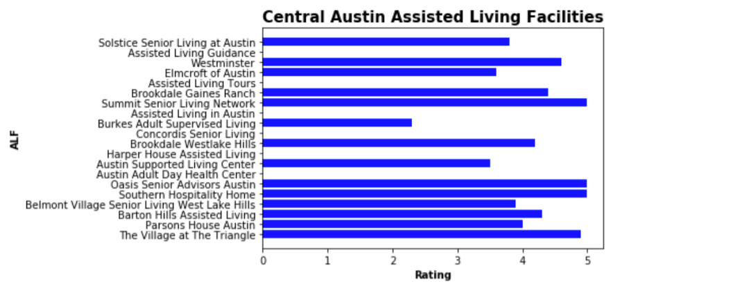
Central Zone

Slide 7
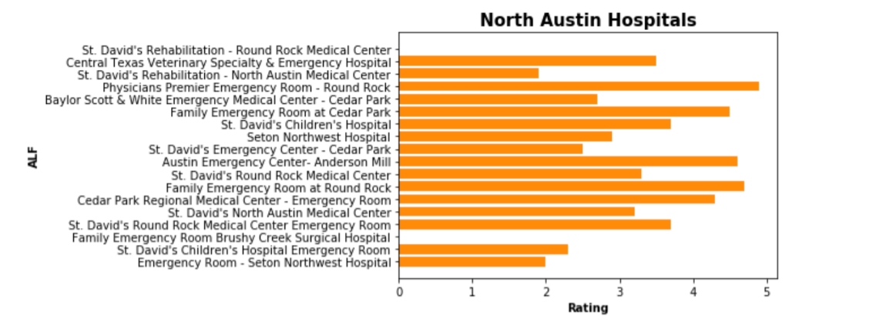
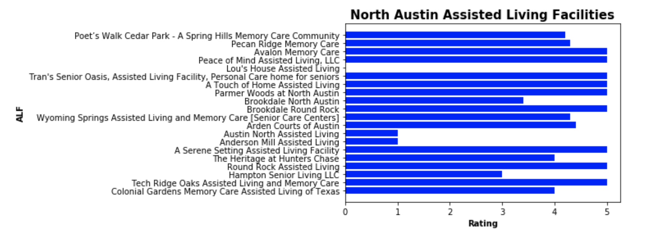
Northern Zone

Slide 8
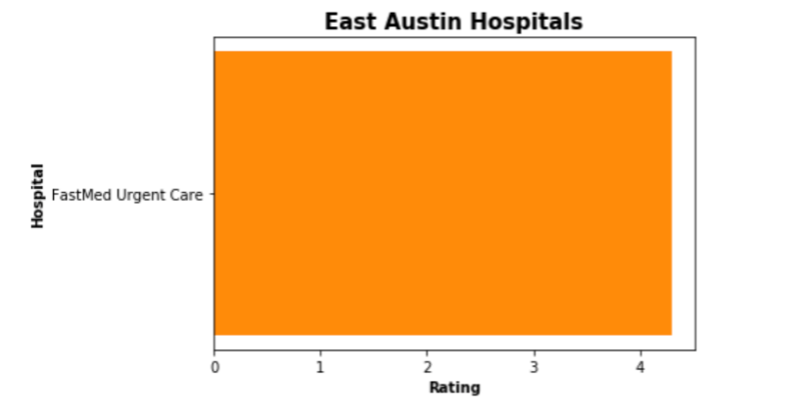

Eastern Zone

Slide 9
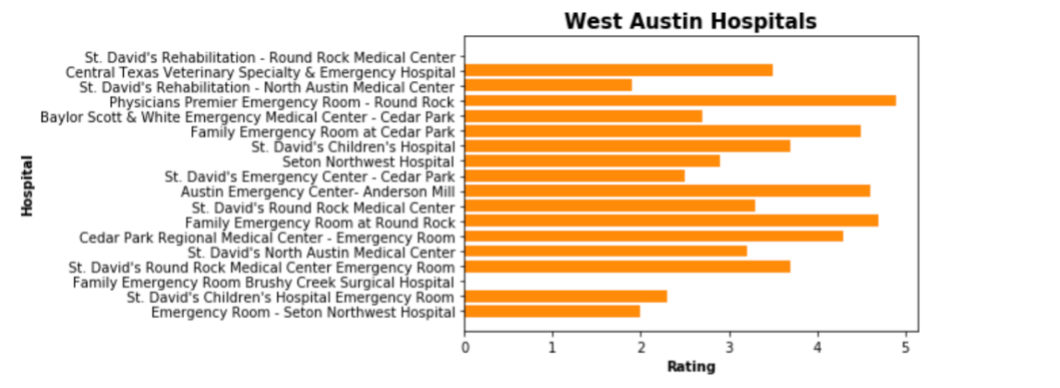
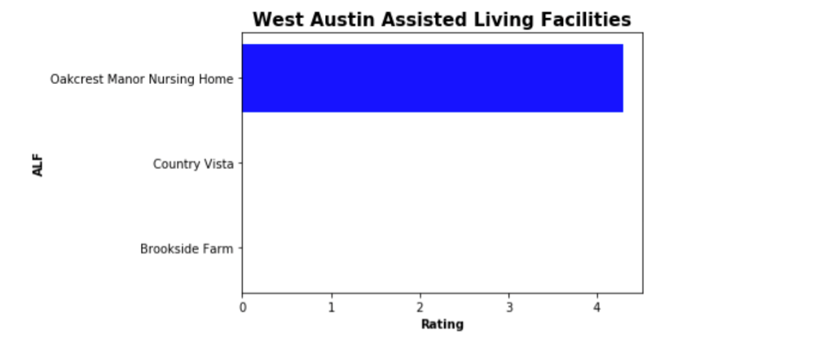
Western Zone

Slide 10
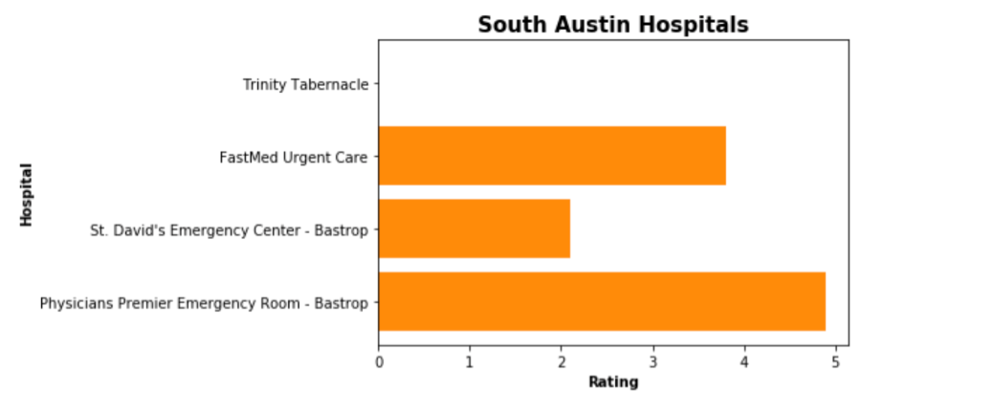
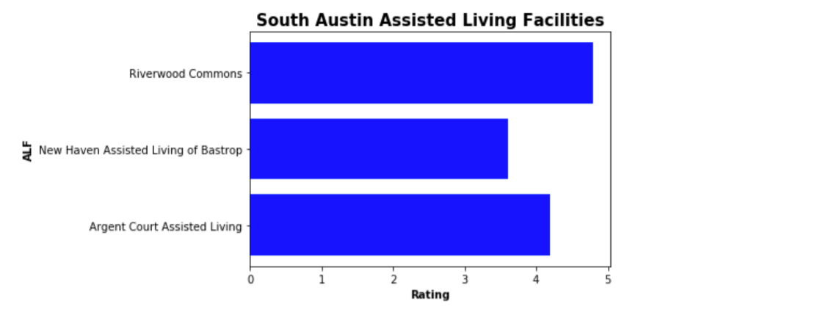
Southern Zone*

Slide 11
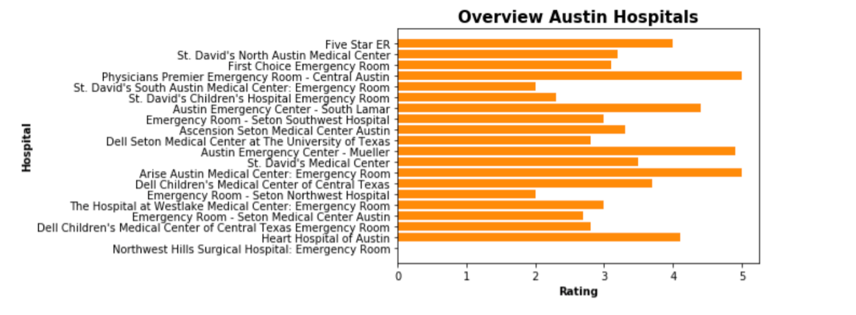
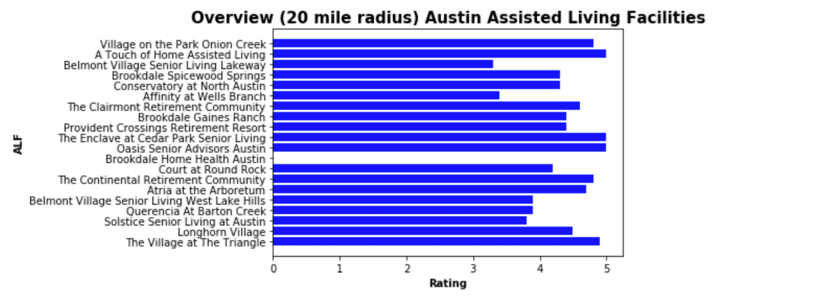
Overview - All zones

Slide 12
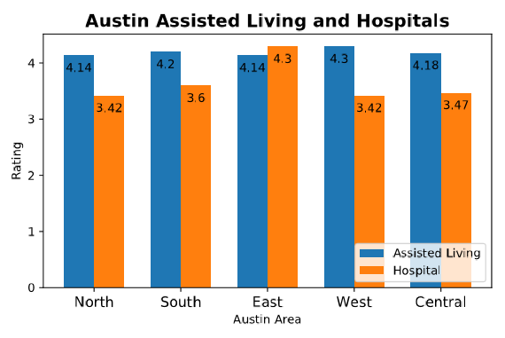
Total Zone Comparison

Slide 13
Major Findings
Where in Austin is the best place to live if one is looking for Assisted Living based on proximity to hospitals and emergency rooms?
The best place to currently live in Austin if looking for Assisted Living would most likely be East Austin from the data we have found based on ratings. Though this could be argued due to the lack of hospital options, so runner up would be South Austin.
Where in Austin is the worst place to live if one is looking for Assisted Living based on proximity to hospitals and emergency rooms?
The worst place to currently live in Austin if looking for Assisted Living would most likely be North Austin from the data we have found based on ratings. This area has the lowest rating score for both hospital and Assisted Living options.
Where in Austin is the best place to live if one is looking for Assisted Living based on quality of living situation?
Going off our data, the best place to live in terms of living situation would be East Austin. A Touch of Home Assisted Living is the highest rated Assisted Living Facility within all zones. This could be a large pull into this area and could be important to most due to the fact one will be spending a large portion of their lives there.
Where in Austin is the best place to live if one is looking for Assisted Living based on quality of care?
Going off our data, the best place to live in terms of quality of care would be Central Austin. Physician’s Premier Emergency Room is the highest rated Hospital within all zones. This could be a large pull into this area due to people focusing on higher risk ailments that require as little commute as possible. This will increase the chances to live if one lives closer to this zone.

Slide 14
Limitations & Next Steps
Some limitations to our project included:
Not calculating actual distances between the locations and the facilities. (haversine)
Needing more investigation of the relevance of a Hospital ER. ( Dell Children’s was frequent, but not actually as relevant fro our purposes)
Some ratings missing
Some next steps we might take:
Add a filter for relevance based on keywords
Calculate actual distances
Possibly compensate for missing ratings or exclude
Thank you to Manuel, Dylan and Billy for their academic support and to our families for their moral support in this project.

