Slide 1
Data Visualization with GGplot2

Slide 2
Lesson objectives
By the end of this session, you’ll be able to:
Locate data visualization within the data science workflow
Use the grammar of `ggpplot2` to create visualizations in R
Make four different plots using `ggpplot2`to visualize an example dataset

Slide 3
Data visualizations
Data visualization is an important part of exploring, understanding and sharing data. Looking at data in a graphical format is a critical part of the data science workflow.

Slide 4
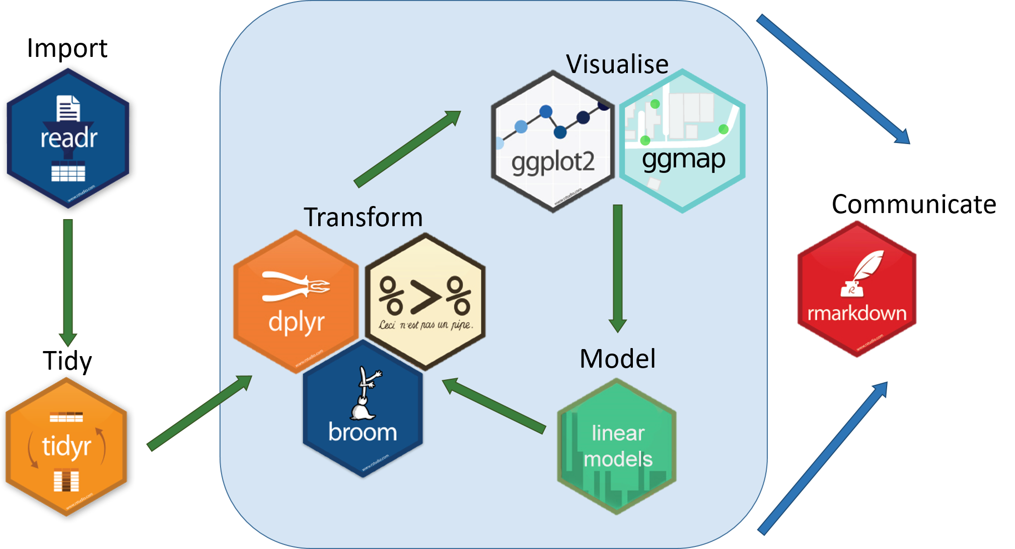
Data visualizations
source

Slide 5
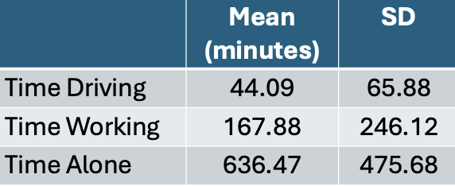
Types of visualizations - Tables
Notes:
Tables to collect and organize data are one of the most common and basic data visualizations. But don’t discount them! They can be efficient ways to convey a large amount of information about your data all at once.

Slide 6
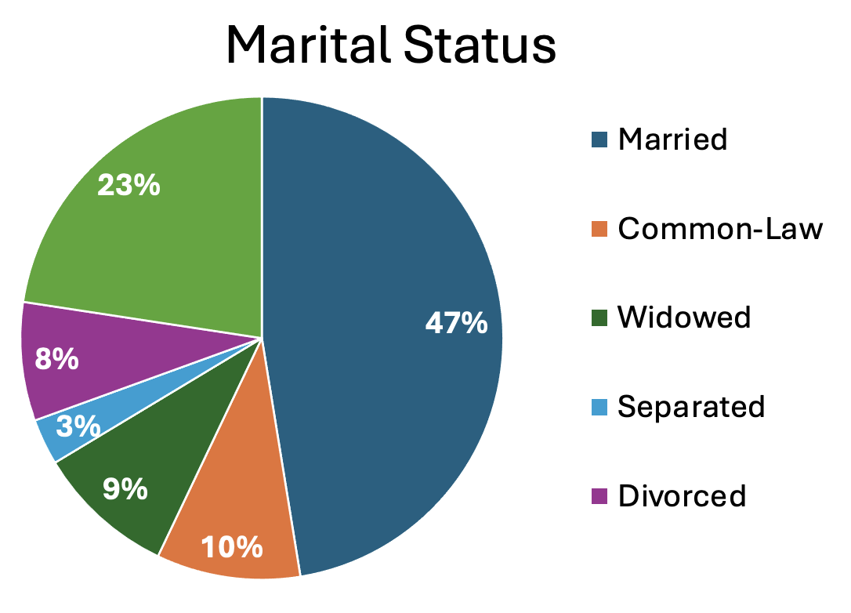
Types of visualizations - Pie charts
Notes:
A classic pie chart is useful for representing parts that add up to a whole. This also allows for comparing group sizes. They are often used for demographic variables, with the whole representing the whole sample, or for representing money, with the whole representing a budget or total money spent/made. Be careful to use a pie chart only when it really adds to the story. For instance, if there are only two parts to the whole, a pie chart might not convey much more information. Conversely, if there are many groups, it can become difficult to really see all of them and compare them.

Slide 7
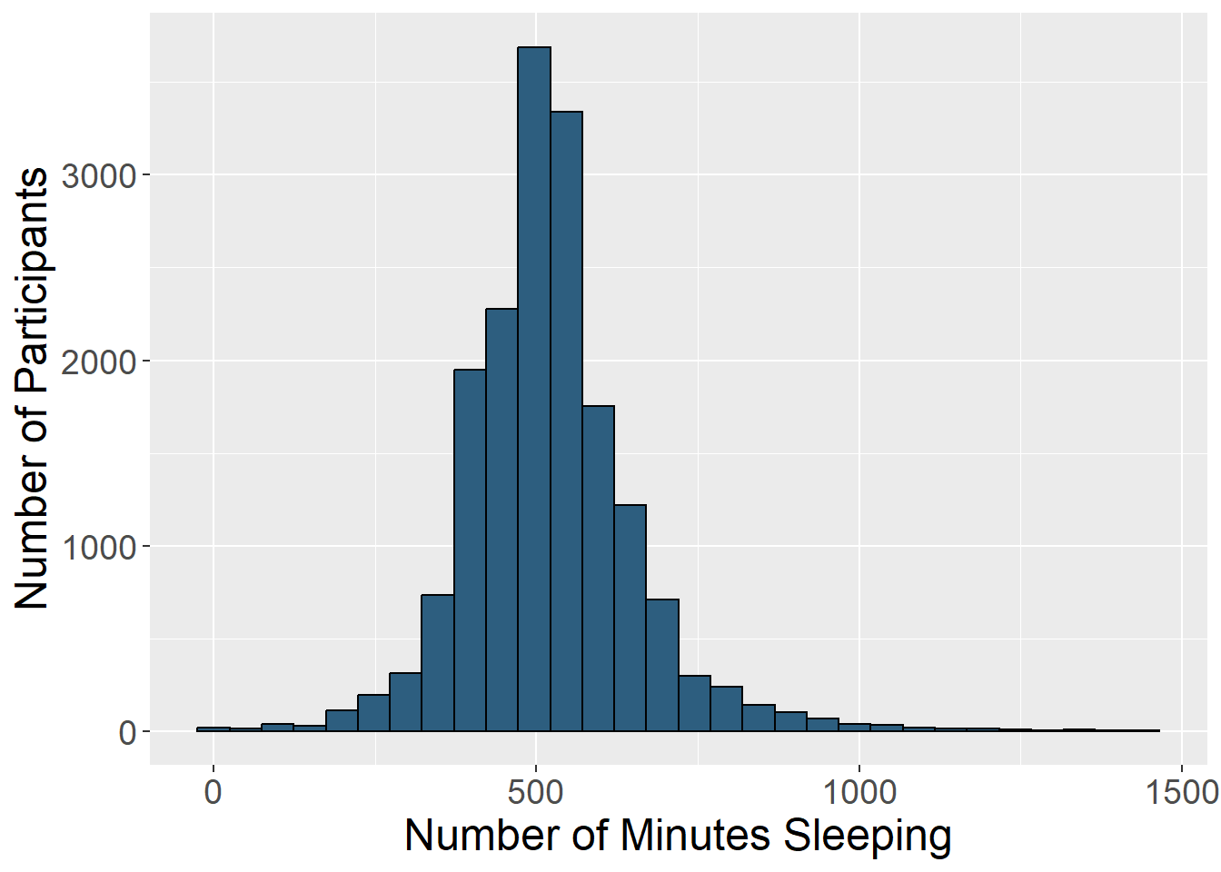
Types of visualizations - Histograms
Notes:
Histograms display the distribution of one variable. The height of the bar represents how many times that value was represented in the data. This is typically what you view if you want to visually inspect if a variable is normally distributed.

Slide 8
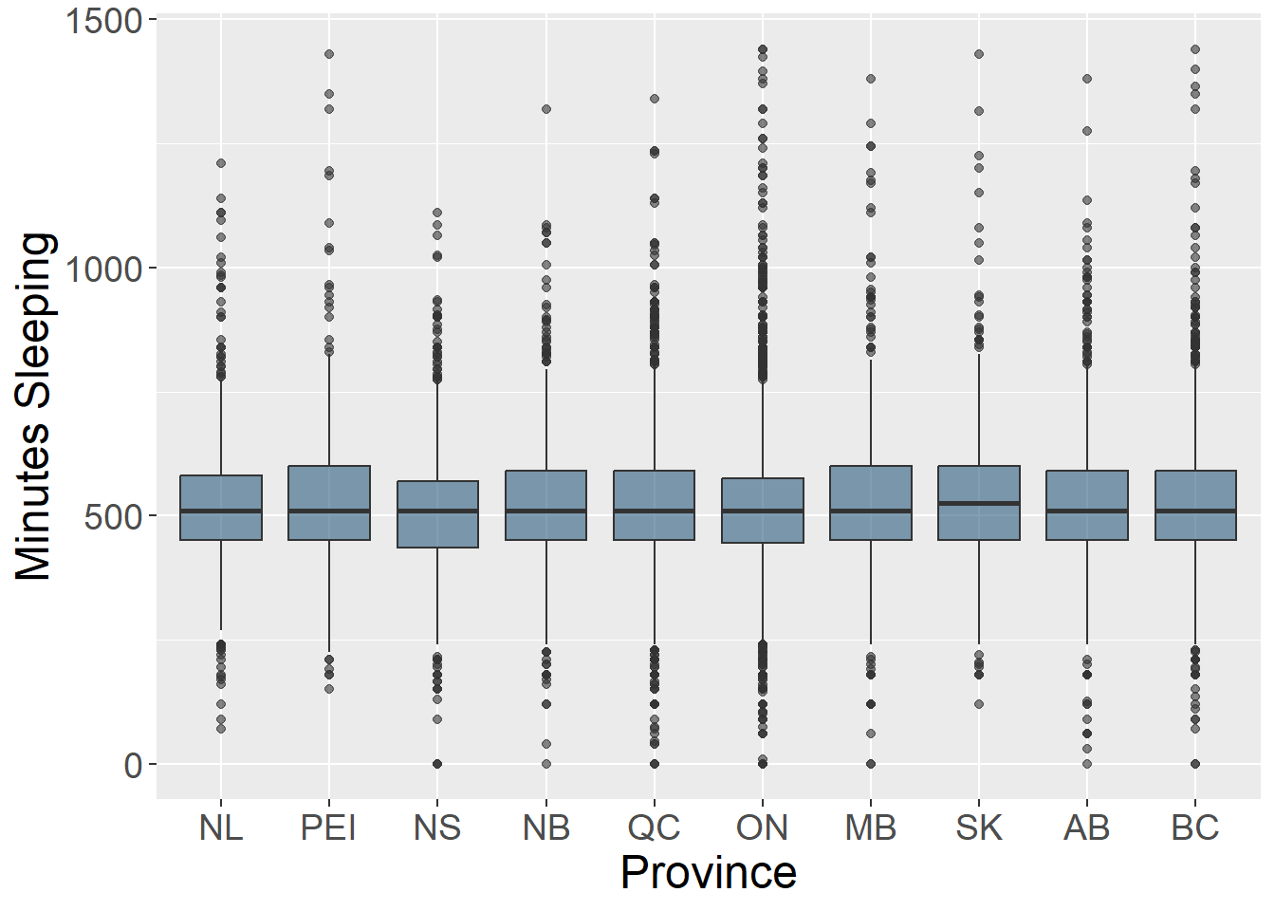
Types of visualizations - Box plots
Notes:
Box plots (also known as box and whisker plots) are good for understanding and comparing variance between groups. They typically depict the median and minimum/maximum of each group for a certain variable. The box portion represents the 1st and 3rd quartiles of the distribution. You can also show change over time with this type of plot.

Slide 9
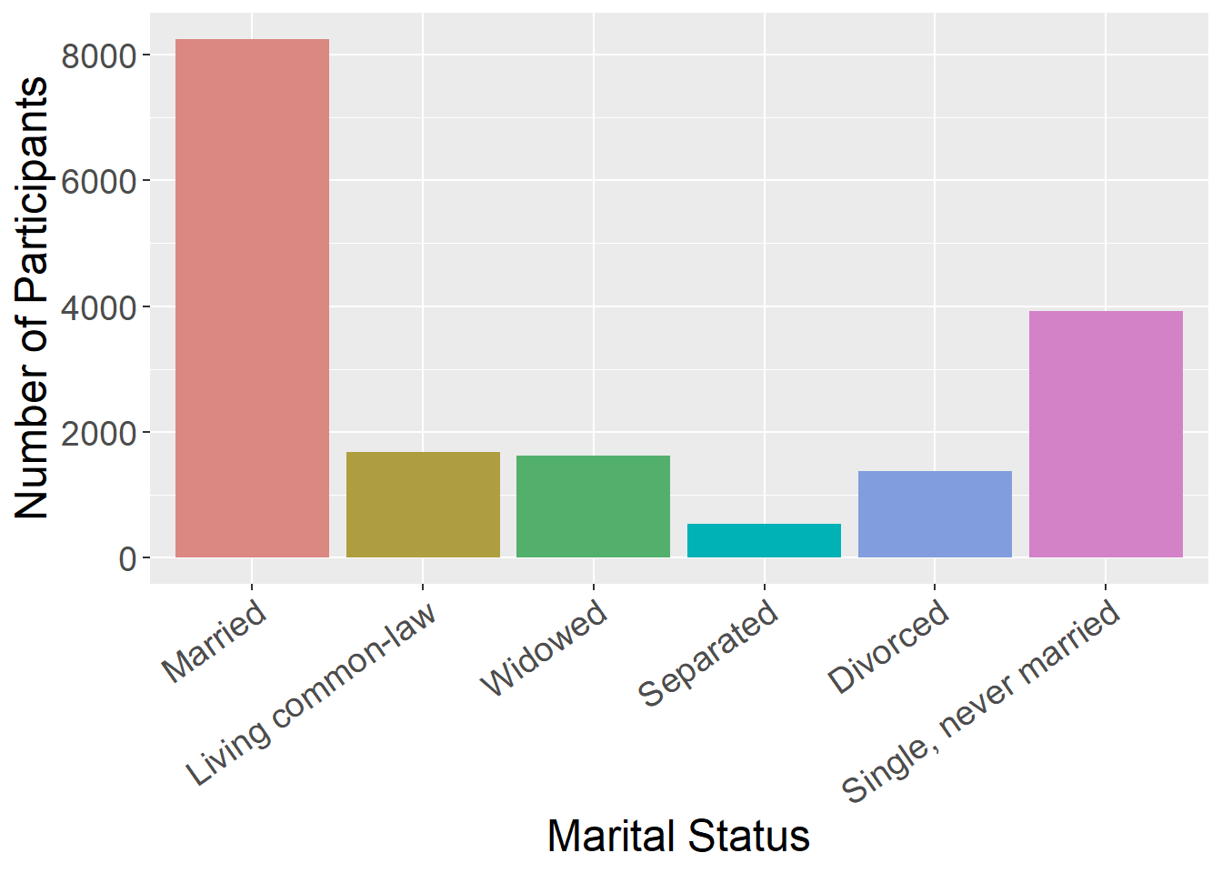
Types of visualizations - Bar charts
Notes:
Bar charts are good for representing data from groups or categories, with the bars representing different categories. The bar height usually represent a mean, a count, or a percentage, by category. These can be useful for comparing groups or showing change over time.

Slide 10
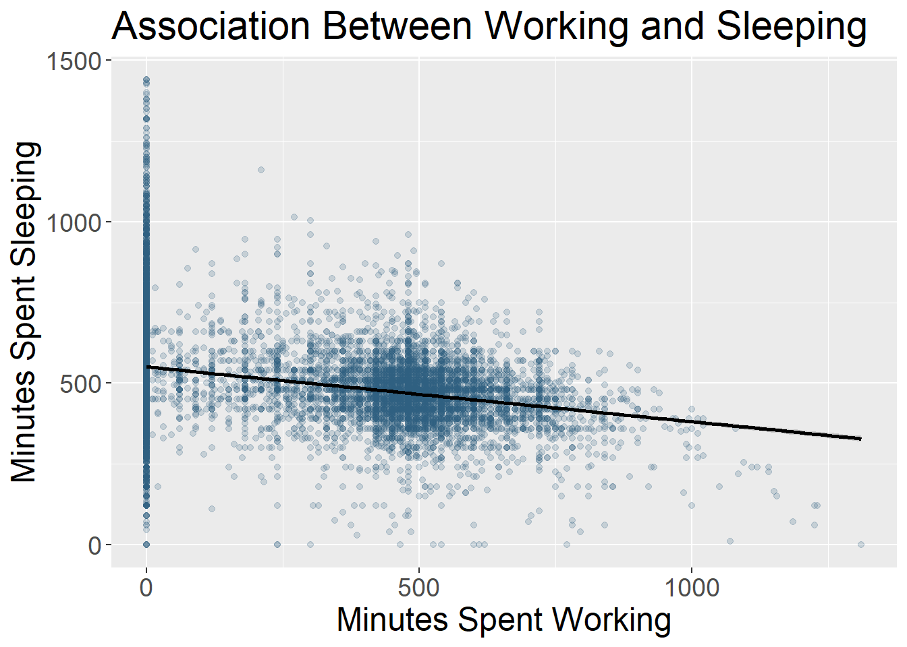
Types of visualizations - Scatter plots
Notes:
Scatter plots include data points that are plotted along an x and y axis, showing the relationship between these two variables. Often researchers add a line to these plots to show the statistical relationship between the variables.

Slide 11
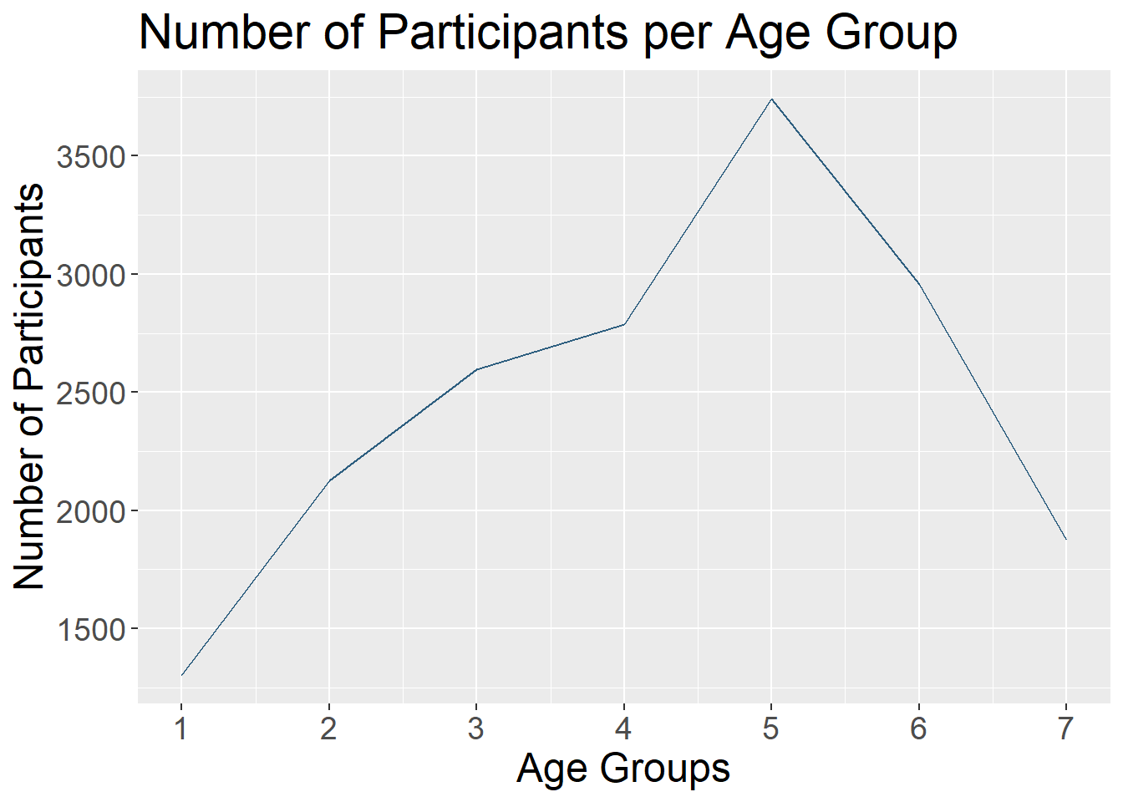
Types of visualizations - Line charts
Notes:
Line charts use connected straight lines to display data. They are good for showing change over time on a continuous variable. They are often similar in purpose to bar charts, but visually simpler if there are many time points. An example of where we often see line charts used in the news is to visualize the stock market. (Plotting the various age groups here is not particularly meaningful since this data was only collected at one time point, but is used to illustrate this type of data visualization.)

Slide 12
Types of visualizations
And many more!
Heat Map
Stacked Bar or Stacked Area Chart
Violin Plot
Gantt Chart
Choropleth Map
…

Slide 13
What makes a good visualization?

Slide 14
What makes a good visualization?
What question are you exploring with your data and how will it inform future analyses?
What is your data visualization adding to your science communication?
What take-away message are you conveying with the image?
What type of variables do you have? Continuous? Categorical? And what type of abstraction (e.g., color, shape) best suits that variable?
Are you comparing groups?
Are you showing change over time?
Are you visualizing a relationship between variables?
Notes:
There is an art to picking the best data visualization that fits your data and the story you are telling. By nature, data visualizations are abstract representations of our data, with color, shape, and position representing the data points. This both hides the exact data itself, while also allowing us to highlight bigger picture ideas about the data, depending on what we choose to emphasize. When deciding on what type of data visualization to use, consider the following:
Reference this link on webpage for more: It can be easy to get in the habit of using the same types of data visualization over and over again. Check out this website that gives many creative data visualization options (with R code!), categorized by goal: https://r-graph-gallery.com/

Slide 15
Let’s jump into R!

