Slide 1
Introduction to Research Data Management (RDM)

Slide 2
Session Objectives
By the end of this session, you’ll be able to:
Define research data, research data management, and the FAIR, CARE, and OCAP principles.
List the different stages of the research data management lifecycle.
Articulate how RDM principles support research transparency, accessibility and reproducibility.
Identify where to find RDM support.
Define sensitive data.
Discuss risk assessment and harm in data management at both the individual participant and global level of privacy and data security.
Connect RDM concepts and practices to previous research and/or data management experiences.

Slide 3
What is Research Data Management (RDM)?

Slide 4
What are research data?
Every research project seeks to investigate a research question. The materials that support the answering of a research question are considered data. This can include:
Spreadsheet data
Audio recordings
Video recordings
Textual transcripts
Images / photographs
Corpora of text
Computer code
Marginalia (writing in the margins of books)
Geographic information, such as coordinates
Others?

Slide 5
What data are you working with?
Share your answers in the chat, or raise a hand!

Slide 6
What is RDM?
RDM involves the practices and activities over the research lifecycle that pertain to the management of research data, including planning, collecting, analyzing, documenting, storing, sharing, and preserving.
Ultimately, RDM is research.
Notes:
RDM is just as important as presenting at conferences and publishing papers. But, instead of framing your journal article as the star of the show, RDM puts the data front and centre.

Slide 7
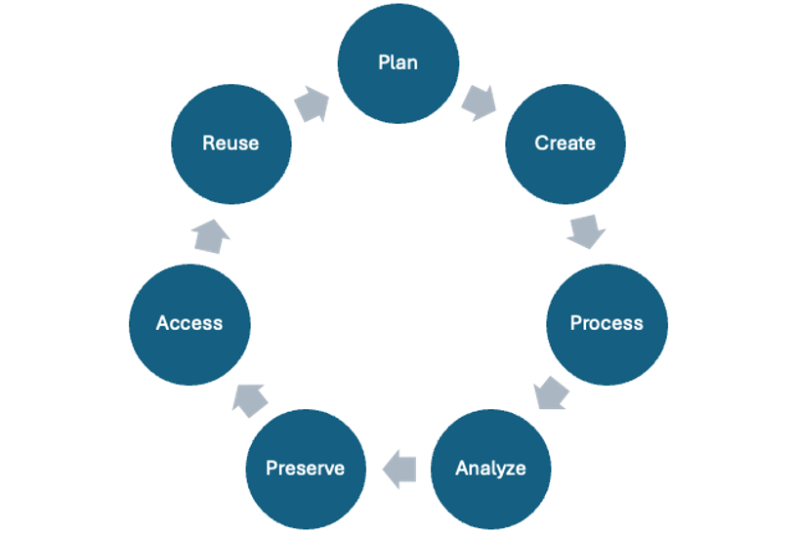
The research data lifecycle
Notes:
Data can outlast a project, and even the researcher who collected it. For this reason, the analogy of a lifecycle is often used to describe the management of research data.
The stages in this lifecycle can be broadly defined. They include:
●Plan: Creating documentation at the beginning of a project, often in the form of a data management plan (DMP), will help you consider and outline how data will be managed throughout the project’s lifecycle.
●Create: This is the stage where people believe research ‘begins.’ It is the creation, collection, collation, or other fun verbs that describe how you will obtain or generate the data for a project.
●Process: The raw materials or data that you gather are not usually in a state that makes it ready to understand. In order to ask meaningful questions of your data, you may need to clean, restructure, or anonymize what you’ve collected.
●Analyze: This is the stage where people believe research ‘happens.’ The research question becomes answerable from the results of the analyzed data.
●Preserve: What happens to research data after analysis and publication? It is not unusual for data to languish on an old hard drive, never to be used again. A key component of RDM is the consideration of how data will be preserved after the project’s completion.
●Access: Some journal publishers and grant funders require research data to be accessible once a paper is published. There are platforms, called data repositories, where data can be deposited for the short or long-term. If data is preserved in a repository that allows other people to find it, the visibility of your work can increase, along with your citations.
●Reuse: Closely related to access, if others can find and access your data, it has the potential to be reused for additional projects, including your own, maximizing the long-term value of your research.
●Even though “create” and “analyze” are what most people think of as research, the other stages are just as important in ensuring the quality of the research project. This lifecycle represents an ideal, but the realities of research are much harder to define and categorize. It is a model designed to help you understand the ways in which you interact with data, and to guide you through these stages before starting your research project. With that in mind, there is no perfectly circular flow to these stages, as there are many interconnections and repetitions of each stage within a research project.
●Throughout this course, we are going to take you through the research lifecycle using a mock research project. For the purposes of instruction, the project data may be a bit cleaner than what exists in reality, but the goal is to prepare you to plan and engage with your own research data in ways that promote the transparency and reproducibility of your work.

Slide 8
Why Should You Care?

Slide 9
What does academic integrity mean to you?
Share your answers in the chat, or raise a hand!

Slide 10
Academic integrity
For undergraduates, academic integrity revolves are plagiarism (cite your sources!)
As you move into graduate research, there is a shift from ‘you as consumer’ of information to ‘you as producer’ of information.
From this perspective, academic integrity encompasses the integrity of your research data, as your data forms the basis of the claims you will make in your research papers.

Slide 11
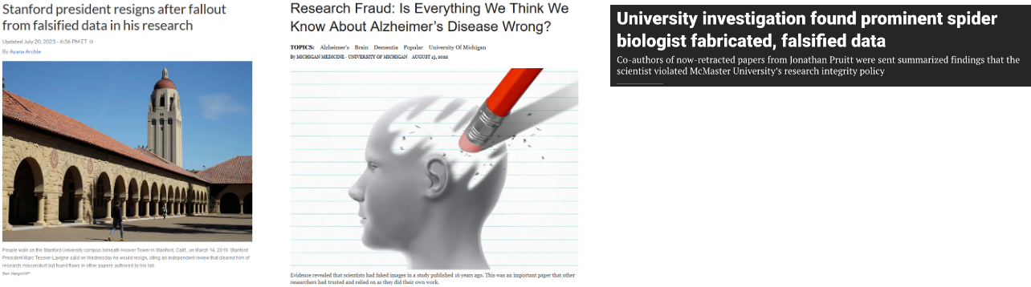
Consider the following
source
source
source
Notes:
Summarize some or all of the stories and their impact on research. Use the Jonathan Pruitt case to highlight impact on graduate students.

Slide 12
Consider the following
In each of these stories, purposeful academic fraud occurred because the data was undocumented and inaccessible.
While these examples represent extreme cases, what happens more commonly is that poor data management practices result in accidental misrepresentations of data.

Slide 13
Can you think of other reasons that data might be misrepresented?
Share your answers in the chat, or raise a hand!

Slide 14
Why should you care?
Our goal is to teach you how you can avoid accidental misrepresentation by focusing on the integrity of your data, and how to incorporate each stage of the research data lifecycle into your overall program of research.

Slide 15
Data Policies

Slide 16
Have you encountered any data policies?
Publishers
Funders
Your institution
Your supervisor
Share your answers in the chat, or raise a hand!

Slide 17
Publisher policies
It is becoming more common for publishers to require that research data be shared upon publication to support the transparency, reproducibility, and validation of the research findings.
Some examples include:
Springer Nature: Research Data Policy
Wiley: Data Sharing Policies
PLOSOne: Data Availability

Slide 18
Funder policies
Research funders are also starting to create data policies.
In Canada, the Tri-Agency RDM Policy, has outlined the following requirements:
Data Management Plans
Data Deposits
Institutional Strategies
Notes:
● Institutional Strategies:
By March 1, 2023, research institutions subject to this requirement were required to post their RDM strategies online and share the link with the agencies so this information can be shared publicly on a dedicated science.gc.ca webpage.
●Data management plans:
In spring 2022, the agencies identified the initial set of funding opportunities subject to the DMP requirement. The agencies are continuing to introduce the DMP requirement into funding opportunities as they finalize a timeline and approach for broader implementation of the requirement.
●Data deposit:
After reviewing the institutional strategies and in line with the readiness of the Canadian research community, the agencies will phase in the data deposit requirement, with deposit requirements expected to be rolled out for awarded projects beginning in 2026.
Mention other funders globally are doing similar:
●Horizon Europe: Research Data Management Guide
●National Institutes of Health (NIH): Data Management and Sharing Policy
●National Science Foundation (NSF): Public Access Initiative

Slide 19
Why do you think these policies are being created?
Share your answers in the chat, or raise a hand!

Slide 20
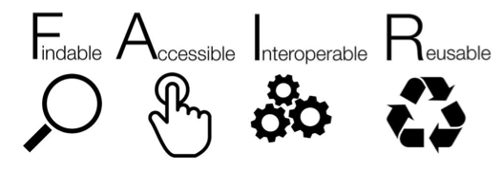
FAIR Principles
source
Notes:
●Position FAIR as the philosophical underpinning for these policies
Describe FAIR:
●Findable
The first step in (re)using data is to find them. Metadata (information about the data) and data should be easy to find for both humans and computers.
●Accessible
Once the user finds the required data, they need to know how they can be accessed, possibly including authentication and authorisation.
●Interoperable
The data usually need to be integrated with other data. In addition, the data need to interoperate with applications or workflows for analysis, storage, and processing.
●Reusable
The ultimate goal of FAIR is to optimise the reuse of data. To achieve this, metadata and data should be well-described so that they can be replicated and/or combined in different settings.

Slide 21
FAIR Principles
FAIR does not mean that all data must be open or public.​
Rather, FAIR supports the structured discoverability and usability of data and other research outputs.

Slide 22
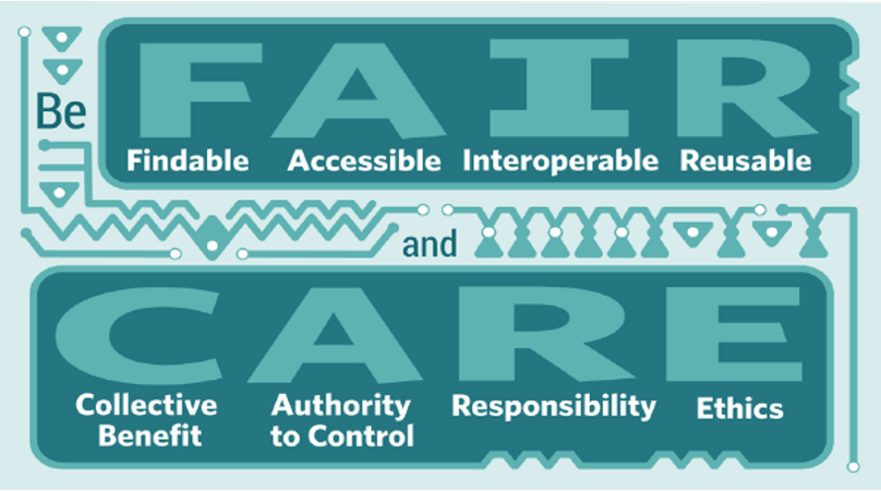
CARE Principles
source
Notes:
Describe CARE
“The CARE Principles (Collective benefit, Authority to control, Responsibility, Ethics) are a set of principles that are meant to work in tandem with the FAIR principles, with a focus on Indigenous self-determination in research and data practices.
●Collective Benefit:
Data ecosystems shall be designed and function in ways that enable Indigenous Peoples to derive benefit from the data.
●Authority to Control:
Indigenous Peoples’ rights and interests in Indigenous data must be recognised and their authority to control such data be empowered. Indigenous data governance enables Indigenous Peoples and governing bodies to determine how Indigenous Peoples, as well as Indigenous lands, territories, resources, knowledges and geographical indicators, are represented and identified within data.
●Responsibility:
Those working with Indigenous data have a responsibility to share how those data are used to support Indigenous Peoples’ self-determination and collective benefit. Accountability requires meaningful and openly available evidence of these efforts and the benefits accruing to Indigenous Peoples.
●Ethics:
Indigenous Peoples’ rights and wellbeing should be the primary concern at all stages of the data lifecycle and across the data ecosystem.”

Slide 23
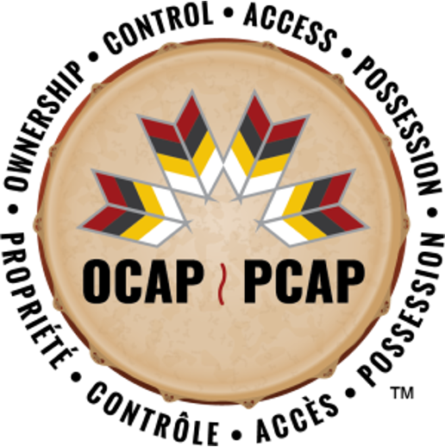
Principles of OCAP
source
Notes:
Describe OCAP
“The First Nations Principles of OCAP (Ownership, Control, Access, Possession) assert that First Nations have control over data collection processes, and that they own and control how this information can be used.
●Ownership:
refers to the relationship of First Nations to their cultural knowledge, data, and information. This principle states that a community or group owns information collectively in the same way that an individual owns his or her personal information.
●Control:
affirms that First Nations, their communities, and representative bodies are within their rights to seek control over all aspects of research and information management processes that impact them. First Nations control of research can include all stages of a particular research project-from start to finish. The principle extends to the control of resources and review processes, the planning process, management of the information and so on.
●Access:
refers to the fact that First Nations must have access to information and data about themselves and their communities regardless of where it is held. The principle of access also refers to the right of First Nations’ communities and organizations to manage and make decisions regarding access to their collective information. This may be achieved, in practice, through standardized, formal protocols.
●Possession:
while ownership identifies the relationship between a people and their information in principle, possession or stewardship is more concrete: it refers to the physical control of data. Possession is the mechanism by which ownership can be asserted and protected.”

Slide 24
Sensitive Data

Slide 25
What types of materials would you be hesitant to post publicly?
Share your answers in the chat, or raise a hand!

Slide 26
Sensitive data
The Sensitive Data Toolkit for Researchers defines sensitive data as “information that must be safeguarded against unwarranted access or disclosure”. Examples include:
Personal information
Personal health information
Educational records
Customer records
Financial information
Criminal information
Geographic information (e.g., detailed locations of endangered species)
Information that is deemed to be confidential
Cultural or community information/data
Proprietary information
Information that is protected by data sharing agreements or other contracts
Notes:
Data may be considered sensitive for ethical, legal, and contextual reasons. While institutional ethics boards will review research projects with the lens of protecting participants, you have a responsibility beyond ethics approval to ensure that your data is managed with care. A risk assessment is a process for identifying, evaluating, and mitigating risks associated with collecting, storing, using, sharing, and preserving research data.

Slide 27
Sensitive data
The Sensitive Data Toolkit for Researchers provides a framework for assessing and protecting participant risk, but it is good practice to ask yourself the following questions:
Can someone be identified?
Could harm result from sharing?
What consent was given?
Are there legal restrictions?
Are there community expectations?

Slide 28
Advisory
Ethically managing sensitive data is beyond the scope of this course,
and we advise you to consult with your institutional supports to
determine adequate strategies for addressing sensitive data in your
research.

Slide 29
Data Storage

Slide 30
Data storage
Where do your research materials live right now?
Have you ever accidentally lost or overwritten your work?
If your personal computer crashed or was stolen, would you still have access to your work?
Share your answers in the chat, or raise a hand!

Slide 31
Data storage
Where your data is stored is a key part of data management.
It is always recommended that your research materials are stored in at least two places, and that one of those places is remote cloud storage beyond your personal machine.
This is known as a back-up.

Slide 32
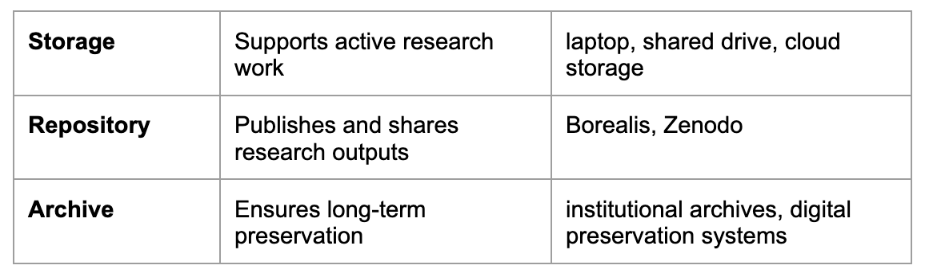
Data Preservation
In addition to storing data for your active work, there are platforms that support the long-term storage and preservation of your data and research materials after the project’s completion.

Slide 33
Data Preservation
In addition to storing data for your active work, there are platforms that support the long-term storage and preservation of your data and research materials after the project’s completion.

Slide 34
Data Preservation
We will talk more about data preservation later in this course, but one of our main goals is to show you how to conduct research in such a way that data, code, and all accompanying materials are able to be shared and interpreted by others after the project is complete.

Slide 35
Breakout!

