Slide 1
File Management

Slide 2
Session Objectives
By the end of this session, you’ll be able to:
Explain best practices for project file naming and directory structure.
Describe how version control can be applied through file naming conventions.
Develop file naming convention and directory structure for a mock list of project files.
Apply pre-determined file naming convention and directory structure for an example project.

Slide 3
Best Practices in File Naming

Slide 4
Best practices in file naming
There are three main best practices when naming files. File names should be:
Human-readable
Machine-readable
Consistently named

Slide 5
Human-readable
When determining if a filename is human-readable, consider the following questions:
Can you look at a filename and, without additional information, know what the file is for? What about in a year?
Are others able to look at your files and know what they are?
Are you or others able to easily find files that are needed for a project?

Slide 6
Human-readable
When determining if a file name is human-readable, consider the following questions:
Can you look at a filename and, without additional information, know what the file is for? What about in a year?
Are others able to look at your files and know what they are?
Are you or others able to easily find files that are needed for a project?

Slide 7
Human-readable
Human-readable file names are short and complete, and they should include at least 3-5 concise conceptual elements. These can include:
Date of data creation/collection
Short description
Activity
Location where data was collected
Editor/creator
Versioning information (see more on this below)
Any other relevant information

Slide 8
Machine-readable
When determining if a filename is machine-readable, consider the following questions:
How will a computer sort your filenames? By date, by number, or by first letter?
If files need to move from one place to another, will they remain interpretable in the same way?
Can the files be opened by different operating systems or computers?

Slide 9
Machine-readable
A big part of organizing files has to do with how machines order characters such as letters and numbers.
Machine-readability across operating systems and applications can be quite complicated, and is beyond the scope of this course.

Slide 10
Machine-readable
Some general guidelines to follow:
Ordering begins with the first character, and works its way from left to right.
Numbers are ordered ahead of alphabetical characters.
Dashes - are ordered ahead of underscores _, and both are ordered ahead of numbers.
Putting a dash or an underscore at the beginning of a filename can be a way to force it to appear first in a list.
While some systems will position capital letters ahead of lowercase, it’s not recommended to use letter casing as a way to order names.

Slide 11
Machine-readable
Machine-readable filenames often have the following characteristics:
Only contain letters in the English alphabet, numbers 0-9, dashes, and underscores.
They do not use spaces or special characters such as: ! @ # $ % ^ & * ( ) + = { } [ ] |.
Naming elements are separated with underscores and/or dashes.
They use the date format YYYYMMDD or YYYY-MM-DD.
Notes:
They use the date format YYYYMMDD or YYYY-MM-DD. These are the formats recommended by the International Standards Organization.

Slide 12
Activity
How would the following file names be ordered?
Data-analyzed_20260504.csv
01_data-analytic_20260504.csv
-README.txt
data-analyzed_20260504.docx
Share your answers in the chat!

Slide 13
Activity
Answer
-README.txt
01_data-analytic_20260504.csv
Data-analyzed_20260504.csv
data-analyzed_20260504.docx

Slide 14
Consistency, Likeness, and Importance

Slide 15
Consistency, likeness, and importance
There is no “right” naming convention, and the most important thing is to be consistent.
When thinking about which elements you want in a naming convention, consider:
Elements that important for your project
Similarities and differences play into how files are sorted
How these play into which element will come first, second, third, etc. in your naming convention
Notes:
For example, if it’s important to know when a given batch of data was collected, you may choose to put the date first in filenames. If it’s important to distinguish locations where data was collected, then the location should come before other information, such as the date.

Slide 16
Example
Example: lldr_mpp_20240723.csv
Documentation:
Convention: project_location_collection-date.file-type
lldr: Leaf litter decomposition rate
mpp: Monk Provincial Park
Notes:
Here is an example of a human- and machine-readable filename
Just because it can be read, doesn’t mean that you or others can understand what it represents, so the convention and abbreviations need to be documented
This filename has characteristics that work for both machines (underscores, date formatting) and humans (when combined with the documentation).

Slide 17
Don’t forget to document!
It is good practice to record your naming conventions, and to define all acronyms, abbreviations, codes, and other notations in your project README file.

Slide 18
Managing Directories

Slide 19
Managing directories
Directories (or folders) are the units that hold files and other directories.
They are a way of keep your files organized and easy to find.
Developing a directory structure before you begin a project can help with managing all the files that will be generated.

Slide 20
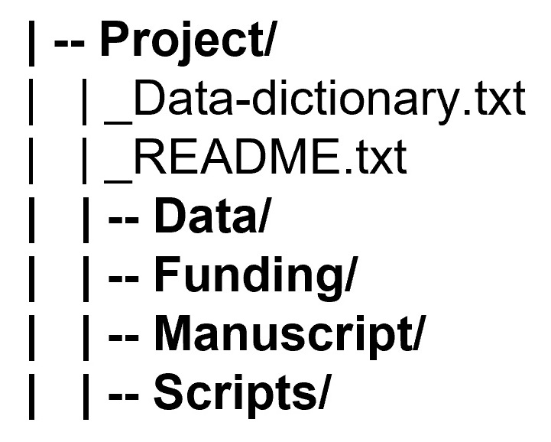
Managing directories
Directory structures typically have:
A root directory (top-level folder)
Subdirectories
Relevant files
Directories are denoted by a slash ‘/’ at the end of their name in these diagrams.
Notes:
An example of a directory structure, with four sub-directories (Data/, Funding/, Manuscript/ and Scripts/) and two files in the root directory (_Data-dictionary.txt and _README.txt)
Before you begin a research project, it’s useful to create a plan of your required directories. It can be helpful to think about the natural and distinct groups of data and files that you’ll be working with. To start the process, you can think about things such as:

Slide 21
Managing directories
Before you begin a research project, it’s useful to create a plan of your required directories. To start the process, you can think about things such as:
Directory names
Directory contents
Access permissions
Notes:
Before you begin a research project, it’s useful to create a plan of your required directories. It can be helpful to think about the natural and distinct groups of data and files that you’ll be working with. To start the process, you can think about things such as:
Directory names:
In general, it’s best to keep directory names short and reflective of the kinds of objects they contain. Like machine-readable filenames, directory names shouldn’t include spaces or special characters. In the example above, the directory names are all single words (Project/, Data/, Funding/, etc.), and you can guess what kinds of objects will be in each one based on the name (e.g., Data/ will contain data files, Funding/ will contain documents and information related to financial matters, etc.). Naming conventions could be based on things like the following:
Steps in a research project: e.g., Collection/, Analysis/, Writing/, Presentations/
Names of collaborators on a research project
For a research group, you may have different root directories for each project
Directory contents:
This is what you’ll put in each directory. Keeping similar objects in the same directory can make it easier to navigate, e.g., having all the data-related files in a directory called Data/ rather than scattered across multiple directories. However, if multiple people need to work on data in different ways, it may make sense for them to have their own directories. Always consider what will work best for your project.
Access permissions:
You will need to decide whether everyone on a project has access to all directories, or whether some directories will be restricted to certain project members, and if so, how that will be managed.

Slide 22
Hierarchy depth
There are two distinct ways you can structure your directories:
A “shallow” directory structure has minimal nesting of sub-directories.
A “deep” directory structure contains many (potentially very many) sub-directories.

Slide 23
Hierarchy depth
Choosing which type of structure you want will depend on:
How many files the project has
The types of files the project has
The size/nature of your research team
Personal preference

Slide 24
A shallow structure

Slide 25
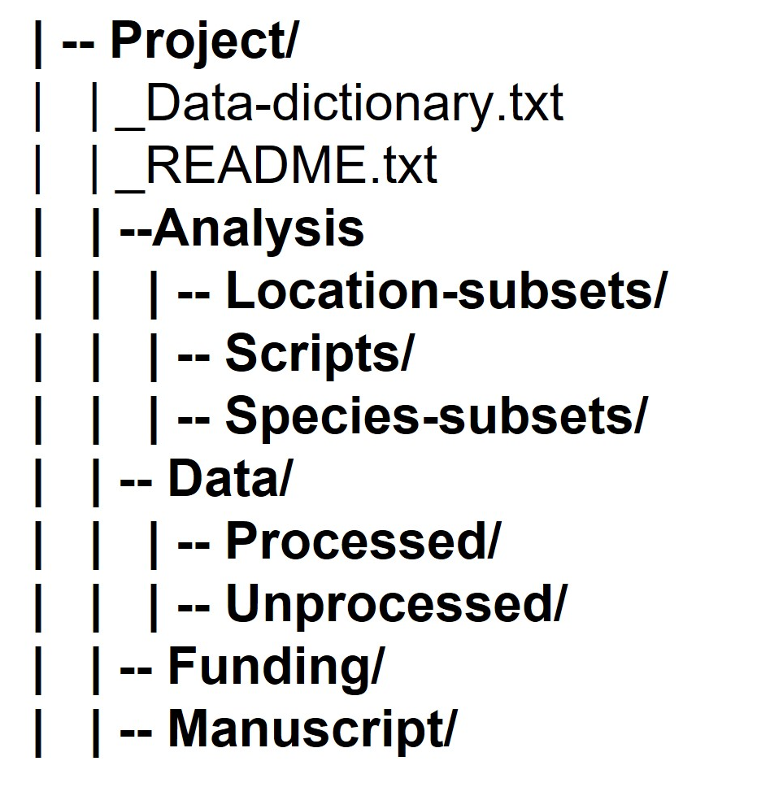
A deep(er) structure
Notes:
In this example, there are nested sub-directories in addition to four main sub-directories: three nested sub-directories in Analysis/ (Location-subsets/, Scripts/, and Species-subsets/) and two nested sub-directories in Data/ (Processed/ and Unprocessed/).

Slide 26
File Naming and Version Control

Slide 27
Version control
Version control is the systematic tracking of the various versions and growth of your files
File naming can be a way to keep track of versions, which is known as “manual” version control
Manual version control lends itself well to administrative documents and manuscripts, but in the right context can work for data
There are also automated version control systems, but these are beyond the scope of the course.

Slide 28
Examples: Manual version control
Administrative documents
Version number: manuscript_v01.docx, manuscript_v02.docx, …
Editor initials: manuscript_v01_NR.docx, manuscript_v01_NR_JA.docx
Data
“Stage” of data:
lldr_mpp_20240723_RAW.csv
lldr_mpp_20240723_CLEAN.csv
lldr_mpp_20240723_GO-subset.csv
Notes:
These files represent the raw, or originally collected data, the cleaned data, and a subset for Gary Oaks, which is represented by the acronym “GO”

Slide 29
Activity: Creating a File Management System

Slide 30
Activity
Your supervisor has given you another task - she needs help organizing the Social Cognition and Wellbeing Lab’s files! With so many students and research assistants in the research group, things have gotten messy and confusing. She’s asked you to organize the files with the structure below, under the project name “social_media_wellbeing”

Slide 31
Activity
In breakout rooms, you’ll be given a document that lists several files belonging to the project, and will be asked to create a naming convention and directory structure.
Remember: there is no “right” way to organize and name files. Your file hierarchy and naming structure will depend on the project, the files, your research group’s standards, your personal preferences, etc!
Notes:
Share link in chat to the docs

