Slide 1
Reproducibility in Research

Slide 2
Session Objectives
By the end of this session, you’ll be able to:
Identify issues with reproducibility in research, and best practices to make research reproducible.
Discuss pros and cons of using Excel for spreadsheet data.
Explain the difference between Excel files (.xlsx) and plain-test .csv files, and their role in reproducibility.
Define scripting and the concept of literate programming.
Connect the data science workflow and the use of R and RStudio with the research data lifecycle.

Slide 3
What is Reproducibility?

Slide 4
What is reproducibility?
Research is reproducible when the same data + the same methods = the same results.
Reproducibility is related to replicability, though replicability occurs when new data + the same methods = results that point in the same direction.
Notes:
As we have learned, research data management supports the responsible conduct of research. Reproducibility is an important aspect of that responsibility. Reproducible research practices lead to research outputs that are verifiable, extendable, and trustworthy.

Slide 5
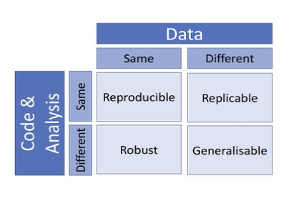
What is reproducibility?
source
Notes:
As we have learned, research data management supports the responsible conduct of research. Reproducibility is an important aspect of that responsibility. Reproducible research practices lead to research outputs that are verifiable, extendable, and trustworthy.

Slide 6
What is reproducibility?
Reproducibility in research can take different forms, including empirical/ methodological, statistical, and computational.
This program is going to focus on computational reproducibility, noting that this is one piece of a bigger picture.

Slide 7
Computational reproducibility
For a project to be computationally reproducible, information about all assets used to test hypotheses and generate results must be available. These include, but are not limited to:
Input data
Code
Software
Computing environment and/or hardware

Slide 8
The Reproducibility Crisis

Slide 9
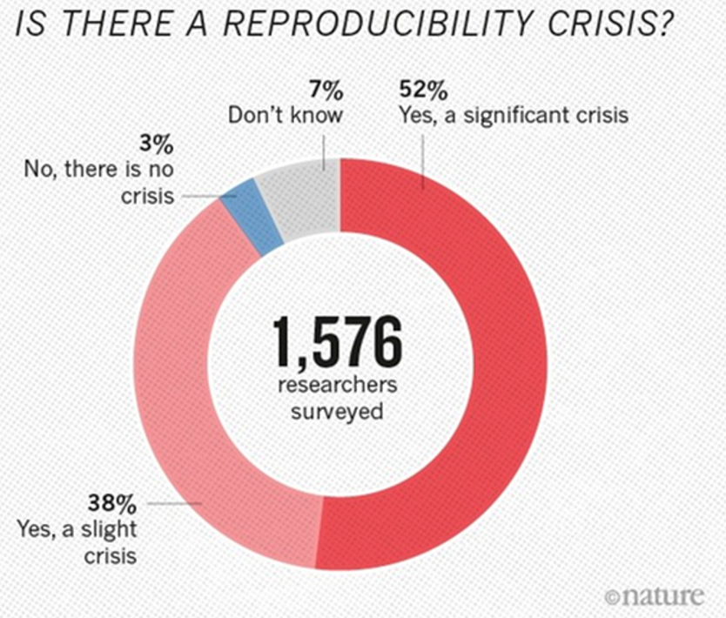
The reproducibility crisis
source
Notes:
‘Crisis’ is a strong word, but it is easy to find examples of fabricated research results. Poorly documented research, whether accidental or purposeful, can create measurable harms to individuals and communities.
As this graph shows, of over 1500 researchers surveyed, over half think there’s a significant crisis, and close to 40% think there’s a slight crisis

Slide 10
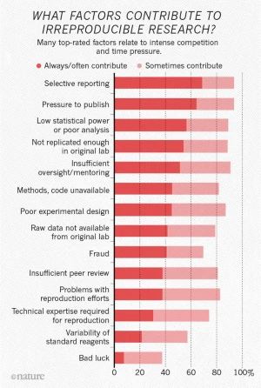
source
Notes:
Discuss different ideas presented in the graph for factors that contribute to irreproducible research
Most researchers are not formally trained as programmers, but they increasingly need to deal with issues such as the growing size and scope of datasets, the availability of data analysis methods and algorithms, and the proliferation of new research tools and software.
For these reasons, the barriers to fully reproducible research must be identified and addressed. These barriers include technical challenges, external dependencies, and human factors.
Technical challenges:
Variations in available computing environments and differing computational complexity across projects / disciplines create hindrances to reproducibility. Technical challenges are not insurmountable, but they highlight the importance of detailed documentation.
External dependencies:
Infrastructure such as external APIs and algorithms are often outside of the control of the research team. Many external services are not open-source, which creates a ‘black box’ of uncertainty when it comes to data processing methods and code documentation.
‘Operator error’ and reluctance to share:
Human factors, such as inexperience with coding or a reluctance to share data, pose significant barriers to reproducible research. Documenting code takes time and skill, and some researchers are unwilling to share due to a fear of criticism or concern about their findings being ‘scooped’ or taken by others.

Slide 11
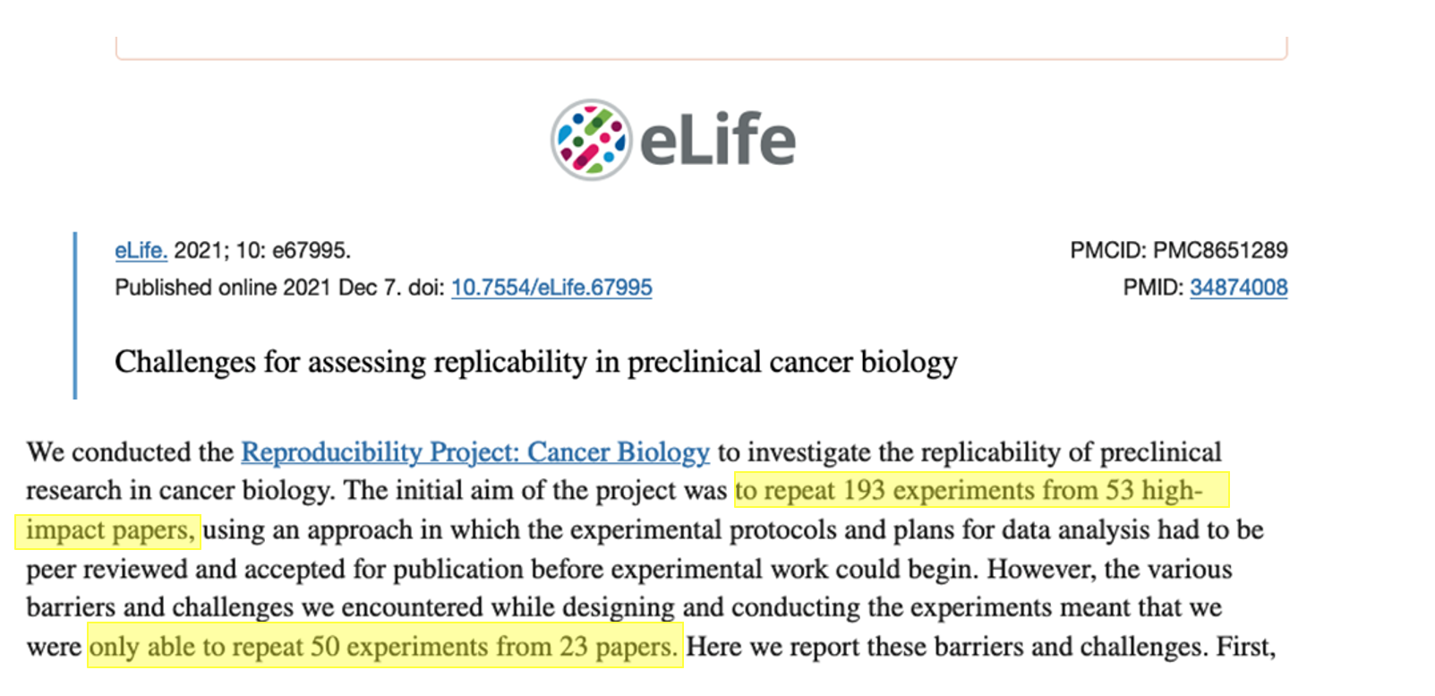
source
Notes:
Optional slide

Slide 12
Nuances of reproducibility
Reproducibility is a spectrum.
The more assets and information provided, the easier it is to reproduce the study.
Notes:
Optional slide

Slide 13
Nuances of reproducibility
High / full reproducibility: studies that provide the code, data, and full computational environment necessary to reproduce the results.
Medium / partial reproducibility: studies that provide the code and data, but not the computational environment in which the code can be run.
Low / shallow reproducibility: studies that provide algorithms and results.
Notes:
Optional slide

Slide 14
Nuances of reproducibility
Sharing ≠ reproducible.
Simply sharing data and code does not make a project reproducible.
Could another researcher, without ever speaking to you, open, understand, run, or reuse your data and code?

Slide 15
Nuances of reproducibility
Not all data are meant to be computationally reproducible.
Qualitative, humanities, or arts-based research are not exempt from good documentation practices just because they are less computationally reproducible than other projects.
Notes:
Research methods are discipline-specific, and what works in one domain may not be possible in another.

Slide 16
Best practices
Good RDM is not about perfection.
Slip-ups happen, and the focus should be on doing the best you can.

Slide 17
Best practices
Be proactive
Document, document, document
Be FAIR
Notes:
Be proactive. Planning for reproducibility should happen at the start of a project, not the end. Make use of resources such as data management plan templates and reproducibility checklists. This will not only help with the project’s reusability, it will make the current research easier to implement and understand.
Document, document document. There can never be too much documentation. If the concept of writing about the project details seems daunting, think of it as a communication with your future self. If you put the project away for six months, how would you describe to yourself what you were working on? Practices such as literate programming and version control can help to streamline and automate documentation.
Be FAIR. Sharing your data, code, and documentation in a recognized repository helps with reproducibility by making your research findable. Ensuring all documentation and data are in open, rather than proprietary, file formats allows your research to be accessible and interoperable. And, providing robust documentation supports research reusability.
[optional]
Use discrete computational environments. Technologies such as software containers and virtual machines create predictable and controlled environments for computational research. As with all practices in RDM, using discrete computational environments is not only helpful for future research, but for the implementation of the current research project.

Slide 18
Working with Microsoft Excel

Slide 19
Have you ever used Excel?
What did you use it for?
Did it do a good job? Why/why not?
Share your answers in the chat, or raise a hand!

Slide 20
Have you ever used Excel?
What did you use it for?
Did it do a good job? Why/why not?
Share your answers in the chat, or raise a hand!

Slide 21
Excel: What it does well
Intuitive point-and-click graphical user interface (GUI)
Easily group and order datasets based on specific values
Easily calculate things like sum, mean, and other basic statistics
Create graphs and charts with a few clicks
It’s easy and convenient
Notes:
Microsoft Excel is widely known and used, and it often elicits strong reactions from people who either strongly like or dislike it. But Excel is popular for a reason. It is easy to use; it can quickly calculate things like sum, mean, and basic statistics; there are many options in the graphical user interface for automation and formatting; it can create colourful graphs and charts; and there is a lot of help available for writing formulas and using advanced features.
The popularity of Excel can lead users to believe that it is the only option for wrangling data, but there are other options depending on the use-case. Programs like OpenRefine, SPSS, Sass, and Stata, and coding languages such as R and Python all have robust functions and features for tasks like data cleaning and advanced statistical analysis and graphing.

Slide 22
Excel: What it doesn’t do so well
Any manual changes made to a document are subject to human errors, and it can be hard to track these changes and identify errors.
Formulaic changes can be hidden in cells and are subject to “breaking”, making manipulations and analyses difficult to track and reproduce.
Manipulations require manual processes for every file.
Notes:
Excel is an easy-to-use program for novice users, but it is full of hidden features and idiosyncrasies. The biggest issue with any technology is ‘operator error’, and this is especially prevalent in Excel, where settings and preferences are hidden away in menus. Since Excel is a proprietary program, users can’t easily inspect or search for errors in their configuration settings.
Dates in Excel need to be formatted correctly in multiple ways. The characters must appear in a predictable pattern, and the cell format needs to be set correctly.
Long strings of numbers will always be truncated, and, depending on the settings, numbers with more than 16 characters may be rounded to zero.
Excel does not handle big, or even medium datasets very well. Files become very hard to load or work with if they have over 800,000 rows of data.
Since Excel is a graphical user interface, it provides multiple ways in which to achieve the same task. For example, formulas can be ‘hard-coded’ (referring to specific cells), or they can be relational (referring to named cells) depending on configuration and user knowledge. When formulas are hard-coded, if a change is made to the data or configuration, the formula may break, or worse, display incorrect information.
And finally, one of the biggest issues with Excel is the lack of versioning support. The program makes direct changes to the source data whenever a file is saved. If the data are overwritten in the absence of a backup copy, a research project can be compromised, delayed, or worse.

Slide 23
Excel: What it doesn’t do so well
The auto-formatting of cells can be very annoying and cause issues.
Rows/columns can be hidden, causing issues with collaboration.
Changing variables will overwrite original data, causing issues with provenance and reproducibility.
It’s not very reproducible.
Notes:
Excel is an easy-to-use program for novice users, but it is full of hidden features and idiosyncrasies. The biggest issue with any technology is ‘operator error’, and this is especially prevalent in Excel, where settings and preferences are hidden away in menus. Since Excel is a proprietary program, users can’t easily inspect or search for errors in their configuration settings.
Dates in Excel need to be formatted correctly in multiple ways. The characters must appear in a predictable pattern, and the cell format needs to be set correctly.
Long strings of numbers will always be truncated, and, depending on the settings, numbers with more than 16 characters may be rounded to zero.
Excel does not handle big, or even medium datasets very well. Files become very hard to load or work with if they have over 800,000 rows of data.
Since Excel is a graphical user interface, it provides multiple ways in which to achieve the same task. For example, formulas can be ‘hard-coded’ (referring to specific cells), or they can be relational (referring to named cells) depending on configuration and user knowledge. When formulas are hard-coded, if a change is made to the data or configuration, the formula may break, or worse, display incorrect information.
And finally, one of the biggest issues with Excel is the lack of versioning support. The program makes direct changes to the source data whenever a file is saved. If the data are overwritten in the absence of a backup copy, a research project can be compromised, delayed, or worse.

Slide 24
What’s in a Spreadsheet?

Slide 25
.xlsx files
Excel spreadsheets save as a .xlsx file, with is a proprietary Microsoft format.

Slide 26
.xlsx files
While it’s natural to think of an Excel file as a single file, it is actually a zipped archive containing multiple files, including:
Worksheet data
Worksheet formatting
Charts and graphs
Pivot tables
Embedded objects
External links
Metadata

Slide 27
.csv files
.csv files (Comma Separated Values) are tabular (spreadsheet) files, with each row representing a record and values within each row separated by commas (even though they can be presented in cells).

Slide 28
Converting Excel files to other formats
.xlsx files can be converted to plain text formats, but there are factors to be aware of:
When converting .xlsx files to plain text, all formatting (bold, colour, etc.) will be lost.
You can only convert one Excel tab to a plain text spreadsheet at a time.
Formulas and tables will be lost.

Slide 29
Converting Excel files to other formats
Original value/format | What can happen | Example of change | Why it happens
01234 | Leading zero lost | 1234 | Treated as a whole number
Résumé | Characters corrupted | Rsum / RÃ©sumÃ© | Encoding issues
31/12/2024 | Date misread or changed | 12/31/2024 | Different regional settings for dates
=SUM(A1:A10) | Formula lost | 55 (only value) | Plain text only keeps values
Hello | Formatting lost | Hello | Plain text doesn’t store formatting
123456789012345 | Rounded or scientific notation | 1.23E+19 or rounded value | Precision limits

Slide 30
Example: Genetic data
In a survey looking at over 11,000 papers with Excel gene lists published between 2014 and 2020, more than 30% contained at least one gene name error caused by Excel's autoformatting.
This was due to gene names being converted to standard dates, internal data numbers (5 digits), and floating point numbers.
https://journals.plos.org/ploscompbiol/article?id=10.1371/journal.pcbi.1008984

Slide 31
Moving to Scripting

Slide 32
What is scripting?
Writing lines of code, or "scripts", is creating a set of instructions that a coding program can perform.
For the purpose of this program, these instructions are performed on a dataset (noting there can be broader usage).
Notes:
Lines of code, or ‘scripts', are instructions that a coding language can perform. They are useful for automating common or repeated operations, such as renaming variables or column names, especially for projects that use medium to large sets of data. Scripts can be used for many purposes, but in this section, the focus is on scripting for datasets.
Scripts improve reproducibility because they are predictable. They perform the same operations, in the same order, every time.

Slide 33
Literate programming
Code is a language that computers can understand, but it is not always easily read by humans.
Literate programming is a method of providing a human-language, or narrative, explanation of how a script works in combination with the script itself, so that it can be accurately interpreted and reused.
We've already discussed how to document our files and data, but as we move through the program we're also going to talk about implementing documentation in our code and literate coding principles.

Slide 34
When not to script
Coding, like any language, takes time and regular practice to learn.
As a beginner, creating scripted solutions to simple research tasks may take much longer than using an easily accessible tool such as Excel.
While scripting is reproducible, it is not always necessary for small, one-off tasks.

Slide 35
When to script
Scripting can overcome the common issues with Excel that were described earlier:
In scripting there are no ‘manual’ changes; everything from the data to the configuration can be tracked and checked.
Scripts are saved as individual documents and provide a clear and ordered list of everything that was done.
A single script can be used for multiple files, and individual lines of code can be taken from one script and altered slightly to perform the same task on different datasets.
There is no graphical user interface to inadvertently obscure settings or hide data.
Scripting can load and work on a copy of the source data, so original data isn't overwritten or corrupted.

Slide 36
Scripting in R

Slide 37
The R coding language
R is an open-source programming language designed for data manipulation, statistical analysis, and visualization in research.
It can be used on any operating system, it has comprehensive documentation, and it has an active user-support and training community.
It is popular in academic settings because researchers from many disciplines can use it on data types that range from bioinformatics to demography.

Slide 38
The R coding language
Because R is open-source, it is easily reproducible, as there are no hidden algorithms or proprietary file formats. Many R users are willing to share their code openly, which means that novice users don’t need to have perfect fluency in order to get started.

Slide 39
RStudio
While R is the programming language, RStudio is an Integrated Development Environment (IDE), which is a fancy term for a software application that makes working in R much more user-friendly.

Slide 40
RStudio
An analogy:
You are writing a document in Microsoft Word. In this case, the plain human language that you are typing would be R, and Microsoft Word, which is the software that allows you to view, format, add visuals, and save your work, is RStudio.

Slide 41
Choosing a coding language
There are many factors that go into choosing a coding language, many of which depend on your needs and goals of data analysis.
While we’ll be focusing on R for this program, once you have learned one coding language, it isn’t too big of a stretch to transfer those skills to another language.

Slide 42
Time to jump into R!
In the next session we’re going to start working with R/RStudio, so please open RStudio on your computer.
Any questions before we begin?

