Slide 1
File Paths

Slide 2
Session Objectives
By the end of this session, you’ll be able to:
Identify how your computer sorts information via file paths
Define relative and absolute file paths
Apply concepts of file paths to importing, or “reading” data into R

Slide 3
What is a file path?

Slide 4
Definitions
Files:
Objects on a computer that store data, information, settings, or commands used with a computer program.
Directories:
Also called "folders", are the units that hold files or other directories.

Slide 5
Definitions
Paths:
A string of characters that specifies a unique location in a directory hierarchy.
A path specifies the location of a directory/file in a machine's file system structure.
Notes:
A path is a string of characters that specifies a unique location in a directory hierarchy; i.e., it specifies the location of a particular directory or file in a computer's file system structure. In paths, each directory in the path is followed by a slash /.

Slide 6
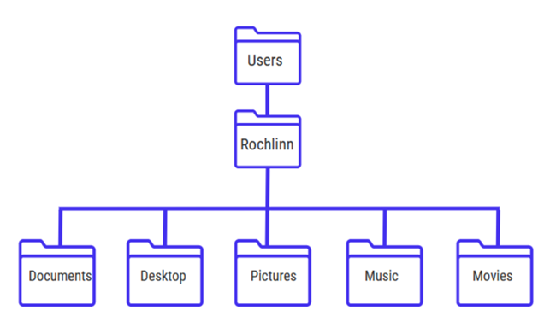
Paths
The picture below illustrates the directory structure of a typical computer.
Within this structure, the path to the Desktop would be:
/Users/Rochlinn/Desktop

Slide 7
Paths
When dealing with file paths, directories are denoted by a slash /, and each layer" of the directory hiearchy is separated by a slash.
/Users/Rochlinn/Desktop

Slide 8
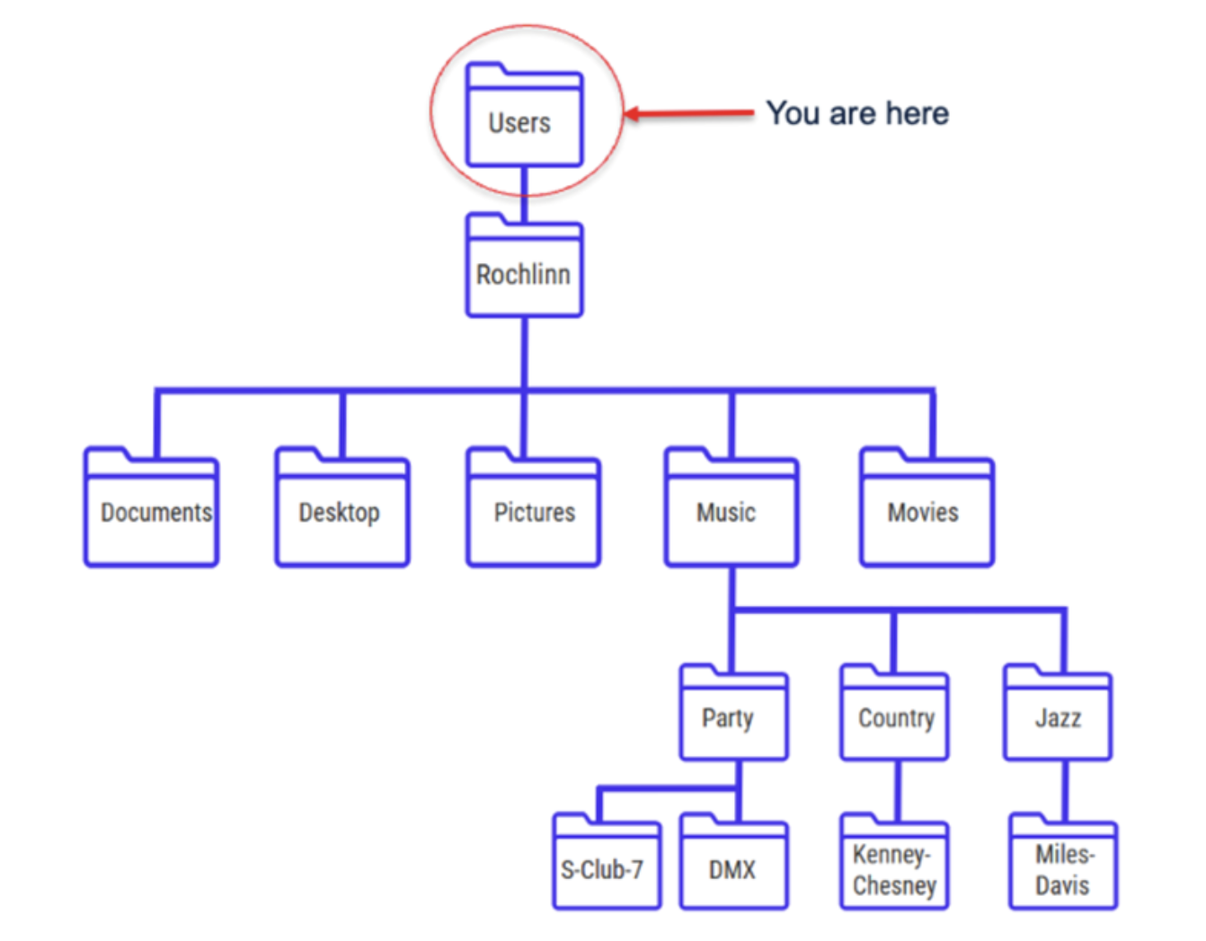
Exercise
What is the path to the Music directory?
What is the path to the S-Club-7 directory?
Notes:
Any in the chat!

Slide 9
Exercise
What is the path to the Music directory?
/Users/Rochlinn/Music
What is the path to the S-Club-7 directory?
/Users/Rochlinn/Music/Party/S-Club-7
Notes:
Explain answers

Slide 10
Absolute and Relative Paths

Slide 11
Absolute and Relative Paths
When thinking about navigating through your files and directories, there are two kinds of paths that can be used:
Absolute paths: Includes the entire path from the root directory.
Relative paths: Includes the path relative to where you are in the hierarchy.

Slide 12
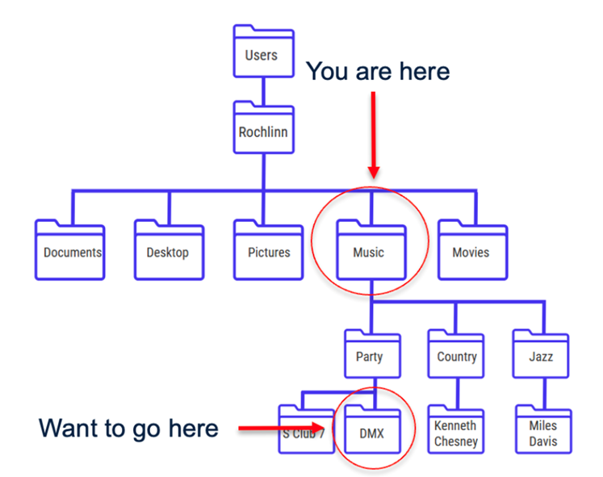
Absolute Paths
/Users/Rochlinn/Music/Party/DMX
Notes:
The absolute path to the DMX folder, i.e., the path from the root directory is:Users/Rochlinn/Music/Party/DMX

Slide 13
Relative Paths
/Party/DMX
Notes:
From the Music folder, the relative path to the DMX folder is:
Party/DMX
The path already assumes your location, so you don't need to write /Users/Rochlinn/Music

Slide 14
Note
Relative paths only work going down the hierarchy, and not upwards.
Notes:
From the Music folder, the relative path to the DMX folder is:
Party/DMX
The path already assumes your location, so you don't need to write /Users/Rochlinn/Music

Slide 15
Why should you care?
So far we have been playing around with R, but we haven’t yet brought data into R.
When reading data into RStudio, file paths tend to be a key point of struggle/issues for those that are new to coding.
There isn’t a need to be an expert in file paths, but this session is meant to provide the necessary information needed to engage with the next session, in which we’ll be importing data into R.

Slide 16
Questions?

