Slide 1
The Tidyverse & Reading Data

Slide 2
Session Objectives
By the end of this session, you’ll be able to:
Install and load the tidyverse package in R.
Check and modify the working directory in an R session.
Create an R project.
Read tabular data into R using tidyverse.
Use both base R and tidyverse functions to view a dataset.

Slide 3
Packages and Libraries
R includes a number of pre-installed tools to use upon installation.
This is called “Base R”.
However, there are additional tools that you can download that are more suited to specific tasks and workflows.

Slide 4
Packages and Libraries
Packages:
Collections of tools that extend beyond the capabilities of Base R. These only need to be installed once.
Libraries:
Once you install a package, it is stored on your computer in a “library”, where R can access it. Libraries need to be installed for every R session.

Slide 5
The Tidyverse
In this course, we will be using an R package called the Tidyverse.
The Tidyverse is actually a package of packages, that are designed to work together to support research and data science.
Notes:
We will be using a collection of R packages called the tidyverse. The tidyverse is commonly used for research and data science, as it is designed to facilitate data manipulation, analysis, and visualization. The tidyverse packages are designed to work well together. They all use the same syntax and rules, which makes learning how to use them easier. The tidyverse website has a lot of documentation and reference material that you can use if you are struggling with how to approach a specific task.

Slide 6
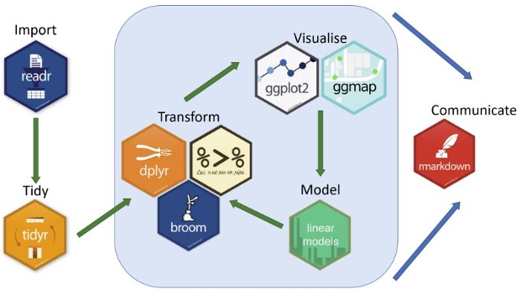
The Tidyverse
source

Slide 7
Let’s checkout the Tidyverse website:
https://tidyverse.org/packages/

Slide 8
Time to jump into R!

