Slide 1
Data cleaning

Slide 2
Lesson objectives
By the end of this session, you’ll be able to:
Describe the importance of data cleaning for the research data lifecycle
Identify data cleaning needs for an example dataset
Use the pipe operator and functions from the tidyverse to clean data of an example dataset
Write reproducible code by applying concepts of literate programming

Slide 3
Activity
Open the survey dataset, and discuss the following questions:
Is this dataset in a consistent format for subsequent work and analysis? Why or why not?
What fields would you want to use to answer the project’s research question? Do they exist already?
Are there any fields that you think might be tricky to work with? Why?
What fields would you want to modify or correct in this dataset? How would you do that?
Make a list of things you would want to modify, transform or correct in this dataset, and choose someone in your group to share the list with the larger group.
You will have 20 min in the break out room.

Slide 4
Breakout!

Slide 5
Data cleaning
Data cleaning is the process of checking and fixing your data to ensure it is ready for analysis
It is time consuming but crucial (“garbage in, garbage out”)
Documenting your data cleaning process ensures reproducibility

Slide 6
Good practices for data cleaning
Do not directly edit raw data
Data cleaning scripts:
Inputs raw data
Performs data cleaning
Outputs the cleaned dataset
Always share clean versions of the data

Slide 7
Data cleaning steps
Not all steps will apply to all datasets, always refer back to your data and research questions
Fix column names
Remove duplicate observations
Correct spelling mistakes
Standardize letter case and use of space or other special characters
Convert variables to correct variable types (e.g., numeric, categorical, date, etc).
Group values into larger categories
Merge and split columns
Create new variables
Deal with missing values
Subset data
Reshape dataset for analysis

Slide 8
The pipe operator
Symbol |> (or %>%)
Feeds the result of one function directly into the other function
Functions well with the tidyverse syntax for data cleaning
Example:
print(count(survey_data, Age, Gender), n = Inf)
count(survey_data, Age, Gender)|>
print(n = Inf)

Slide 9
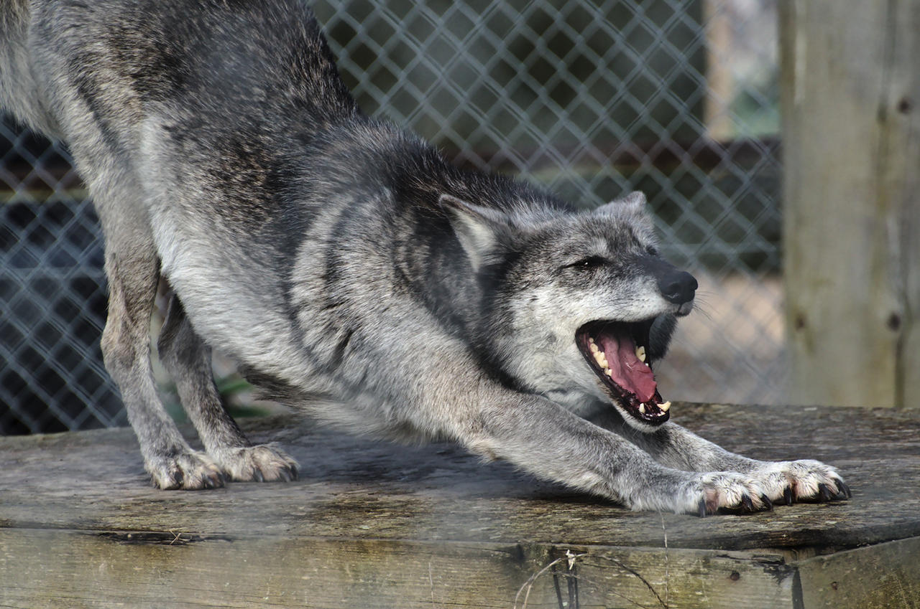
Time to stretch! (10 min break)

Slide 10
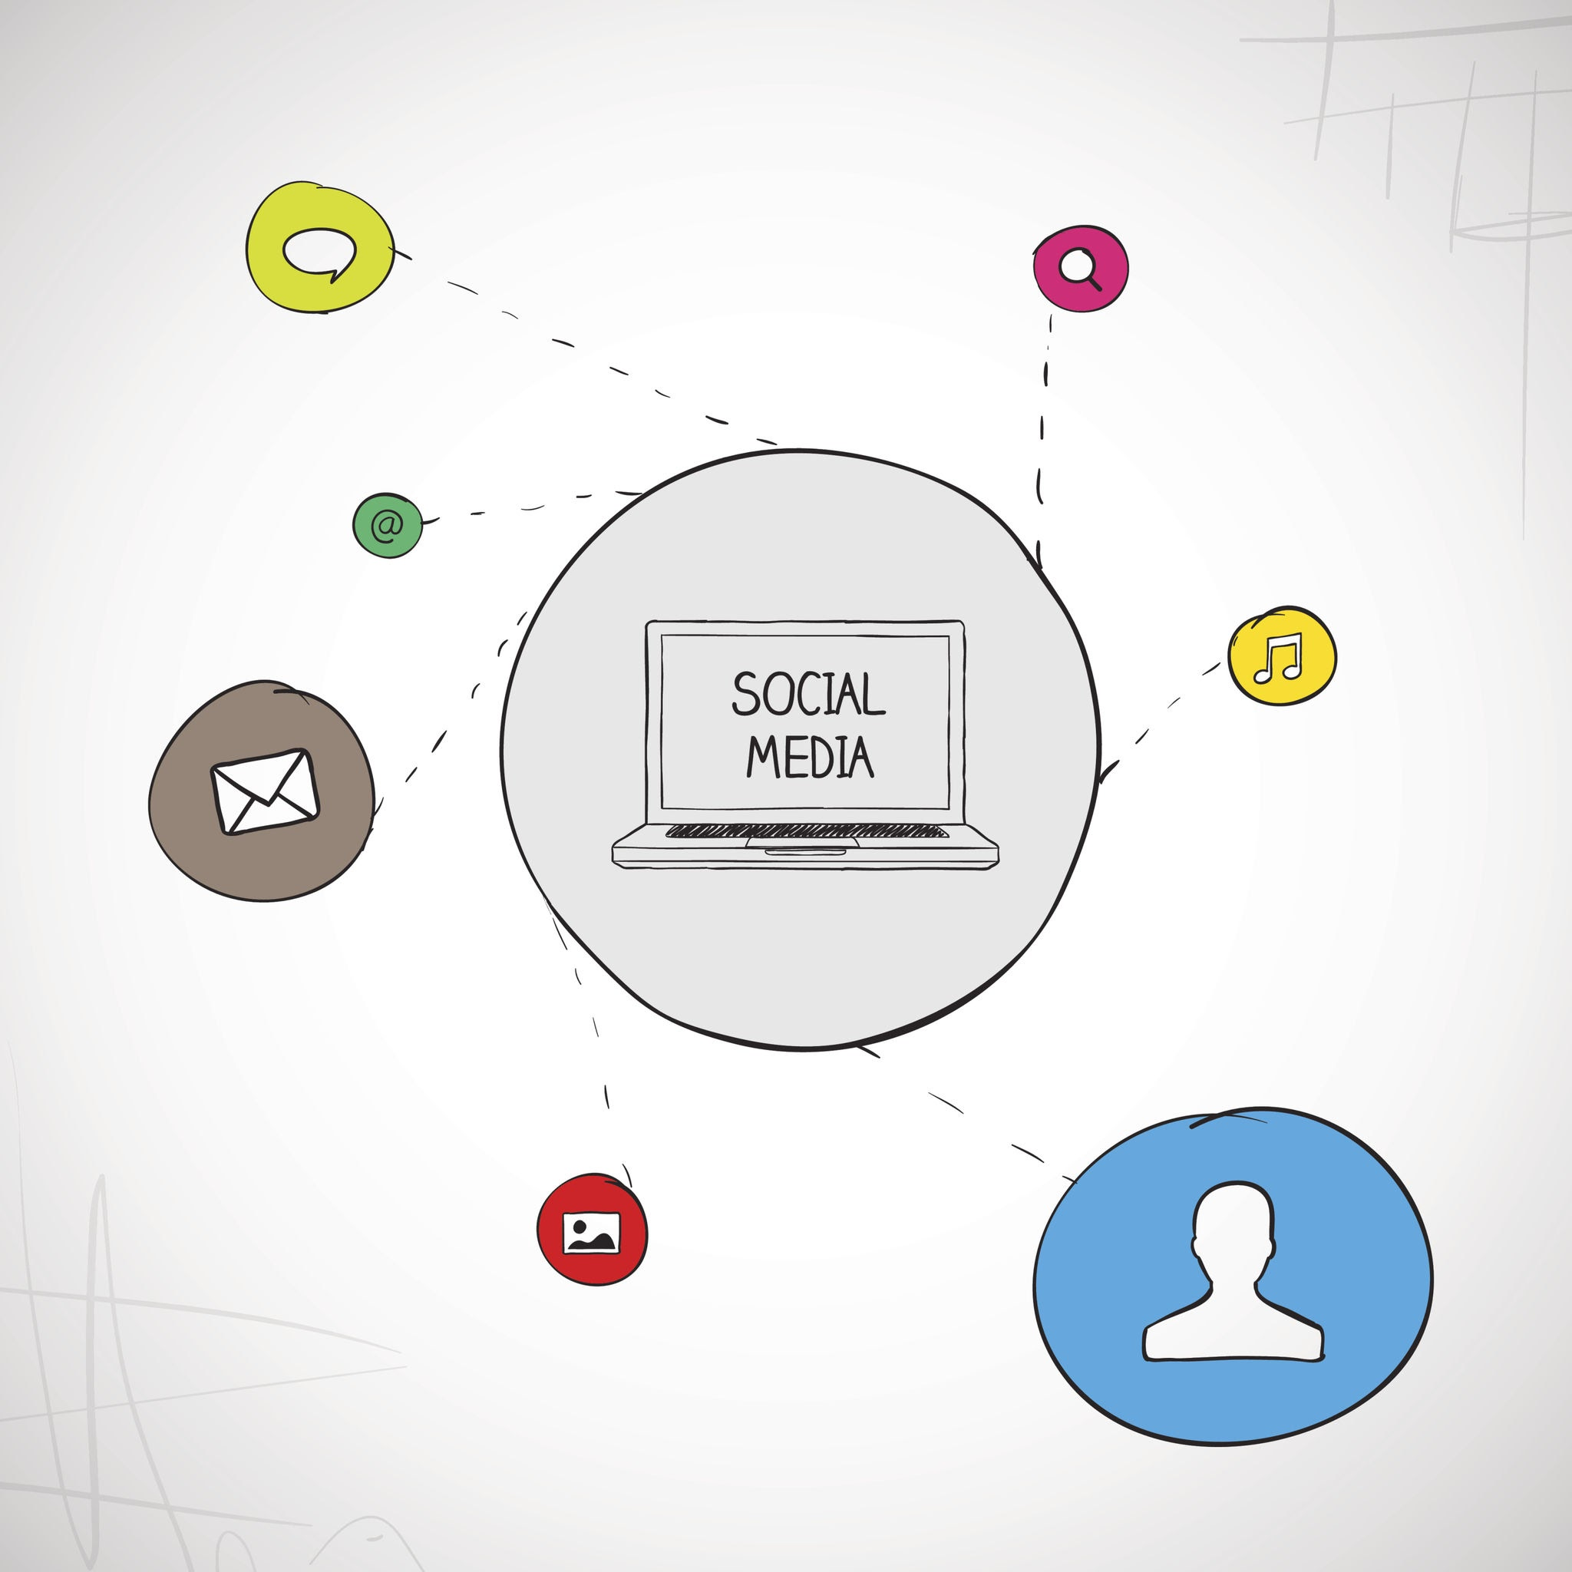
Time to clean!

Slide 11
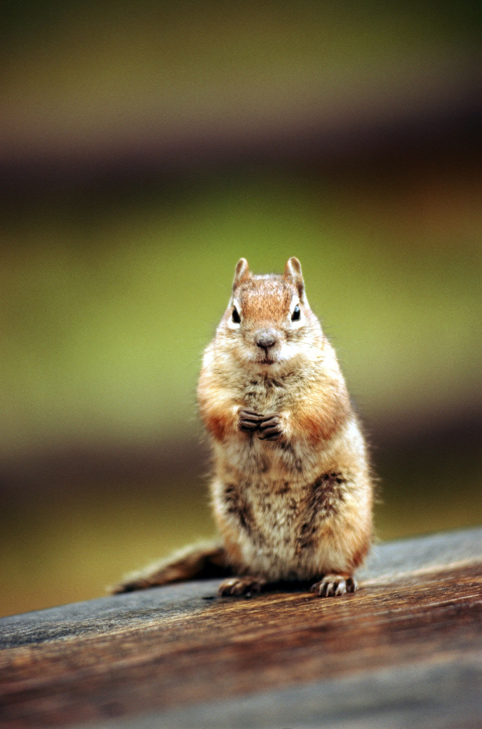
Optional activity
Practice your skills in data cleaning with another dataset!
Squirrels in Central Park, in New York City
Not required for the course
Instructions on the bottom of Day 4 - Lesson 1 content
Download the dataset
Perform requested data cleaning actions
Save the cleaned dataset
Can start from scratch or use the fill-in-the-blanks template

