Slide 1
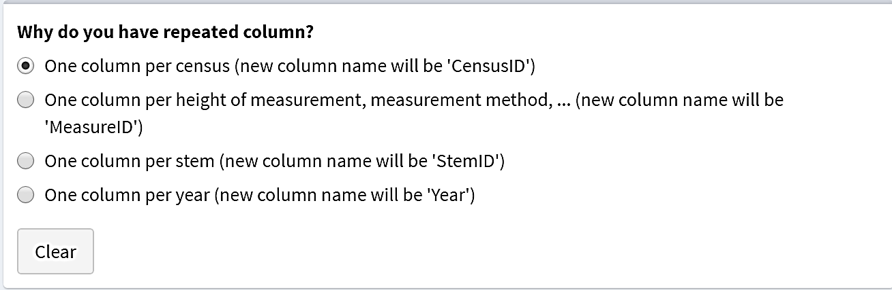
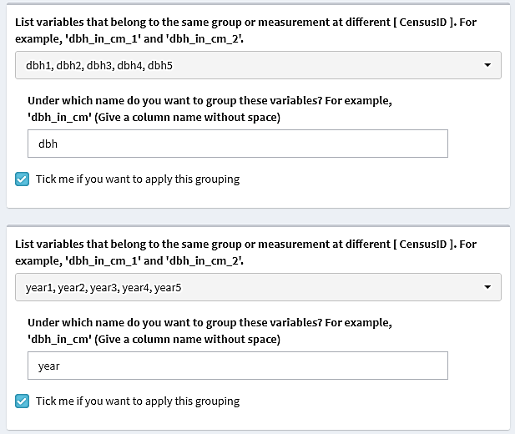
TreeID | dbh1 | dbh2 | year1 | year2
A | 10.2 | 10.9 | 2015 | 2020
B | 15.3 | 15.5 | 2016 | 2021
TreeID | CensusID | year | dbh
A | 1 | 2015 | 10.2
A | 2 | 2020 | 10.9
B | 1 | 2016 | 15.3
B | 2 | 2021 | 15.5

