Slide 1
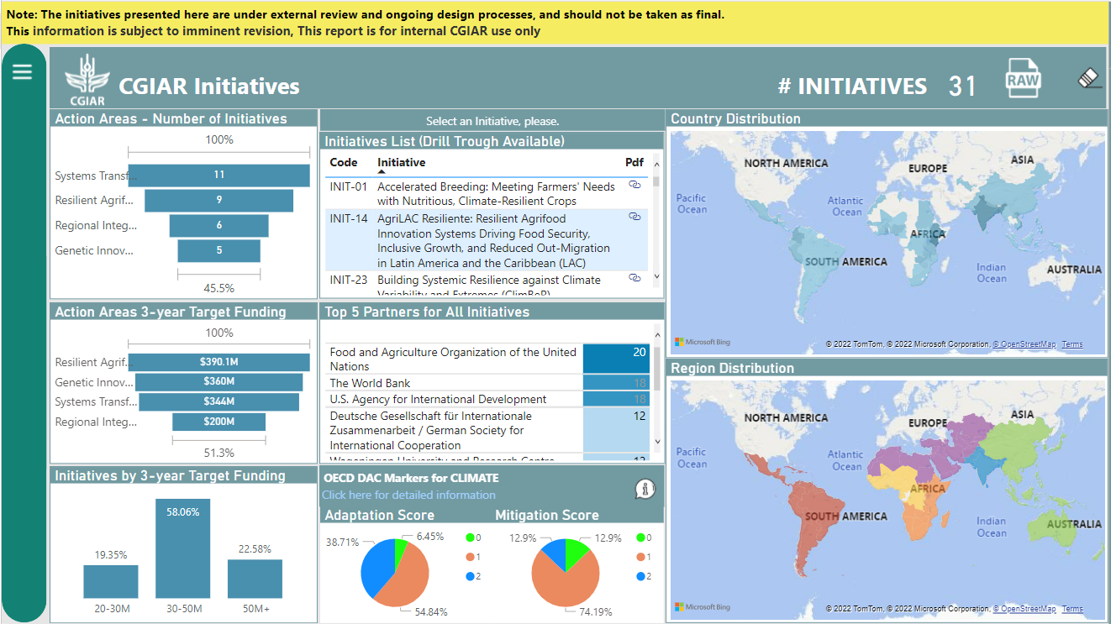
Development Workspace
Development Desktop Application
Power BI Platform
CLARISA
OST DB
Data Acquisition Development
API
Development Data Flow
Dev
Pro
Production Data Flow
Data Acquisition Production
Publication
Public Dashboard (P&R)
Production Desktop Application
Production Workspace

